Slide 1
His Excellency the University Vice-Rector for Graduate Studies and Scientific Research Visits the Deanship of Library Affairs

Slide 2
His Excellency the University Vice-Rector for Graduate Studies and Scientific Research Dr. Mohammad Al-Shaya’a along with the directors of the administrations and units of the deputyship visited on Sunday 25/6/1434 H the Deanship of Library Affairs.
The purpose of the visit was to check the progress of activities and annual plan of the deanship. The Dean of Library Affairs Dr. Abdel Aziz Al-Omran reviewed during the meeting the progress of the work and the achievements made with regard to building database of information as well as making contracts with several knowledge sources which reached three million titles on the digital library.

Slide 3
he also reviewed the efforts of the deanship in providing the main library as well as the other libraries in various regions with books. A reference was also made to the strategic plan of the deanship during the three years.
Dr. Al-Shaya’a praised the efforts being exerted by the deanship via providing excellent services to the university staff and faculty members.
The visit was concluded by an inspective tour to the library halls to have a look at the latest books.

Slide 4
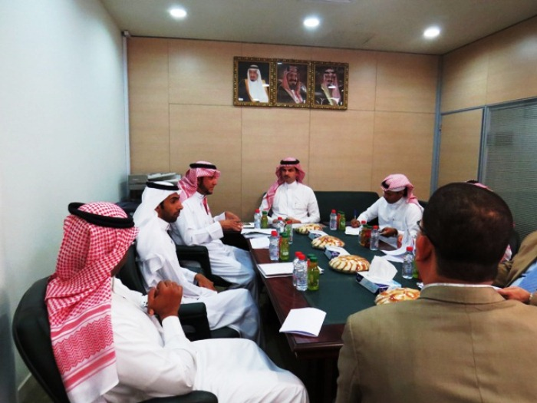

Slide 5
