Slide 1
Alzheimer’s & Parkinson’s Disease
By: Dr. Atif Ali Bashir
MD Pathology

Slide 2
Definition
Neurodegenerative disease is a condition which affects brain function. Neurodegenerative diseases result from deterioration of neurons. They are divided into two groups:
  conditions causing problems with movements
  conditions affecting memory and conditions related to dementia.
  Examples:
    Alzheimer’s
    Parkinson’s
    Huntington’s
    Creutzfeldt-Jakob disease
    Multiple Sclerosis
    Amyotrophic Lateral Sclerosis (ALS or Lou Gehrig's Disease)
  http://www.reference.com/browse/wiki/Neurodegenerative_disease
Notes:
Read from slide

Slide 3
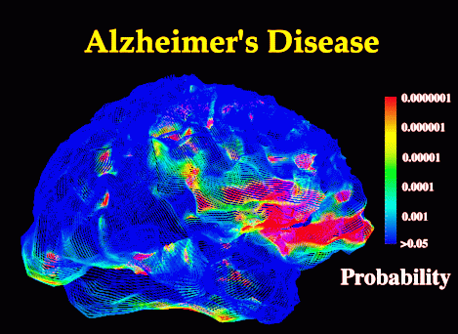
Alzheimer’s Disease (AD)
An Understanding of Alzheimer’s Disease
By Atif Ali Bashir

Slide 4
Alzheimer’s Disease
• Alzheimer’s disease (AD) is a devastating illness
characterized by progressive memory loss,
impaired thinking, personality change, and
inability to perform routine tasks of daily living.
• The neural damage in AD is irreversible, and
hence the disease cannot be cured.
• There is no effective drug for relieving
symptoms, and no prospect of one in the near
future.

Slide 5
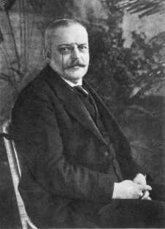
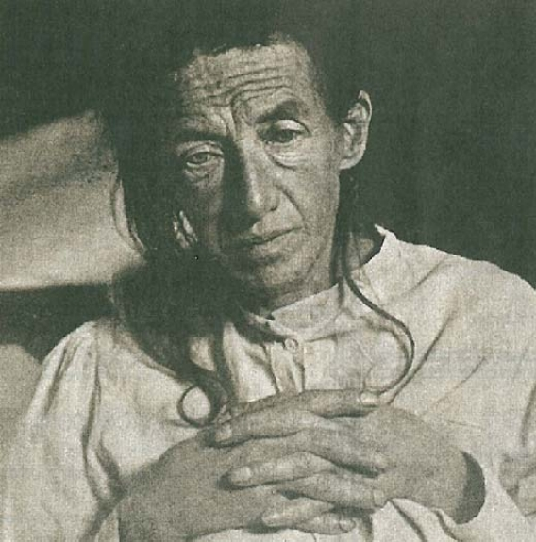
[Auguste Deter, Alois Alzheimer's patient in
November 1901, first described patient with
Alzheimer's Disease.]
[1864 - Dr. Alois Alzheimer, psychiatrist,
pathologist, born in Marktbreit, Bavaria]

Slide 6
Prevalence of Neurodegenerative Diseases
4-5 million people in the U.S. with Alzheimer’s disease (AD)
  By 2050 this number is predicted to be 16 million
1-1.5 million people in the U.S. with Parkinson’s Disease
Thousands with other NDs
100,000 deaths/yr attributed to AD
Notes:
There are anywhere from 4 to 5 million people who have Alzheimer’s, 1 to 1 ½ million who have Parkinson’s. and thousands who are diagnosed with other neurodegenerative diseases. The two major forms of neurodegenerative disorders are Alzheimer’s and Parkinson’s and they will be my main focus today.

Slide 7
What Causes AD?
Age is the number one risk factor.
A family history of having AD is another risk factor.
Scientists don’t know exactly what causes the disease, and there is still a lot of research to be done.
We do know that the main cause of brain cell death is an accumulation of the protein A-Beta.
Once a brain cell dies it doesn’t come back, so AD causes a gradual loss of brain function.

Slide 8
Why do some people exposed to an environmental agents develop disease and others do not?
Poor Nutrition
Other Diseases
Genetics
Environmental Toxins
Adverse Health Outcome
Development and Age
Obesity
Drugs
http://www.niehs.nih.gov/od/presentations/ppt/NIH-DHHS/PD-Schwartz-2006.ppt
Notes:
We have seen this a number of times, but I like this visual description of the importance of genetics and the greater importance of the environment. Obviously environmental toxins can lead to an adverse health outcome, and genetics can affect that outcome. We have also discussed the effect of poor nutrition and drugs, and here age is also a major factor, and other diseases and obesity can play a part.

Slide 9
Genetic and Environmental Factors in Alzheimer’s Disease
Genes
Environment
Susceptibility
APOE-E ε4
Susceptibility
Head trauma
Vascular factors
HSV-1
Total cholesterol
Hypertension
Alzheimer’s
Disease
Probabilistic
β-amyloid precursor
Presenilin – 1
Presenilin – 2
Protective
N.S.A.I.D.’s
Estrogen
Education
Slooter & Van Duijn, 1997
http://www.offordcentre.com/symposium/Merikangas.ppt#27
Notes:
This graph shows the susceptibility factors in both genes and environment, as well as probabilistic and protective factors. The genetic and environmental susceptibility factors can work together to lead to Alzheimer’s. Risk prediction is enabled
Genetic heterogeneity is shown in the different genetic causes of ALZ shown on the left side of the diagram.
Risk prediction is enabled by knowledge of susceptibility genes: probabilistic vs protective vs susceptibility.
Implementing public health measures for prevention and intervention would be important.

Slide 10
APP and PS families of proteins
Familial Alzheimer disease is caused by mutations in at least 3 genes:
PSEN1 - Presenilin 1 (PSEN1 located on chromosome 14)
  Mutations in this gene cause familial Alzheimer's type under 50 years old.
  This protein has been identified as part of the enzymatic complex that cleaves amyloid beta peptide from APP.
PSEN2 - Presenilin 2 (PSEN2 located on chromosome 1)
  The Presenilin 2 gene is very similar in structure and function to PSEN1.
APP – Amyloid beta (A4) precursor protein
  Processing of the amyloid precursor protein
  Mutations to the amyloid beta A4 precursor protein (APP) located on the long arm of chromosome 21 causes familial Alzheimer disease.

Slide 11
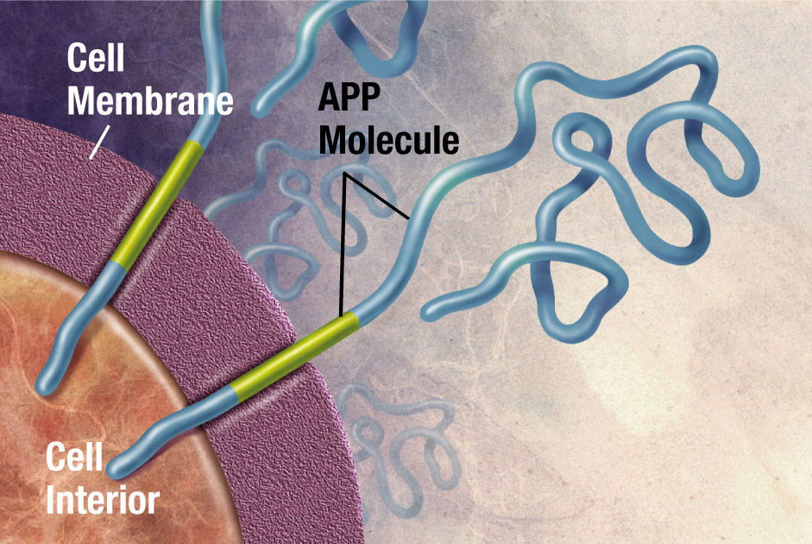
http://ibgwww.colorado.edu/~carey/p4102dir/slidesdir/HGSS_Chapter6_DCG.ppt
Notes:
Amyloid precursor protein (APP) is membrane protein that sits in the membrane and extends outward. It is though to be important for neuronal growth, survival, and repair.

Slide 12
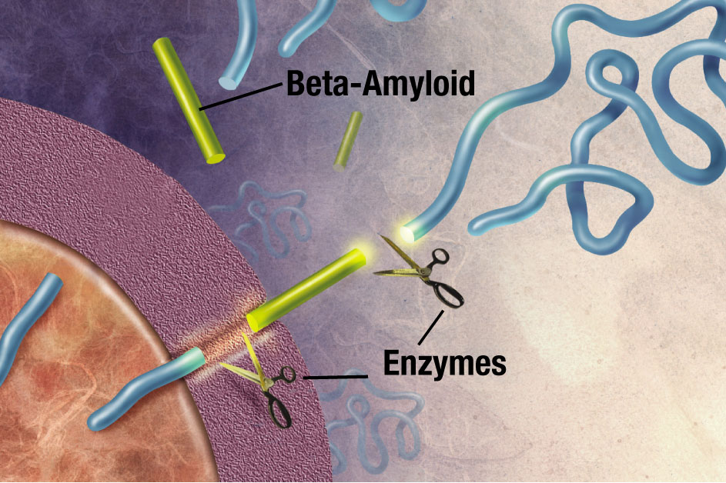
http://ibgwww.colorado.edu/~carey/p4102dir/slidesdir/HGSS_Chapter6_DCG.ppt
Notes:
With Alzheimer’s, enzymes come along and cut the APP into fragments, with the most important fragment being the beta-amyloid

Slide 13
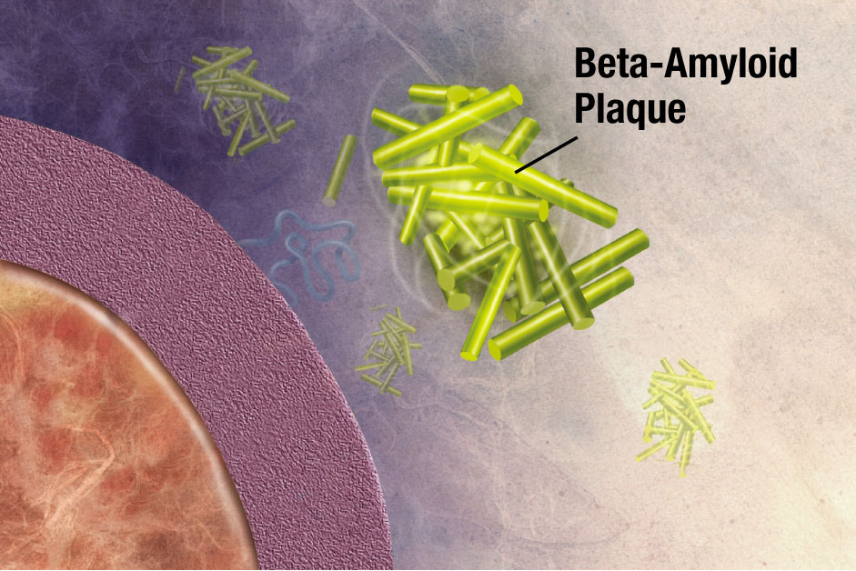
http://ibgwww.colorado.edu/~carey/p4102dir/slidesdir/HGSS_Chapter6_DCG.ppt http://www.upstate.com/features/app_lp.asp?c=221&r=556
Notes:
Beta-amyloid is “sticky” so the fragments cling together along with other material outside of the cell, forming the
plaques, causing neuronal death, and leading to Alzheimer’s
APP is expressed from a single gene, and has about 10 identified isoforms (any of two or more functionally similar proteins that have a similar but not identical amino acid sequence and are either encoded by different genes or by RNA transcripts from the same gene which have had different exons removed ).

Slide 14
Alzheimer’s disease: Gross and microscopic features
Gross brain atrophy: neuronal loss
Neuritic (senile) plaques containing B-amyloid
Neurofibrillary tangles composed of phosphorylated microtubule associated tau protein
Cerebral amyloidosis

Slide 15
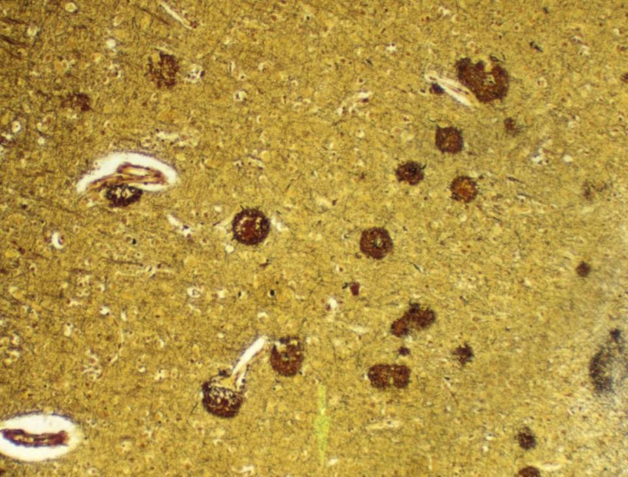

Slide 16
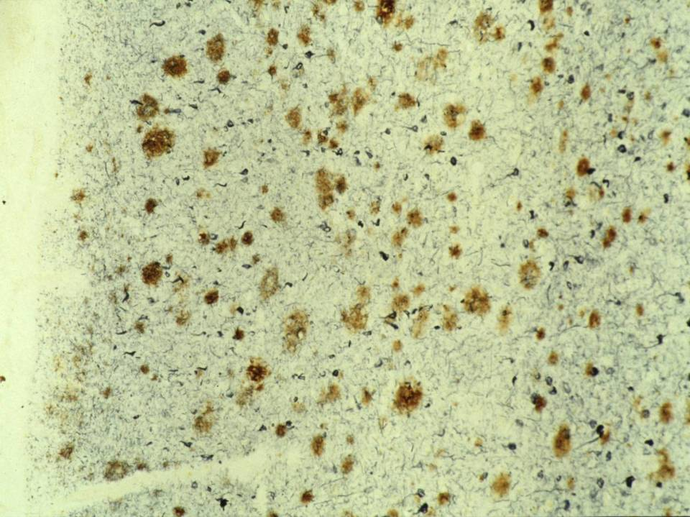

Slide 17
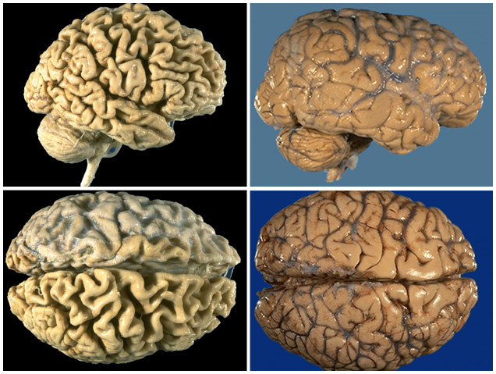
Alzheimer’s Brain Control Brain
Notes:
This picture shows very well the vast difference in the brains of a person with Alzheimer’s and someone without the disease.

Slide 18
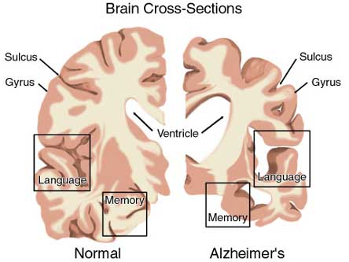
A Normal Brain and an AD Affected One
In the normal brain there is a lot of healthy brain tissue in the language area. In the AD affected brain there is little in that area.
There are many differences between the two brains including the memory, sulcus, gyrus, ventricle, and language areas. In the AD brain, these are either shrunken or stretched out to unhealthy measures.

Slide 19
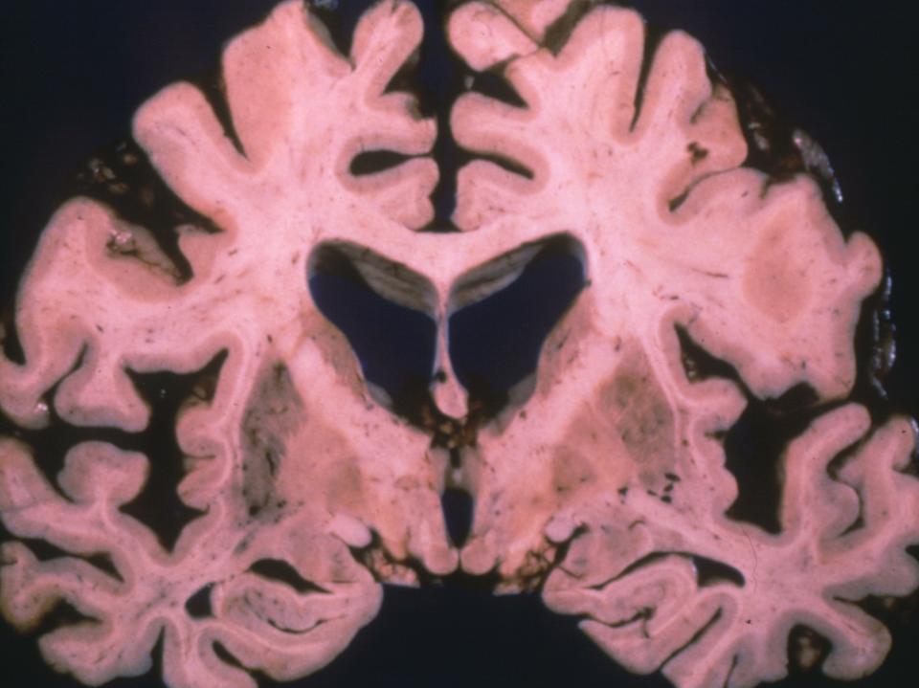

Slide 20
Alzheimer’s disease: Clinical features
Clinical features of dementia
  Impairment of recent memory
  Aphasia (naming), apraxia (motor), agnosia (object), executive functioning
  Impaired level of function
  Progressive over time
  47% of people over 85 years of age are affected
Notes:
Apraxia: loss of the ability to execute or carry out learned purposeful movements.

Slide 21
Advanced Symptoms
As the disease progresses the symptoms are more easily noticed.
The AD patient might forget how to brush their teeth or comb their hair.
They may not be able to think clearly and may fail to recognize familiar people or places.
People with AD can become anxious or aggressive or wander away from home.

Slide 22
Parkinson's Disease

Slide 23
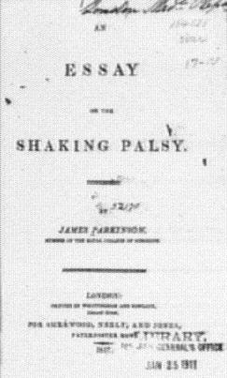
History
James Parkinson
1817, England
Shaking palsy
Paralysis agitans

Slide 24
Introduction
Parkinson’s disease is a chronic neurodegenerative movement disorder affecting voluntary and emotional movements and most commonly seen in the elderly, but is also found in the young and inexorably progresses leading to significant disability.

Slide 25
Epidemiology
Primarily a disease of the elderly
Mean age 55, Range 20 - 80 years
Juvenile parkinsonism- Less than 20 years
M/F = 3:2
Prevalence increases with age

Slide 26
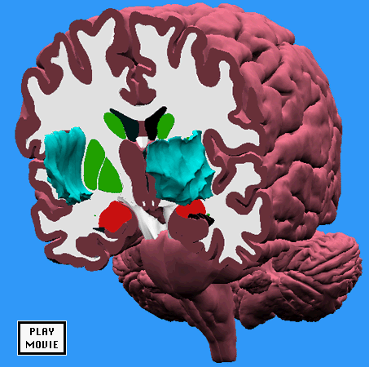
Anatomy-Basal Ganglia
Internal capsule
Putamen
Caudate Nucleus
Globus pallidus

Slide 27
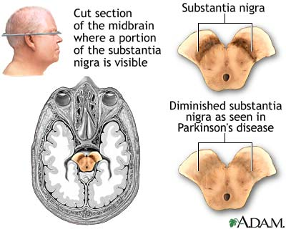
PATHOPHYSIOLOGY

Slide 28
PATHOPHYSIOLOGY
DA
SUBSTANTIA NIGRA
GLOBUS, PARS RETICULATA
ACH
GABA
STRIATUM
CAUDATE, PUTAMEN

Slide 29
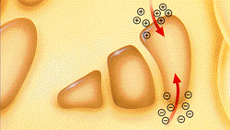
Chemical Balance in Corpus Striatum
Excitatory Cholinergic pathway
Inhibitory Dopaminergic pathway
BALANCE

Slide 30
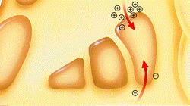
Chemical Balance in Corpus Striatum
Excitatory Cholinergic pathway
Inhibitory Dopaminergic pathway
Imbalance

Slide 31
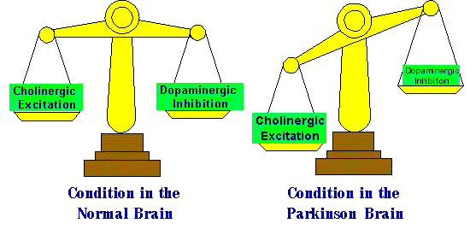
Parkinson’s disease - Pathophysiology

Slide 32
Parkinson’s disease: Gross and microscopic findings
Gross--loss of pigment in the substantia nigra
Microscopic--Lewy bodies with pigmented neuronal cell loss and gliosis
  cortical Lewy bodies present in 80% or more of PD cases

Slide 33
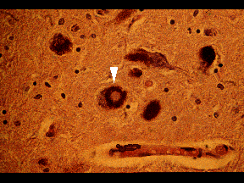
Pathology - Lewy Bodies
Eosinophilic hyaline inclusion bodies
Spherical dense hyaline core with a clear halo
Mechanism of formation unknown

Slide 34
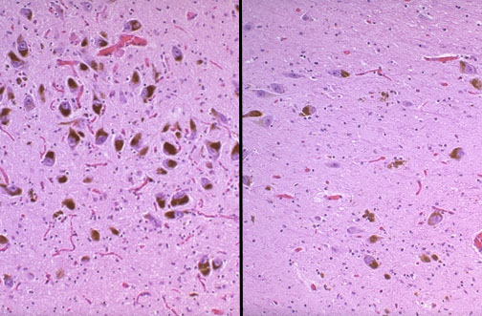
Pathology
Lewy body dementia
Parkinson’s disease

Slide 35
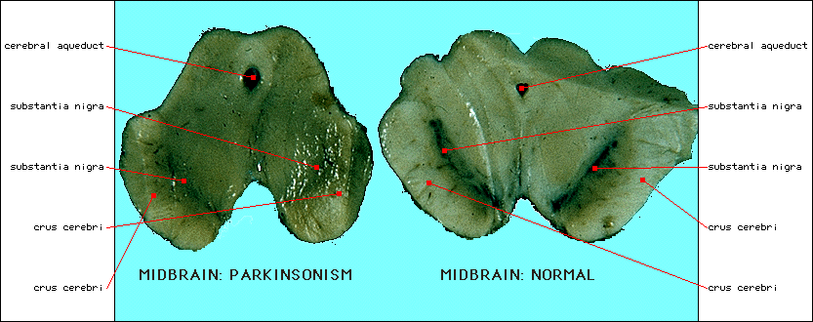
Pathology-Parkinson’s disease
MIDBRAIN

Slide 36
Classification and Etiology
Idiopathic Parkinson’s disease
Parkinson-like syndromes
Drug induced parkinsonism
Hypoxia
Tumor
Trauma
Vascular: Multiinfarct
Toxin: Mn, CO, MPTP and cyanide
Post-encephalitic parkinsonism (von Economo’s encephalitis)
Normal pressure hydrocephalus
Wilson’s disease, Huntington's disease

Slide 37
Clinical features of Idiopatic Parkinson’s disease.
Major features
Resting tremor in hands, arms, legs, jaw, and face
Bradykinesia
Rigidity- cogwheel or lead-pipe
Minor features
Bradyphrenia
Speech abnormalities
Depression
Dysautonomia
Dystonia
Constipation
Hallucinations
Dysphagia
Notes:
Bradyphrenia: slowness of thought (Parkinson & schizophrenia). Dystonia: repetitive movements or abnormal posture. Dysautonomia: malfunction of the ANS.

Slide 38
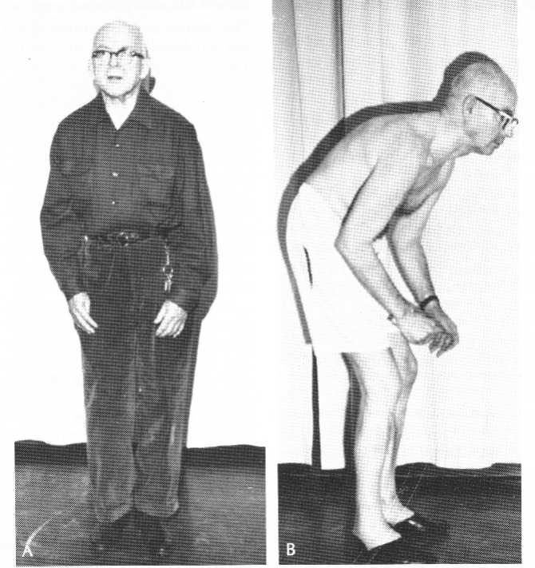
Parkinson’s disease-Symptomatology
Posture
Kyphosis
Flexed elbows, knees and hips
Hands held in front of body
Trunk bent forward
Head bowed

Slide 39


Slide 40

THANK U

