Slide 1

بسم الله الرحمن الرحيم
BRAINSTEM
Supervised by : Dr. rehan
Done by : fawaz alotaibi

Slide 2
OBJECTIVES
At the end of the session the student should be able to :
describe the intarnal structure of pons at cranial and caudal level .
Discuss gross features of midbrain .

Slide 3
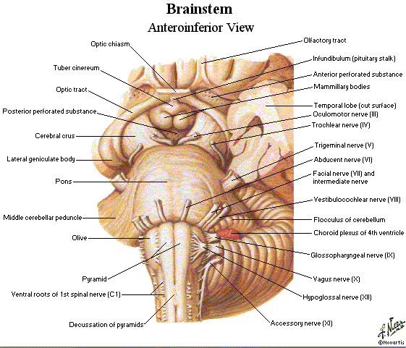

Slide 4
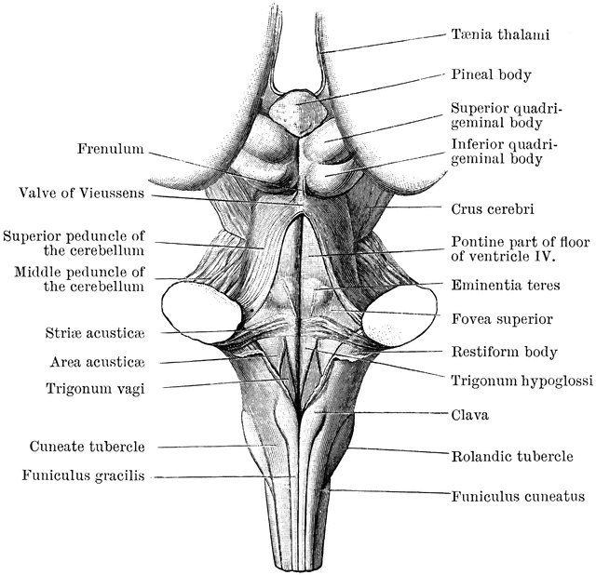

Slide 5
PONS
the pons is commonly divided into a posterior part, the tegmentum, and an anterior basal part by the transversely running fibers of the trapezoid body .
The structure of the pons may be studied at two levels:
(1) transverse section through the caudal part, passing through the facial colliculus .
(2) transverse section through the cranial part, passing through the trigeminal nuclei

Slide 6
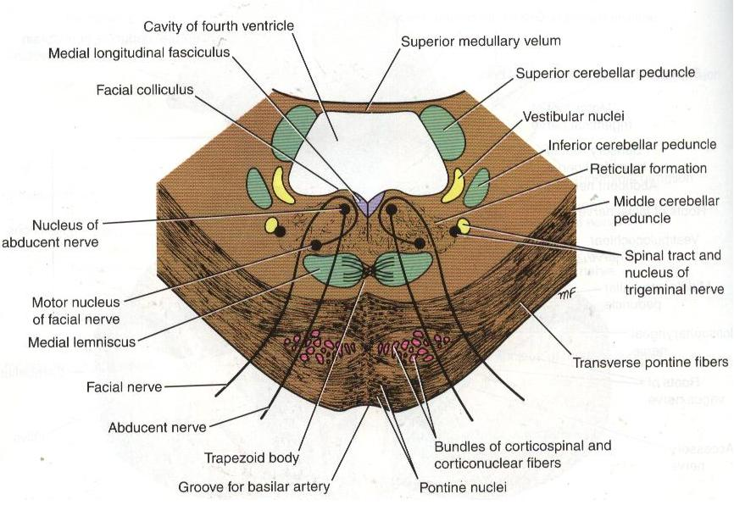
Transverse Section Through the Caudal Part :
The medial lemniscus
rotates as it passes from the medulla into the pons. It is situated in the most anterior part of the tegmentum, with its long axis running transversely .The medial lemniscus is accompanied by the spinal and lateral lemnisci .

Slide 7
The facial nucleus
lies posterior to the lateral part of the medial lemniscus.
The fibers of the facial nerve wind around the nucleus of the abducent nerve, producing the facial colliculus The fibers of the facial nerve then pass anteriorly between the facial nucleus and the superior end of the nucleus of the spinal tract of the trigeminal nerve .

Slide 8
The medial longitudinal fasciculus :
situated beneath the floor of the fourth ventricle on either side of the midline .
The medial longitudinal fasciculus is the main pathway that connects the vestibular & cochlear nuclei with the nuclei controlling the extraocular muscles (oculomotor, trochlear, and abducent nuclei).

Slide 9
The medial vestibular nucleus :
is situated lateral to the abducent and is in close relationship to the inferior cerebellar peduncle. The superior part of the lateral and the inferior part of the superior vestibular nucleus are found at this level. The posterior and anterior cochlear nuclei are also found at this level.

Slide 10
The spinal nucleus of the trigeminal nerve and its tract lie on the anteromedial aspect of the inferior cerebellar peduncle
The trapezoid body is made up of fibers derived from the cochlear nuclei and the nuclei of the trapezoid body. They run transversely in the anterior part of the tegmentum .

Slide 11
The basilar part of the pons, at this level, contains small masses of nerve cells called pontine nuclei .
The corticopontine fibers of the crus cerebri of the midbrain terminate in the pontine nuclei. The axons of these cells give origin to the transverse fibers of the pons, which cross the midline and intersect the corticospinal and corticonuclear tracts, breaking them up into small bundles.

Slide 12
CONT….
The transverse fibers of the pons enter the middle cerebellar peduncle and are distributed to the cerebellar hemisphere. This connection forms the main pathway linking the cerebral cortex to the cerebellum.

Slide 13
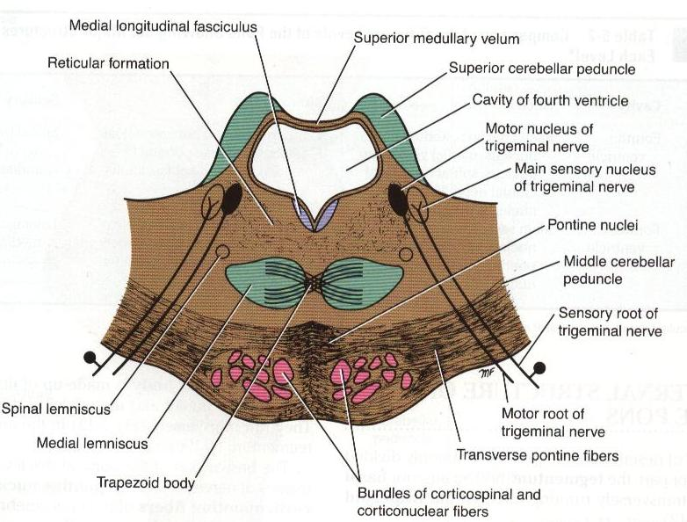
Transverse Section Through the
Cranial Part :
The internal structure of the cranial part of the pons is similar to that seen at the caudal level, but it now contains the motor and principal sensory nuclei of the trigeminal nerve.
The motor nucleus of the trigeminal nerve is situated beneath the lateral part of the fourth ventricle within the reticular formation The emerging motor fibers travel anteriorly through

Slide 14
through the substance of the pons & exit on its anterior surface .
The principal sensory nucleus of the trigeminal nerve is situated on the lateral side of the motor nucleus . it is continuous inferiorly with the nucleus of the spinal tract. The entering sensory fibers travel through the substance of the pons and lie lateral to the motor fibers .

Slide 15
The superior cerebellar peduncle is situated posterolateral to the motor nucleus of the trigeminal nerve . It is joined by the anterior spinocerebellar tract.
The trapezoid body and the medial lemniscus are situated in the same position as they were in the previous section . The lateral and spinal lemnisci lie at the lateral extremity of the medial lemniscus .

Slide 16
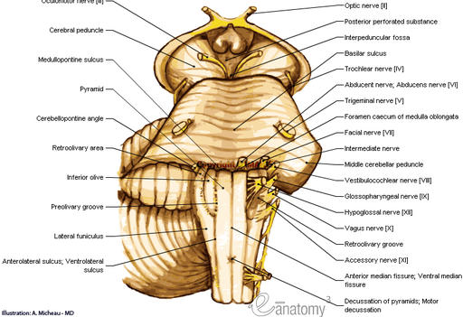
MIDBRAIN
The midbrain measures about 0.8 inch (2 cm) in length and connects the pons and cerebellum with the forebrain .
Its long axis inclines anteriorly as it ascends through the opening in the tentorium cerebelli. The midbrain is traversed by a narrow channel, the cerebral aqueduct, which is filled with cerebrospinal fluid ( CSF ).

Slide 17
The anterior surface of the midbrain:
-The interpeduncular fossa is a depression in the midline bounded on either side by the crus cerebri.
The floor of the
interpeduncular fossa is called the posterior perforated substance and it is perforated by many small blood vessels. Also it contains infundibulum and 2 mammillary bodies .
The oculomotor nerve emerges from the medial side of the crus cerebri and passes forward in the lateral wall of the cavernous sinus.

Slide 18
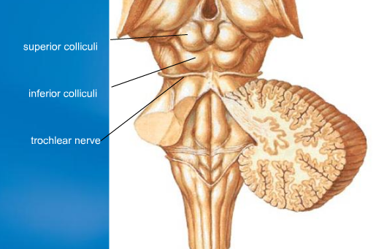
The posterior surface of the midbrain:
They are four rounded colliculi, two superior and two inferior separated by vertical and transverse groove.
The superior colliculi are centers for visual reflexes and the inferior colliculi are auditory centers.
The trochlear nerves emerges in the midline below the inferior colliculi.

Slide 19
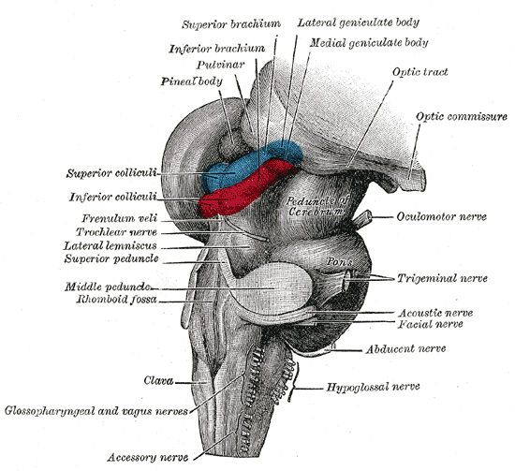
The lateral surface of the midbrain:
The superior brachium passes from the superior colliculus to the lateral geniculate body and the optic tract.
The inferior brachium connects the inferior colliculus to the medial geniculate body.
The trochlear nerves wind around the lateral aspect of the midbrain to enter the lateral wall of the cavernous sinus.

Slide 20
Referance
Clinical neuroanatomy by S.Snell .
Page no. 208 – 210 .

Slide 21


