Slide 1
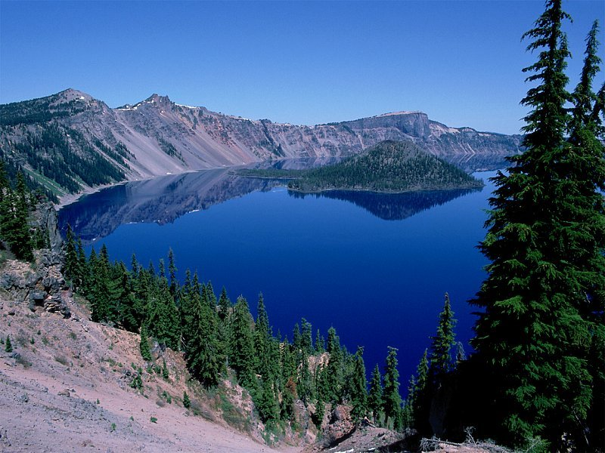

Physiology of
Autonomic Nervous System
DR QAZI IMTIAZ RASOOL

Slide 2
OBJECTIVES
1. Recall the organization of ANS
2. Describe the different types of receptors in ANS
3. Express the characteristics and distribution of sympathetic and parasympathetic nervous system
4. Analyze the role of renal medulla in ANS
5. Identify the clinical correlation of ANS

Slide 3
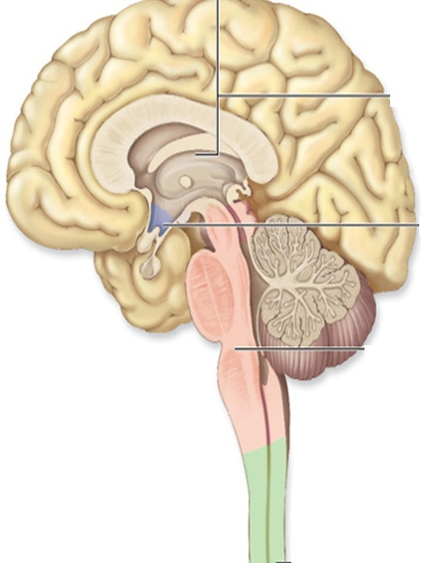
DEFINITION
Functions , reaction r
Prompt
Subconcisious
May be inborn
Purposive
Autonomous
Mostly motor system
Notes:
AUTO=SELF, NOMOS=LAW
By definition it is entirely a motor(efferent) system & autonomus in the sense that most of its functions r carried out below conscious level, hence it is independent of volitional control, thus enjoys some % of autonomy
The ANS consists of motor neurons that:
Innervate smooth and cardiac muscle and glands
Make adjustments to ensure optimal support for body activities Operate via subconscious control Have viscera as most of their effectors
The absence of voluntary control means that the ANS has little cortical representation.

Slide 4
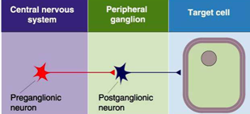
PHYSIOLOGICAL ANATOMY
Notes:
2 neurons in the efferent pathway.
2. Preganglionic,primary,pre synaptic/postganglionic,secondary postsynaptic
3. 1st neuron has its cell body in gray matter of brain or spinal cord.
4. 2nd neuron within an autonomic ganglion

Slide 5
General Organization
1. Afferent Visceral Neurons
Subconscious sensory signal from visceral organs
2. Activation centers
Spinal cord, brain stem, hypothalamus, limbic system.
3. Efferent autonomic signals
Sympathetic , E.N.S ,and Parasympathetic

Slide 6
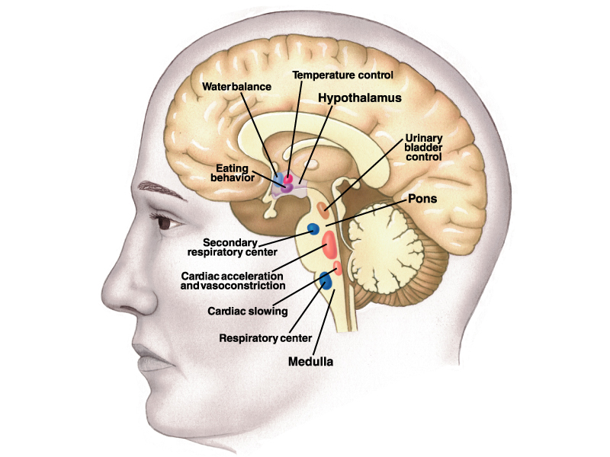
Levels of ANS Control
1.Hypothalamus
2.Subconscious cerebral input
via limbic lobe connections influences
hypothalamic function
3. Other controls come from the cerebral cortex, the reticular formation, and the spinal cord
4. Dual Innervations; 1.Most of viscera receive from both divisions
  2.both do not normally innervate an organ equally
  3. Dominance controlled by either --2 systems
Notes:
Centers of the hypothalamus control:
Heart activity and blood pressure
Body temperature, water balance, and endocrine activity
Emotional stages (rage, pleasure) and biological drives (hunger, thirst, sex)
Reactions to fear and the “fight-or-flight” system

Slide 7
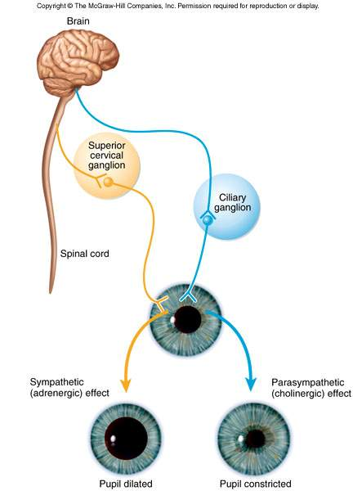
1. Antagonistic effects
Mostly Organs With Dual Innervations
SNS
1.Vasodilatation
2.Constricts
  ↑motility of colon
  leads to expulsion
  of stool
PNS
  1 Blood Vessels
  Vasoconstriction
  2. Dilates pupil
3.Defecation
  ↓motility of colon until “appropriate time”
  2.Synergonistic effects
  -Micturition. ,

Slide 8
3.Dual but different effect –AGONIST
Salivary gland
Symp. produces a thick mucus secretion
Parasymp. Produces copious of a clear,watery, serous
4.Without Dual Innervation
- only sympathetic- adrenal medulla,
-arrector pili muscles,
-sweat glands and
- many blood vessels
Notes:
Cooperative effects seen when 2 divisions act on different effectors to produce a unified effect
parasympathetics increase salivary serous cell secretion
sympathetics increase salivary mucous cell secretion
ANS cooperation is best seen in control of the external genitalia
Parasympathetic fibers cause vasodilation and are responsible for erection of the penis and clitoris
Sympathetic fibers cause ejaculation of semen in males and reflex peristalsis in females

Slide 9
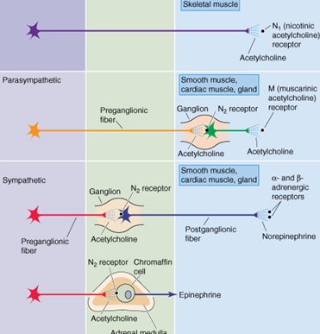
Cholinergic Receptors
Nicotinic ------Ionotrophic

Slide 10
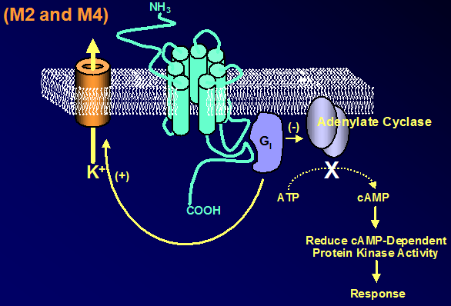
2. Muscarinic receptors Metabotrophic)
M1, M2, M3, M4, M5
  M 1 ;-CNS , ANS+ ENS
  ↑ secretions
  ↑ seizure activity
  ↑ Cognitive Function
  Blocked by Atropine, etc.
Notes:
The muscarinic receptor family of AC h receptors comprises five different genes (m1-
m5), and is pharmacologically defined as M1-M5 subtypes,. The M1-M4 receptors are the most abundant mAChRs in the cortex and hippocampus
These receptors can be grouped according to the type of G proteins that they activate.
Indeed, while M2 and M4 mAC hRs are coupled to the pertussis toxin-sensitive Gi and Go proteins, leading to the inhibition of adenylyl cyclase, the M1 and M3 mAC hRs preferentially interact with the pertussis toxin-insensitive Gq/11 and G13 proteins, leading to the activation of phospholipases C and D
. The affinity of AC h is higher for M2 and M4 than for the M1 or M3 receptors (103 130). In the neocortex, the relative abundance
The role of cholinergic system in neuronal plasticity
M₂

Slide 11
Adrenergic Receptors α+ β
1.α₁,A, B ,D contraction smooth muscle,
2. α₂, A,B,C ↓ secretions (salivary glands)+ Regulating NT SNS+CNS
3β₁, ↑ CO+ Renin release from JGA
4.β₂ , Eye, Bronchi ,Uterus.Bladder ,Arteries to SK. muscles ,GIT Mnemonic: 1, 2 lungs
5.β_{3,} lLipolysis in adipose tissue+CNS effects
NOTE;-
α1 + β1 ARE USUALLY EXICITATORY
α2 +β2 ARE USUALLY INHIBITATORY

Slide 12
Dopamine
1. D₁₋₃ receptors
stimulation of AC↑ cAMP open Na channels,
2. D₂ receptors :
↓ AC ,cAMP, open K channels,
ACTION;-
DA in the hypothalamus cause prolactin release.
Basal ganglia coordinate motor function.
Smooth muscle of UGIT → ↑ secretion, production & ↓ intestinal motility.
Is to stimulate the CTZ of medulla producing vomiting.
Natriuresis and diuresis

Slide 13
  PARA-SYMPATHETIC DIVISION
1, CRANO-SACRAL
CHOLENERGIC
NERVOUS SYS. OF TOMORROW
ANABOLIC SYSTEM
TROPHOTROPIC SYSTEM
“D” division
1. DIGESTION,
2. DEFEACATION
3. DULL,
4. DIURESIS
Notes:
Concerned with keeping body energy use low
Involves the D activities – digestion, defecation, and diuresis
TROPHO= NOURISHMENT TROPIC= RELEASING
ANABOLIC= ASSIMILATION

Slide 14
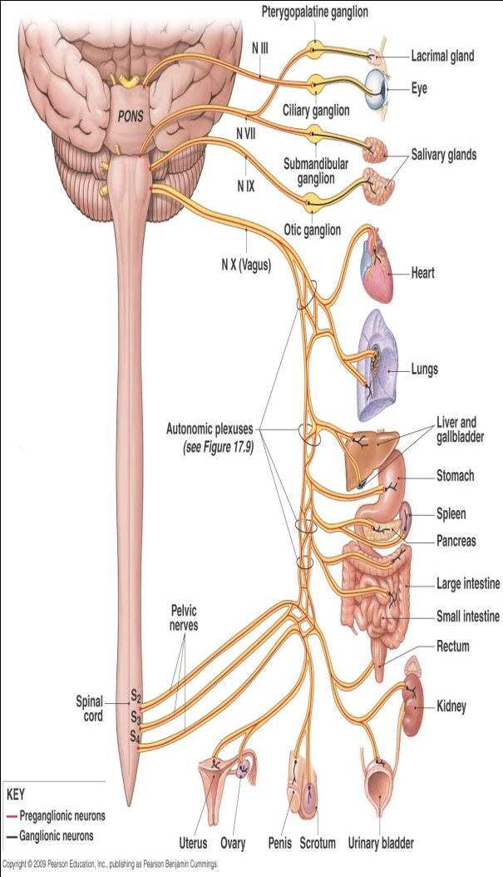
PHYSIOLOGICAL-ANATOMY (PNS)
CRANO-SACRAL
Carry inhibitory fibres to anal,
vesical, uterine sphincters
2. Vasodilatory– blood vessels of UT,
reproductive system
Notes:
Presynaptic neuron usually synapses with 4-5 postsynaptic neurons all of which supply a single visceral effector.
: Preganglionic neurons originate from the cranial nerves 3,7,9,10.
2.4 pairs of ganglia
Ciliary ganglia
Pterygopalatine ganglia
Submandibular ganglia
Otic ganglia
2.Sacral spinal nerves S2-S4.
1/3rd distal large intestine,
urinary +reproductive organs
Carry inhibitory fibres to anal,
vesical, uterine sphincters
4. Vasodilatory– blood vessels of UT,
reproductive system

Slide 15
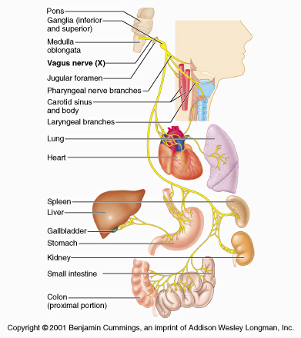
Vagus Nerve (X) 75% fibres of PNS
80%=afferent,20%=efferent
Cell bodies-Nucleus ambigus+ dorsal motor nucleus of the vagus in the medulla
Fibers --visceral organs of the thorax + most of the abdomen upto 2/3rd descending colon(esophageal, pulmonary, and cardiac plexuses) and travel to terminal ganglia that are located within their target organs.
3. Vagal afferents--- information of hollow organs (e.g., blood vessels, cardiac chambers, stomach, bronchioles), blood gases (e.g., P_{o2}, P_{co2}, pH,glucose ---- medulla.

Slide 16
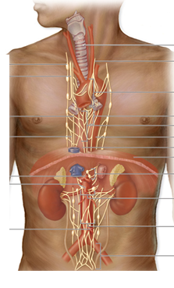
  SYMPATHETIC DIVISION
  LIFE POSSIBLE WITHOUT IT
1. THORACO-LUMBAR
2.ADRENERGIC,NON-ADRENERGIC
3.NERVOUS SYSTEM OF TODAY
4.CATABOLIC SYSTEM
5.ERGOTROPIC SYSTEM
6. “E” division
exercise,
excitement,
emergency,
embarrassment
Notes:
ERGO= WORK, HENCE ENERGY TROPIC =RELEASING, CANNON 1920 ,

Slide 17
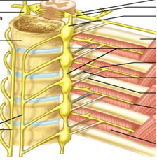
Cell-bodies
Preganglionic neurons originate in thoracic + lumbar levels of the spinal cord (T1-L2).
1.inter­mediolateral horn
2. 5000 cell bodies
3.(lamina VII)
4. Tracts Desend From Above
  Sympathetic ganglia
1. 20000–30000 nerve cell bodies, more ganglia than PNS
2. Stellate ---neuroblastoma tumours
Paravertebral
Prevertebral/colletral
Terminal
Intermediate
Adrenal gland
23 (+- 1)ganglia
  3 cervical
  11 thoracic
  4 lumbar
  4 sacral
  1 coccygeal
Notes:
They contain approximately 20000–30000 nerve cell bodies and are located close to and on either side of the spinal cord in long chains. Sympathetic ganglia are the tissue from which neuroblastoma tumours arise The sympathetic ganglia lie close to the vertebral bodies and are also known as paravertebral ganglia. They are strung together to form a sympathetic or paravertebral chain. There are two of these chains, one on either side of the vertebral column connected in front of the coccyx by the single ganglion impar (Fig-2).
Some of the fibers from nerve cells within the ganglia return to the spinal nerve trunk via a gray ramus. The fibers traveling through the white rami are myelinated while those in the gray rami are not, and this fact is responsible for their respective names. Each of the twelve thoracic and first two lumbar nerves is in contact with a paravertebral ganglion via a white and gray ramus. However, there are three ganglia in the chain above the thoracic region as well as several below L2 (Fig. 14-2). Each of these additional ganglia is connected to a spinal nerve by a single gray ramus.
In addition to the paired paravertebral ganglia, there are several unpaired prevertebral ganglia in the abdomen and pelvis. They also playa role in the sympathetic outflow

Slide 18
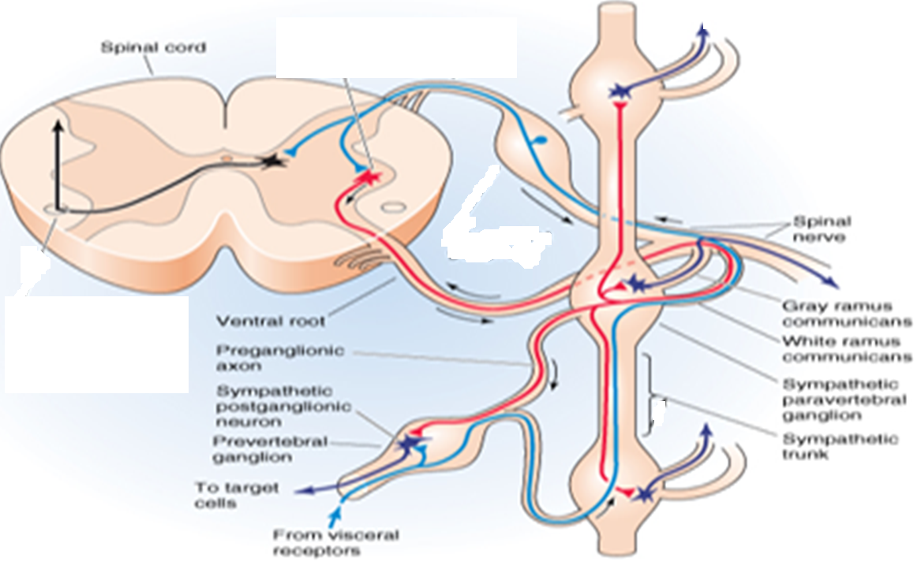
Postganglionic Fibers
Spinal nerves
Gray rami communicantes:
Each spinal nerve carries
a grey rami from its corresponding
ganglias,but not white
3. 8% in spinal nerve r sym;
.
Notes:
All sympathetic preganglionic neurons enter the paravertebral ganglion chain via the white ramus communicans.
1: 190 -----superior cervical ganglia 1 million cells
1:30 in the SYM; GANGLIAS chain,100;1 RHODES
1:25,000 effector cells are long
axons of postganglions exit via Spinal nerve Sympathetic nerve
Exceptions: some pre do not synapse at symp chain
Uterus, adrenal gland

Slide 19
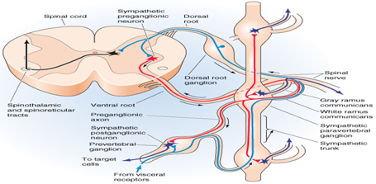
Sympathetic Pathways
5 ways:
1. Spinal nerves
2.Perivascular plexus
i.e along blood vessel,
3. Sympathetic nerves
straight to the target organ.
4. Splanchnic nerves
5. Adrenal medulla pathway
Notes:
Travel along the spinal nerves.
2.Travel along the blood vessel, e.g. internal carotid artery.
3.Travel straight to the target organ.e.g. fibers to the heart.
Perivascular plexus
- Sympathetic : postganglionic
sympathetic fibers AS SYM; NERVES—VISERAL ORGANS, SPINAL NERVE PARTS GO TO VISERAL EFFECTOR PARTS
-Parasympathetic : preganglionic
parasympathetic fibers
- Sensory fibers

Slide 20
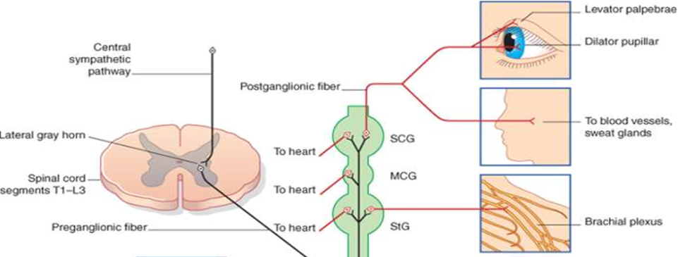
Notes:
GANGLIA – GENERAL FEATURES Supported/Surrounded by C.T.
Nerve fibers Of ganglionic neurons Synapse with ganglionic neurons Pass through – no synapses
Size: small to large masses – up to 50,000 neurons

Slide 21
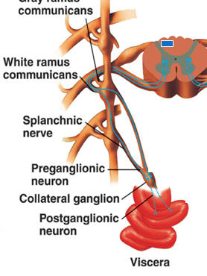
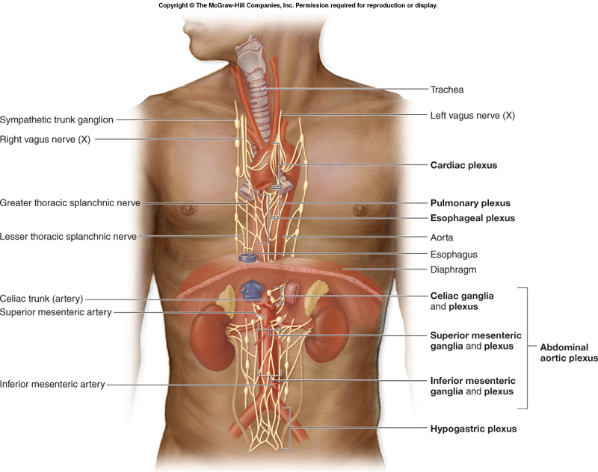
2.Collateral /Prevertebral Ganglia
1.Unpaired, not segmentally arranged only in abdomen and pelvis
2 .Lie anterior to the vertebral column main ganglia R Celiac, superior mesenteric, inferior mesenteric, inferior hypogastric ganglia, aorticorenal ganglia
3.Intermediate Ganglias
Close to the Anterior Spinal Roots but outside to the chain
Notes:
The prevertebral ganglia are located anterior to the vertebral column Unlike the paravertebral ganglia the prevertebral ganglia . . . Are neither paired nor segmentally arranged
They occur only in the abdomen and pelvis Pathways to the Thorax Pathways with Synapses in Collateral Ganglia These fibers (T5-L2) leave the sympathetic chain
without synapsing They form thoracic, lumbar, and sacral splanchnic nerves
Their ganglia include the celiac, the superior , inferior mesenterics, celiac stomach, liver, gall bladderpancreas and spleen
superior mesenteric small intestine proximal 2/3’s of large intestine
inferior mesenteric large intestine, kidneys, bladder reproductive organs and the hypogastric .
-

Slide 22
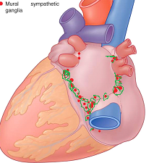
4. Intramural Ganglias/Terminal ganglia
Notes:
Terminal: few close to viseral organs i.e rectum, bladder, heart

Slide 23
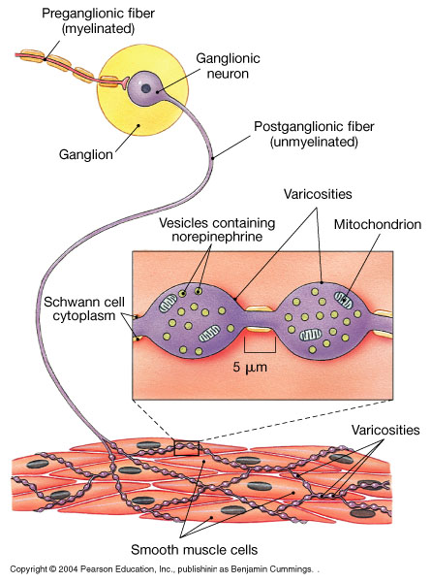
Organs of supply
Sympathetic Variosities are long
1:25,000 effector cells; cleft ∼50 nm across
Cutaneous blood vessels
Deep blood vessels
Glands
cardiac muscles
pilomotor
Smooth muscles

Slide 24
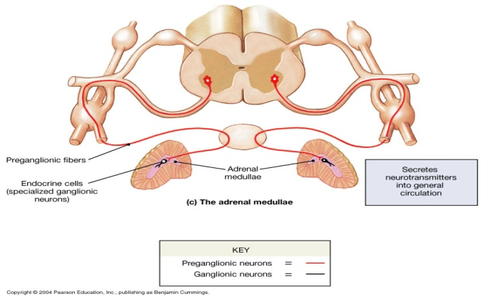
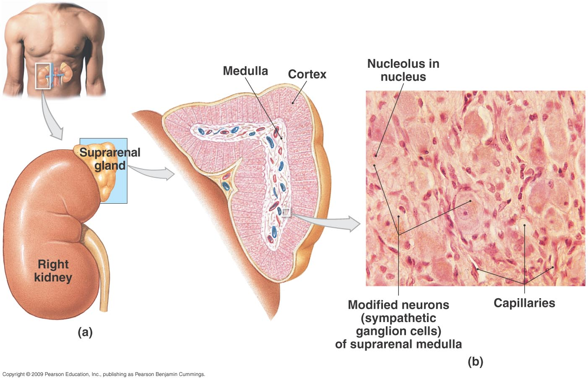
5.Adrenal gland
Adrenal=a modified sym: gang: pyramid-shaped on top of each kidney
2. Structurally and functionally, they are2 glands:
a) Adrenal cortex (outside) glandular (epithelial)
b) Adrenal medulla (inside) is nervous hormonal
3. Embryologically derived from pheochromoblasts differentiate into modified neuronal cells
Pheochromocytes (= chromaffin cells; axonless secretory cells
2.Release into blood- 80% -E 20% -NE
4. Acts as a peripheral amplifier

Slide 25
Differences between SNS AND PNS
1.ANATOMICAL
2. PHYSIOLOGICAL
3.BIOCHEMICAL
4.PHARMACOLOGICAL
5.PATHOLOGICAL
6.MEDICAL

Slide 26
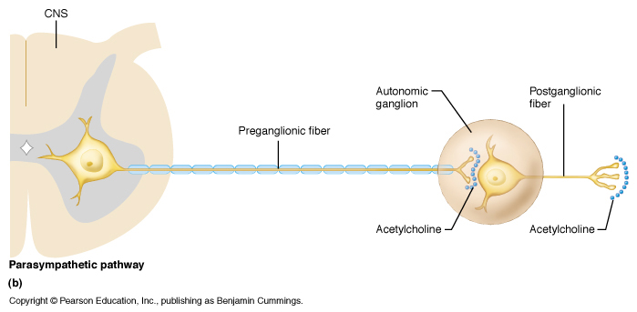
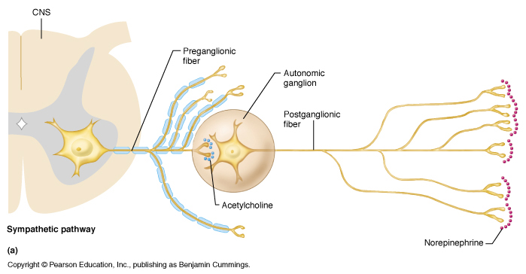
Differences
SYMPATHETIC
PARASYMPATHETIC
1. sympathetic chain
(Paravertebral ganglias)
2. Thoraco-lumbral region
3.Most divergence
4.postganglionic cells :
mostly start from sympathetic chain
1.-Brainstem,-S2 → S4 (Cranio-sacral)
2.Targets in head and body cavities
3.Preganglionic cells: less divergence than SNS
4.Postganglionic cells: in terminal
(near organ)or intramural (in organ
ganglia

Slide 27
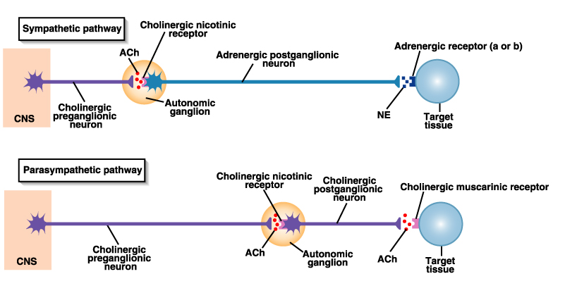
Receptor/NT Differences:
Symp . Parasymp.
6.. NT at Target Synapse
Mostly NE (adrenergic neurons) 6 Ach(cholinergic neurons)
7.Type Receptors at Target Synapse
                7. Nicotinic /Muscarinic
(α and β)D₁₋₄

Slide 28
Indications for ANS testing
Syncope
Central autonomic degeneration ex. Parkinsons
Pure autonomic failure
Postural tachycardia syndrome
Autonomic and small fiber peripheral neuropathies ex.- diabetic neuropathy
Sympathetically mediated pain
Evaluating response to therapy
Differentiating benign symptoms from autonomic disorders

Slide 29
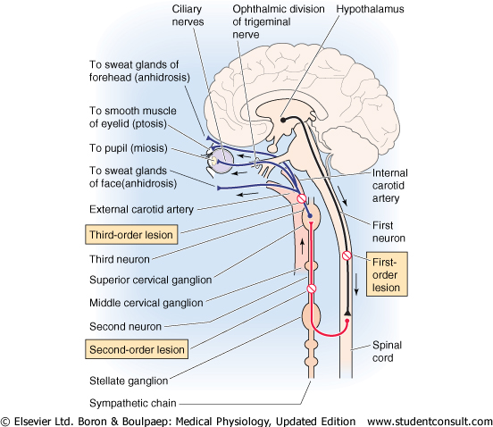
Horner’s Syndrome
in descending pathway b/w T1-T5 Damage to SCG.
1. Miosis – lack of SNS innervation of dilator pupillae
  ( nothing to counteract PNS sphincter pupillae)
2. Ptosis – drooping of upper eyelid ( inactivity of superior
tarsal muscle (smooth muscle)
3. Anhidrosis – lack of facial sweating if lesion occurs before branching of sympathetics in the periphery
4. Enophthalmos – sinking of one eye w/in the orbit
(possibly due to inactivity of smooth muscle)
Notes:
Horner’s Syndrome: results from loss of the normal sympathetic innervation on one side of the face. The D/D of this syndrome is large, but it can be narrowed if the site of involvement of the sympathetic pathways can be identified.
Lesion of SNS in descending pathway b/w T1-T5 Damage to superior cervical ganglia
Signs/Symptoms of Horner’s
Miosis – constriction of pupil due to lack of SNS innervation of dilator pupillae
Pupil constricts b/c there is nothing to counteract PSNS-controlled sphincter pupillae muscles
Ptosis – drooping of upper eyelid due to inactivity of SNS innervation of superior tarsal muscle (smooth muscle)
Also seen in Myasthenia Gravis (ie you would have ptosis, but NO miosis)
Could also occur b/c of lesion to CN III – GSE component
But would get more pronounced eyelid drop
Anhidrosis – lack of facial sweating
It would be apparent if lesion occurs before branching of sympathetics in the periphery
Branch to facial sweat glands follows ECA
Branch to eye follows ICA
Enophthalmos – sinking of one eye w/in the orbit (possibly due to inactivity of smooth muscle)

Slide 30
CLINICAL APPLICATION
can be primary, familial or due to secondary systemic disease or idiopathic.
A) Primary :
1. Idiopathic Orthostatic Hypotension
2. Shy-Drager type of Orthostatic Hypotension
B)Familial :
1. Riley-Day Syndrome (Autonomic neuropathy in infants and children)
2. Lesch-Nyhan Syndrome
3. Gill Familial dysautonomia

Slide 31
C)Secondary to systemic diseases:
Aging
Diabetes Mellitus
Chronic Alcoholism
Chronic Renal Failure
Hypertension
Rheumatoid Arthritis
Carcinomatosis
Chaga's disease
Tetanus
Spinal cord injury – Transection
  Acute
  Chronic
Neurological diseases
  Tabes Dorsalis
  Syringomyelia
  Amyloidosis

Slide 32
Autonomic Nervous System
Adrenergic
(Sympathomimetic)
Increases heart rate
Bronchodilates
Dilates Pupils
Decreases GI tract
Decreases lacrimation
Decreases urination
“Fight or Flight”
Cholinergic
(Parasympathomimetic)
Decreases heart rate
Bronchoconstricts
Constricts Pupils
Increases GI tract
Increases lacrimation
Increases urination
“Rest and Digest”

Slide 33
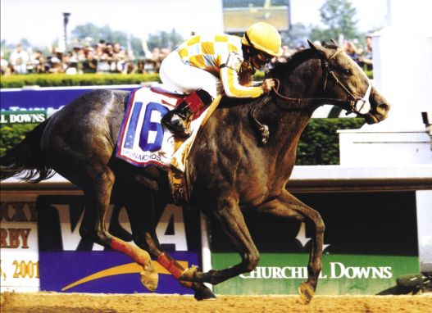
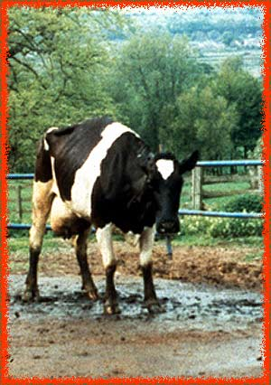

The Race Horse and the Cow
SYMPATHETIC
Fight or Flight
PARASYMPATHETIC
Rest and Digest

