Slide 1
LECTURE 28- ANATOMY OF CEREBELLUM AND ITS CONNECTIONS
Dr. Mohammad Rehan Asad

Slide 2
At the end of the lecture the student should be able to
Identify external features of cerebellum
Enumerate neurons, fibers, nuclei and layers of cerebellum
Identify connections of cerebellum
Identify clinical application

Slide 3
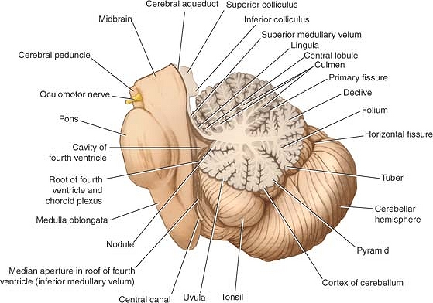
Cerebellum
Situated in the posterior cranial fossa and is covered superiorly by the tentorium cerebelli.
It is the largest part of the hindbrain (10% of total weight) and lies posterior to the fourth ventricle, the pons, and the medulla oblongata.
It consists of two cerebellar hemispheres joined by a narrow median vermis.

Slide 4
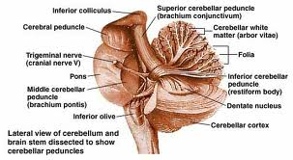
Cerebellum
Three symmetrical bundles of nerve fibers called the superior, middle, and inferior cerebellar peduncles.
Superior peduncle enters mid brain
Middle peduncule consist of transverse fibres of pons
Inferior peduncle connect with medulla

Slide 5
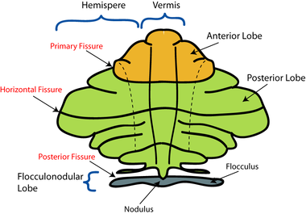
Cerebellum
The cerebellum is divided into three main lobes: the anterior lobe, the middle lobe, and the flocculonodular lobe.
The anterior lobe may be seen on the superior surface.
It is separated from the middle lobe by a wide V-shaped fissure called the primary fissure.
The middle lobe (sometimes called the posterior lobe), which is the largest part of the cerebellum, is situated between the primary and uvulonodular fissures.
The flocculonodular lobe is situated posterior to the uvulonodular fissure.

Slide 6
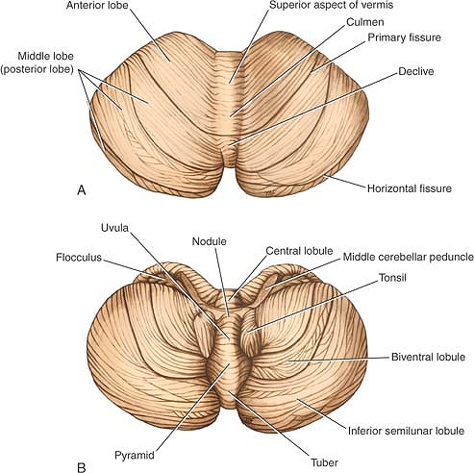
Cerebellum
Sup part of vermis
Lingula
Culmen
Declive
Folium
Inferior part of vermis
Tuber
Pyramid
Uvula
Nodule

Slide 7
Vermis

Slide 8
Cerebellum connections
Functionally cerebellum divided in corpus cerebelli and flocculonodular lobe
Corpus cerebelli:
afferent from spinal cord and trigeminal nuclei
Inputs from pontine nucleus
Flocculonodular lobe
Connections with vestibular nucleus

Slide 9
Cerebellum connections
Anterior lobe and pyramid mainly receive spinal and trigeminal afferents
Corticopontine connections are relayed to posterior lobe, tuber, vermis and uvula

Slide 10
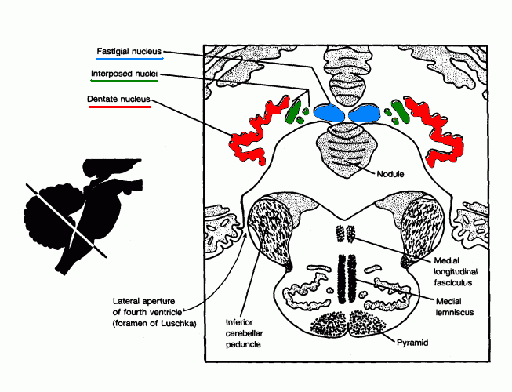
Cerebellar nuclei
Histologically made up of three layers
Embedded in white matter are four paired nuclei
Dentate is largest
Main connection is cerebropontocerebellar
Efferent fibres pass to contralateral red nucleus, thalamus, and cerebral cortex.

Slide 11
Cerebellar peduncles
Superior cerebellar peduncle
Efferent of dentate nucleus
Afferent: anterior spinocerebellar tract, Tectocerebellar from mid brain.
Middle cerebellar peduncle
Afferent fibres from pontine nucleus.
Inferior cerebellar peduncle
Efferent: cerebellovestibular tarct
Afferent: vestibulocerebellar tract, post spinocerebellar, cuneocerebellar, oivocerebellar

Slide 12
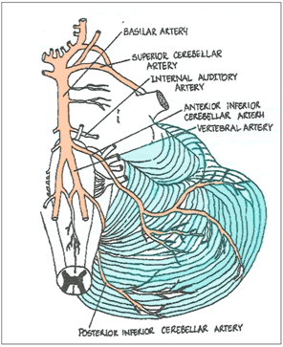
Blood supply
Posterior inferior cerebellar artery
Anterior inferior cerebellar artery
Branch of basilar artery
Superior cerebellar artery

Slide 13
Clinical application
Lesion of floccolonodular lobe leads to disequilibrium.
Lesion of cerebropontine connections leads to hypotonia, diminished muscle jerk, intention tremor, clumsy movements
Isolated lesions of the vermis are produced in children by medulloblastomas in the roof of the fourth ventricle

Slide 14
Clinical application
Anterior lobe lesions leads to ataxia
Dysdiadochokinesia: inability to perform alternating movements regularly and rapidly
Dysarthria occurs in cerebellar disease because of ataxia of the muscles of the larynx

