Slide 1
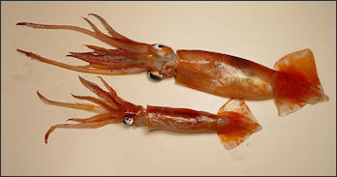
Action Potentials
DR QAZI
Notes:
Given the crude equipment available in the 1930’s, advances could not have come without the help of one of the most remarkable animal models ever discovered: the squid and its system of giant axons that control its escape response. The largest axons in a 2 foot long squid is a millimeter in diameter – visible to the naked eye and large enough to push one and even 2 wires into. First record by
HARTMAN IN 1934
USING EXTRA CELLULAR ELECTRODES
INTERNAL EKLECTRODES WERE USED IN 1960

Slide 2
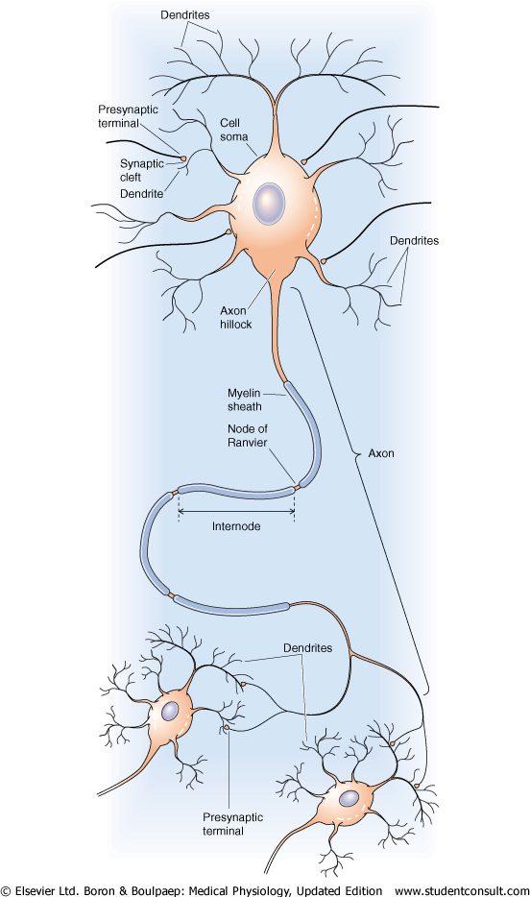
OBJECTIVES
Define the action potential.
Describe the changes during action potential.
Discuss conduction (propagation) of action potential
Describe recording of monophasic action potential.

Slide 3
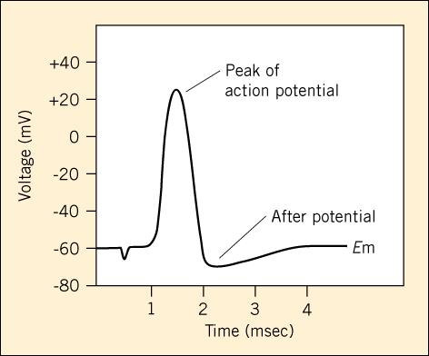
Action Potential
-Rapid, large alterations in the membrane potential during which time the membrane potential may change 100 mV,
( -70 to +30), and then repolarize to its RMP
Nerve
Muscle cells
Endocrine
Immune
Reproductive cells

Slide 4
FUNCTIONS OF AP
Relay a neuron’s message over a relatively long distance, leading to NT release.
Relay the activation signal over the surface of a muscle cell.
“Motivate” neuroendocrine cells to release hormones.
Spread an activation response over the membrane surface of immune cells.
Relay the message of fertilization over the surface of an egg.

Slide 5
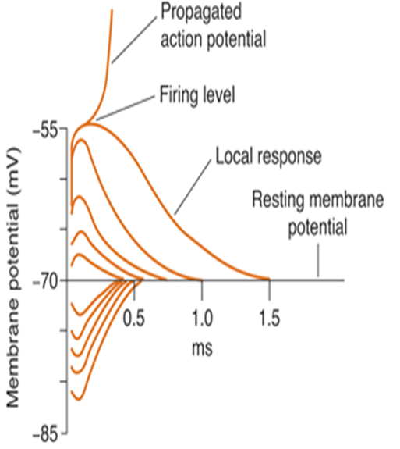
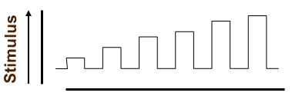
Stimulus: sudden change of (internal or external) environmental condition - cell.
5 types
1.Submiminal
2. Miminal
3.Submaximal
4. Maximal
5. Supra maximal
Notes:
imuli IS SEGMENT +IN SENSORY NEURONS TRIGGER ZONE IS IN CLOSE TO TARGET ORGANS
Physical
chemical
Electrical
Sound
Threshold (intensity): the lowest or minimal intensity of stimulus to elicit AP
3 factors of the stimulation: intensity, duration, rate of intensity change)

Slide 6
  Local Response
  It s a graded potential
  Its propagation is electronic conduction
  Subthreshold stimulus
  It can be summed by 2 ways
    Spatial summation
    Temporal summation
Excitatory
a
Excitatory
b
d
Inhibitory
c
a
b
Membrane Potential (mV)
c
d
Time
Temporal
Summation
Temporal & Spatial
Summation

Slide 7
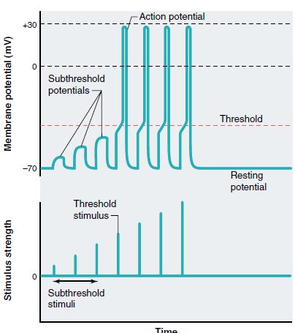
1. All-or-none principle.
2. Amplitude- same.
Notes:
No matter how strong the stimulus, as long as it is greater than threshold, AP will occur.

Slide 8
CODING OF INFORMATION
1.
Weak stimulus
2.
Moderate stimulus
3.
Strong stimulus
Pattern = Intensity of stimulus frequency of APs
Place = type of stimulus Visual, auditory, pain, etc.
Brain area that receives signal Doctrine of Specific Nerve Energies
Notes:
All action potentials are alike (of the same amplitude) and are independent of stimulus intensity.
The amplitude of the action potential is the same for a weak stimulus as it is for a strong stimulus.
So how does one stimulus feel stronger than another?
Strong stimuli generate more action potentials than weaker stimuli.
More action potentials stimulate the release of more neurotransmitter from the synaptic knob
The CNS determines stimulus intensity by the frequency of impulse transmission

Slide 9
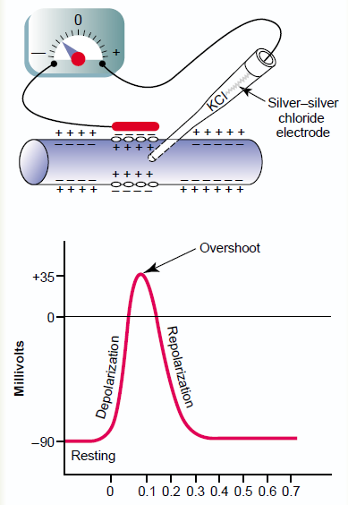
IS
Notes:
The action potential is a rapid depolarization of the membrane.
It starts at the axon hillock and passes quickly along the axon.
The membrane is quickly repolarized to allow subsequent firing.
IS

Slide 10
Stages of AP
  1. NORMAL, UNPOLARIZED, EQULIBRIUM
  2. POLARIZED RMP
  3. STIMULUS
    4. ARTIFACT
    5. FIRING LEVEL
    6. ELECTROTONIC POTENTIAL GP
    7. THRESHOLD
  8. UPSTROKE / ASCENDING WAVE /DEPOLARIZATION
    9. OVERSHOOT
    10. ZERO –LEVEL ISOPOTENTIAL PEAK
  11. DOWN STROKE/DESCEDINGWAVE/ REPOLARIZATION
    12. SPIKE POTENTIAL
    13. -ve AFTER DEPOLARISATION
  14 +ve AFTERDEPOLARISATION / HYPERPOLARIZATION/ UNDER SHOOT
Notes:
12.SPIKE POTENTIAL (4MSE)
13.-AFTER DEPOLARISATION
14 + AFTERDEPOLARISATION OR HYPERPOLARIZATION UNDER SHOOT
(40 MSEC)

Slide 11
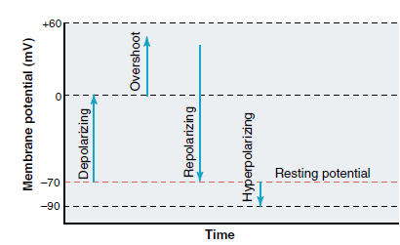

Slide 12
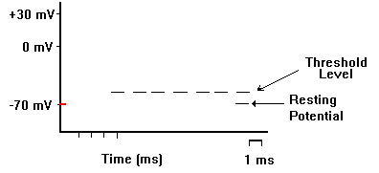
RMP= -65mV
-65
Notes:
-65mV

Slide 13
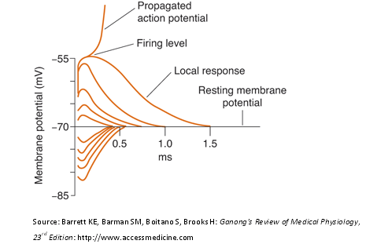
Electrotonic potentials & local response
10-20 mv < -ve than the RMP . trigger AP
2 types ;-
  cat –electrotonic potentials= is a depolarising---- allows the Na+ ion to move in
  an–electrotonic potentials = is a hyperpolarising current allows the k+ ion to move out

Slide 14
+30
Amplitude
= 100 mV
0
Depolarization
Na+ influx
- 70 mV to +30 mV
-55
-70
-80
Time
Notes:
AP (neuron firing) are triggered at the axon hillock when a neuron is depolarized to the point that the membrane potential reaches about -65 mV; threshold of excitation
Once -65mV is reached, AP is reversal of the membrane potential from -70 mV to +50 mV in about one millisecond

Slide 15
Rapid depolarization
When partial depolarization reaches the activation
threshold, voltage-gated sodium ion channels open.
Sodium ions rush in.
The membrane potential changes from -70mV to +40mV.
+
Na⁺
-
-
+
Na⁺
Na⁺

Slide 16
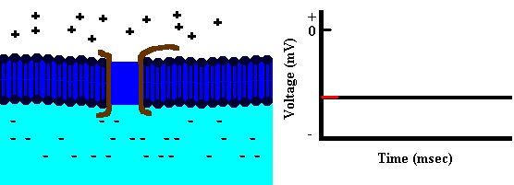
Depolarization

Slide 17
+35
0
Repolarization
K+ efflux
-60
-70
-80
Time
Notes:
Reverses Polarity
At peak of action potential the membrane potential reverses polarity
Becomes positive inside as predicted by the E_{na} Called OVERSHOOT
Return to membrane potential to a more negative potential than at rest
Called UNDERSHOOT
Reverspolarization: a reversal of membrane potential polarity.
The inside of a cell becomes positive relative to the outside.
Repolarization: restoration of normal polarization state of membrane.
a process in which the membrane potential returns toward from depolarized level to the normal resting membrane value.

Slide 18
Repolarization
Na⁺⁺ ion channels close and become refractory.
Depolarization triggers opening of voltage-gated K⁺ ion channels.
K+ ions rush out of the cell, repolarizing and then hyperpolarizing the membrane.
Na⁺
K⁺
+
K⁺
-
Na⁺
Na⁺
K⁺

Slide 19
Repolarization

Slide 20
+35
0
After-
hyperpolarization
-60
-70
-80
Time
Notes:
Process lasts about 1/1000th of a second.
Potassium Channel Property
K channels open with a delay and stay open for length of depolarization
Repolarize the Vm to Ek= -75mV which is why you have hyperpolarization.
Also called a delayed rectifier channel

Slide 21
Resuming the RMP
Potassium channels close.
Repolarization resets sodium ion channels.
Ions diffuse away from the area.
Sodium-potassium transporter maintains polarization.
The membrane is now ready to “fire” again.
Na⁺
K⁺
K⁺
K+
K+
K+
K+
Na+
Na+
Na+
K+
K+
K+
K+
K+
K+
K+
K+
K+
K⁺
K⁺

Slide 22
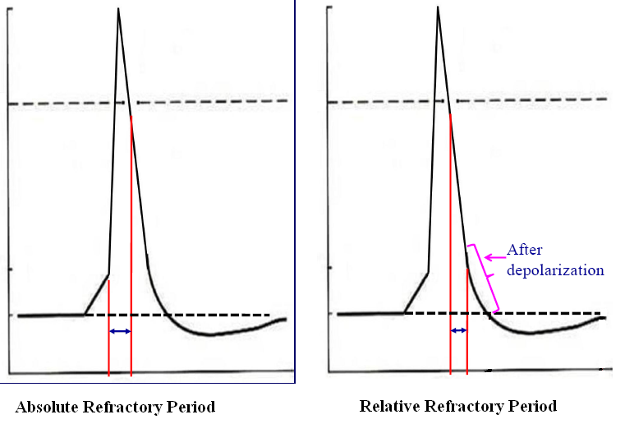
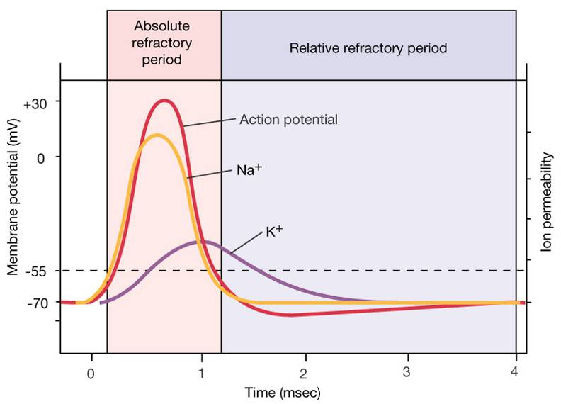
Refractory Period
  Absolute Lasts 1 msec
    Complete insensitivity exists to another stimulus
    From beginning of action potential until near end of repolarization.
    No matter how large the stimulus, a second action potential cannot be produced.
    Has consequences for function of muscle
  Relative
    A stronger-than-threshold stimulus can initiate another action potential
Notes:
AP won’t fire again
During the time interval between the opening of the Na⁺ channel activation gate and the opening of the inactivation gate, a Na⁺ channel CANNOT be stimulated.
This is the ABSOLUTE REFRACTORY PERIOD.
A Na⁺ channel cannot be involved in another AP until the inactivation gate has been reset.
This being said, can you determine why an AP is said to be unidirectional.
What are the advantages of such a scenario?

Slide 23
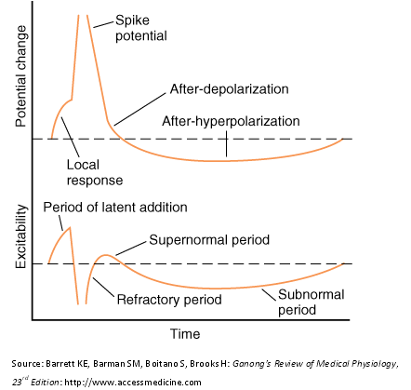
Notes:
Relative during after hyperpolarization requires greater depolarization Limits firing rate to 1000AP/sec
Could an AP be generated during the undershoot? Yes! But it would take an initial stimulus that is much, much stronger than usual.WHY? This situation is known as the relative refractory period.
When you pull the handle, water floods the bowl. This event takes a couple of seconds and you cannot stop it in the middle. Once the bowl empties, the flush is complete. Now the upper tank is empty. If you try pulling the handle at this point, nothing happens (absolute refractory). Wait for the upper tank to begin refilling. You can now flush again, but the intensity of the flushes increases as the upper tank refills (relative refractory)

Slide 24
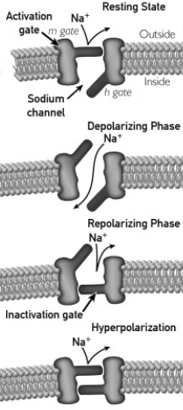
Voltage-Gated Na⁺⁺Channel
1. M gate= activation gate on Na channel; opens quickly when membrane is depolarized
2. H gate- inactivation gate on Na channel; Closes slowly after membrane is depolarized
Notes:
M gate= activation gate on Na channel; opens quickly when membrane is depolarized
H gate- inactivation gate on Na channel; Closes slowly after membrane is depolarized
causes the absolute refractory period for AP propagation
If resting potential depolarized by 15 – 20 mV, then activation gate opened with 5000x increase in Na⁺ permeability followed by inactivation gate close 1 ms later

Slide 25
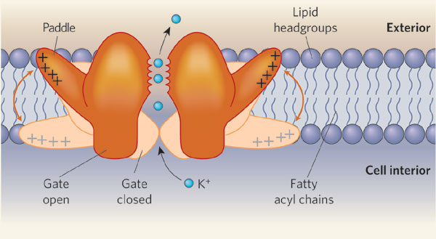
Gate on the Delayed Rectifier K⁺Channel
SINGLE GATE (N) that stays open as long as Vm is depolarized.
slowly this allows the Vm to depolarize due to Na influx;
Na and K currents do not offset each other right away
Notes:
K channels open with a delay and stay open for length of depolarization
Repolarize the Vm to Ek= -75mV which is why you have hyperpolarization.
Also called a delayed rectifier channel
single gate (n) that stays open as long as Vm is depolarized.
n gate on K channels opens very slowly this allows the Vm to depolarize due to Na influx; Na and K currents do not offset each other right away

Slide 26
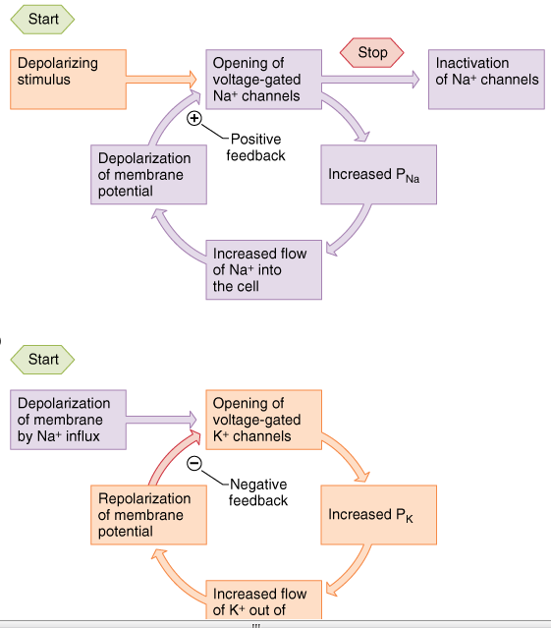
Hogkin’s cycle Positive feedback loop
graded Na+
potential
Na+ enters
(depolarization
V-gate Na+
channels open
Notes:
Na+ channels are relatively quick to respond to depolarization
Voltage-gated Na⁺ channels have 3 states:
1.Closed but responsive to voltage changes
2.Open
3. Closed and inactivated
(In this state, they are non-functional until hyperpolarization of
the membrane potential resets their molecular structure so that
they can again respond to depolarization by opening)
Voltage-gated K⁺ channels open more slowly in response to depolarization and are less synchronized in their response.
Voltage-gated K⁺ channels have only open and closed states

Slide 27
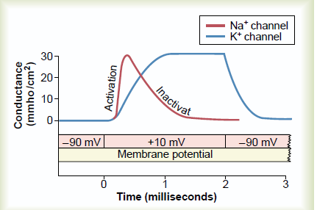
Ionic Events Underlying
Action Potentials
Notes:
because only a few ions adjacent to the membrane are involved in the generation of an action potential, the resting potential is readily reestablished by the random motion of ions (and NOT the Na+/K+ pump!)
when the threshold of excitation (about -65mV) is reached, voltage-gated Na+ channels open momentarily, and Na+ ions rush into the neuron under tremendous pressure from both their concentration gradient and the electrostatic gradient; this drives the membrane potential to about +50mV
At the same time, voltage-gated K+ channels slowly begin to open. Most of these channels open at about the time that the membrane potential is about +50mV. At this point, K+ ions are driven out by the +50mV charge and by their high internal concentration; this repolarizes the neuron and leaves it slightly hyperpolarized for a few milliseconds

Slide 28
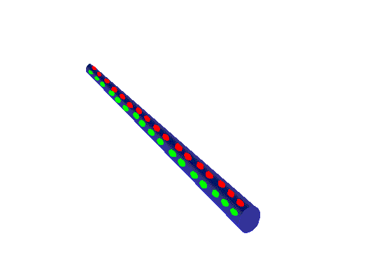
Action Potential Propagation:
Local Currents depolarize adjacent channels causing
depolarization and opening of adjacent Na channels
Question: Why doesn’t the action potential travel backward?
Notes:
- Act locally
- Attenuate with distance
- Spread in both directions

Slide 29
Transmission of a signal
Think dominoes!
  start the signal
    knock down line of dominoes by tipping 1st one
    → trigger the signal
  propagate the signal
    do dominoes move down the line?
    → no, just a wave through them!
  re-set the system
    before you can do it again,
    have to set up dominoes again
    → reset the axon
Notes:
protein channels are set up once first one is opened, the rest open in succession all or nothing response a “wave” action travels along neuron have to re-set channels so neuron can react again
Action Potentials are like magic: you can’t see or feel them…Capturing and analyzing the events depended upon fast electronics and electronic displays
Formation of AP in one site, generates AP in the next site, and so forth at the peak of AP Na+ conductance beghins fall as inactivation gate close
A single action potential does not actually move through the cell

Slide 30
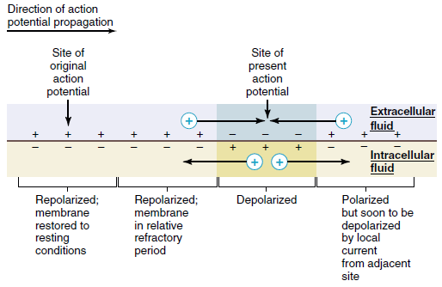

Slide 31
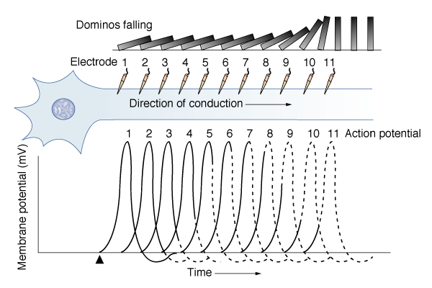
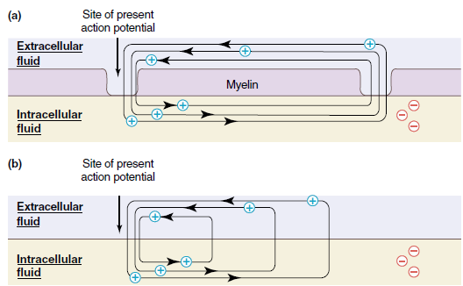

Slide 32
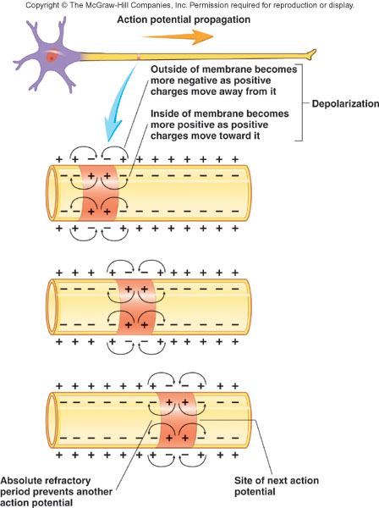
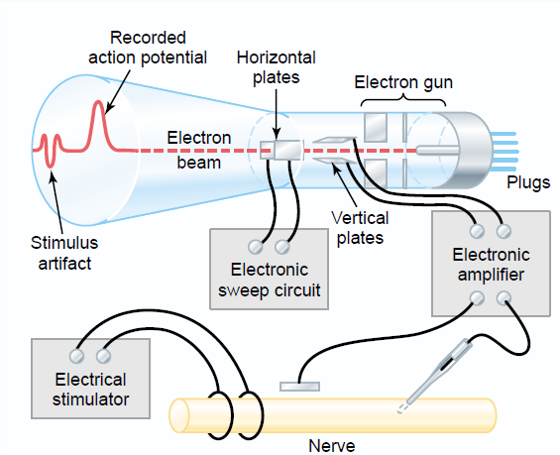
Notes:
Stimulated
(lo
Propagation
(current spreadcal depolarization

Slide 33
Saltatory Conduction
Notes:
Type A: large-diameter (4-20 µm), heavily myelinated. Conduct at 15-120 m/s (= 300 mph).
Motor neurons supplying skeletal muscles and most sensory neurons carrying info. about position, balance, delicate touch
Type B: medium-diameter (2-4 µm), lightly myelinated. Conduct at 3-15 m/s.
Sensory neurons carrying info. about temperature, pain, general touch, pressure sensations
Type C: small-diameter (0.5-2 µm), unmyelinated. Conduct at 2 m/s or less.
Many sensory neurons and most ANS motor neurons to smooth muscle, cardiac muscle, glands
Myelinated regions of axon are electrically insulated.
Electrical charge moves along the axon rather than across the membrane.
Action potentials occur only at unmyelinated regions: nodes of Ranvier.
When depolarization reaches a node, Na⁺ enters the axon through open channels.
At the nodes, Na⁺ entry reinforces the depolarization to keep the amplitude of the AP constant, but slows the current flow due to a loss of charge to the extracellular fluid.
However, it speeds up again when the depolarization encounters the next node.
The apparent leapfrogging of APs from node to node along the axon is called saltatory conduction.
When depolarization reaches a node, Na⁺ enters the axon through open channels.
At the nodes, Na⁺ entry reinforces the depolarization to keep the amplitude of the AP constant, but slows the current flow due to a loss of charge to the extracellular fluid.
However, it speeds up again when the depolarization encounters the next node.
The apparent leapfrogging of APs from node to node along the axon is called saltatory conduction.

Slide 34
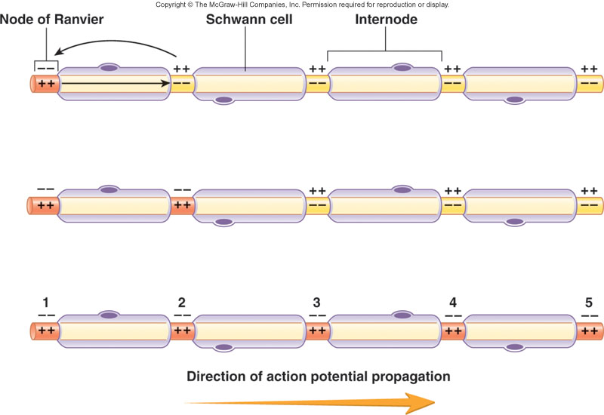
Saltatory Conduction
Impulse Conduction in Myelinated Neurons
Most Na+ channels concentrated at nodes. No myelin present.
Leakage of ions from one node to another destabilize the second leading to another action potential in the second node. And so on….
Notes:
Myelinated neurons oligodendroglia & Schwann cells
1. Transmit long distances, speed without loss of signal
2. Nodes of Ranvier
APs relatively slow, regenerates
EPSPs - fast, decremental but triggers AP at next node combines both currents like electricity through wire
3. Safety factor - trigger AP across 5 nodes
.2 - 2 mm apart larger neurons → farther apart
4. It is of value for two reasons:
very fast
conserves energy.

Slide 35


:
:
:

Slide 36
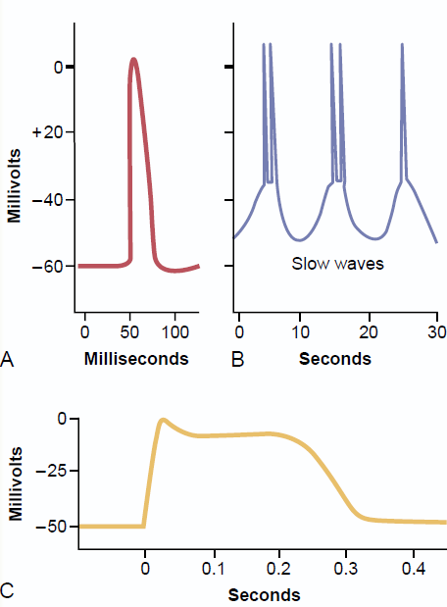
Notes:
The Action Potential Types

Slide 37
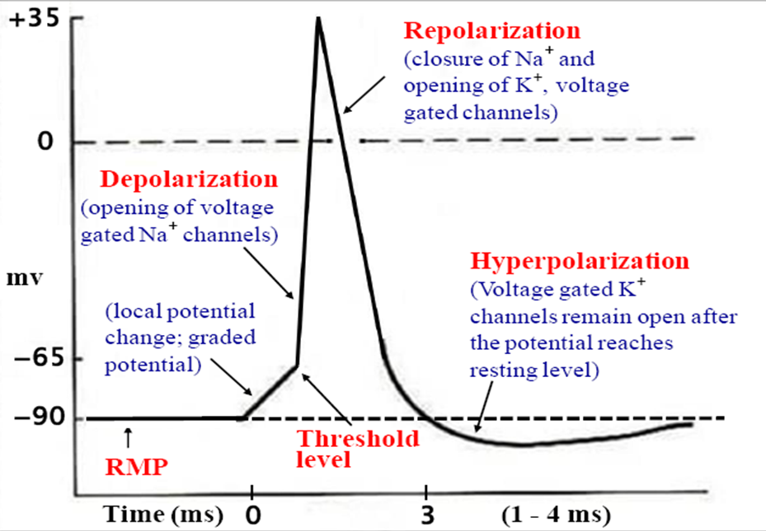
SUMMARY

