Slide 1
Organization of ANS
CHOLINERGIC
NERVOUS
SYSTEM
BY DR QAZI IMTIAZ

Slide 2
OBJECTIVES
1.Know anatomical organization of ANS.
2.Discuss the synthesis, storage, release,
actions and degradation of Ach
3. Explain cholinergic transmission
4. Discuss cholinergic receptors

Slide 3
Organization Nervous System
Central Nervous System
Peripheral Nervous System
Autonomic Nervous System
Somatic Nervous System
Sympathetic Enteric
Parasympathetic

Slide 4
MEDICAL -
BIOCHEMISTRY
PATHOPHYSIOLOGY
ANS
PHARMACOLOGY
CLINICAL
THERAPEUTICS
DISEASE STATE MANAGEMENT

Slide 5
ANS 1.Vegetative nervous system Reil( 1807) vege= growing
2. Autonomic nervous system
james langley (1898) prof; cambridge autos= self nomos= control
3.Involuntary nervous system
Prof; gaskell 1st editor of physiology magazine
4. Viseral nervous system
5. Viseral motor system
6. Efferent nervous system
Notes:
Vegetative -n –sys Reil( 1807) vege= growingHowever, in general, they work synergistically to control visceral activity and often act in opposite ways, like an accelerator and brake to regulate visceral function. An increase in output of the sympathetic division occurs under conditions of stress, anxiety, physical activity, fear, or excitement; parasympathetic output increases during sedentary activity, eating, or other "vegetative" behavior.
a.n.s James langley (1898) prof; cambridge autos= self nomos= control
Involuntary –n-s gaskell prof; 1 editor of physiology magazine
Viseral-n-s
Efferent-n-s
Viseral=motor sys
Autonomic responses usually occur without conscious control or awareness, as though they were indeed autonomous (in fact, the autonomi cnervous system has been called the “involuntary”
nervous system). However, it is wrong to assume that this is always the case, for it has been shown that discrete visceral or glandular responses can be learned and thus, to this extent, voluntarily controlled
The autonomic (from the Greek for "self-governing," functioning independently of the will) nervous system was first defined by Langley in 1898 as including the local nervous system of the gut and the efferent neurons innervating glands and involuntary muscle.

Slide 6
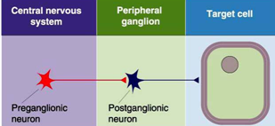
PHYSIOLOGICAL ANATOMY 2 neurons in the efferent pathway.

Slide 7
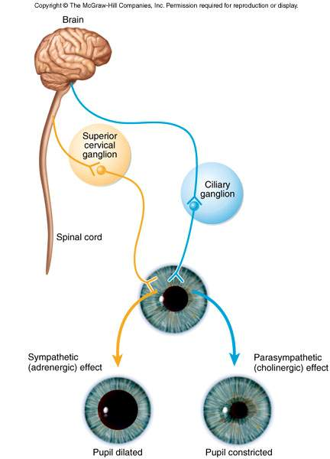
Dual Innervations
1.Most of viscera receive from
both divisions ( the same cells).
2.Both do not normally innervate
an organ equal
3.Dominance controlled by either
of the 2 systems
Notes:
Both systems function continuously and occasionally react in a reciprocal fashion
Most organs are dominantly controlled by one of the two systems

Slide 8
Lock & Key Model
NT binds to receptor
NT = key
Receptor = lock
Receptor changes shape
determines if EPSP or IPSP
receptor subtypes
NOT NT

Slide 9
Central Control of Autonomic Function
At several levels of the CNS
cerebral cortex
influenced by our emotions
hypothalamus
fight or flight responses originate here
reticular formation
can respond directly to sensory input from cardiac, vasomotor, & GI tract
spinal cord
defecation & micturition reflexes are integrated in the spinal cord

Slide 10
NTs in ANS
 |  | CNS Neurons | Preganglionic Autonomic | Postganglionic Autonomic | Visceral Afferent | Ganglion Interneurons | Enteric Neurons
1 . Acetylcholine |  |  | X | X
2. Monoamines
Norepinephrine |  | X |  | X |  |  | X
Epinephrine
5-Hydroxytryptamine |  | X |  |  |  |  | X
Dopamine |  |  |  |  |  | X | X
3. Amino acids
Glutamate |  | X
Glycine |  | X
GABA |  |  |  |  |  |  | X
4.Neuropeptides
Substance P |  | X | X |  | X | X | X
Thyrotropin- R H |  | X |  |  | X |  | X
Enkephalins |  | X |  |  |  |  | X
Neuropeptide Y |  | X |  | X |  |  | X
Neurotensin |  | X |  |  |  |  | X
Neurophysin II |  | X |  |  |  |  | X
Oxytocin |  | X |  |  |  |  | X
Somatostatin |  | X |  | X |  |  | X
Calcitonin gene-related peptide |  |  |  |  |  |  | X
Galanin |  |  | X | X |  |  | X
Vasoactive I P |  |  |  | X |  |  | X
Opioids? |  |  |  | X |  |  | X
Tachykinins (substance P, neurokinin A, neuropeptide K, neuropeptide γ)
Cholecystokinin
Gastrin-releasing peptide
Dynorphin
5.Nonclassical
Nitric oxide
ATP |  |  |  | X |  |  | X
 |  |  |  | X |  |  | X
Notes:
Small-Molecule, Rapidly Acting Transmitters
Class I
Acetylcholine
Class II: The Amines
Norepinephrine
Epinephrine
Dopamine
Serotonin
Histamine
Class III: Amino Acids
Gamma-aminobutyric acid (GABA)
Glycine
Glutamate
Aspartate
Class IV
Nitric oxide (NO)
Neuropeptide, Slowly Acting Transmitters or Growth
Factors
Hypothalamic-releasing hormones
Thyrotropin-releasing hormone
Luteinizing hormone–releasing hormone
Somatostatin (growth hormone inhibitory factor)
Pituitary peptides
Adrenocorticotropic hormone (ACTH)
b-Endorphin
a-Melanocyte-stimulating hormone
Prolactin
Luteinizing hormone
Thyrotropin
Growth hormone
Vasopressin
Oxytocin
Peptides that act on gut and brain
Leucine enkephalin
Methionine enkephalin
Substance P
Gastrin
Cholecystokinin
Vasoactive intestinal polypeptide (VIP)
Nerve growth factor
Brain-derived neurotropic factor
Neurotensin
Insulin
Glucagon
From other tissues
Angiotensin II
Bradykinin
Carnosine
Sleep peptides
Calcitonin

Slide 11
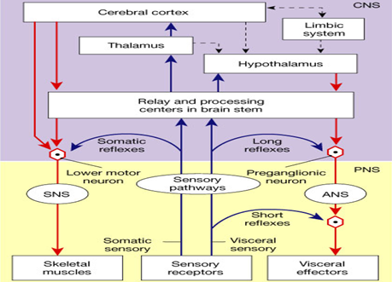
Notes:
sensory fibers enter the spinal cord and synapse directly on motor neurons in that same segment, this connection underlies a simple segmental reflex or interaction. If the incoming fibers synapse with neurons in other spinal segments, they can participate in an intersegmental reflex or interaction. Finally, if the incoming signals travel rostrally to the brainstem before they synapse, they constitute a suprasegmental interaction.

Slide 12
PNS
CRANO-SACRAL
CHOLENERGIC
NERVOUS SYS. OF TOMORROW
ANABOLIC SYSTEM
TROPHOTROPIC SYSTEM
“D” division digestion, defecation, diuresis
Notes:
Concerned with keeping body energy use low
Involves the D activities – digestion, defecation, and diuresis
TROPHO= NOURISHMENT TROPIC= RELEASING
ANABOLIC= ASSIMILATION

Slide 13
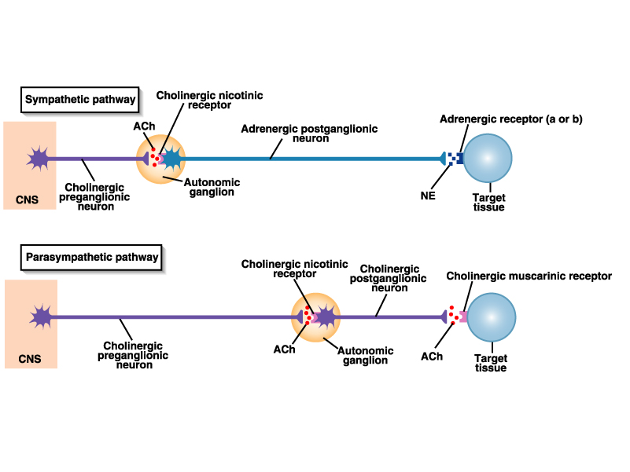
PHYSIO-ANATOMY
Notes:
PHYSIO-ANATOMY

Slide 14
1. Cranial Outflow
1. Oculomotor nerve (III)
2. Facial nerve (VII)
3. Glossopharyngeal nerve (IX)
4. Vagus nerve (X)
2. SACRAL Outflow S2-S4
Notes:
Cell bodies located in cranial nerve nuclei in the brain stem
cranial nerves III (oculomotor), VII (facial) and IX (glossopharyngeal) supply parasympathetic innervation to visceral targets in the head PSN follows a two-neuron efferent. In the cranium, preganglionic PSN (CN III, CN VII, and CN IX) arise from specific nuclei in the CNS and synapse at one of four parasympathetic ganglia: ciliary, pterygopalatine, otic, or submandibular. From these four ganglia the PSN complete their journey to target tissues via CN V (trigeminal) branches (ophthalmic nerve CN V₁, maxillary nerve CN V₂, mandibular nerve CN V₃). The vagus nerve does not participate The preganglionic fibers are long and the post are short.
The preganglionic neurons synapse with postganglionic neurons in terminal ganglia located in or close to their effector organs.
in these cranial ganglion as most of its PSN fibers are destined for a broad array of ganglia on or near organs including the thoracic viscera (esophagus, trachea, heart, lungs) and abdominal viscera (stomach, pancreas, liver, kidneys) traveling all the way down to the midgut/hindgut junction just before the splenic flexure of the transverse colon. The pelvic splanchnic preganglionic nerve cell bodies arise in the ventral horn of the spinal cord and continue away from the CNS to synapse at an autonomic ganglion. The PSN ganglion, where the preganglionic neurons synapse, will be close to the organ of innervation (unlike the SN where the ganglion is typically farther away from the target organ). The two neuron system is only for efferent innervation. Afferent, unconscious sensations sent from the viscera to the CNS are done so in a one neuron tract.

Slide 15
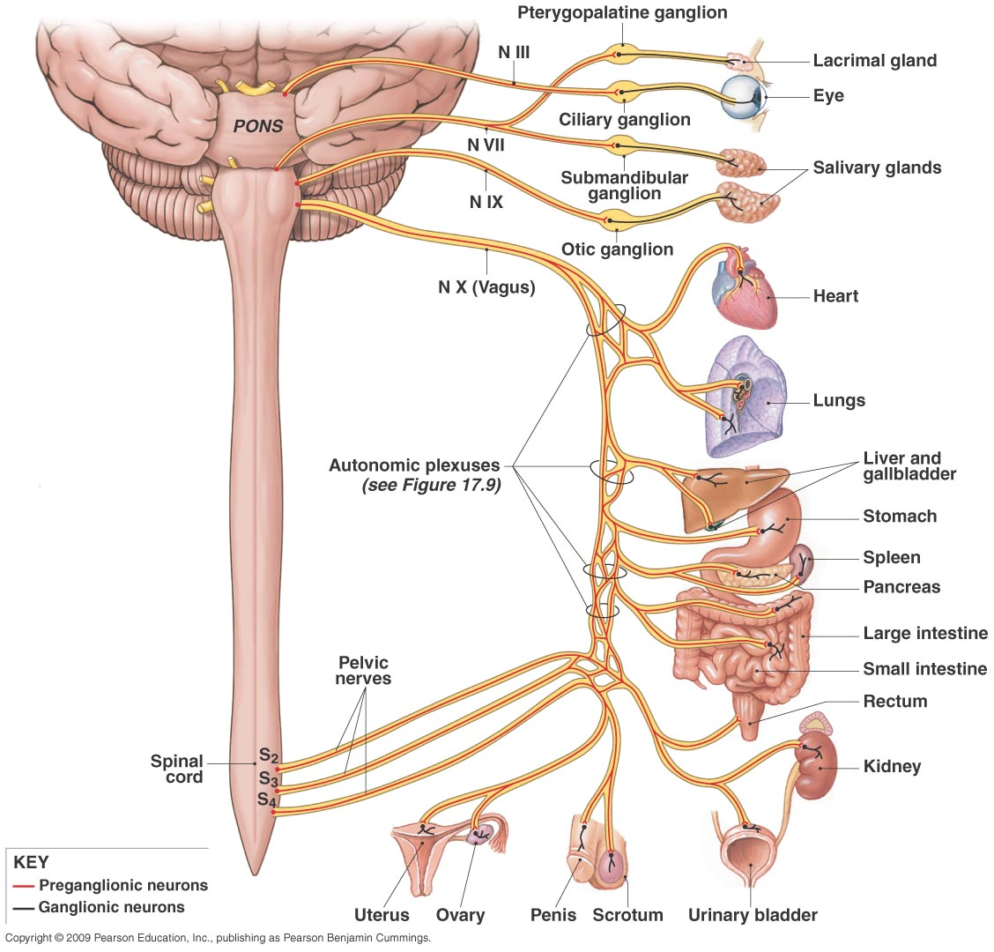
SLUDD
1. Salivation
2.Lacrimation
3.Urination
4.Digestion
5.Defaction

Slide 16
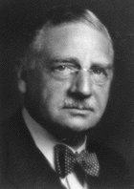
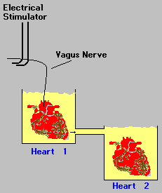
Acetylcholine
Otto Loewi (1903-1961)
Born in Germany, American Citizen
1920 - Discovered 1st NT
“Dreamed” the experiment
Acetylcholine → “vagus substance”
1936 - Nobel Prize
ACh
ACh
ACh
Notes:
"The night before Easter Sunday, I woke, turned on the light and jotted down a few notes on a tiny slip of paper. Then I fell asleep again. It occurred to me at six o'clock in the morning that during the night I had written down something most important, but I was unable to decipher the scrawl. The next night at three o'clock, the idea returned. It was the design of an experiment to determine whether or not the hypothesis of chemical transmission that I had uttered seventeen years ago was correct. I got up immediately went to the laboratory and performed the simple experiment."
…The experiment worked

Slide 17
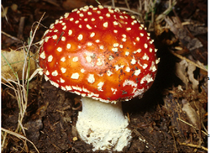
Amanita muscarina
1869
Notes:
It was first isolated from fly agaric Amanita muscaria in 1869. It was the first parasympathomimetic substance ever studied and causes profound activation of the peripheral parasympathetic nervous system that may end in convulsions and death. Muscarine has no effects on the central nervous system because it does not cross the blood-brain barrier due to its positively charged (polar) nitrogen atom.Muscarine mimics the action of the neurotransmitter acetylcholine at metabotropic receptors that are also known under the name muscarinic acetylcholine receptors.Muscarine poisoning is characterized by increased salivation, sweating (perspiration), and tearflow (lacrimation) within 15 to 30 minutes after ingestion of the mushroom. With large doses, these symptoms may be followed by abdominal pain, severe nausea, diarrhea, blurred vision, and labored breathing. Intoxication generally subsides within 2 hours. Death is rare, but may result from cardiac or respiratory failure in severe cases. The specific antidote is atropine

Slide 18
Ach - Distribution
N.S.
Excites somatic skeletal muscle (NMJ)
Smooth muscles,blood vessels- Neuroeffector junction
Autonomic NS
Ganglia , Adrenal gland
5. Few sympath NS, i.e, sweat gl.+ bld vessels of skl.m)
6. Central N.S. – C.C. Betz Cells Spinal cord, Eyes
Hippocampus, Basal Ganglia,
Hypothalamus
7. Eye
8. Skin Erectorus pilorum
Notes:
synthesized from choline (ie.
phosphatidylcholine) by acetylation
using acetyl CoA (from Krebs cycle)
pumped into vesicles using VChAT- vesicular cholinergic transporter
entire gene is in the first intron of choline acetyltransferase, forcing
these genes to be regulated using the same promoter
inactivated by acetyl and butyryl cholinesterases (AChE and BChE)
irreversible AChE inhibitors can be deadly toxins- curare, sarin, VX
reversible weak inhibitors may be Alzheimer's disease treatments

Slide 19
Major Cell Bodies Sites
Cholinergic Projections
interneurons
Learning & memory
PGO Spiking

Slide 20
PNS NTs
SOMATIC NERVOUS SYSTEM
ACh
Striated
muscle
AUTONOMIC NERVOUS SYSTEM
Sympathetic
Heart
Sm. mus.
Glands
ACh
NE
ACh
ACh
Sweat, PILOERECTOR
Glands,vasodilator
SK; MUS;
E, NE
ACh
Ad. M.
→ →
Parasympathetic
Heart
Sm. mus.
Glands
ACh
ACh
Notes:
affect is longer lasting than at a neuromuscular jn (Ach; 20 msec) NE adrenal medulla lasts even longer
(minutes) NE affects its targets until it is reabsorbed or broken down (seconds 2. 2% OF POSTGANGLIONIC
SYMPATHETIC SECRETED Ach

Slide 21
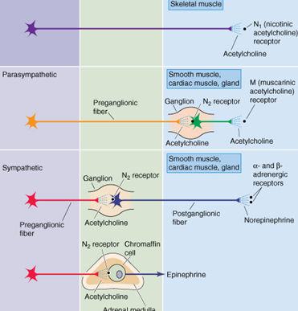

Slide 22
Biosynthetic Pathway for Acetylcholine
Pyruvate
PDH complex
(FAD, lipoamide, B₁)
Choline + Acetyl-CoA
ECF, MEMBRANE –
PLATLET ACTIVATING FACTOR
,
Reuptake or diet
(mitochondria
choline acetyl transferase (CAT)
Acetylcholine (
in terminal button)
Acetylcholinesterase (AChE)
Acetate
+ choline
Cauliflower, Milk, Lecithin (egg yolks, liver, soybeans, butter, peanuts
Notes:
Acetyl coA (mitochondria)
Choline (dietary). ECF, MEMBRANE PL MOLECULES- PLATLET ACTIVATING FACTOR, sphingomylin, phosphoti dyl- choline
Catalyzed by choline acetyl transferase (ChAT
PDH: pyruvate dehydrogenase FAD: flavin adenine dinucleotide
TPP: thiamine pyrophosphate (vitamin B₁) AChE: acetylcholinesterase
Choline may be obtained from eggs, liver, beef steak, soy (lecithin = phosphatidyl choline)
CAT deficiency found in Alzheimer’s disease, amyotrophic lateral sclerosis (ALS), schizophrenia

Slide 23
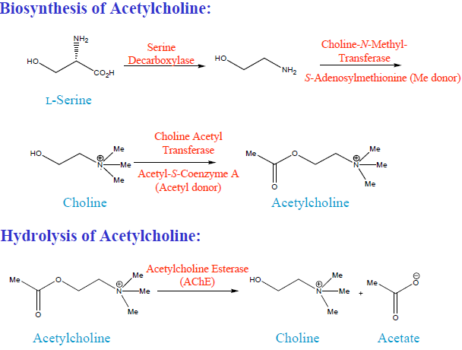

Slide 24
A cholinergic synapse
Choline
Nerve fiber (axon)
Na⁺, Cl⁻
Action
potential
Acetyl-CoA
Acetyl-Choline
Ca ⁺ ⁺
Ca ⁺ ⁺
Acetyl-Choline

Slide 25
β
α
δ
α
γ
ACh
Leucine
residues
ACh
R Pentamers of 5 types of glycoprotein
subunits: α (a1-a10), β (b2-b5),γ, δ & ε.

Slide 26
Cholinergic receptors
1.Nicotinic
ion channels (Ionotrophic)
N₁ Nicotinic nerve (NN)
N₂ Nicotinic muscle (NM)
Ch is both an excit; and inhibitory , depending on organs.

Slide 27
Nicotinic Receptors
Stimulated by Nicotine,+ on etc.
Motor end plates (somatic targets)
All ganglionic neurons of both sympathetic and parasympathetic divisions
The hormone-producing cells of the adrenal medulla
NOTE;- ACh binding to nicotinic receptors is always stimulatory
Notes:
Myasthenia Gravis autoimmune IgG against α₁ subunit (muscle nAChR
receptors are concentrated in clusters in postsynaptic structures close to the endings of neurons that secrete the neurotransmitters specific for them. This is generally due to the presence of specific binding proteins for them. In the case of nicotinic acetylcholine receptors at the neuromuscular junction, the protein is rapsyn, and in the case of excitatory glutamatergic receptors, a family of PB2-binding proteins is involved. GABA_{A} receptors are associated with the protein gephyrin, which also binds glycine receptors, and GABA_{C} receptors are bound to the cytoskeleton in the retina by the protein MAP-1B. At least in the case of GABA_{A} receptors, the binding protein gephyrin is located in clumps in the postsynaptic membrane. With activity, the free receptors move rapidly to the gephyrin and bind to it, creating membrane clusters. Gephyrin binding slows and restricts their further movement. Presumably, during neural inactivity, the receptors are unbound and move again

Slide 28
Parasympathetic Ganglionic Synapse
Ca²⁺
Acetylcholinesterase
Na⁺
ACH
α
Action Potential
β
α
Nicotinic
Receptor
Na⁺
Preganglionic neuron
Postganglionic neuron

Slide 29
Muscarinic cholinergic receptors
M₁ CNS , ANS+ ENS Ganglia,
M_{2 Heart} ↓ Some sympathetic targets
(sweat glands, skeletal muscle blood vessels
M₃ Blood Vessels: i.e, Relaxes Renal Artery .
M ₄ receptor is found in pancrease, smooth muscle.
Notes:
Muscarinic cholinergic receptors are very different from nicotinic cholinergic receptors. Five types, encoded by five separate genes, have been cloned. The exact status of M₅ is uncertain, but the remaining four receptors are coupled via G proteins to adenylyl cyclase, K⁺ channels, and/or phospholipase C
M₁ in is abundant in the brain. The M₂ receptor is found in the heart. The M₄ receptor is found in pancreatic acinar and islet tissue, where it mediates increased secretion of pancreatic enzymes and insulin. The M₃ and M₄ receptors are associated with smooth muscle.

Slide 30
Parasympathetic Organ Synapse
Acetylcholinesterase
Ca²⁺
Effector
Organ
Na⁺
K⁺
G
Action Potential
ACH
Muscarinic
Receptor
Postganglionic neuron

Slide 31
. Muscarinic ( Metabotrophic G-protein couple
NH
3
Phospho
-
lipase C
M1, M3, M5 IP₃, DAG Ca²⁺
(+)
G
q
PIP
2
COOH
IP
Diacylglycerol
3
2+
Increase Ca
Activate Protein
Kinase
C
Response

Slide 32
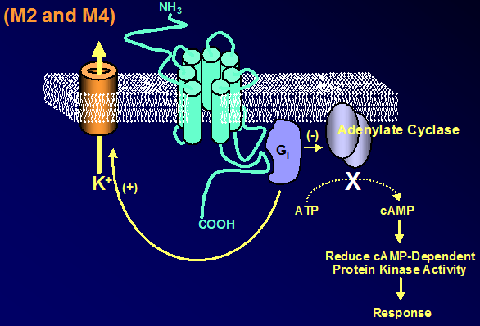
Cyclic AMP K⁺
Notes:
2. M2 & M4 Cyclic AMP K⁺

Slide 33
synapse inactivation by cholinesterase
Choline
Acetate
Action
potential
Acetyl-CoA
Acetyl-Choline
Choline
esterase
Ca ⁺ ⁺
Notes:
ACh is the only NT known to be deactivated in the synapse by enzymatic degradation rather than by uptake; it is deactivated by an
Cholinesterase provides for a very rapid mechanism of inactivation. This makes acetylcholine a preferred transmitter where rapid modulation of the signal is desired. Example: Voluntary muscular action.

Slide 34
2 Kinds of ChE in the Body
1. Plasma & Liver Cholinesterase
Butyrlcholinesterase, pseudocholinesterase, PChE,
2. All cholinergic Neurones , NM-Junctions & RBC Cholinesterase
True cholinesterase, specific acetylcholinesterase, or AChE
Notes:
What Cholinesterase Does: Physiologically Autonomic Nervous System
Parasympathetic
Presynaptic Sympathetic PNS Skeletal muscle CNS Memory & others
Plasma ChE
Floats freely in plasma
Made by liver
Rapid recovery from depression
Rapid replacement by new synthesis
Liver disease may affect levels
Sensitive to most ChE inhibitor pesticide exposures
Red Blood Cell Cholinesterase
Bound to red blood cells
Made at the same time as the Rbc's
Recovery from depression 0.8%/day
Slower to depress, slower to recover
Low RBC count may cause lower levels
Identical to neuronal ChE

Slide 35
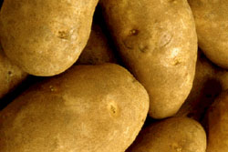
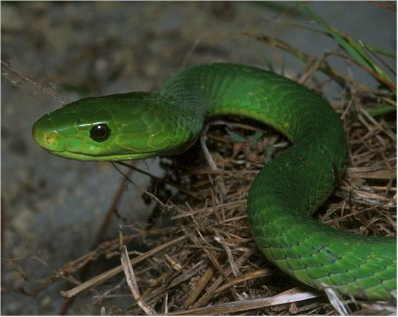
Why do we have this enzyme in the blood?
A buffer for poisons
Potatoes
Solanaceous alkaloids
Calabar Bean
Physiostigma venenosum
Green Mamba Snake
Fascilin inhibits AChE
Notes:
Nicotine is an alkaloid found in the nightshade family of plants (Solanaceae), predominantly in tobacco, and in lower quantities in tomato, potato, eggplant (aubergine), and green pepper. Nicotine alkaloids are also found in the leaves of the coca plant. Nicotine constitutes 0.3 to 5% of the tobacco plant by dry weight, with biosynthesis taking place in the roots, and accumulates in the leaves. It is a potent neurotoxin with particular specificity to insects; therefore nicotine was widely used as an insecticide in the past, and currently nicotine derivatives such as imidacloprid continue to be widely used.In lower concentrations (an average cigarette yields about 1mg of absorbed nicotine), the substance acts as a stimulant in mammals and is one of the main factors responsible for the dependence-forming properties of tobacco smoking. According to the American Heart Association, "Nicotine addiction has historically been one of the hardest addictions to break.
Calabar beans (Ordeal Beans)— contain Physostigmine, an ACE Inhib Used by African Native Tribe Innocents consumed quickly— vomited due to gastric irritant . Clever people used to take slowly— complete absorption— toxicity.

Slide 36
NT Removal
Notes:
NTs are removed from the synaptic cleft via:
Enzymatic degradation
Diffusion
Reuptake

Slide 37
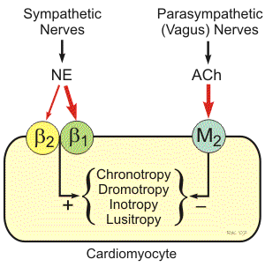
Notes:
Heart:
The heart is well supplied by SNS and PNS. These nerves affect cardiac pumping is 3 ways -By changing the rate (Chronotropism),By changing the strength of contraction (Inotropism), Modulating coronary blood flow.
The PNS cardiac vagal fibres approaches the stellate ganglion and then join the efferent cardiac SNS fibres.

Slide 38
Definitions
parasympathomimetic
is a drug or poison that acts by stimulating or mimicking the (PNS). These chemicals are also called cholinergic because(ACh) is the NT used by the PNS.
Some chemical weapons i. e. -Sarin
- Non-lethal roits control agents i.e TEAR GAS,
-Insecticides (DIAZINON) Fall Into This Category.
Notes:
Sympathetic and parasympathetic divisions typically function in opposition to each other. But this opposition is better termed complementary in nature rather than antagonistic. For an analogy, one may think of the sympathetic division as the accelerator and the parasympathetic division as the brake.

