Slide 2
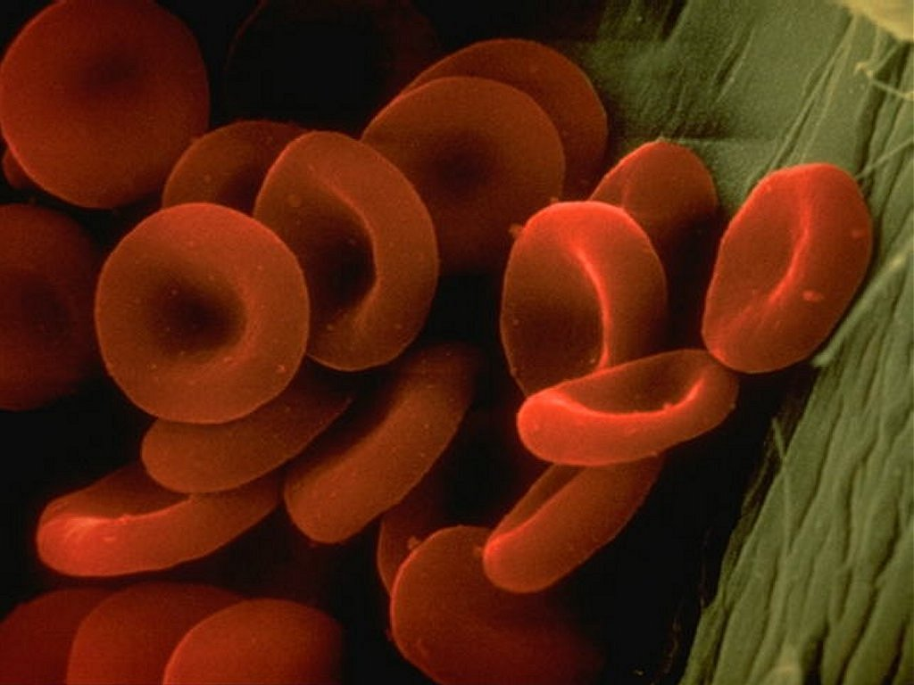
Hemoglobin
DR QAZI IMTIAZ RASOOL

Slide 3
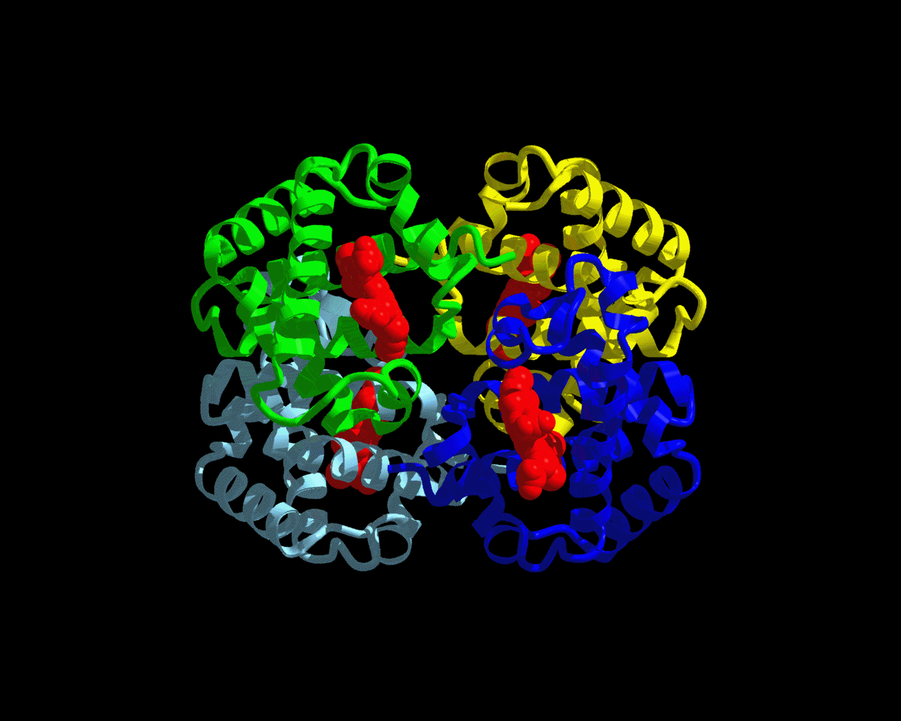
OBJECTIVES
Describe the structure of hemoglobin molecule
Describe synthesis of hemoglobin in brief.
List the functions of hemoglobin.
Enlist various types of normal and abnormal hemoglobin’s.

Slide 4
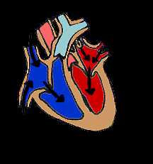
Hemoglobin
1. if the body had to depend upon
dissolved O₂ in the plasma
to supply O₂ to the cells
2.The heart would have
to pump 140 l/min instead
of 4-6 l/min.
3. RBC have nuclei during
early stages of development
mature to make room for Hb
Notes:
Blood cells are made up of two components. The hemoglobin is in solution inside the cell. The cell is surrounded by a membrane that holds in the hemoglobin.A rough analogy would be a rubber water balloon.The rubber would be the membrane, and the water would be the hemoglobin
5ml of O₂ /100ml of blood/miinx1ox5=250=0.3ml only soluble in plasma

Slide 5
HB historical facts
1st protein to be crystallized (1849);
1st to be associated with a specific physiological function (1875);
1st proteins to have its molecular weight (64,500) determined correctly (1920s);
2nd protein having its 3-D structure determined (1969)
.Hb: A protein that you can “see” with your naked eyes!

Slide 6
Synthesis: following R essential
1.1st class proteins – milk, fish, egg, soyabean etc.
2. Metals – iron and sulphur.------copper+calcium
3. Vitamin B12 (Folic acid).-------cobalt
4. Porphyrin compound

Slide 7
Synthesis
1.- Erythroblasts, =65% ---7days—intermediate normoblast stage
- Reticulocyte stage=35% ------2 days
2. Haem synthesis in the mitochondria.
3. Globin synthesis in the polyribosomes
4. Although synthesis occur separately within developing red cell precursors, their rates R coordinated for Hb assembly.

Slide 8
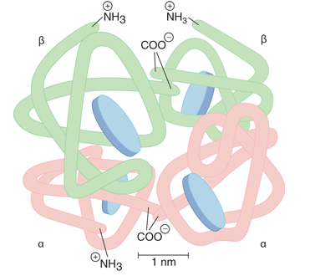
Haemoglobin Chemistry: It is a chromo protein, mol:wt. 64000
1.Single RBC contains about 270 million HB molecules. Each RBC can hold about 1 billion mol of O₂. Hb =1/3 of the weight of RBC
2. Heme = porphyrin ring + Fe²
non-protein (pigment)
Source of iron in body
Iron – held in organic lattice
Each iron holds 1 mol O₂
3. Adult Hb Globin = 2 α + 2β chains
each with its own haem group
i.e. α₁ β₁ and α₂ β₂
Notes:
O₂ would not bind if the iron is in ferric (Fe³⁺) state!

Slide 9
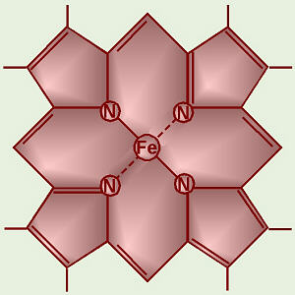
Structure of Heme
1.a protoporphyrin ring with an iron atom at its centre starts from a cyclic tetrapyrrole i.e. consists of 4 mol; of pyrrole (mol:wt1600 X 4).
2. - imparts a red color
3. -R,
-methyl (M),
-vinyl (V)
- proprionate (Pr) groups
Pyrrole ring

Slide 10
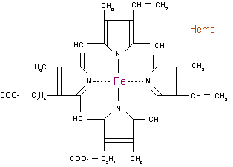
Porphyrin Ring
1
Notes:
The protoporphyrin ring consists of four pyrrole groups which are united by methane bridges (=C-).αβɣ
1,3,5,8
2,4,
6,7
The hydrogen atoms in the pyrrole groups are replaced by four methylene (CH3-), two vinyl (-C=CH2) and two propionic acid (-CH2-CH2-COOH) groups

Slide 11
Iron distribution

Slide 12
Iron
Food: Fe³⁺ absorbable Fe²⁺
`Gastric juice (gastroferrin)+ vit C reduces
Absorbed in duodenum
Fe²⁺ plasma level 10-35 μmol/l
Apoferritin (mucosa)
Transferrin ( Fe³⁺; plasma; β₁-globulin),
Ferritin; spleen, liver, bone marrow; plasma ferritin,
hemosiderin
There is no physiological mechanism for the
excretion of excess iron
Notes:
Iron is indipensable for life
(either in heme or non-heme form essential for oxygen transport, electron transfer, DNA synthesis, etc.)
Iron is insoluble
([Fe] cannot exceed 10⁻¹⁷)
Iron is potentially toxic
(unless appropriately chelated, Fe plays a key role in the formation of oxygen radicals)

Slide 13
Iron metabolism
Iron is indipensable for life
(either in heme or non-heme form essential for oxygen transport, electron transfer, DNA synthesis, etc.)
2.Iron is insoluble
([Fe] cannot exceed 10⁻¹⁷)
3. Iron is potentially toxic
(unless appropriately chelated, Fe plays a key role in the formation of oxygen radicals)

Slide 14
1st : Haem synthesis
Notes:
Haem synthesis The first step starts with the condensation of glycine and succinyl coenzyme A under the action of a rate limiting enzyme d-aminolaevulinic acid synthase. 2.d-ALA will be formed. 3. Pyridoxal phosphate (vit. B₆) is a coenzyme for this reaction. .

Slide 15
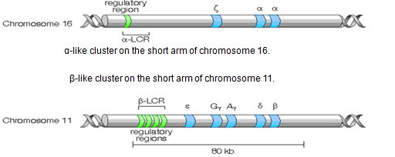
GENETIC ROLE
Humans normally carry 8 functional globin genes, arranged in 2 duplicate gene clusters:
These genes code for 6 different types of globin chains: α,β,γ,δ,ε,ζ, .
2 α (each with141 amino acids) 6. 2 β each - 146
Notes:
Humans normally carry eight functional globin chains, arranged in two, duplicated gene clusters: the β-like cluster (β, γ, δ and ε globin genes) on the short arm of chromosome 11 and the α-like cluster (α and ζ globin genes) on the short arm of chromosome 16

Slide 16
siage | types | name | Region | Time
embryonic | τ₂ε₂ α₂ε₂ | Gower I Gower II | Yolk Sac | 3 weeks of Gestation
embryonic | ( ζ₂γ₂) | Portland | Yolk-Sac | 5 wks Gestation
fetal, higher affinity to O₂ | α₂γ₂ | Hb F | Liver & spleen | 6-30 wks Gestation
adult, 2.5% Hb | α₂σ₂ | Hb B | Liver | 30 wks Gestation
adult Hb | α₂β₂ | Hb A | B.M | At Birth

Slide 17
Normal Hb in adult blood
 | Hb A | Hb A₂ | Hb F
structure | a₂b₂ | a₂d₂ | a₂g₂
Normal % | 96-98 % | 1.5-3.2 % | 0.5-0.8 %
HbA_{IC}: glycated Hb – important marker of long-term diabetes compensation

Slide 18
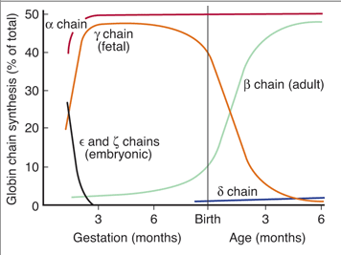
Notes:
The major switch from fetal to adult haemoglobin occurs 3-6 months after birth.

Slide 19
Haemoglobin catabolism
Destruction - life span- 120 days.
removed extravascularly by macrophages of the reticuloendothelial system (RES),
- specially in the bone marrow
- but also in the liver and spleen.
3. cell metabolism deteriorates as enzymes R degraded and not replaced, makes it non viable, but the exact reason why the red cells die is obscure.
Notes:
normal red cell destruction

Slide 20
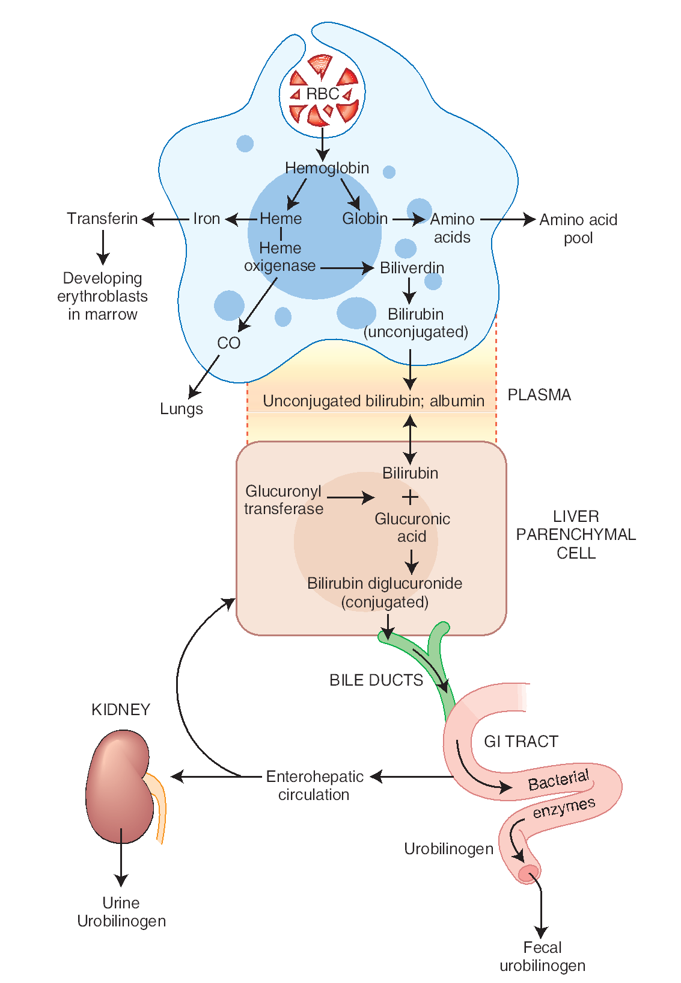
HEMOGLOBIN BREAKDOWN
MACROPHAGE
Notes:
Macrophages, mainly the Kupffer cellsin the liver phagocytose Hemoglobin.

HEMOGLOBIN = HEME + GLOBINHEME Fe
++
+ PORPHYRINPORPHYRIN BILVERDIN + CO.CO TO THE LUNGS AND OUT.BILVERDIN REDUCED TO BILIRUBIN ANDSENT TO BLOOD & LIVER FOREXCRETION.

Slide 21
HB breakdown
haemoglobin
haem
globin
iron
protoporphyrin
Amino acids
CO
Expired air
Bilirubin
(free)
transferrin
Liver
conjugation
erythroblast
Bilirubin glucuronides
Enterohepatic cir
Urobilin(ogen)
Stercobilin(ogen)
Urine
faeces
Notes:
Enterohepatic cir

Slide 22
FUNCTIONS
1. - combines reversibly with O₂ to form oxy-HB (HbO₂)
.
2. combines + CO₂ and transports 30% of total as(carbamino-HB)
3. Acts as a buffer
4. forms typical haem crystals with NaCl and glacial acetic acid
which is useful in diagnosis of blood sample (man or animal).
5. combines with other gases like CO, H₂S ( poisoning ,death)
6.Nitric oxide (NO) binds to Hb, NO causing vasodilation to ↑ blood
flow and O₂ delivery
Notes:
which is loose compound and can easily be broken to give O2
. combines with CO2 to form a carbamino Hb( 3 ml of CO₂) .
3. combines with other gases like CO, NO₂, H₂S of
which combination with Carbon monoxide is important as poisoning
and death with the gas is common.
4. It forms typical haem crystals with NaCl and glacial acetic acid which
is useful in diagnosis of blood sample (man or animal). In the
spectroscope it can be diagnosed as human sample by presence of dark
band between D and E.
Also transports 23% of total carbon dioxide
Combines with amino acids of globin (carbaminohemoglobin)
Nitric oxide (NO) binds to hemoglobin
Releases NO causing vasodilation to improve blood flow and oxygen delivery

Slide 23
Normal values
At birth: 23 gm%
Falls to 10.5gm% by 3 month (breast feed no iron)
Rises gradually to 12.5 rises at 1 year of age.
Males: 14 – 18 gm%
Females: 12 – 15 gm % females: 12 – 15 gm%

Slide 24
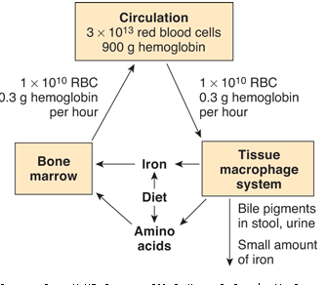

Slide 25
Differences Hemoglobin & Myoglobin
Found in Blood
Composed of 4 Heme and 4 Globin chains
Carrier of Oxygen and Carbon dioxide
Higher Oxygen affinity
Found in Heart and skeletal muscles
Composed of 1 Heme and 1 Globin chain
Reservoir and Carrier of Oxygen
Lesser Oxygen affinity

Slide 26
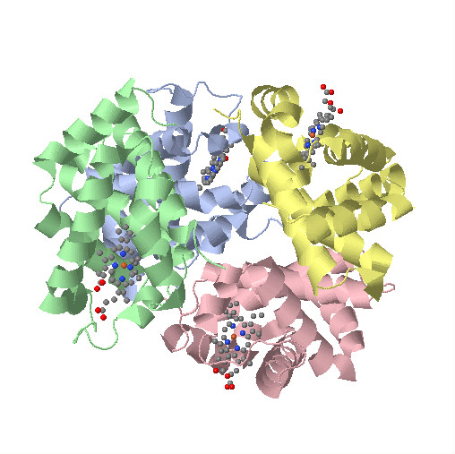
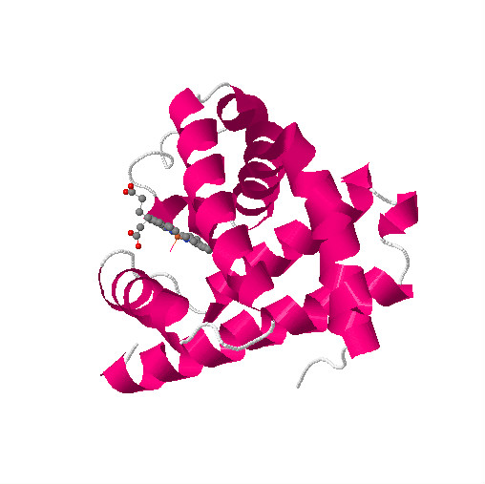
Myoglobin and Hb Structure
Glu6Val6
oxyMb (MbO₂)
oxyHb (HbO₂)
α
deoxyMb
deoxyHb
O₂
β
O₂
O₂
O₂
β
O₂
α
Glu6Val6

Slide 27
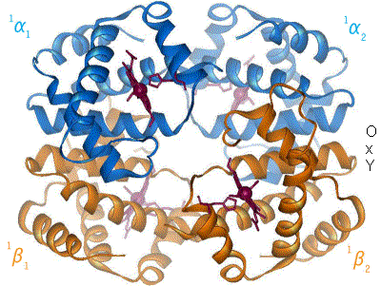

Slide 29
CLASSIFICATION of ANEMIAS Deficiency of Hb in the blood caused by either: RBC Count or Hb in the RBCs
Hemorrhagic anemiahemorrhagic anemia
Aplastic anemiaaplastic anemia
Megaloblastic anemiamegaloblastic anemia
Pernicious anemiapernicious anemia
Hemolytic anemiahemolytic anemia
Sickle cell anemiasickle cell anemia
Iron deficiency anemiairon deficiency anemia
Secondary anemia (renal)secondary anemia (renal)

Slide 30
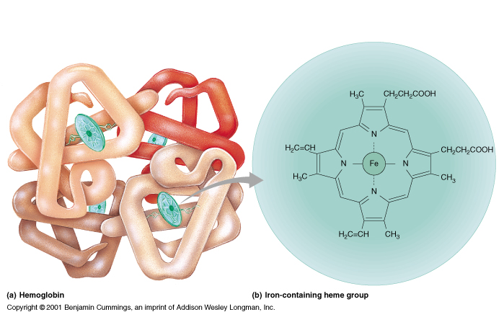
Anemia – reduced O₂ carrying capacity of the blood
Insufficient hemoglobin content in RBCs:
Iron Deficiency - inadequate intake or absorption of iron.
Pernicious - dietary deficiency of Vitamin B₁₂ or inadequate production of intrinsic factor for absorption of Vitamin B₁₂.
Notes:
Another possible cause of anemia is insufficient hemoglobin content in the RBCs. * These causes of anemia are sometimes referred to as nutritional because they are often the result of some dietary deficiency. For instance, iron deficiency anemia * is caused by an inadequate intake or absorption of iron. * Since iron (Fe) * is the principle component in the heme portion of the hemoglobin molecule * to which O₂ binds and is transported inside the RBC, an adequate intake and absorption of iron is essential. Pernicious anemia * is due to a dietary deficiency of Vitamin B₁₂ or more commonly a lack of sufficient production of intrinsic factor by the stomach. Intrinsic factor is required for the intestines to be able to absorb Vitamin B₁₂. The elderly are particularly susceptible to pernicious anemia due to insufficient intrinsic factor and may need periodic intramuscular injections of Vitamin B₁₂ to off set its effects. *

Slide 31
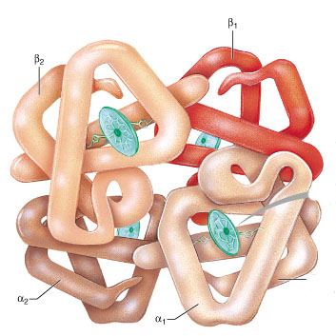
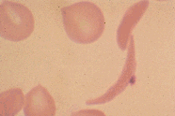
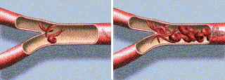
Abnormal hemoglobin
Sickle Cell - one amino acid in the 287 forming the beta chains is wrong
.
In low O₂ conditions the beta chains form stiff rods which cause RBCs to sickle blocking small vessels.
Notes:
A third general cause of anemia is due to abnormal hemoglobin in the RBCs.*
As an example, sickle cell anemia * is due to an abnormality of the beta chains * in the hemoglobin molecule. * Just one of the 287 amino acids forming the beta chain is wrong. * As a result, in low O₂ conditions, the abnormal beta chains change to form stiff rods which change the shape of the RBC * into a sickled form. * The sickled RBCs block the flow of blood through small vessels * disrupting blood flow causing pain and possible strokes.*

Slide 32
Hb S
CAUSE:
This disease is caused by a mutation in Hb.
(Abnormal polypeptides due to substitution of amino acids)
Supression of synthesis of polypeptide chains.
Occurs in 0.3 to 1 % of west african & american black people
Valine is substituted for glutamic acid at 6 position of beta chain.
Notes:
SICKLE CELL DISEASE

WHEN Hb S IS REDUCED, ITWHEN Hb S IS REDUCED, ITBECOMES LESS SOLUBLE & ‘GELS’BECOMES LESS SOLUBLE & ‘GELS’

THIS CHANGES THE SHAPE OF THE THIS CHANGES THE SHAPE OF THEERYTHROCYTES.ERYTHROCYTES.

THEY BECOME ‘SICKLE’ SHAPED THEY BECOME ‘SICKLE’ SHAPED

THEY INCREASE THE BLOOD THEY INCREASE THE BLOODVISCOSITY AND UNDERGOVISCOSITY AND UNDERGOHEMOLYSIS.HEMOLYSIS.

THIS IS A SERIOUS CONDITION, CAN THIS IS A SERIOUS CONDITION, CANBE FATAL BY MIDDLE AGE.BE FATAL BY MIDDLE AGE.

Slide 33
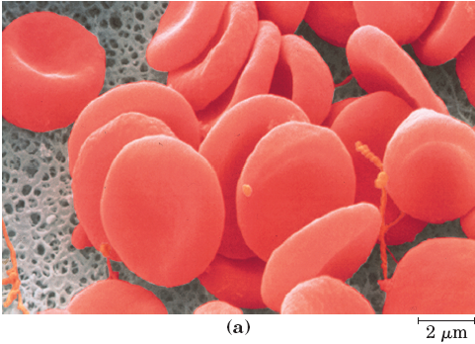
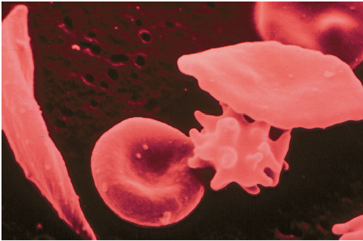
Red blood cells from sickle cell anemia patients: become sickle-shaped only in the deoxygenated state!

Slide 34
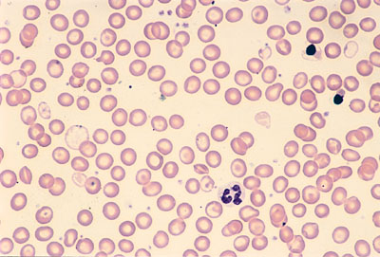
Thalassemia
Defect in the synthesis of either α & β
If the body doesn't produce enough of either proteins, the RBC cannot carry sufficient O₂.
- is anemia in early childhood and lasts throughout life.

Slide 35
Porphyria
abnormalities in the chemical steps production of heme
It is characterized by extreme sensitivity to light (expo-
sure to sunlight causes vesicular erythema),
-reddish-brown urine,
- reddish-brown teeth, and ulcers which
destroy cartilage and bone,
3.causing the deformation of the nose,
ears, and fingers. Mental aberrations
such as hysteria, manic-depressive
psychosis, and delirium,

Slide 36
Hemoglobine derivates unable to transport CO₂
Methemoglobin: contains Fe ³ instead of Fe² (e.g. nitrate/nitrite containing food or water)
Carboxyhemoglobin– CO poisoning, smokers (cherry red colour)
Sulfhemoglobin – green

