Slide 1

HOMEOSTASIS
BY DR QAZI IMTIAZ RASOOL
Notes:
Homeostasis refers to maintaining internal stability within an organism and returning to a particular stable state after a fluctuation.

Slide 2
OBJECTIVES
      Define the terms homeostasis and steady state.
      Identify the components of a control system.
      Describe the Various types and their Mode of Operation.
      Define what is meant by the gain of a control system.
      Compare tonic and antagonistic mechanisms of effect control

Slide 3
How do stay alive?
Keeping our cells happy
1.Cells work best at certain temperatures and with the right amount of hydration (water present)
2.The levels of glucose, salts, urea, oxygen and carbon dioxide must also be controlled
3.The control of these factors should occur via control systems.

Slide 4
Control systems.
1.Concentration of nutrient molecules
2.Concentration of water, salt, and electrolytes
3.Concentration of waste products
4.Conc; of O₂ = 100mmHg , CO₂ = 40 mmHg
5.pH = 7.35
6.Blood volume 4-6 L and pressure 110/70
7.Temperature = 37º C
Notes:
Various Organ systems work together To maintain a relatively constant internal environment to which the cells are exposed Hence the various organ systems carry it

Slide 5
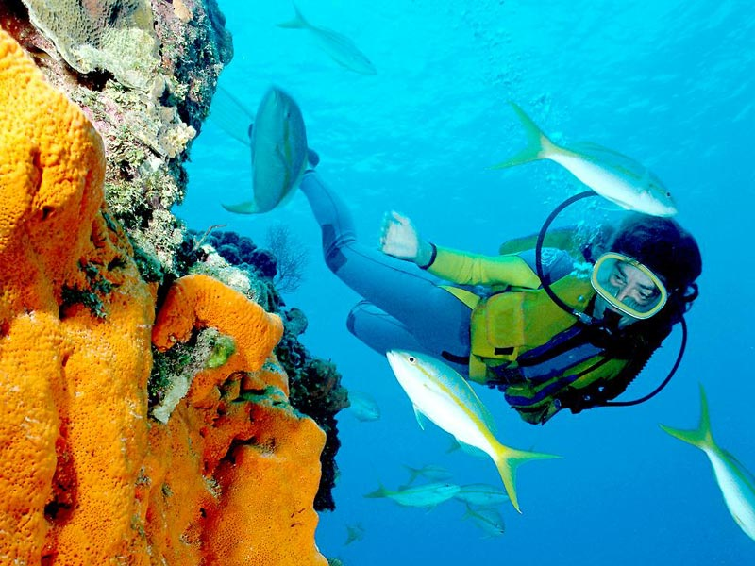
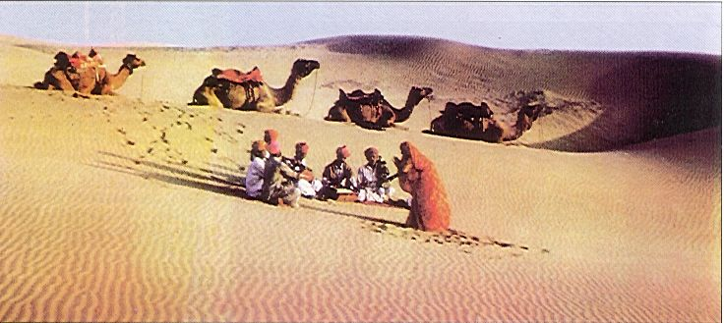
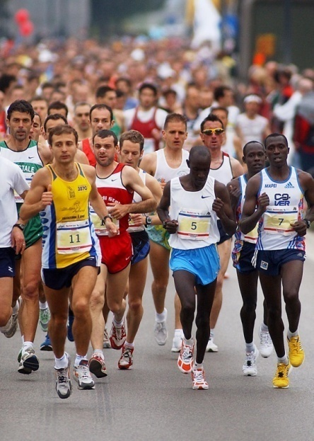
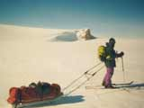
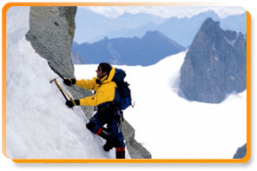
Where we are and what we do affect our levels…
Which internal factors are being stressed in each picture?

Slide 6
Disruptions can be mild to severe
  1.External stimuli
    heat, cold, lack of oxygen, pathogens, toxins
  2.Internal stimuli
    Body temperature
    Blood pressure
    Concentration of water, glucose, salts, oxygen, etc.
    Physical and psychological distresses
3.If not maintained, death may result

Slide 7
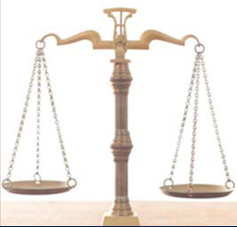

Slide 8
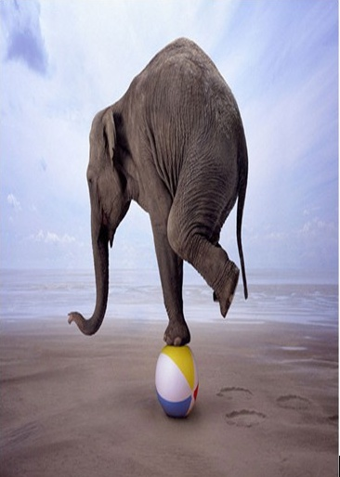

Slide 9
Homeostasis
1. Claude Bernard (1872)
  milieu interieur
2. Walter B. Cannon (1871-1945)
      “Homeostasis”
      GREEK ‘’ HOMOI= SAME”
      STASIS= ‘’ STANDING STILL”
Notes:
IN 1932 THE AMERICAN PHYSIOLOGIST WALTER CANNON (1871-1945), COINED THE TERM HOMEOSTAS

Slide 10
Definition
the maintenance of a relatively constant steady stable state of internal environment

Slide 11
Homeostatic mechanisms
Operate at all levels
  Molecular
  Cellular
  Tissues
  Organs
  Organ Systems

Slide 12
PROPERTIES OF HOMOSTASIS
Central concept of physiology
Maintenance of the relative stable “internal environment” in an ever changing world.
Balance or equilibrium of all functions.
It is a dynamic steady state.
Dynamic: parameters do change
Notes:
Homeostasis involves dynamic mechanisms that detect and respond to deviations in physiological variables from their “set point” values by initiating effector responses that restore the variables to the optimal physiological range. Maintenance of Relatively Constant Chemical/Physical Conditions of the internal environment.
Claude Bernard__ The father of modern Physiology...The internal environment remains relatively constant though there are changes in the external environment
stable =/= rigidity, can vary within narrow limit (normal physiological range) The golden goal of every organ : to maintain homeostasis (concept of REGULATION)

Slide 13
6.Steady state: parameters change in very narrow limits.
7.It has to respond to both internal and external threats to that stability
8.Disease, by and large is a failure of homeostasis
  9.Excessive perturbations result ultimately in death of the organism

Slide 14
Internal environment
Intracellular
fluid
Plasma
Interstitial fluid
Extracellular fluid directly baths body cells
Internal environment = Extracellular fluid

Slide 15
Extracellular fluids
Intracellular
fluid
2.. Plasma
1.Interstitial fluid/tissue fluid
3. Fluid of special compartments: pericardial fluid, pleural fluid, cerebrospinal fluid ,plasma ,lymph
Notes:
Definition: The environment, where the cells live. It is “salty water”.

Slide 16
Normal Physiological ranges
Arterial pH 7.35-7.45
Bicarbonate 24-28 mEq/L
O₂ content 17.2-22.0 ml/100 ml
Total lipid 400-800 mg/100 ml
Glucose 75-110 mg/100 ml
Notes:
Osmoregulation regulates solute concentrations and balances the gain and loss of water.
Excretion gets rid of metabolic wastes.

Slide 17
Balancing the Internal and External Environment
1.Cells, the fundamental units of life, exchange nutrients and wastes with their surroundings:
2.The intracellular fluid is “conditioned by”…
3. the interstitial fluid, which is “conditioned by”
4. the plasma, which is “conditioned by” …
5. the organ systems it passes through.
ICF
ISF
plasma
organs
external
environment
internal environment

Slide 18
Homeostasis
r balanced between 3 major compartments separated by 2 membranes
1.Plasma
2.ISF
3.ICF
Specific composition -selective permeability of membrane;
active transport mechanisms
Comparable composition due
to high permeability of endothelium

Slide 19
Control Systems
must be able to
  1. Detect deviations from normal in the internal environment that need to be held within narrow limits
  2. Integrate this information with other relevant information
  . Make appropriate adjustments in order to restore factor to its desired value

Slide 20
Feedback Loops
1.Sensor:
  Detects deviation from set point.
2.Integrating center:
  Determines the response
  ACCORDING TO THE SET-PIONT
3.Effector:
  Produces the response.
Notes:
HOMEOSTATIC CONTROL SYSTEM: controls the “variable Components of control system:
Set Point: the level or range at which a variable is to be maintained. Determined by control center.
Sensor : receptors or receptor organs that monitor variable.
Integrator = control center : compares variable to set point makes adjustment of variable to keep set point
sends command out to effector
↓Effector: brings about the adjustment to set point

Slide 21
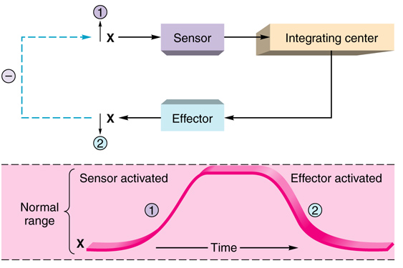

Slide 22
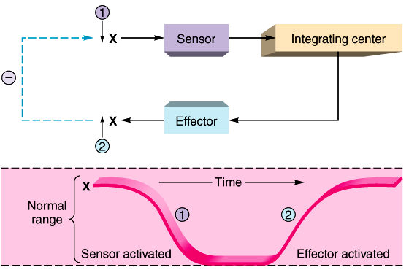

Slide 23
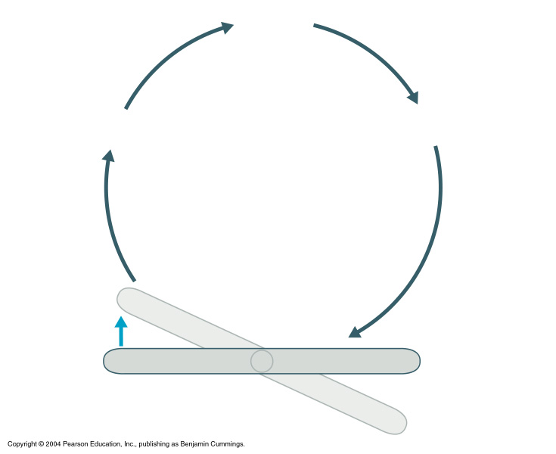
Control
center
3
Input:
Information
sent along
afferent
pathway to
4
Output:
Information sent
along efferent
pathway to
Receptor (sensor)
Effector
2
Change
detected
by receptor
5
Response of
effector feeds
back to influence
magnitude of
stimulus and
returns
variable to
homeostasis
1
Stimulus:
Produces
change
in variable
Imbalance
Variable (in homeostasis)
Imbalance

Slide 24
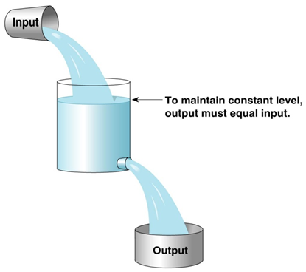
Law of Mass Balance
Most simply, ins = outs
Homeostasis is not the
same as equilibrium
  e.g.RMP

Slide 25
Properties Of Control Systems
1.Single loop usually does not operate in isolation but complex interplay.(Coupling)
2.Must determine the relative weight of loop feedback in competition with 1 another
3.Hierachy must be established among various operating loops
4.Redundancy –more vital a parameter more systems r involved
5. Equilibrium =state in which no energy is used to maintain the steady state
Notes:
Homeostasis is the control of a vital parameter. One of the most common themes in physiology is the negative feedback mechanism responsible for homeostasis. Negative feedback requires at least four elements.
First, the system must be able to sense the vital parameter (e.g., glucose) or something related to it.
Second, the system must be able to compare the input signal with some internal reference value called a set-point, thereby forming a difference signal.
Third, the system must multiply the error signal by some proportionality factor (i.e., the gain) to produce some sort of output signal (e.g., release of insulin).
Fourth, the output signal must be able to activate an effector mechanism (e.g., glucose uptake and metabolism) that opposes the source of the input signal and thereby brings the vital parameter closer to the set-point (e.g., decrease of blood glucose levels to normal).
A single feedback loop often does not operate in isolation but rather as part of a larger network of controls. Thus, a complex interplay may exist among feedback loops within single cells, within a tissue, within an organ or organ system, or at the level of the whole body. After studying these individual feedback loops in isolation, the physiologist may find that two feedback loops act either synergistically or antagonistically. For example, insulin lowers blood glucose levels, whereas epinephrine and cortisol have the opposite effect. Thus, the physiologist must determine the relative weights of feedback loops in competition with one another. Finally, the physiologist must also establish hierarchy among various feedback loops. For example, the hypothalamus controls the anterior pituitary, which controls the adrenal cortex, which releases cortisol, which helps control blood glucose levels.
Another theme of homeostasis is redundancy. The more vital a parameter is, the more systems that the body mobilizes to regulate it. If one system should fail, others are there to help maintain homeostasis. It is probably for this reason that genetic knockouts sometimes fail to have their expected deleterious effects. The result of many homeostatic systems controlling many vital parameters is a milieu intérieur with a stable composition.
Whether at the level of the milieu intérieur or the cytoplasm of a single cell, homeostasis occurs at a price: energy. When a vital parameter (e.g., the blood glucose level) is well regulated, that parameter is not in equilibrium. Equilibrium is a state that does not involve energy consumption. Instead, a well-regulated parameter is generally in a steady state. That is, its value is constant because the body or the cell carefully matches actions that lower the parameter value with other actions that raise it. The net effect is that the vital parameter is held at a constant value.
An important principle in physiology, to which we have already alluded, is that each cell plays a specialized role in the overall function of the body. In return, the body-which is the sum of all these cells-provides the milieu intérieur appropriate for the life of each cell. As part of the bargain, each cell or organ must respect the needs of the body as a whole and not run amok for its own greedy interests. For example, during exercise, the system that controls body core temperature sheds heat by elaborating sweat for evaporation. However, the production of sweat ultimately reduces blood volume. Because the body as a whole places a higher priority on the control of blood volume than on the control of body core temperature, at some point the system that controls blood volume will instruct the system that controls body core temperature to reduce the production of sweat. Unfortunately, this juggling of priorities works only if the individual stops exercising; if not, the result may be heat strok
The adaptability of an organism depends on its ability to alter its response. Indeed, flexible feedback loops are at the root of many forms of physiological adaptation. For instance, at sea level, experimentally lowering the level of oxygen (the sensory stimulus) in the inspired air causes an increase in breathing (the response). However, after acclimatization at high altitude to low oxygen levels, the same low level of oxygen (the same sensory stimulus) causes one to breathe much faster (a greater response). Thus, the response may depend on the previous history and therefore the "state" of the system. In addition to acclimatization, genetic factors can also contribute to the ability to respond to an environmental stress. For example, certain populations of humans who have lived for generations at high altitude withstand hypoxia better than lowlanders do, even after the lowlanders have fully acclimatized.

Slide 26
6.Priority-cells/system should not run amok for its own greed
7. Adaptability- on ability to alter the response
8. Adaptive control as an example of delayed negative feedback
9. Most control systems display negative feedback
10 .Not all control systems are equally effective i.e. concept of gain( variable gain)

Slide 27
1. BASED ON VOLUNTARY CONTROL
CLASSIFICATION OF CONTROL System
Non-automatic Control
Open-loop system
2.Automatic Control
“feedback” means a process in which a part of output (feedback signal) from controlled organ returns to affect or modify the action of the control system.

Slide 28
2. Based on location:
1. Intrinsic or local control
Regulatory mechanism is initiated inside an organ. (= inherent to an organ)
Ex: local vasodilation
movement of cilia
    2.Extrinsic:
    Regulatory mechanism is initiated outside the organ. Accomplished by nervous and endocrine systems

Slide 29
3. Based on kinds of response
1.Negative feedback
2.Positive feedback
3.Feedforward
4. Servomechanisms
Notes:
Negative Feedback: Inhibitory ACTION.Stimulus triggers response to counteract further change in the same direction. Negative-feedback mechanisms prevent small changes from becoming too large.Prevents sudden, severe changes in the body Reduces the actions of the effectors Corrects the set point Causes opposite of bodily disruption to occur, i.e. the ‘negative’Limits chaos in the body by creating stability
Most common type of feedback loop
Examples: body temperature, blood pressure & glucose regulation
POSITIVE FEEDBACK USUALLY DOES NOT MAINTAIN HOMEOSTASIS .IT IS CHARACTERIZES BY BEING SHORT IN DURATION, AND INFREQUEN Examples: Blood clotting, Micturition, defecation, Na⁺ inflow in genesis of nerve signals, Contraction of the uterus during childbirth (parturition).
Increases (accelerates) the actions of the body
Produces more instability in the body
Produces more chaos in the body
There are only a few types necessary for our survival
Positive feedback mechanisms are short-lived
Controls only infrequent events that do not require continuous adjustments
Considered to be the uncommon loop
Examples: blood clotting and child birth

Slide 30
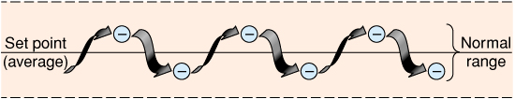
Negative Feedback
Defending the set point
Main form , most feedback systems in the body are negative
3. Driving the variable in the opposite direction of the initial change.
4. Multiply the error signal by some proportionate factor e.g. - feel cold, - start shivering
Notes:
THYROID REGULATION FROM HYPOTHALMUS

Slide 31
Positive feedback
↑ (accelerates) amplifies the actions of the body
Produces more instability in the body
Produces more chaos in the body
Only a few types necessary for our survival
R short-lived
Controls less frequent forms of events that do not require continuous adjustments
Considered to be the uncommon loop
Driving the variable in the same direction of the initial change.
Notes:
BLOOD CLOTTING

Slide 32
3. Feed-forward control
Principle: a direct effect of stimulus on the control system before the action of feedback signal occurs.
Less frequent form of regulation.
Stimulus triggers a response in anticipation of a change in a variable.
Here the direct effect of the stimulus is termed
disturb signal or interfere signal.
e,g 1. Shivering before diving into the cold water. H₂O
2. smell of food triggers digestive juice secretion

Slide 33
Significance of Feedback-forward :
Adaptive feedback control.
Makes the human body to fore-see and adapt the environment promptly and exactly
Prepare the body for the change.

Slide 34
4. Servomechanism
1.Set piont is not fixed
2. Changes from time to time e.g stretch reflex
Notes:
Resting length of of muscle changes in different position.

Slide 35
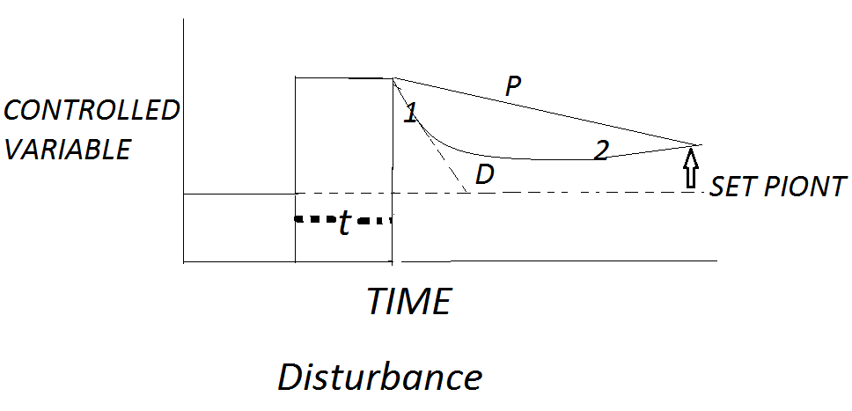
(Y)
(T)
Notes:
Dead time=t, Disturbance is not corrected compeletly ---residual change
INITIAL RESPONSE IS RELATED ---TO RATE AT WHICH THE DISTURBANCE IS PRODUCED OR TECHNICALLY DY/ DT-----CALLED DERVATIVE OR DIFFERENTIAL d COMPONENT. SLOPE =TAN THETA
THE LATTER PART IS RELATED TO THE MAGNITUDE OF DISTURBANCE –PROPORTIONAL P COMPONENT
GA IN= CORRECTON/ RESIDUAL CHANGE. 120 haemorraghe 100 without regulation it will be 60 hence gain is 2

Slide 36
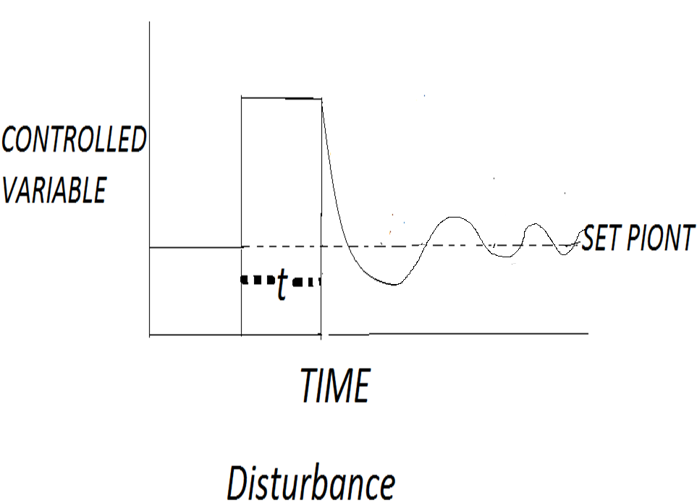
(Y)
(T)
Notes:
Large D means an oscillatiory responsde, also longer dead time

Slide 37
CORRECTION APPLIED
RESIDUAL CHANGE
GAIN=
Notes:
RESIDUAL CHANGE=ERROR

Slide 38
Regulation of the Body Functions
3 regulatory systems have to coordinated and acts as one system, “feedback control system”.
    1. Endocrine/ Chemical Regulation- process performed by hormone or active chemical substance in blood or tissue.
    -It response slowly, acts extensively and lasts for a long time.
    2. Nervous Regulation- a process in which body functions are controlled by nerve system
    - Pathway: nerve reflex
    - Types: unconditioned reflex and conditioned reflex
Notes:
the ability of an organism to maintain a stable internal conditions in a constantly changing environment
-Three types:

Slide 39
    - e.g baroreceptor reflex of arterial blood pressure
    - Characteristics: response fast; acts exactly or locally, last for a short time
    3. Autoregulation – a tissue or an organ can directly respond to environmental changes that are independent of nervous and hormonal control
  Characteristics：
  Amplitude of the regulation is smaller than other two types.
  Extension of the effects is smaller than other two types.

Slide 40
REGULATION OF HOMEOSTASIS
The 2 work together or independently to regulate homeostasis
Nervous system
  1. Receptors input –CNS-output
  2. Role of autonomic nervous system
  3. Local action
    4.Spatially-determined information-
    5. uses nerve impulses to respond to
    stresses in the body
    6.response is rapid compare to
    endocrinal system
ENDOCRINAL SYSTEM
Uses hormones to responds to stresses
Generalized action throughout body
Specificity conferred by receptor distribution
Response is slower than nervous system an
also is more fine tuning
Notes:
) NERVOUS SYSTEM .g. Active muscle contraction – produces ↑ CO² and ↓ O² in blood. Nerve cells detects changes in blood gases → sends impulses to brain → brain send impulses to heart to ↑ heart rate → brain also sends impulses to respiratory centre in brain to ↑ breathing rate → blood gases are quickly restored back to normal.
ENDOCRINAL SYSTEM
E.g. Active muscle contraction → produces ↑ CO² and ↓ O² in blood → ↑ CO² causes the release of epinephrine into blood → epinephrine causes ↑ in heart rate →↑ delivery to and removal of CO² in lungs .

Slide 41
Nervous
Endocrine
Wired
Wireless
Neurotransmitters
Hormones
Short Distance
Long Distance
Closeness
Receptor Specificity
Rapid Onset
Delayed Onset
Short Duration
Prolonged Duration
Rapid Response
Regulation

Slide 42
Examples of homeostasis

Slide 43
Why do we have an optimum temperature?
Chemical reactions in our body rely on enzymes (biological catalysts made of proteins)
They need a reasonably high temperature to allow enough collisions with other molecules (substrates) but not too high in case they denature (no longer work)

Slide 44
Body temperature over time
37.0 °
(set point)

Slide 45
Blood ph over time
7.4

Slide 46
Controlling Glucose levels
Your cells also need an exact level of glucose in the blood.
Excess glucose gets turned into glycogen in the liver
This is regulated by 2 hormones (chemicals) from the pancreas
Insulin Glucagon
Notes:
Some people do not produce enough insulin.When they eat food, the glucose levels in their blood cannot be reduced.
This condition is known as DIABETES.
Diabetics sometimes have to inject insulin into their blood. They have to be careful of their diet.

Slide 47
Blood glucose over time
100 dl/ml

Slide 48
Glycogen
If there is too much glucose in the blood, Insulin converts some of it to glycogen
Insulin
Glucose in the blood

Slide 49
Glycogen
If there is not enough glucose in the blood, Glucagon converts some glycogen into glucose.
Glucagon
Glucose in the blood

Slide 50
Glycogen
But there is no insulin to convert it into glycogen.
The glucose in the blood increases.
Glucose concentration rises to dangerous levels.
Insulin
Glucose in the blood

Slide 51
Glucose levels rise after a meal.
Glucose
Concentration
Insulin is produced and glucose levels fall to normal again.
Normal
Time
Meal eaten

Slide 52
Glucose levels rise after a meal.
Glucose
Concentration
Diabetic
Insulin is not produced so glucose levels stay high
Time
Meal eaten

Slide 53
Sweating
The skin
Notes:
When your body is hot, sweat glands are stimulated to release sweat. The liquid sweat turns into a gas (it evaporates)To do this, it needs heat .It gets that heat from your skin. As your skin loses heat, it cools down.

Slide 54
This means more heat is lost from the surface of the skin
If the temperature rises, the blood vessel dilates (gets bigger).

Slide 55
What mechanisms are there to warm the body up?
Vasoconstriction
Notes:
This is the opposite of vasodilation
The capillaries underneath your skin get constricted (shut off).
This takes the blood away from the surface of the skin so less heat can be lost.

Slide 56
This means less heat is lost from the surface of the skin
If the temperature falls, the blood vessel constricts (gets shut off).

Slide 57
What mechanisms are there to warm the body up?
Piloerection
This is when the hairs on your skin “stand up” .
It is sometimes called “goose bumps” or “chicken skin”!
The hairs trap a layer of air next to the skin which is then warmed by the body heat
The air becomes an insulating layer.

Slide 59
Controlling water levels
H₂O levels is carried out by the KIDNEYS.
It is closely linked to the excretion of urea.
Urea is a waste product that is made when the LIVER breaks down proteins that are not needed by the body.
Urea contains the element Nitrogen.

Slide 60
The kidneys
The kidneys “clean” the blood of waste products and control how much water is kept in the body. The waste products and water make up urine which is excreted via the ureter.
“Dirty” blood enters the kidney through the renal artery. Then, several things happen to clean the blood...

Slide 61
1. Filtration
1.Blood enters the tubule area in a capillary.
2. The capillary forms a small “knot” near the kidney tubule.
3. The blood is filtered so all the small particles go into the tubule.
4. The capillary then carries on to run next to the tubule.

Slide 62
The kidney tubule now contains lots of blood components including:
Glucose:
Ions:
Water:
Urea:

Slide 63
2. Reabsorb sugar
The body needs to have sugar in the blood for cells to use in respiration. So all the sugar is reabsorbed back into the capillary.

Slide 64
2. Reabsorb sugar
The body needs to have sugar in the blood for cells to use in respiration. So all the sugar is reabsorbed back into the capillary.

Slide 65
3. Reabsorb water
Water and ions are the next to be absorbed. It depends on how much is needed by the body.

Slide 66
3. Reabsorb water
Water and ions are the next to be absorbed. It depends on how much is needed by the body.

Slide 67
Reabsorbing water
If you have too little water in your blood, you will produce very concentrated urine.
(very little water in it)
If you have too much water in your blood, you will produce very dilute urine.
(lots of water in it)

Slide 68
5. Excrete the waste
Everything that is left in the kidney tubule is waste:
All the urea
Excess water
This waste is called urine. It is excreted via the ureter and is stored in the bladder.
Renal vein
The “clean” blood leaves the kidney in the renal vein.
Ureter

Slide 69
Homeostasis & Controls
Successful compensation
  Homeostasis reestablished
Failure to compensate
  Pathophysiology
    Illness
    Death

Slide 70
Sensory homunculus

