Slide 1
INTRODUCTION TO MODULE MED 122
BY Dr. QAZI IMTIAZ RASOOL

Slide 2


Slide 3
OBJECTIVES
Module Title Blood, Body Fluids, and Electrolytes
Module Code & Number : MED122
Credit Hour : 5 Hours
Module Duration : 6 Weeks
Module Starting Dates: 12-6-1434 H (22-4-2013G)
Module Coordinator : Dr. Qazi Imtiaz Rasool

Slide 4


Slide 5
Contact hours
-Theory 46 hrs
- DSL, Tutorial 10/6
-Practical 44 hrs
2. Credits 5

Slide 6
Three major subthemes-
Body fluids along with electrolytes
b) Urinary system and
c) Blood.

Slide 7
Major emphasis -to develop understanding of body’s internal environment, its regulation and vital role of kidney in its maintenance.
Include the patho-physiology of major diseases affecting the body fluids, kidney along with other excretory organs and blood.
4 integration cases
3RD theme blood and its component will be more on composition, functions, hematopoiesis, and coagulation.

Slide 8
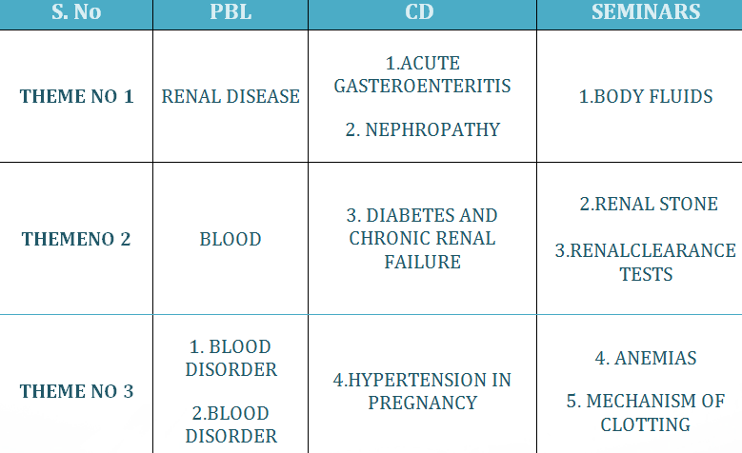
STUDENTS ACTIVITY

Slide 9
Only 10-15 slides are required for each presentation.
Presentation should last for 15 minutes only.
5 minutes will be allowed for whole group discussion.
5 minutes are devoted for the tutor for giving feedback and comments.
NOTE: - Topics discussed during seminars will be thoroughly examined in the written examinations in the form of scenario based questions and/or MCQs, SEQs.

Slide 10
Teaching Methodology:
The following instructional strategies are used:
Interactive Lectures
Small-group problem-based learning sessions
Integrated seminars
Virtual laboratory
Practical laboratories
Field visits
Hospital visits
Direct student learning
Tutorials

Slide 11
BLUE PRINT OF TEACHING
 | WEEK1 | WEEK2 | WEEK3 | WEEK 4 | WEEK5 | WEEK 6 | TOTAL Hrs.
THEORY | 6 | 11 | 12 | 8 | 5 | 4 | 46
TUTORIALS | 1 | 1 | - | - | 1 | 1 | 6
DSL | 1 | 1 | 1 | 1 | 2 | 2 | 10
SK; LAB | 1 | 1 | 1 |  | 1 |  | 4
CD | 1 | - | - | 1 | 1 | 1 | 4
SEMINAR | - | - | 1 | 1 | 2 | 1 | 5
PBL | - | 1 | - | 1 | 1 | 1 | 4
PRACTICALS | 1 | 4 | 4 | 4 | 3 | 6 | 22
 |  |  | FIELD VISIT | FIELD VISIT

Slide 12
BLUE PRINT OF DISTRIBUTION OF CLASSES THEORY
 | 1 | 2 | 3 | 4 |  |  | 5 | 6 | TOTAL
PHYSIOLOGY | 3 | 4 | - |  | 8 | - |  | - | 15
PATHOLOGY | - | - | 5 |  | - | 4 |  | - | 9
ANATOMY | - | 5 | - |  | - | - |  | - | 5
MEDICINE | - | 2 | 5 |  | - | - |  | 3 | 10
PHARMACOLOGY | - | - | 1 |  | - | 1 |  | 1 | 3
MICROBIOLOGY | - | - | 1 |  | - | - |  | - | 1
BIOCHEMISTRY | 3 | - | - |  | - | - |  | - | 3
Grand total | 6 | 11 | 12 |  | 8 | 5 |  | 4 | 46

Slide 13
Learning
How will you study for this course?
Any Suggestions?
This will depend on your learning style.

Slide 14
How to use the Course Power-Points
A good way to study the course material is to follow the powerpoint
while having the text open to the chapter.
The pictures, diagrams and tables are listed in the powerpoints.

Slide 15
Learning outcomes of the course
(A) – Scientific in their approach to practice;
(B) –Proficient in clinical care;
(C) – Professional.
(D) – Community conscious
(E) - Scholars;

