Slide 1
Nervous System
1.Central Nervous System 2. Peripheral Nervous System
  1. Somatic 2. Autonomic 1.Brain 2. Spinal Cord

Slide 2
FUNCTIONALLY
1. 5 parts
1 BRAIN
2 SPINAL CORD
3. AUTNMIC .NERVOUS.SYSTEM.
4.ENTERIC .NERVOUS.SYSTEM.
5.PERIPHERAL NERVES
2. 3 parts-
1.SENSOR
2.MOTOR
3. MOTIVATION
3. Central Nervous System is Organized in 3 ways
1. Hierarchical Organization
2. Lateralized Organization
3. Localized Organization
Notes:
5- 1 BRAIN2SPINAL CORD3. A.N.S.4.E.N.S. 5.PERIPHERAL NERVES( best &taylor)
3--- 1.SENSORY 2.MOTOR3. MOTIVATION

Slide 3
GLIAL CELL
CLASSFICATION size=0.02µm
          CNS
PNS
1.ASTROCYTES
Fibrous
Protoplasmic
Radial glial cells
Müller cells
Bergmann glia
2. EPENDYMAL CELLS
3.OLIGODENDROCYTES
4. MICROGLIAL CELLS
5.SATELLITE CELLS
6.SCHWANN CELLS
7.ENTERIC GLIAL
Notes:
Recent findings in the hippocampus and cerebellum have indicated that glia are also active participants in synaptic transmission, In the central nervous system, glia develop from the ventricular zone of the neural tube. These glia include the oligodendrocytes, ependymal cells, and astrocytes. In the peripheral nervous system, glia derive from the neural crest. These PNS glia include Schwann cells in nerves and satellite glial cells in ganglia.

Slide 4
Morphology of neuron
1.membrane
Cell body (soma)
2.perikaryon
3.nucleus
2 parts
Dendrites
Processes
Axon
  Presynaptic terminals.
  terminal (bouton / button)
Notes:
Terminal branches (telodendria)
End in knobs called axon terminals (aka synaptic terminals, end bulbs, boutons, synaptic knobs)

Slide 5
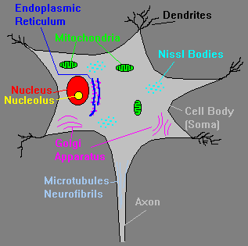
Cell Body.
Soma or Perikaryon
  Size - 5–140µm
  Contains usual organelles(mitochondria are
  present in soma only)
  3. Chromatophilic bodies =(Nissl bodies)
      Clusters of rough ER and free ribosomes
      primary site of protein synthesis
      Stain darkly and renew membranes of the cell
    4.. Cytoskeleton of neurofilaments and neurotubules
    Neurofibrils – bundles of intermediate filaments found in axon and dendrites larger than in other cell consists of 3 protiens
    5.No centrioles (hence its amitotic nature)
  6. Tapers to form axon hillock
Notes:
Contains many bundles of protein filaments (neurofibrils) which help maintain the shape, structure, and integrity of the cell.
Contains nucleus plus most normal organelles.
Biosynthetic center of the neuron.
Contains a very active and developed rough endoplasmic reticulum which is responsible for the synthesis of ________.
The neuronal rough ER is referred to as the Nissl body.
Contains many bundles of protein filaments (neurofibrils) which help maintain the shape, structure, and integrity of the cell.
Contains nucleus plus most normal organelles.
Biosynthetic center of the neuron.
Contains a very active and developed rough endoplasmic reticulum which is responsible for the synthesis of ________.
The neuronal rough ER is referred to as the Nissl body.
Contains many bundles of protein filaments (neurofibrils) which help maintain the shape, structure, and integrity of the cell.
Contains nucleus plus most normal organelles.
Biosynthetic center of the neuron.
Contains a very active and developed rough endoplasmic reticulum which is responsible for the synthesis of ________.
The neuronal rough ER is referred to as the Nissl body.
Contains many bundles of protein filaments (neurofibrils) which help maintain the shape, structure, and integrity of the cell.

Slide 6
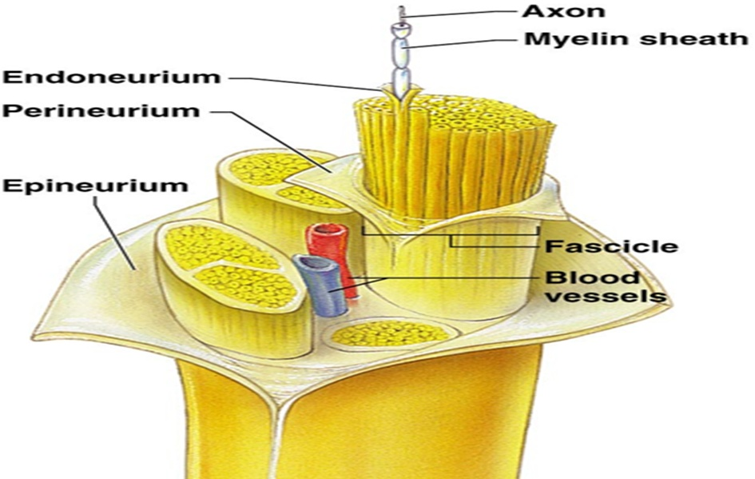
Axon
Covered by neurolemma(:Made up of Schwann cells).
Often myelinated:( Myelin is formed by Schwann cells).
Note: axon is only part of neuron that is ever myelinated.

Slide 7
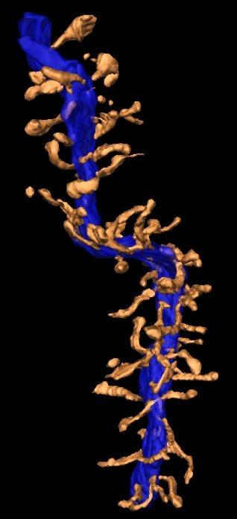
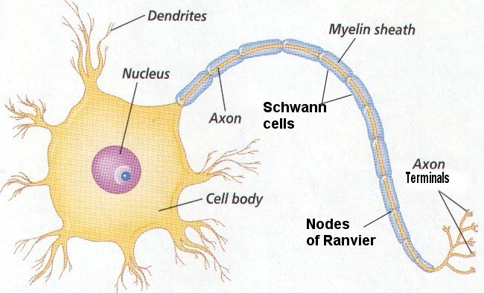
2- 7 processes
composition is similar that To soma : neurofilaments ,microtubule , mitochondria, Nissl bodies,
no Golgi apparatus
Dendrite
Dendritic spine:
flattened and parallel cisternae
Branches off the cell body that carry information to the cell body.
Relatively short.
Often branched.
Have receptors for neurotransmitters.
Conduct local potentials.
Notes:
dendritic function is more complex than was previously believed; for example, dendrites appear to be able to actively conduct action potentials, and many dendritic signals appear to be compartmentalized to just certain parts of the dendritic tree
the functional significance of these abilities remains to be determined; however, dendrites are clearly more than just passive conductors of action potentials

Slide 8
COMPARISION WITH COMPUTORS
Input
Output
Centre
Integration
Speed
New ideas
Energy
Proper connections
Insulation
Day dreaming
Output flexibility
Orginality
Notes:
INPUT -sensors
OUTPUT-motor
CENTRE brain +spinal cord
INTEGRATION- far better
SPEED- slower
NEW IDEAS –owns its ideas 99% of sensory information is ignored by the brain & !% is utilised.
ENERGY
PROPER CONNECTIONS
INSULATION
DAY DREAMING lately some of the computors have been proceessed to have day dreaming
OUTPUT FLEXIBILITY
ORGINALITY

Slide 9
Principle
Binary code
Neurons-encode information at the cellular level.
Frequency modulation
On and Off mechanism of electrical impulses,
Notes:
Frequancy modulation frequancy of impulses/time unit
EXCITATION & INHIBITION

Slide 10
.
Basic Principles of NS Function
at molecular level
1. Electrical properties of the neuron
2. Signal transmission
3. Action potential
4. Events at the synapse
5. Electrical synapses
6. Ionic environments of the neurons
7. Chemical messengers of the neurons
a. Neurotransmitters
b. Neuromodulators
c. Neuropeptides
d. Neurohormones
Notes:
59The nervous system works through excitation and inhibition.
Chemical signals released from one cell leads to increases (excitation) or decreases (inhibition) in electrical impulses in the receiving cell.
System level processes work by interaction of inhibition and excitation
.

Slide 11
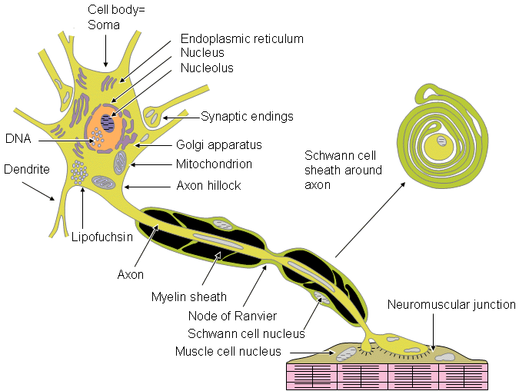

Slide 12
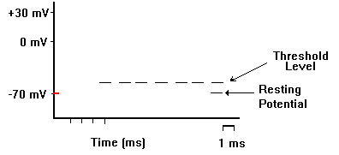
.
PRIMARY 1.RMP 2.CONDUCTION 3. EXICITATION
RMP= -65mV
-65
-65-65
------
-65
Notes:
-65mV

Slide 13
Notes:
IN ANIMATIONS R CLICK --------.>PRESENTATION OBJECT ------------------------.>SHOW

Slide 14
SECONDARY 1. Action Potential
1. Monopotential 2. Biphasic-potential 3.Compound-potential
2. LATENT PERIOD
1. Velocity 2.Diameter
3. EXCITIBILITY
Stimulus
1.Mechanical 2.Chemical 3.Thermal
4.Electric 5.Osmotic
4 ACCOMODATION
If the stimulus, even with stronger strength is applied very slowly to a nerve, these may have no response only due to l of attaining the threshold strength.

Slide 15
5. CONDUCTION
TYPE
1.Law of forward conduction
2. Law of bell and magendie
3. Law of isolated conduction
4. Law of physical integeration
5.Law of 2 way conduction
FACTORS 1.Diameter
2. Mylenated
3.Temp;
4.Mechanical pressure
5. Chemical
6.Spike potential ^ conduction increases
7._{P}H
8.O₂
9.Effect of ions
10.Level of RMP
11.Blood supply

Slide 16
6.REFRACTORY PERIOD
MAXIMUM FREQUENCY=1000/SEC.
0.5 mSEC
1.Absolute Refractory Period - due to time dependence of Na⁺ channel
  No amount of inward current will generate another AP
  Due to the Na⁺ inactivation gate which is slow to close when triggered at threshold
2.Relative Refractory Period
  Need an excess of current to generate an AP because the Na+ channels are still inactivated until the end of repolarization phase
Notes:
ABSOLUTE -
During an action potential, a second stimulus will not produce a second action potential (no matter how strong that stimulus is)
corresponds to the period when the sodium channels are open (typically just a millisecond or less)
Source: http://members.aol.com/Bio50/LecNotes/lecnot11.html
RELATIVE -
Another action potential can be produced, but only if the stimulus is greater than the threshold stimulus
corresponds to the period when the potassium channels are open (several milliseconds)
the nerve cell membrane becomes progressively more 'sensitive' (easier to stimulate) as the relative refractory period proceeds. So, it takes a very strong stimulus to cause an action potential at the beginning of the relative refractory period, but only a slightly above threshold stimulus to cause an action potential near the end of the relative refractory period
The absolute refractory period places a limit on the rate at which a neuron can conduct impulses, and the relative refractory period permits variation in the rate at which a neuron conducts impulses. Such variation is important because it is one of the ways by which our nervous system recognizes differences in stimulus strength, e.g., dim light = retinal cells conduct fewer impulses per second vs. brighter light = retinal cells conduct more impulses per second.
How does the relative refractory period permit variation in rate of impulse conduction? Let's assume that the relative refractory period of a neuron is 20 milliseconds long and, further, that the threshold stimulus for that neuron (as determined, for example, in a lab experiment with that neuron) is 0.5 volt. If that neuron is continuously stimulated at a level of 0.5 volt, then an action potential (and impulse) will be generated every 20 milliseconds (because once an action potential has been generated with a threshold stimulus [and ignoring the absolute refractory period], another action potential cannot occur until the relative refractory period is over). So, in this example, the rate of stimulation (and impulse conduction) would be 50 per second (1 sec = 1000 ms; 1000 ms divided by 20 ms = 50).
If we increase the stimulus (e.g., from 0.5 volt to 1 volt), what happens to the rate at which action potentials (and impulses) occur? Because 1 volt is an above-threshold stimulus, it means that, once an actional potential has been generated, another one will occur in less than 20 ms or, in other words, before the end of the relative refractory period. Thus, in our example, the increased stimulus will increase the rate of impulse conduction above 50 per second. Without more information, it's not possible to calculate the exact rate. However, it's sufficient that you understand that increasing stimulus strength will result in an increase in the rate of impulse conduction.
When the nerve fiber is once excited, it will not responds to second stimulus for a brief period, this is called Refractory period.

Slide 17
7. Infatigability
1. Long refractiory period
2. Can conduct only 1 impulse at a time
Notes:
In the nerve muscle preparation, if the nerve is stimulated repeatedly, then after a certain period llic muscle fail to give response., Now, if the nerve is isolated from the muscle and placed in fresh muscle, then stimulated it will excited the muscle; as the nerve is not fatigue.

Slide 18
8. SUMMATION
Response may be inhibitory or excitatory depending on the nature of stimulus
Temporal or Spatial Summation
  Temporal - multiple signals from 1 axon firing in rapid succession such that successive inputs add to the still-existent present inputs.
  Spatial - multiple signals from different axons occurring simultaneously.
Repetitive Stimulations
  Facilitation - successive APs cause postsynaptic membrane potential to grow more and more intense in amplification
  Post-tetanic Potentiation - after repetitive firing, Ca⁺² channels are synchronized resulting in a more amplified EPSP following tetanus
  Synaptic Fatigue - delay in response after synapse following prolonged tetanus (NTs have to be re-packaged)
Notes:
In a nerve fibre summation of two subminiinal stimuli is possible.

Slide 19
9. ADAPTATION
The nerve fibre is quickly adapt itself, thus gradual changes to excite, but sudden alteration cause excitation.
10. ALL OR NONE LAW
a stimulus be adequate , a single nerve will always give a maximum response .If the duration or strength of the stimulus be further no alteration in the response will lake place.
NOTE;-(In the whole nerve this property differ ,but is true for a single nerve).
11. NEUROSECRETION/NEUROTROPINS

Slide 20
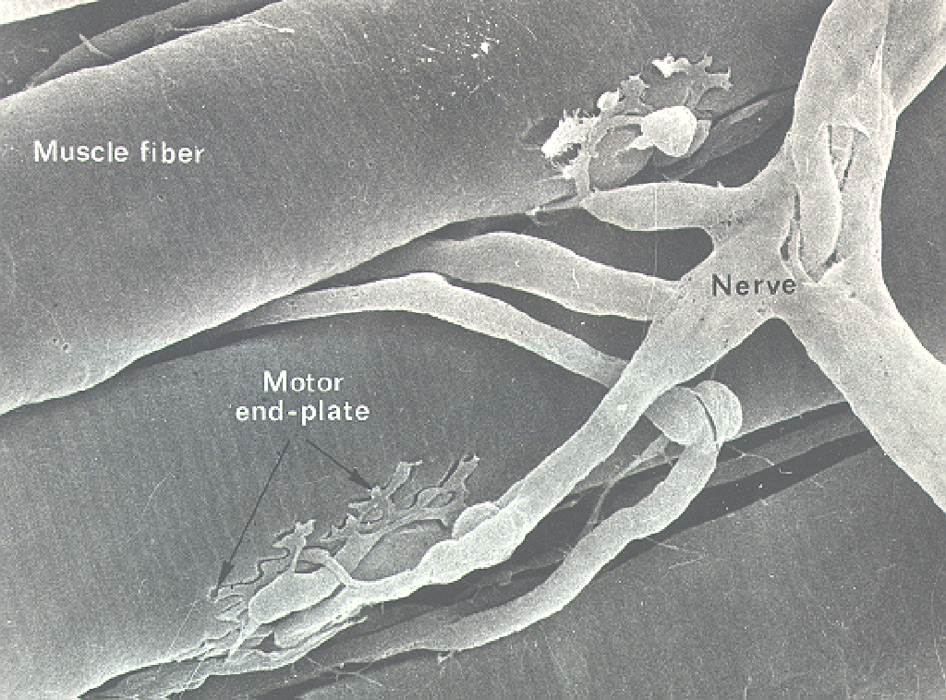
The Neuromuscular Junction

Slide 21
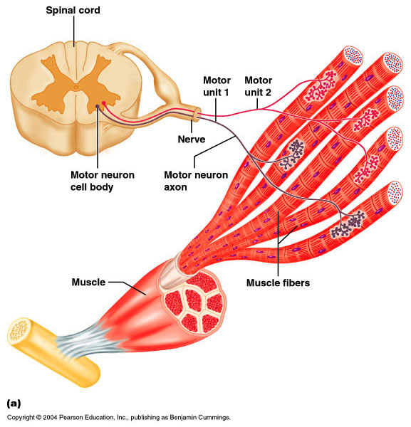
Nerve-Muscle Functional Unit
Motor Unit
  Composed of an alpha motor neuron and all the myofibers innervated by that neuron
Neuromuscular junction
  Where the axon terminal and the motor endplate meet
Motor Endplate-sole plate-postjunctional membrane
  The region of the myofiber directly under the terminal axon branches
Notes:
Many muscle fibers (muscles cells) may be innervated by one motor neuron. This complex is called the MOTOR UNIT.
Junction between neuron and muscle fiber is the NEUROMUSCULAR JUNCTION.
Actual contact is at the MOTOR ENDPLATE.
a single axon from a motor neuron in the ventral horn and all the muscle fibers it innervates

Slide 22
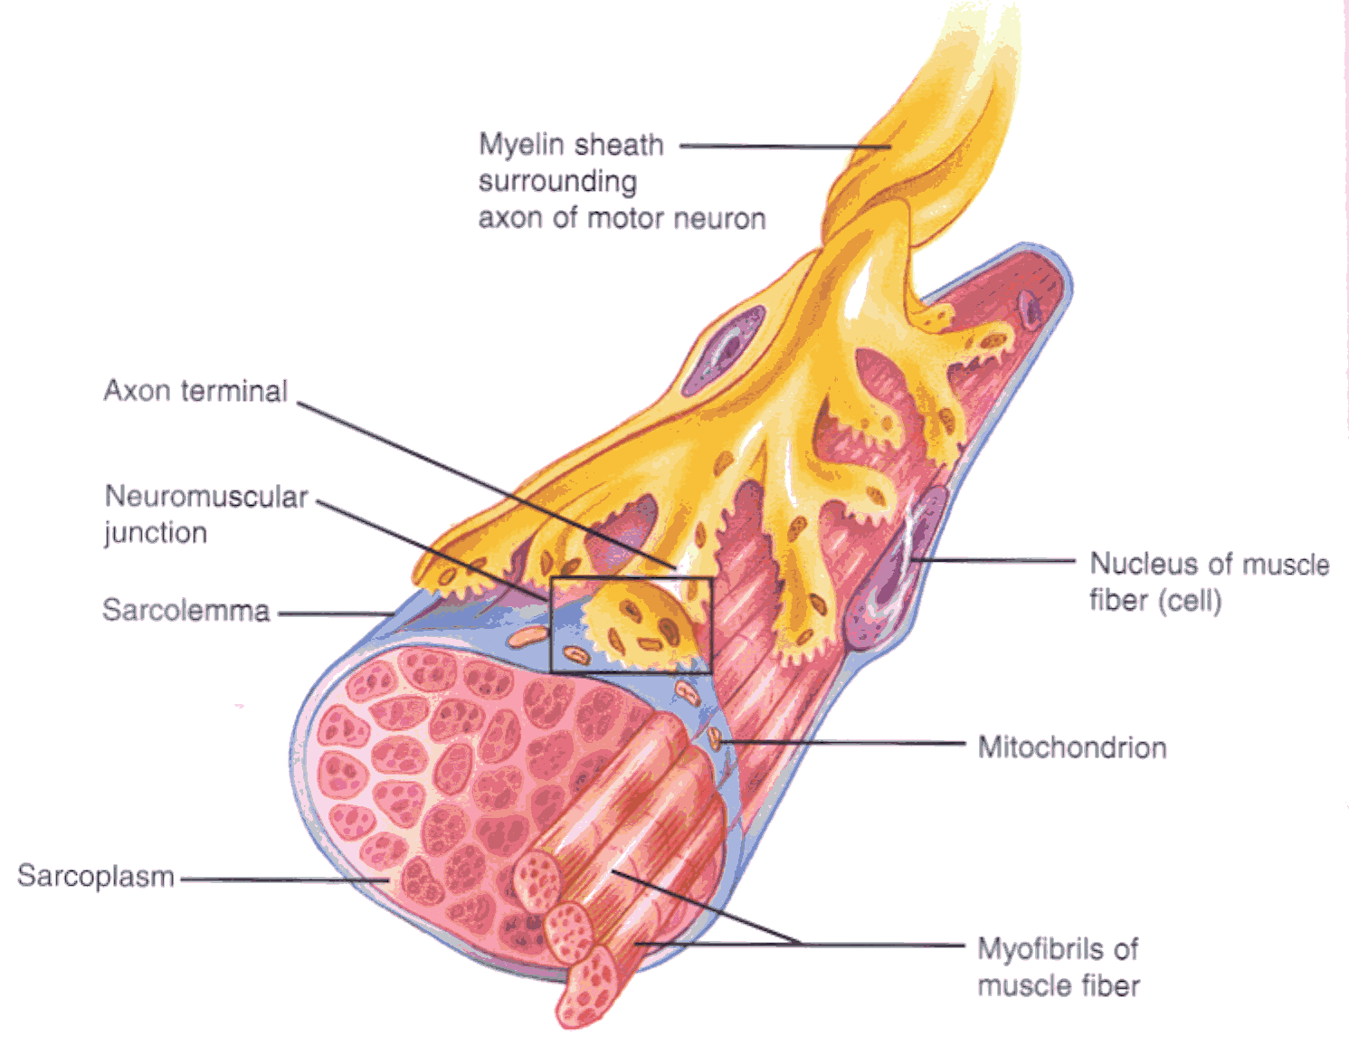

Slide 23
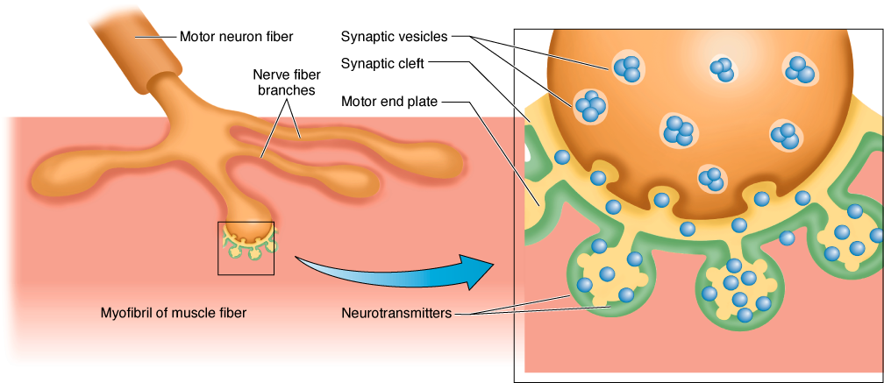
Neuromuscular Junction
Notes:
ACh (acetylcholine) is the neurotransmitter at all neuromuscular junctions. Not shown is how ACh is rapidly removed following release; otherwise, the action potentials would not cease causing continual contraction. Many drugs, including nerve gases, work at these locations by either blocking the neurotransmitter receptors or inhibiting the removal of the neurotransmitter.

Slide 24
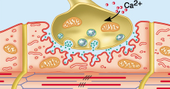
SUBNEURAL CLEFTS-PALISADES-JUNCTIONAL FOLDS

Slide 25
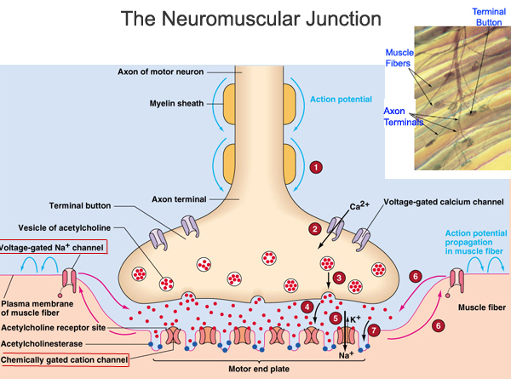

Slide 26
Events at NJM
An action potential (AP), an electrical impulse, travels down the axon of the motor neuron to the end bulbs (synaptic terminals)
The AP causes the synaptic vesicles to fuse with the end bulb membrane, resulting in the release of Acetylcholine (Ach) into the synaptic cleft
Ach diffuses across the synaptic cleft & binds to Ach receptors on the motor end plate
The binding of Ach to its receptors causes a new AP to be generated along the muscle cell membrane
Immediately after it binds to its receptors, Ach will be broken down by Acetylcholinesterase (AchE) – an enzyme present in the synaptic cleft

Slide 27
EXCITATION-CONTRACTION COUPLING:
Action Potential
Depolarization of the T-Tubules - Causes conformational change in the DHPR - opens Ca²⁺ channels(Ryr) on sacroplasmic reticulum
Ca²⁺ released from SR into ICF
Ca²⁺ binds to Troponin C cooperatively - causes conformational change
Tropomyosin is out of way
Cross-bridge cycling
Relaxation via Ca²⁺ ATPase

Slide 28
Transmission at this junction involves several steps:
When an action potential (inhibited by tetrodotoxin) reaches the axon terminal it causes Ca channels to open. Ca²⁺ rushes into the cell because Ca²⁺ outside is much higher than Ca²⁺ inside
The terminal region is loaded with vesicles containing the transmitter acetylcholine (ACh)
Ca²⁺ causes some of the vesicles to fuse with the membrane and release their ACh (inhibited by botulinum toxin)
ACh diffuses across the junction and binds to the ACh receptor protein (inhibited by curare) in the postsynaptic membrane
Binding causes an ion channel to open

Slide 29
The flow of ions depolarizes the membrane, producing an EPSP. In muscle a single impulse usually causes enough depolarization to reach threshold
An action potential is generated in the muscle membrane
The muscle action potential causes release of Ca²⁺ from the sarcoplasmic reticulum of the muscle and this triggers muscle contraction
Back in the synapse the ACh is broken down to acetate and choline by the enzyme acetylcholinesterase (inhibited by physostigmine, nerve gases, organophosphate insecticides).
The choline is recycled. A choline pump transports it back into the nerve terminal and there it is converted back into ACh

Slide 30
Chemical Transmitters Are Made and Stored in the Presynaptic Terminal
The end of the nerve enlarges into an axon terminal
Transmitters are made in the terminal and are stored in tiny vesicles so that they can be released whenever an action potential comes along
Transmitters are made only by the incoming (presynaptic) nerve
Because the transmitter is only on one side the impulse can go in only one direction

Slide 31
Calcium is Required for Transmitter Release
Transmitter release requires Ca²⁺ ions
Normally Ca²⁺ in the cell is kept very low (by a Ca pump)- if the cell needs Ca²⁺ it must come from the outside
The action potential coming in to the terminal opens Ca channels -> Ca comes rushing in
The Ca²⁺ causes some of the vesicles to fuse to the membrane- then they open up and the transmitter is released
Botulinum and tetanus toxins block transmitter release

Slide 32
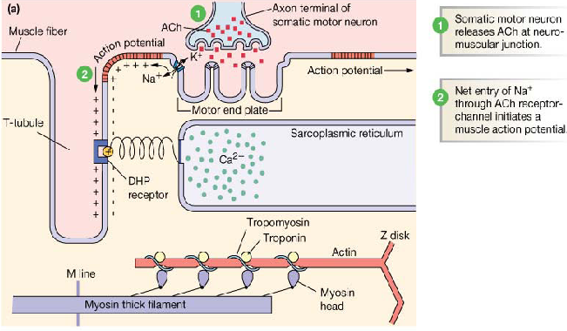

Slide 33
