Slide 1
On Behalf of his Excellency the Rector of the University, Dr. Al Rukban Chairs the Second Meeting of the Supreme Central Committee for Quality and Academic Accreditation

Slide 2
On behalf of his Excellency the Rector of the University, Dr. Khalid bin Saad Al Muqrin, his Excellency the Deputy Chairman of the Committee and the Vice Rector for Educational Affairs, Prof. Mohammed bin Othman Al Rukban, has chaired the second meeting of the Supreme Central Committee for Quality and Academic Accreditation, which was held yesterday, on Monday, 15/08/1434 H. Dr. Al Rukban has initiated the meeting by welcoming everyone and stressing the attention of his Excellency the Rector of the University of the Committee, as dealing with one of the most important issues given by the University of a special interest which is the academic accreditation.

Slide 3
Then, the Secretary of the Committee, Dr. Khaled Al-Jarallah, browsed the agenda of the meeting, which included a number of topics and the most important ones were: the development of the internal quality system at the university and convert it to an electronic system, and the developmental evaluation in collaboration with the National Commission for Assessment and Academic Accreditation, as well as the external accreditation of the university programs, in addition to discuss the topic of the training programs that could qualify the academic staff to meet the requirements of quality and academic accreditation.

Slide 4
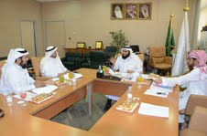

Slide 5
وبنهاية الزيارة اجتمع سعادة د. الركبان ببعض مشرفي الأقسام بالعمادة , وتقدم سعادة د. الرميح بخالص شكره لسعادة وكيل الجامعة للشؤون التعليمية على تلك الزيارة, وحرص قيادات الجامعة على الوقوف المباشر على كل ما يخدم مصلحة الطالب .

Slide 6
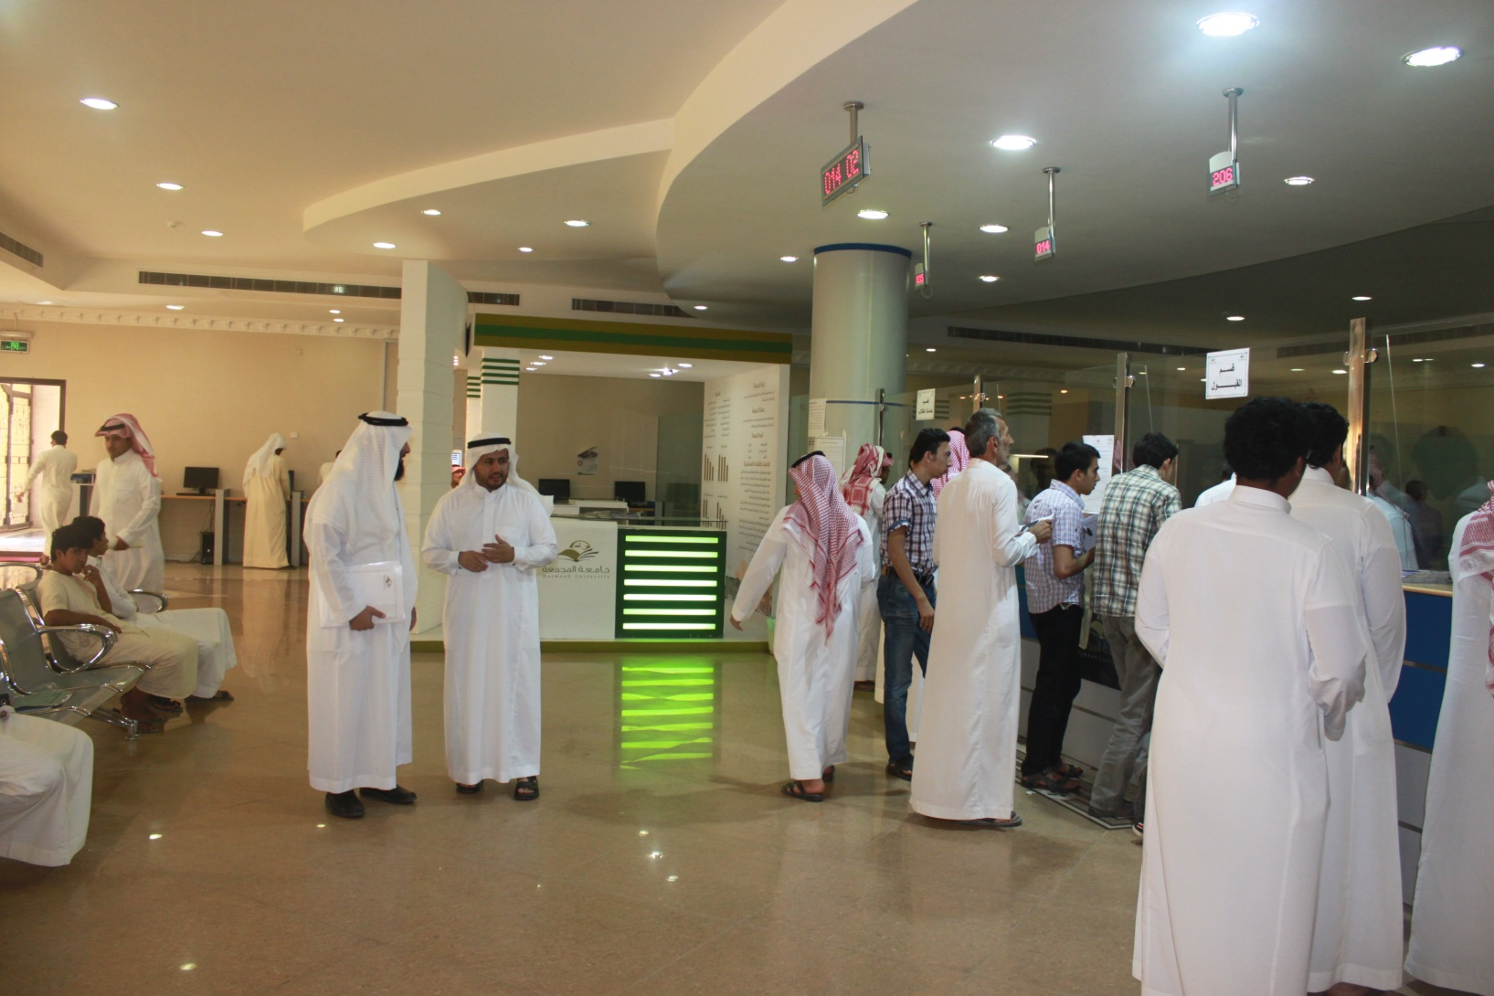

Slide 7
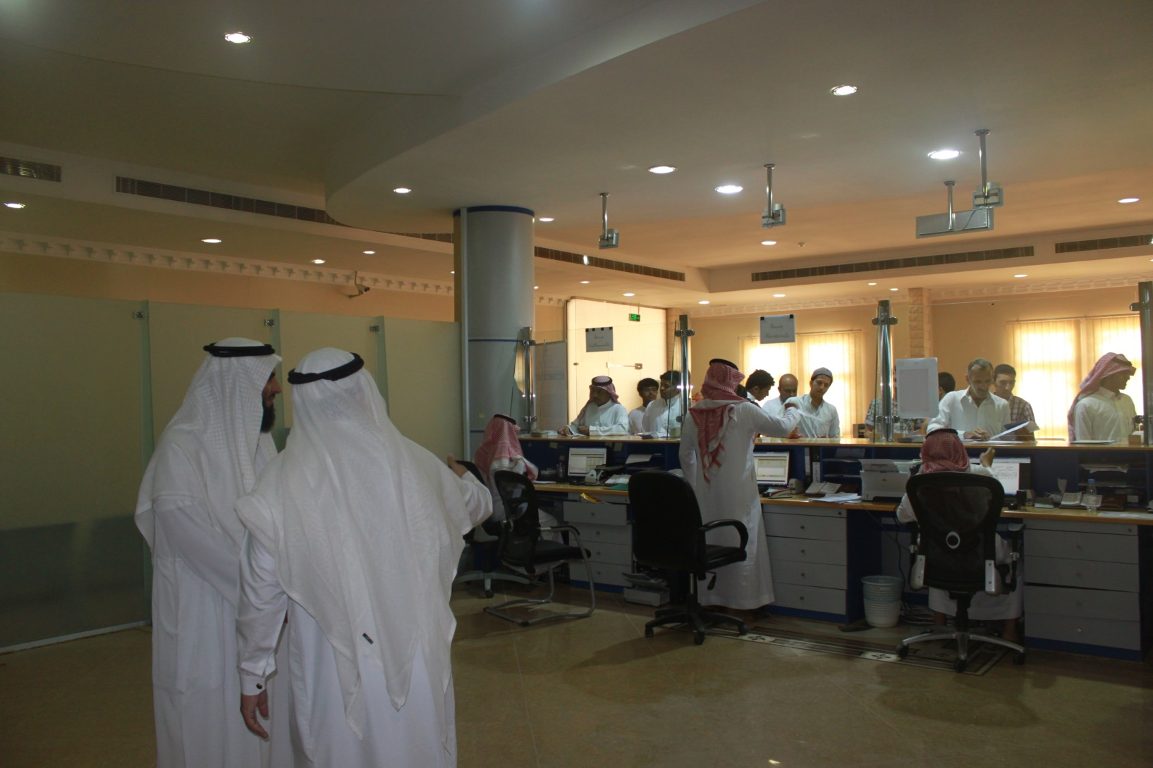

Slide 8
