Slide 1
Within the Program of Visiting the Colleges of the University, College of Education in Majmaah was the Next Station of The Working Team at the Vice Presidency for Academic Affairs

Slide 2
Within the framework of visits of the Working Team at the Vice Presidency for Academic Affairs to the Colleges of the University , the advisory team at the Vice Presidency for Academic Affairs, under the chairmanship of His Excellency the Vice Rector for Academic Affairs, Prof. Mohammed bin Othman Al Rukban, has paid a visit to the College of Education in Majmaah.
Dr. Al Rukban started the visit by meeting the Supervisor of the College of Education, Dr. Mohammed Al Shaya , with the presence of Vices Dean of the College as well as the Heads of Departments. His Excellency the Vice Rector of the university stated the main objective of this visit, where he clarified the trends of the Vice Presidency in the next phase, indicating the priorities that the university is planning to adapt in the next year which are revolving around accreditation. On his part, the Supervisor of the College of Education welcomed the delegation. Then, he explained the overall management trends of the College, followed by presentation and discussion of the report of the College achievements , and some of the challenges that stand in the way of achievement, as well as the ways to deal with these challenges .

Slide 3
His Excellency the Vice Rector of the university and the Working Team completed their tour of the college by meeting some of faculty members of various Academic Departments at the college; some of them were away because of being busy with Examination Committees, where His Excellency the Vice Rector of the university opened the gate for a dialogue about various important topics.

Slide 4
Afterwards, The working team of the Vice Presidency for Academic Affairs met the Committee of Plans and Study Programs at the College, where the members of the Committee displayed the current situation of the plans and the future plans of the College Programs. After that, the working team has paid a visit to the Test Committee at the College, where a kind of discussion occurred concerning Tests and Evaluation. Then, the working team visited the Committee of Academic Guidance at the College and who are in charge of it; where they presented the efforts of the Committee which have been done in serving students in the Academic Counselling side.

Slide 5
The working team of the Vice Presidency for Academic Affairs has finished the visit to the College of Education by meeting the Faculty Members of female section, where His Excellency the Vice Rector for Academic Affairs met the female staff at the College branch of females section, where he listened to many of proposals that have been presented by the Faculty Members of female section, and answered many of the inquiries that have been inquired about.

Slide 6
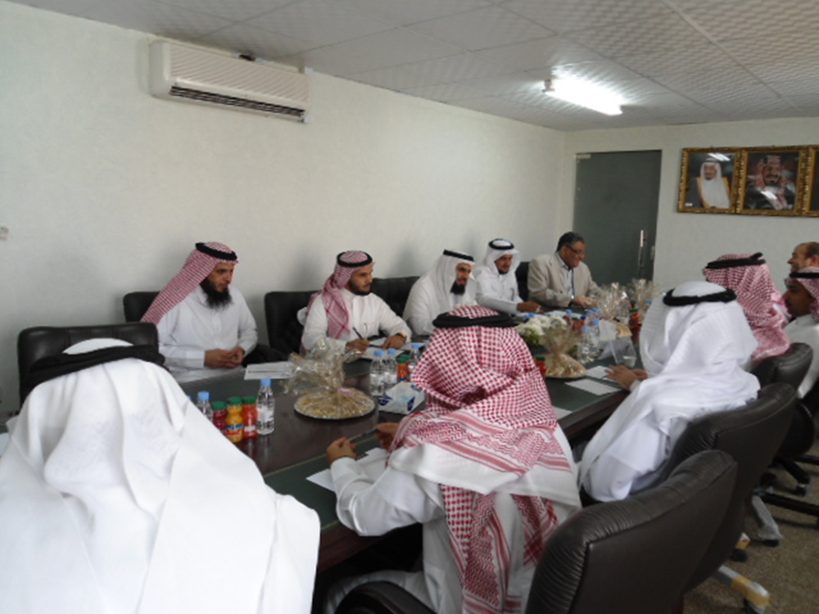

Slide 7
