Slide 1
Dr. Al Rukban has Paid a Field Visit to the Deanship of Admission and Registration to Follow-up the Mechanism of Ongoing Process of General Admission for the Next Academic Year 1434/1435 H

Slide 2
In order to enable the Vice Presidency for Educational Affairs to stand on the stages of students registration who are applying for undergraduate study for the next academic year 1434/1435 H, His Excellency the Vice Rector for Educational Affairs, Prof. Mohammed bin Othman Al Rukban, has paid a field visit to the Deanship of Admission and Registration on Sunday morning 15/08/1434 H, to stand on the ongoing process of Registration and Admission of the fresh students for the academic year 1434/1435 H.

Slide 3
His Excellency the Vice Rector was received by the Dean of Admission and Registration, Dr. Ahmed Bin Ali Al Rumaih, where the later accompanied his Excellency the Vice Rector to the relevant sections of the Deanship, in addition to a detailed explanation about the mechanism of Admission and Registration presented by Dr. Al Rumaih , as well as meeting the team of the Deanship. His Excellency Dr. Al Rukban expressed his thanks to the staff of the Deanship for their outstanding efforts, valuing the active role played by the Deanship of Admission and Registration in particular the procedures of admission of the fresh students for the next academic year.

Slide 4
At the end of the visit, His Excellency Dr. Al Rukban has met some Supervisors of Departments at the Deanship, then Dr. Al Rumaih expressed his sincere gratitude to His Excellency the Vice Rector for Educational Affairs for this visit, and the keenness of the leaderships of the university to follow up and stand on everything that serves the interest of the student.

Slide 5
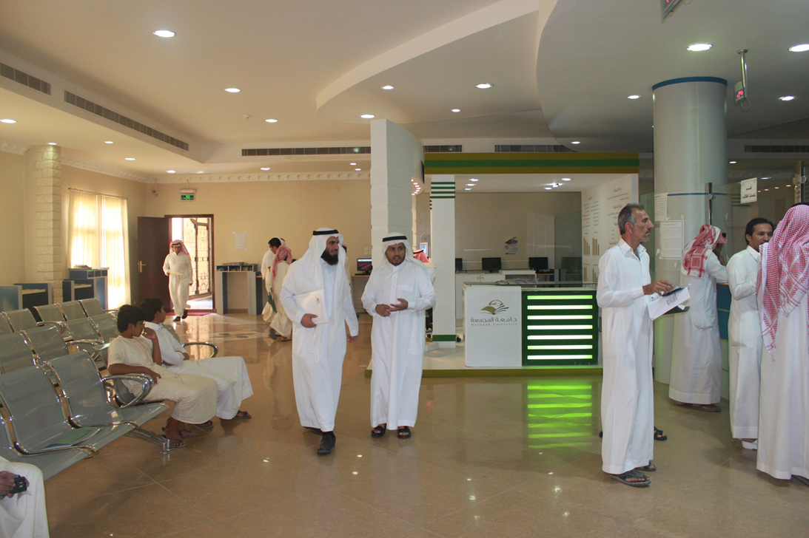

Slide 6
وبنهاية الزيارة اجتمع سعادة د. الركبان ببعض مشرفي الأقسام بالعمادة , وتقدم سعادة د. الرميح بخالص شكره لسعادة وكيل الجامعة للشؤون التعليمية على تلك الزيارة, وحرص قيادات الجامعة على الوقوف المباشر على كل ما يخدم مصلحة الطالب .

Slide 7
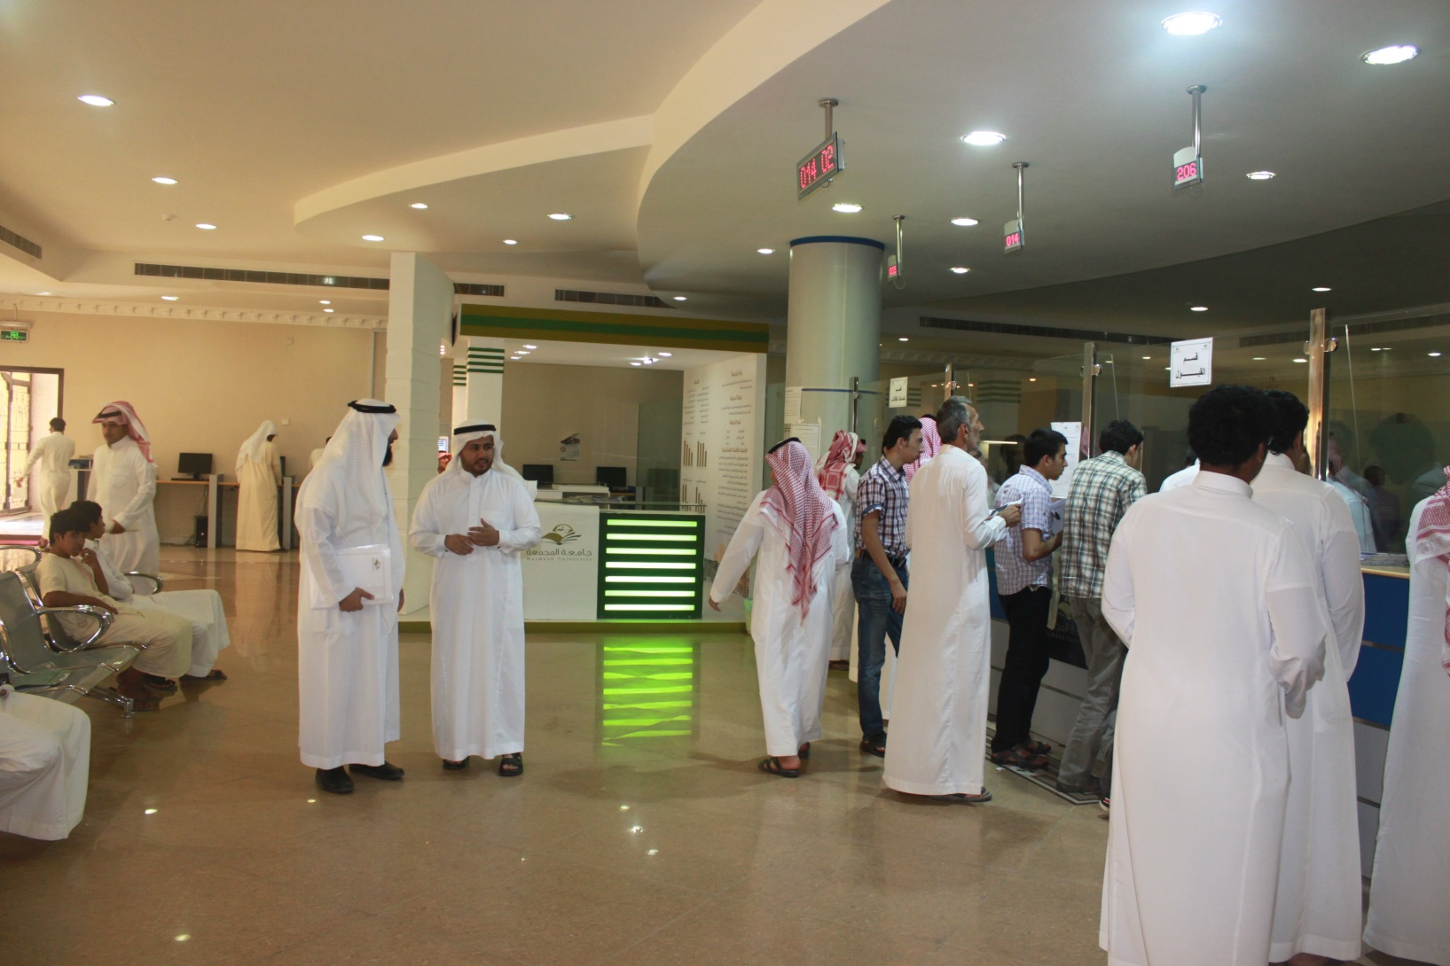

Slide 8
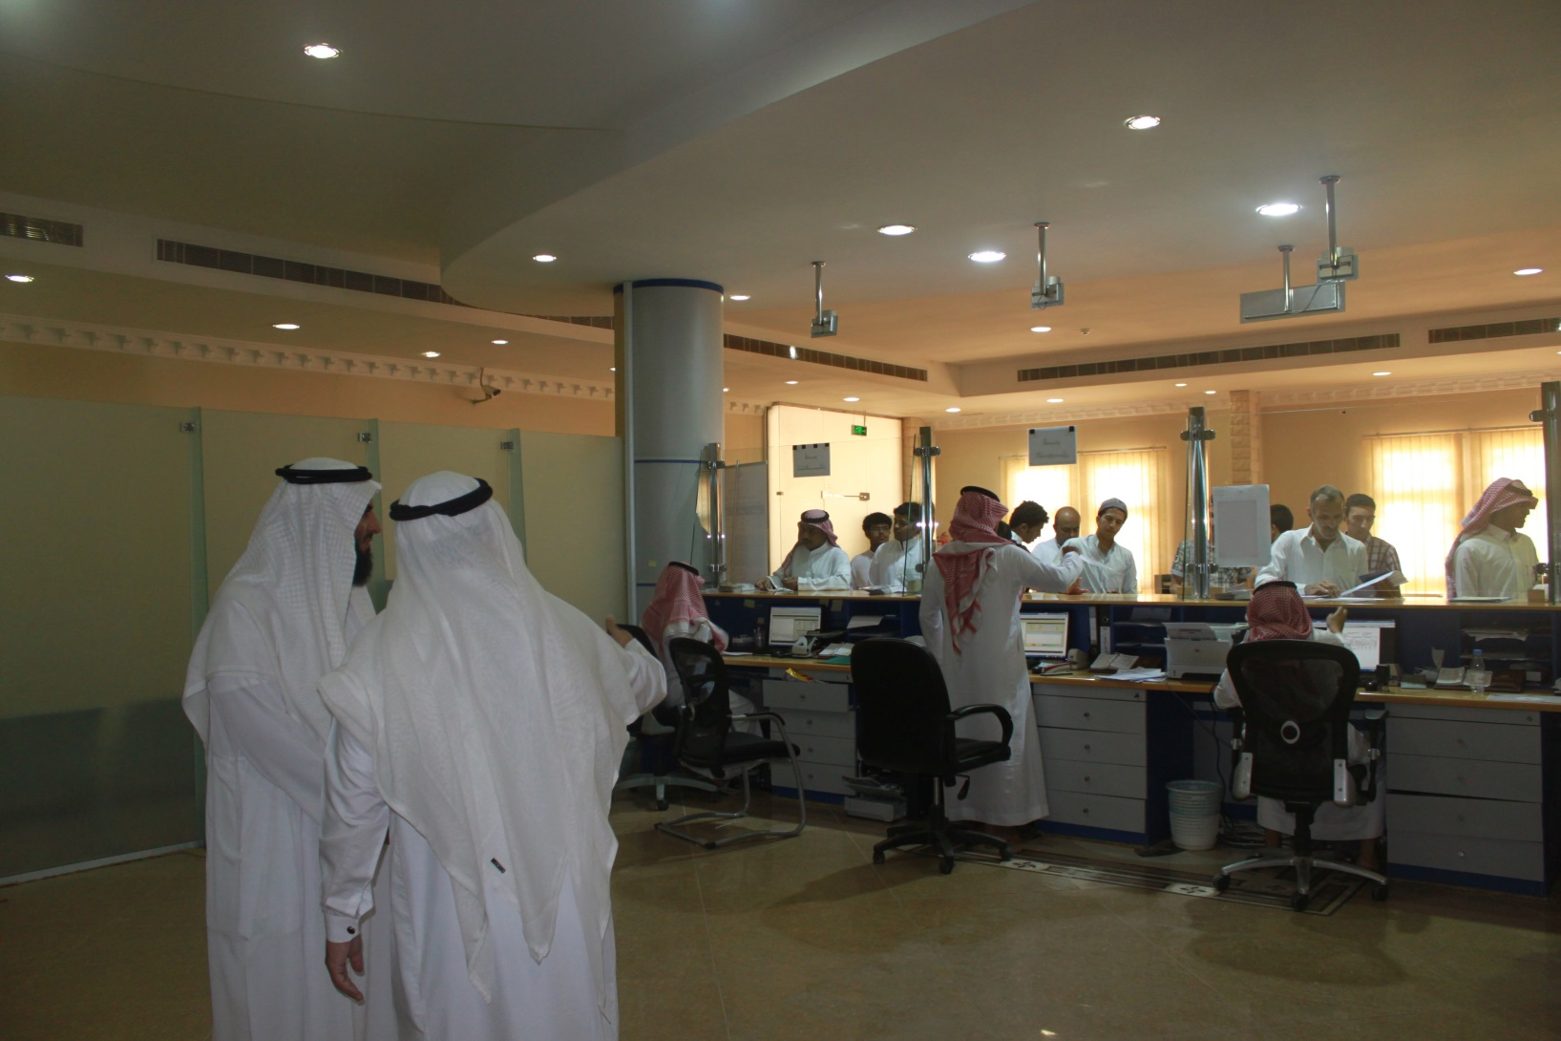

Slide 9
