Slide 1
Chapter 2:
SOFTWARE PROCESSES

Slide 2
Video Tutorials
Software Engineering Process Models
Reasons for Agile Processes
Spiral Model

Slide 3
CONTENTS
Introduction
Maintenance
Waterfall Process Model
Prototyping Process Model
Iterative Process Models
V Process Model
Reuse-Oriented Process Model

Slide 4
CONTENTS
Time-Boxing Process Model
Extreme Programming and Spiral Model
Project Management Process
ETVX Approach for Process Specification
Software Standards
Exercises

Slide 5
SOFTWARE-DEVELOPMENT LIFE-CYCLE
The software-development life-cycle is used to facilitate the development of a large software product in a systematic, well-defined, and cost-effective way

Slide 6
MAINTENANCE
Maintenance is an important part of the SDLC
Maintenance may consume more time than the time consumed in the development
The cost of maintenance varies from 50% to 80% of the total development cost

Slide 7
MAINTENANCE

Slide 8
TYPES OF MAINTENANCE
1. Corrective Maintenance:
Corrective maintenance means repairing processing failures or making changes because of previously uncorrected problems
2. Adaptive Maintenance:
Adaptive maintenance means changing the program function. This is done to adapt to the external environment change

Slide 9
TYPES OF MAINTENANCE
3. Perfective Maintenance:
Perfective maintenance means enhancing the performance or modifying the programs to respond to the user’s additional or changing needs

Slide 10
TYPES OF MAINTENANCE
4. Preventive Maintenance:
Preventive maintenance is the process by which we prevent our system from being obsolete
It involves the concept of re-engineering and reverse engineering in which an old system with an old technology is re-engineered using new technology

Slide 11
A REASONABLE SET OF
DOCUMENTS PRODUCED IN A PROJECT
Requirements document
Project plan
Design documents (architecture, detailed)
Test plan and test reports
Final code
Software manuals (e.g., user, installation, etc.)

Slide 12
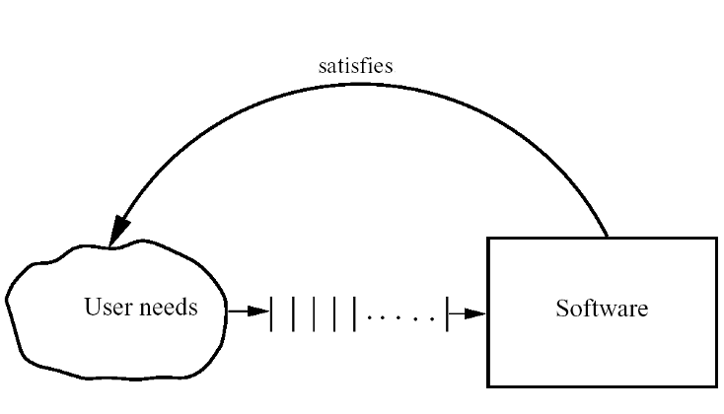
PROCESS AND PROJECT

Slide 13


Slide 14
WATERFALL PROCESS MODEL
.

Slide 15
FEASIBILITY STUDY
Its result is a document that should contain at least the following items:
A definition of the problem
Determination of viability
Alternative solutions and their expected benefits
Required resources, costs, and delivery dates in each proposed alternative solution

Slide 16
REQUIREMENT ANALYSIS AND SPECIFICATION
The purpose of a requirements analysis is to identify the qualities required of the application, in terms of functionality, performance, ease of use, portability, and so on
The requirements describe the “what” of a system, not the “how”

Slide 17
REQUIREMENT ANALYSIS AND SPECIFICATION
An SRS (Software Requirements Specification) document must contain the following:
Detailed statement of problem
Possible alternative solution to problem
Functional requirements of the software system
Constraints on the software system

Slide 18
DESIGN AND SPECIFICATION
The goal of the design phase is to transform the requirements specified in the SRS document into a structure that is suitable for implementation in some programming language

Slide 19
DESIGN AND SPECIFICATION
Traditional Design Approach:
Architectural design (also called high-level design)
Detailed design (also called low-level design)
Object-Oriented Design Approach:
Lower development time and effort
Better maintainability

Slide 20
CODING AND MODULE TESTING
Output of this phase is an implemented and tested
collection of modules

Slide 21
INTEGRATION AND SYSTEM TESTING
Integration is normally carried out incrementally over a number of steps
The system testing is done in three phases:
Alpha Testing
Beta Testing
Acceptance Testing

Slide 22
DELIVERY AND MAINTENANCE
The delivery of software is often done in two stages
The cost of maintenance is often more than 60% of the total cost of software
Over 50% of maintenance costs attributed to perfective maintenance
Evolution is probably a better term than maintenance

Slide 23
ADVANTAGES OF WATERFALL MODEL
The main advantage of the waterfall model is its simplicity
It is straightforward and divides the large task of building a software system into a series of cleanly divided phases, each phase dealing with a separate logical concern

Slide 24
ADVANTAGES OF WATERFALL MODEL
Waterfall model is also easy to administer in a contractual setup. As each phase is completed and its work product produced, some amount of money is given by the customer to the developing organization

Slide 25
DISADVANTAGES OF WATERFALL MODEL
It assumes that the requirements of a system can be frozen before the design begins
Freezing the requirements usually requires choosing the hardware
It follows the “big bang” approach. The entire software is delivered in one shot at the end
It encourages “requirements bloating”
It is a document-driven process that requires formal documents at the end of each phase

Slide 26
WATERFALL MODEL
Despite these limitations, the waterfall model has been the most widely used process model
If the developing organization is quite familiar with the problem domain and the requirements for the software are quite clear, the waterfall model works well, and may be the most efficient process

Slide 27


Slide 28
PROTOTYPING PROCESS MODEL
The goal of a prototyping-based development process is to counter the first limitation of the waterfall model
The basic idea here is that instead of freezing the requirements before any design or coding can proceed, a throwaway prototype is built to help understand the requirements

Slide 29
PROTOTYPING PROCESS MODEL
Prototyping is an attractive idea for complicated and large systems for which there is no manual process for existing system to help determine the requirements
Letting the client “play” with the prototype provides invaluable and intangible inputs that help determine the requirements for the system

Slide 30
PROTOTYPING PROCESS MODEL
It is also an effective method of demonstrating the feasibility of a certain approach
This might be needed for novel systems, where it is not clear that constraints can be met or that algorithms can be developed to implement the requirements
In both situations, the risks associated with the projects are being reduced through the use of prototyping

Slide 31
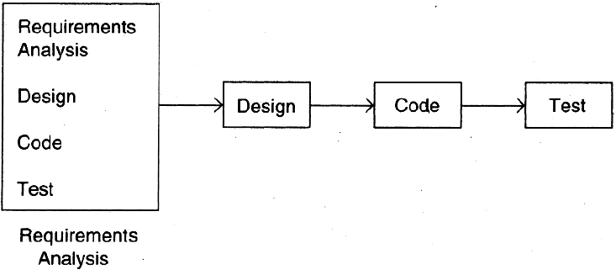
PROTOTYPING PROCESS MODEL
.

Slide 32
PROTOTYPING PROCESS MODEL
After the prototype has been developed, the users are given an opportunity to use and explore the prototype
Based on their experience, they provide feedback to the developers regarding the prototype: What is correct, what needs to be modified, what is missing, what is not needed, etc

Slide 33
PROTOTYPING PROCESS MODEL
Based on the feedback, the prototype is modified to incorporate some of the suggested changes that can be done easily, and then the users and the clients are again allowed to use the system
This cycle repeats until we reach the requirements needed

Slide 34
ADVANTAGES OF PROTOTYPING MODEL
Suitable for large systems for which there is no manual process to define the requirements
User training to use the system
Quality of software is good
Requirements are not freezed

Slide 35


Slide 36


Slide 37
ITERATIVE ENHANCEMENT PROCESS MODEL
The iterative-enhancement model combines elements of the linear sequential model (Waterfall) with the iterative philosophy of prototyping
The software is broken down into several modules, which are incrementally developed and delivered

Slide 38
ITERATIVE ENHANCEMENT PROCESS MODEL
First, the development team develops the core module of the system and then it is later refined into increasing levels of capability of adding new functionalities in successive versions
Each linear sequence produces a deliverable increment of the software

Slide 39
ITERATIVE ENHANCEMENT PROCESS MODEL
For example, word-processing software developed using the iterative paradigm might deliver basis file management, editing, and document production functions in the first increment
More sophisticated editing and document production capabilities in the second increment; and spelling and grammar checking in the third increment
It should be noted that the process flow for any increment could incorporate the prototyping paradigm

Slide 40

ITERATIVE ENHANCEMENT PROCESS MODEL
.

Slide 41
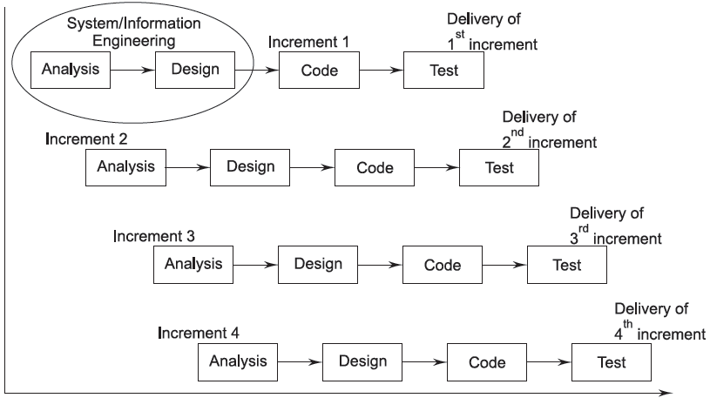
ITERATIVE ENHANCEMENT PROCESS MODEL
.

Slide 42
ADVANTAGES OF
ITERATIVE ENHANCEMENT MODEL
The feedback from early increments improve the later stages
The possibility of changes in requirements is reduced
Users get benefits earlier than with a conventional approach
Early delivery of some useful components improves cash flow

Slide 43
ADVANTAGES OF
ITERATIVE ENHANCEMENT MODEL
Smaller sub-projects are easier to control and manage
The requesting of features that are unnecessary and not in fact used is less
The project can be temporarily abandoned if more urgent work crops up
Job satisfaction is increased for developers

Slide 44
DISADVANTAGES OF
ITERATIVE ENHANCEMENT MODEL
Later increments may require modifications to earlier increments
Programmers may be more productive working on one large system than on a series of smaller ones
Some problems are difficult to divide into functional units (modules)

Slide 45
ITERATIVE DELIVERY PROCESS MODEL
In this approach, the requirements and the architecture design is done in a standard waterfall or prototyping approach, but deliver the software iteratively
That is, the building of the system, is done iteratively, though most of the requirements are specified upfront

Slide 46
ITERATIVE DELIVERY PROCESS MODEL
At the start of each delivery iteration, requirements which will be implemented in this release are decided, and then the design is enhanced and code developed to implement the requirements
The iteration ends with delivery of a working software system providing some value to the end user

Slide 47
ITERATIVE DELIVERY PROCESS MODEL
.

Slide 48
ADVANTAGES OF
ITERATIVE DELIVERY PROCESS MODEL
As the requirements are mostly known upfront, an overall view of the system is available and a proper architecture can be designed which can remain relatively stable
Hopefully rework in development iterations will diminish

Slide 49
ADVANTAGES OF
ITERATIVE DELIVERY PROCESS MODEL
The value to the end customer is delivered iteratively so it does not have the all-or-nothing risk
Feedback from an iteration can be incorporated in the next iteration
Even new requirements that may get uncovered can also be incorporated

Slide 50
DISADVANTAGES OF
ITERATIVE DELIVERY PROCESS MODEL
Programmers may be more productive working on one large system than on a series of smaller ones
Some problems are difficult to divide into functional units (modules), which can be incrementally developed and delivered

Slide 51
ITERATIVE MODEL POPULARITY
In today’s world clients do not want to invest too much without seeing returns
As businesses are changing rapidly today, they never really know the “complete” requirements for the software, and there is a need to constantly add new capabilities to the software to adapt the business to changing situations

Slide 52
ITERATIVE DELIVERY
PROCESS MODEL
The advantage of this approach is that as the requirements are mostly known upfront, an overall view of the system is available and a proper architecture can be designed which can remain relatively stable
With this, rework in development iterations will diminish

Slide 53
TIME BOXING PROCESS MODEL
To speed up development, parallelism between the different iterations can be employed
A new iteration commences before the system produced by the current iteration is released, and hence development of a new release happens in parallel with the development of the current release

Slide 54
TIME-BOXING PROCESS MODEL
.

Slide 55
TIME-BOXING PROCESS MODEL
In the time boxing model, the basic unit of development is a time box, which is of fixed duration
Since the duration is fixed, a key factor in selecting the requirements to be built in a time box is what can be fit into the time box
This is in contrast to regular iterative approaches where the functionality is selected and then the time to deliver is determined

Slide 56
TIME-BOXING PROCESS MODEL
Each time box is divided into a sequence of stages
The model requires that the duration of each stage is approximately the same
Having time-boxed iterations with stages of equal duration and having dedicated teams renders itself to pipelining of different iterations

Slide 57
TIME-BOXING PROCESS MODEL
To illustrate the use of this model, consider a time box consisting of three stages: requirement specification, build, and deployment
The requirement stage is executed by its team of analysts and ends with a prioritized list of requirements to be built in this iteration along with a high-level design

Slide 58
TIME-BOXING PROCESS MODEL
The build team develops the code for implementing the requirements, and performs the testing
The tested code is then handed over to the deployment team, which performs pre-deployment tests, and then installs the system for use
These three stages can be done in approximately equal time in an iteration

Slide 59
TIME-BOXING PROCESS MODEL
Timeboxing is well suited for projects that require a large number of features to be developed in a short time around a stable architecture using stable technologies
These features should be such that there is some flexibility in grouping them for building a meaningful system in an iteration that provides value to the users

Slide 60
TIME-BOXING PROCESS MODEL
The main cost of this model is the increased complexity of project management (and managing the products being developed) as multiple developments are concurrently active
Also, the impact of unusual situations in an iteration can be quite disruptive

Slide 61
TIME-BOXING PROCESS MODEL
Tasks of Different Teams

Slide 62
REUSE-ORIENTED DEVELOPMENT PROCESSES
In the majority of software projects, there is some software reuse
This usually happens when people working on the project know of designs or code which is similar to that required
They look for these, modify them as required and incorporate them into their system

Slide 63
THE GENERIC PROCEE MODEL FOR REUSE
.

Slide 64
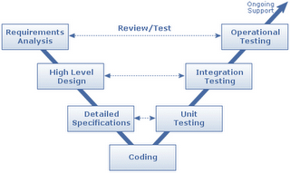
V PROCESS MODEL
.

Slide 65
V PROCESS MODEL
The V model is a variant of the waterfall model
It represents a tacit recognition that there are testing activities occurring throughout the waterfall software life cycle model and not just during the software testing period

Slide 66
V PROCESS MODEL
For example, during requirements specification, the requirements are evaluated for testability and an STRS may be written
This document would describe the strategy necessary for testing the requirements

Slide 67
V PROCESS MODEL
Testing is a full life-cycle activity and that it is important to constantly consider the testability of any software requirement and to design to allow for such testability

Slide 68
EXERCISE-1
Design your own development process for the following software project:
The developing organization is quite familiar with the problem domain and the requirements for the software are quite clear
The client wanted to improve the cash flow and get some of system benefits as soon as possible

Slide 69
EXERCISE-2
Design your own development process for the following software project:
The system is novel and it is not clear that constraints can be met - The client wanted to improve the cash flow and get some of system benefits as soon as possible

Slide 70
EXERCISE-3
Design your own development process for the following software project:
The client is willing to spend some time only three times to help develop the requirements (divide the requirements phase into three equal parts)
The system is designed to automate an existing manual system

Slide 71
EXERCISE-4
Design your own development process for the following software project:
The client is willing to spend some time only at the start to help develop the requirements
The developing organization is not familiar with the problem domain

Slide 72
EXERCISE-5
Design your own development process for the following software project:
The system is complicated and large
There is no manual process for the system to help determine the requirements

Slide 73
EXERCISE-6
2. The client wanted to reduce the delivery time as much as possible - The developing organization is quite familiar with the problem domain - The project requires a large number of features

Slide 74
EXERCISE-7
A software project uses the time-boxing process model with five stages in each time box. Suppose that each stage takes 8 days. Find the number of time boxes if the time required to complete this project is 120 days.

Slide 75
EXERCISE-8
A software project uses the time-boxing process model with four stages in each time box. Suppose that each stage takes 3 days. Find the time required to complete this project if the number of time boxes is 146.

Slide 76
EXERCISE-9
A software project uses the time-boxing process model with N stages in each time box. Suppose that each stage takes 3 days. Find the number of stages in each time box (N) if the number of time boxes is 40 and the time required to complete this project is 126 days.

Slide 77
EXTREME PROGRAMMING
AND AGILE PROCESSES
Agile development approaches evolved in the 1990s as a reaction to documentation and bureaucracy-based processes, particularly the waterfall approach

Slide 78
COMMON PRINCIPLES
FOR AGILE APPROACHES
Working software is the key measure of progress in a project
For progress in a project, software should be developed and delivered rapidly in small increments
Even late changes in the requirements should be entertained
Face-to-face communication is preferred over documentation

Slide 79
COMMON PRINCIPLES
FOR AGILE APPROACHES
Continuous feedback and involvement of customer is necessary for developing good-quality software
Simple design which evolves and improves with time is a better approach than doing an elaborate design up front for handling all possible scenarios
The delivery dates are decided by empowered teams of talented individuals

Slide 80
EXTREME PROGRAMMING XP
Many detailed agile methodologies have been proposed, some of which are widely used now
Extreme programming (XP) is one of the most popular and well-known approaches in the family of agile methods

Slide 81
XP UNIQUE PRACTICES
The XP approach used in a development iteration has some unique practices:
Development is done by pairs of programmers (called pair programming), instead of individual programmers
Automated unit tests are written first before the actual code is written, and then the code should be written to pass the tests (test-driven development)

Slide 82
XP UNIQUE PRACTICES
It suggests that refactoring be done to improve the design. During refactoring, no new functionality is added, only the design of the existing programs is improved
It encourages frequent integration of different units. Only one pair at a time can release their changes and integrate into the common code base

Slide 83
OVERALL PROCESS OF XP

Slide 84
AN ITERATION IN XP

Slide 85
USES OF AGILE PROCESSES
They are suitable for situations where the volume and pace of requirements change is high
It is effective when teams are collocated and of modest size, of up to about 20 members
It works well when the customer is willing to be heavily involved during the entire development, working as a team member

Slide 86
SPIRAL MODEL
It was originally proposed by Boehm (Boehm, 1988)
Rather than represent the software process as a sequence of activities with some backtracking from one activity to another, the process is represented as a spiral

Slide 87
SPIRAL MODEL

Slide 88
SPIRAL MODEL
Each loop in the spiral represents a phase of the software process
The innermost loop might be concerned with system feasibility, the next loop with requirements definition, the next loop with system design and so on

Slide 89
SPIRAL MODEL
The main difference between the spiral model and other software process models is the explicit recognition of risk in the spiral model
Risk simply means something that can go wrong

Slide 90
SPIRAL LOOP SECTORS
Objective Setting:
Specific objectives for that phase of the project are defined
Constraints on the process and the product are identified and a detailed management plan is drawn up
Project risks are identified
Alternative strategies, depending on these risks, may be planned

Slide 91
SPIRAL LOOP SECTORS
Risk Assessment and Reduction:
For each of the identified project risks, a detailed analysis is carried out
Steps are taken to reduce the risk
For example, if there is a risk that the requirements are inappropriate, a prototype system may be developed

Slide 92
SPIRAL LOOP SECTORS
Development and validation:
After risk evaluation, a development model for the system is chosen
The waterfall model may be the most appropriate development model if the main identified risk is sub-system integration

Slide 93
SPIRAL LOOP SECTORS
If safety risks are the main consideration, development based on formal transformations may be the most appropriate and so on

Slide 94
SPIRAL LOOP SECTORS
Planning:
The project is reviewed and a decision made whether to continue with a further loop of the spiral
If it is decided to continue, plans are drawn up for the next phase of the project

Slide 95
DISADVANTAGES
No strict standards for software development
No particular beginning or end of a particular phase

Slide 96
ADVANTAGES
It is risk-driven model
It is very flexible
Less documentation is needed
It uses prototyping

Slide 97
PROJECT MANAGEMENT PROCESS
The selection of the development process decides the phases and tasks to be done
It does not specify things like how long each phase should last, or how many resources should be assigned to a phase, or how a phase should be monitored

Slide 98
PROJECT MANAGEMENT PROCESS
To meet the cost, quality, and schedule objectives, resources have to be properly allocated to each activity for the project, and progress of different activities has to be monitored and corrective actions taken when needed

Slide 99
PROJECT MANAGEMENT PROCESS

Slide 100
PROJECT PLANNING
A software plan is usually produced before the development activity begins and is updated as development proceeds and data about progress of the project becomes available

Slide 101
PROJECT PLANNING
During planning, the major activities are cost estimation, schedule and milestone determination, project staffing, quality control plans, and controlling and monitoring plans

Slide 102
PROJECT MONITORING
It includes all activities the project management has to perform while the development is going on to ensure that project objectives are met and the development proceeds according to the developed plan (and update the plan, if needed)

Slide 103
PROJECT MONITORING
As cost, schedule, and quality are the major driving forces, most of the activity of this phase revolves around monitoring factors that affect these

Slide 104
PROJECT MONITORING
If the information obtained by monitoring suggests that objectives may not be met, necessary actions are taken in this phase by exerting suitable control on the development activities

Slide 105
PROJECT MONITORING
Monitoring a development process requires proper information about the project
Such information is typically obtained by the management process from the development process

Slide 106
PROJECT TERMINATION ANALYSIS
The last phase of the management process—termination analysis—is performed when the development process is over
This phase is also often called post-mortem analysis
The basic reason for performing termination analysis is to provide information about the development process and learn from the project in order to improve the process

Slide 107
PROJECT TERMINATION ANALYSIS
In iterative development, this analysis can be done after each iteration to provide feedback to improve the execution of further iterations

Slide 108
ETVX APPROACH
FOR PROCESS SPECIFICATION
A quality process has the right inputs and performs the right actions to produce outputs that meet the needs of customer processes
ETVX is a structure for assuring the quality of a process
To reduce the cost, a process should aim to detect defects in the phase

Slide 109
ETVX APPROACH
FOR PROCESS SPECIFICATION
This requires that there be some verification at the end of each step (phase), which in turn requires that there is a clearly defined output of a phase, which can be verified
As a process typically contains a sequence of steps, the next issue to address is when a phase should be initiated and terminated

Slide 110
ETVX APPROACH
FOR PROCESS SPECIFICATION
This is frequently done by specifying the entry criteria and exit criteria for a phase
The entry criteria of a phase specifies the conditions that the input to the phase should satisfy to initiate the activities of that phase

Slide 111
ETVX APPROACH
FOR PROCESS SPECIFICATION
The exit criteria specifies the conditions that the work product of this phase should satisfy to terminate the activities of the phase
As errors can be introduced in every stage (phase), a stage should end with some verification of its activities, and these should also be clearly stated

Slide 112
ETVX APPROACH
FOR PROCESS SPECIFICATION
This approach for process specification is called the ETVX (Entry criteria, Task, Verification, and exit criteria) approach
Besides the entry and exit criteria for the input and output, a step needs to produce some information to aid proper management

Slide 113
A STEP IN A DEVELOPMENT PROCESS

Slide 114
ETVX APPROACH
FOR PROCESS SPECIFICATION
This requires that a step produce some information that provides visibility into the state of the process
This information can then be used to take suitable actions, where necessary, to keep the process under control

Slide 115
SOFTWARE STANDARDS
ISO ➔ International Organization for Standardization
ACM ➔ Association for Computing Machinery
IEEE ➔ Institute of Electrical and Electronics Engineers
DOD ➔ The U.S. Department of Defence

Slide 116
SOFTWARE STANDARDS
Standardizing organizations such as ISO, ACM, IEEE, the U.S. Department of Defence (DOD) [DOD standards are sometimes referred to as “MIL-STD,” for “military standard], and others actively promote the development, use, and improvement of standards for software processes

Slide 117
THE DOD-STD-2167A STANDARD
This extinct standard had a great deal of influence on the development of military software systems in the 1980s and 1990s
Because the U.S. DOD is the single largest procurer of software, the 2167A and waterfall “culture” pervades suppliers of military systems software even today
DOD-STD-2167A provided structure and discipline for the chaotic and complex development environment of large and mission-critical embedded applications

Slide 118
THE DOD-STD-498 STANDARD
DOD-STD-498 [DOD-STD- 498” is equivalent to “MIL-STD-498 for “military standard] was a merger of DOD-STD-2167A, used for weapon systems, with DOD-STD- 7935A, used for automated information systems
Together, they formed a single software development standard for all of the organizations in the purview of the U.S. DOD

Slide 119
THE DOD-STD-498 STANDARD
The purpose of developing this new standard, (1994), was to resolve issues raised in the use of the old standards, particularly with their incompatibility with modern software engineering practice

Slide 120
THE DOD-STD-498 STANDARD
The process model adopted in DOD-STD-498 was significantly different from 2167A
The former standard explicitly imposed a waterfall model, whereas 498 provided for a development model that is compatible with all of the software life-cycle models

Slide 121
THE ISO 9000 STANDARD
ISO (International Organization for Standardization) 9000 is a generic, worldwide standard for quality improvement
The standard, which collectively is described in five standards (ISO 9000 through ISO 9004), was designed to be applied in a wide variety of manufacturing environments

Slide 122
THE ISO 9000-3 STANDARD
For software development, ISO 9000-3 is the document of interest
ISO released the 9000-3 quality guidelines in 1997 to help organizations apply the ISO 9001(1994) requirements to computer software
ISO 9000-3 is essentially an expanded version of ISO 9001 with added narrative to encompass software
The ISO standards help companies create a quality environment. The principal areas of quality focus are:

Slide 123
THE ISO 9000-3 STANDARD
Management responsibility
Quality system requirements
Contract review requirements
Product design requirements
Document and data control
Purchasing requirements
Customer supplied products

Slide 124
THE ISO 9000-3 STANDARD
Process control requirements
Inspection and testing
Inspection and test status
Control of nonconforming products
Corrective and preventive actions
Handling, storage, and delivery
Training requirements

Slide 125
THE ISO 9000-3 IS VERY GENERAL

Slide 126
EXERCISE 1
Design your own development process for the following software project:
1. The client is willing to spend some time only three times to help develop the requirements (divide the requirements phase into three equal parts) - The system is designed to automate an existing manual system

Slide 127
EXERCISE 1 (Cont.)
2. The client wanted to reduce the delivery time as much as possible - The developing organization is quite familiar with the problem domain - The project requires a large number of features

Slide 128
EXERCISE 2
Design your own development process for the following software project:
The pace of requirements change is high - The customer is willing to be heavily involved during the entire development

