Slide 1
بسم الله الرحمن الرحيم

Slide 2
SOFTWARE
DESIGN
تـصـمـيـــــم
الـبــرمـجـيــــــات

Slide 3
Presentation plan
Software Design: Introduction
Design Objectives & Principles
Architectural Design & Pseudo-Code
Coupling & Cohesion
Modularization
Structured Design Methodology
Verification for Design

Slide 4
Software Design
Design activity begins when the requirements document for the software to be developed is available and the architecture has been designed
Design focuses on the what we have called the module view

Slide 5
Software Design
A software system: A set of modules with clearly defined behavior which interact with each other in a defined manner to produce some behavior or services for its environment

Slide 6
Software Design
The design process for software systems often has two levels:
System design or top-level design
Detailed design or logic design

Slide 7
Software Design methods
Function-Oriented Methods
[Structured Design Methodology]
Object-Oriented Methods

Slide 8
Software Design Definition
A design methodology is a systematic approach to creating a design by applying of a set of techniques and guidelines
Most design methodologies do not reduce the design activity to a sequence of steps that can be blindly followed by the designer

Slide 9
Design Objectives/ Properties
The goal of the design process is not simply to produce a design for the system
Instead, the goal is to find the best possible design within the limitations imposed by the requirements and the physical and social environment in which the system will operate

Slide 10
Design Objectives/ Properties
The various desirable properties or objectives of software design are:
Correctness - Verifiability
Completeness - Traceability
Efficiency - Simplicity

Slide 11
Design Principles
The three design principles are as follows:
Problem partitioning
Abstraction
Top-down and Bottom-up design

Slide 12
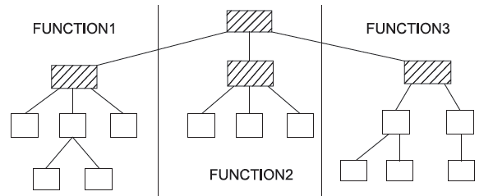
Horizontal Partitioning

Slide 13
Horizontal Partitioning
The simplest approach to horizontal partitioning defines three partitions: Input , Data Transformation (often called processing) , and Output

Slide 14
Horizontal Partitioning
Partitioning benefits:
Software that is easier to test
Software that is easier to maintain
Software that is easier to extend
Propagation of fewer side effects

Slide 15
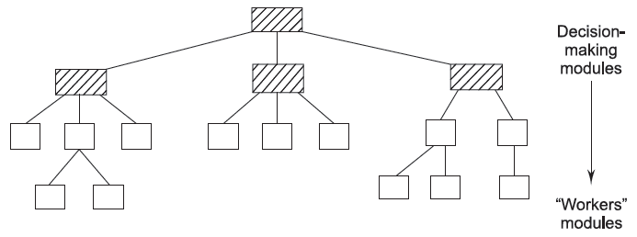
Vertical Partitioning

Slide 16
Vertical Partitioning
Vertical partitioning, often called factoring, suggests that control and work should be distributed from top-down in the program structure

Slide 17
Vertical Partitioning
Top-level modules should perform control functions and do actual processing work
Modules that reside low in the structure should be the workers, performing all input output tasks

Slide 18
Abstraction
An abstraction of a component describes the external behavior of that component without bothering with the internal details that produce the behavior
Abstraction is an indispensable part of the design process and it is essential for problem partitioning

Slide 19
Abstraction
Partitioning essentially is the exercise in determining the components of a system
These components are not isolated from each other, but interact with other component

Slide 20
Abstraction
In order to allow the designer to concentrate on one component at a time, abstraction of other components is used

Slide 21
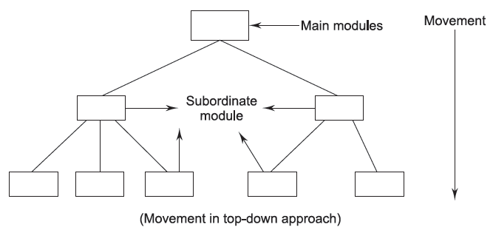
Top-Down Approach

Slide 22
Top-Down Approach
A top-down design approach starts by identifying the major components of the system, decomposing them into their lower-level components and iterating until the desired level of detail is achieved
Top-down design methods often result in some form of stepwise refinement

Slide 23
Top-Down Approach
Starting from an abstract design, in each step the design is refined to a more concrete level, until we reach a level where no more refinement is needed and the design can be implemented directly
Most design methodologies are based on the top-down approach

Slide 24
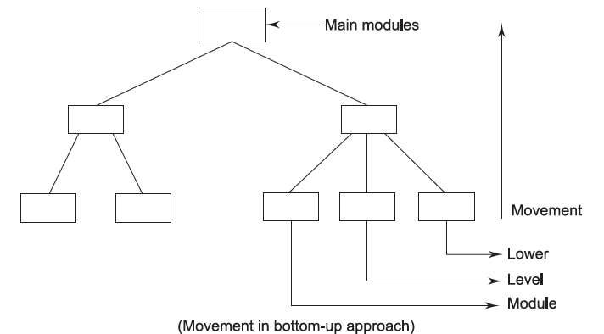
Bottom-Up Approach

Slide 25
Bottom-Up Approach
A bottom-up design approach starts with designing the most basic or primitive components and proceeds to higher-level components that use these lower-level components

Slide 26
Bottom-Up Approach
Bottom-up methods work with layers of abstraction. Starting from the very bottom, operations that provide a layer of abstraction are implemented

Slide 27
Bottom-Up vs. Top-Down
A top-down approach is suitable only if the specifications of the system are clearly known and the system development is from scratch

Slide 28
Bottom-Up vs. Top-Down
However, if a system is to be built from an existing system, a bottom-up approach is more suitable, as it starts from some existing components

Slide 29
ARCHITECTURAL DESIGN
Large systems are always decomposed into subsystems that provide some related set of services
The initial design process of identifying these subsystems and establishing a framework for subsystem control and communication is called architectural design

Slide 30
Architectural Design
The number of levels of a component in the structure is called depth and the number of components across the horizontal section is called width

Slide 31
Architectural Design
The number of components, which controls the component, is called fan-in, i.e., the number of incoming edges to a component
The number of components that are controlled by the module is called fan-out, i.e., the number of outgoing edges

Slide 32
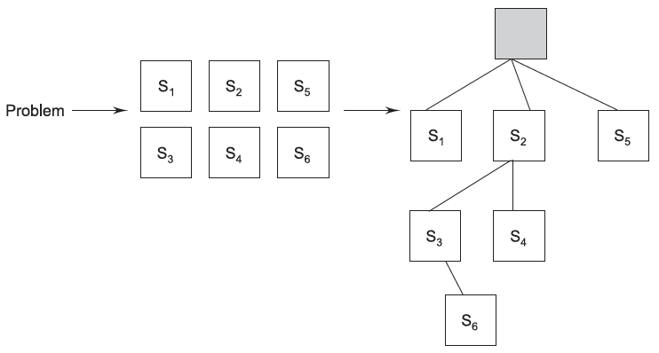
Objectives of
Architectural Design

Slide 33
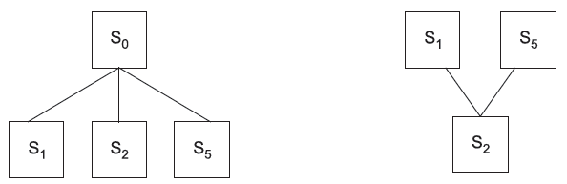
Fan-in and Fan-out

Slide 34
Modularization
System is considered modular if it consists of discrete components so that each component can be implemented separately, and a change to one component has minimal impact on other components

Slide 35
Advantages of
Modular Systems
Modular systems are easier to understand because their parts are functionally independent
Modular systems are easier to document because each part can be documented as an independent unit

Slide 36
Advantages of
Modular Systems
Programming individual modules is easier because the programmer can focus on just one small, simple problem

Slide 37
Advantages of
Modular Systems
Testing and debugging individual modules is easier
Bugs are easier to isolate and understand, and they can be fixed without fear of introducing problems outside the module

Slide 38
Advantages of
Modular Systems
Well-composed modules are more reusable
Also, a good module should be easy to extract from one program and insert into another

Slide 39
COUPLING AND COHESION
The coupling between two modules indicates the degree of interdependence between them
The cohesion of a component is a measure of the closeness of the relationships between its components

Slide 40
Coupling
Highly Coupled: When the modules are highly dependent on each other
Loosely Coupled: When the modules are dependent on each other but the interconnection among them is weak
Uncoupled: When the different modules have no interconnection among them

Slide 41
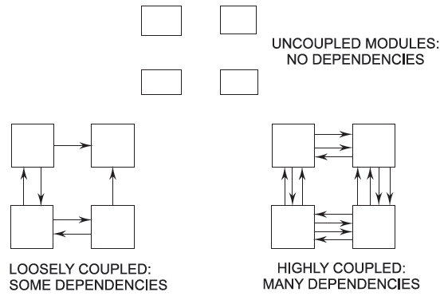
Coupling

Slide 42
Types of Couplings
Different types of couplings include content, common, external, control, stamp, and data
The strength of a coupling from the lowest coupling (best) to the highest coupling (worst) is given in the figure below

Slide 43
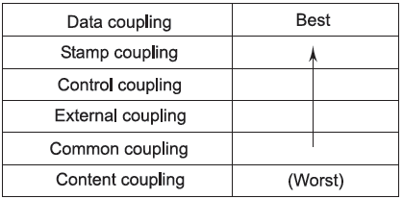
Types of Couplings

Slide 44
Data Coupling
Two modules are data coupled if they communicate using an elementary data item that is passed as a parameter between the two; for example, an integer, a float, etc
This data item should be problem related and not used for a control purpose

Slide 45
Stamp Coupling
Two modules are stamp coupled if they communicate using a composite data item, such as a record, structure, etc.
For example, passing a record in PASCAL or a structure variable in C or an object in C++ language to a module

Slide 46
Control Coupling
Control coupling exists between two modules if data from one module is used to direct the order of instruction execution in another
The sending module must know a great deal about the inner workings of the receiving module

Slide 47
External Coupling
It occurs when modules are tied to an environment external to software
An example of external coupling is a program where one part of the code reads a specific file format that another part of the code wrote
Both pieces need to know the format so when one changes, the other must as well

Slide 48
Common Coupling
Two modules are common coupled if they share some global data items (e.g., Global variables)
Diagnosing problems in structures with considerable common coupling is time-consuming and difficult

Slide 49
Content Coupling
Content coupling exists between two modules if their code is shared; for example, a branch from one module into another module
It is when one module directly refers to the inner workings of another module. Modules are highly interdependent on each other

Slide 50
Coupling
High coupling among modules not only makes a design difficult to understand and maintain, but it also increases development effort as the modules having high coupling cannot be developed independently by different team members

Slide 51
Couplings

Slide 52
Cohesion
A cohesive module performs a single task within a software procedure, requiring little interaction with procedures being performed in other parts of a program

Slide 53
Cohesion
An important design objective is to maximize the module cohesion and minimize the module coupling

Slide 54
Cohesion Strength

Slide 55
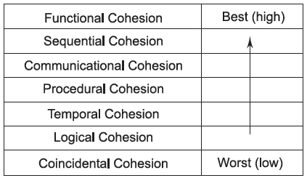
Types of Cohesion

Slide 56
Functional Cohesion
Functional cohesion is said to exist if different elements of a module cooperate to achieve a single function (e.g., managing an employee’s payroll)
When a module displays functional cohesion, we can describe it using a single sentence

Slide 57
Sequential Cohesion
A module is said to possess sequential cohesion if the elements of a module form the parts of a sequence, where the output from one element of the sequence is input to the next

Slide 58
Communicational Cohesion
A module is said to have communicational cohesion if all the functions of the module refer to or update the same data structure; for example, the set of functions defined on an array

Slide 59
Procedural Cohesion
A module is said to possess procedural cohesion if the set of functions of the module are all part of a procedure (algorithm) in which a certain sequence of steps has to be carried out for achieving an objective; for example, the algorithm for decoding a message

Slide 60
Temporal Cohesion
When a module contains functions that are related by the fact that all the functions must be executed in the same time span, the module is said to exhibit temporal cohesion
The set of functions responsible for initialization, start-up, shutdown of some process, etc., exhibit temporal cohesion

Slide 61
Logical Cohesion
A module is said to be logically cohesive if all elements of the module perform similar operations; for example, error handling, data input, data output, etc.
An example of logical cohesion is the case where a set of print functions generating different output reports are arranged into a single module

Slide 62
Coincidental Cohesion
A module is said to have coincidental cohesion if it performs a set of tasks that relate to each other very loosely
In this case, the module contains a random collection of functions

Slide 63
How does one determine the cohesion level of a module ?
There is no mathematical formula that can be used
A useful technique for determining if a module has functional cohesion is to write a sentence that describes, fully and accurately, the function or purpose of the module

Slide 64
How does one determine the cohesion level of a module?
  If the sentence contains a comma, or it has more than one verb, the module is probably performing more than one function, and it probably has sequential or communicational cohesion

Slide 65
How does one determine the cohesion level of a module?
  If the sentence contains words relating to time, like "first," "next," "when," and "after" the module probably has sequential or temporal cohesion

Slide 66
How does one determine the cohesion level of a module?
If the predicate of the sentence does not contain a single specific object following the verb (such as "edit all data") the module probably has logical cohesion

Slide 67
How does one determine the cohesion level of a module?
Words like "initialize" imply temporal cohesion
Modules with functional cohesion can always be described by a simple sentence

Slide 68
Relationship between
Coupling and Cohesion
A software engineer must design the modules with the goal of high cohesion and low coupling
A good example of a system that has high cohesion and low coupling is the ‘plug and play’ feature of a computer system

Slide 69
Structure Charts
The structure chart is one of the most commonly used methods for system design
For a function-oriented design, the design can be represented graphically by structure charts

Slide 70
Structure Charts
Structure charts are used during architectural design
The structure of a program is made up of the modules of that program together with the interconnections between modules

Slide 71
Structure Charts
Procedural information is not represented in a structure chart, and the focus is on representing the hierarchy of modules

Slide 72

Basic Building Blocks of a Structure Chart
A rectangular box represents a module
Usually a rectangular box is annotated with the name of the module it represent

Slide 73
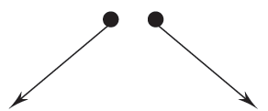
Basic Building Blocks of a Structure Chart
An arrow connecting two modules implies that during program execution, control is passed from one module to the other in the direction of the connecting arrow

Slide 74
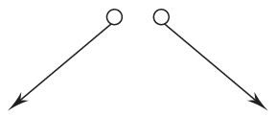
Basic Building Blocks of a Structure Chart
Data-flow arrows represent that the named data passes from one module to the other in the direction of the arrow

Slide 75

Basic Building Blocks of a Structure Chart
Library modules are usually represented by a rectangle with double edges

Slide 76

Basic Building Blocks of a Structure Chart
The diamond symbol represents that one module out of several modules connected with the diamond symbol are invoked depending on the condition satisfied, which is written in the diamond symbol

Slide 77
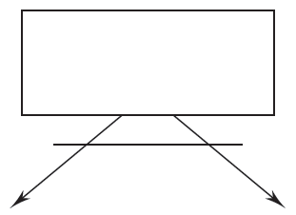
Basic Building Blocks of a Structure Chart
loop around the control-flow arrows denotes that the respective modules are invoked repeatedly

Slide 78
loops and decisions

Slide 79
Different types of modules

Slide 80
Structure Chart Example
A software system called RMS calculating software reads three integral numbers from the user in the range between –1000 and +1000 and determines the root mean square (rms) of the three input numbers and then displays it

Slide 81
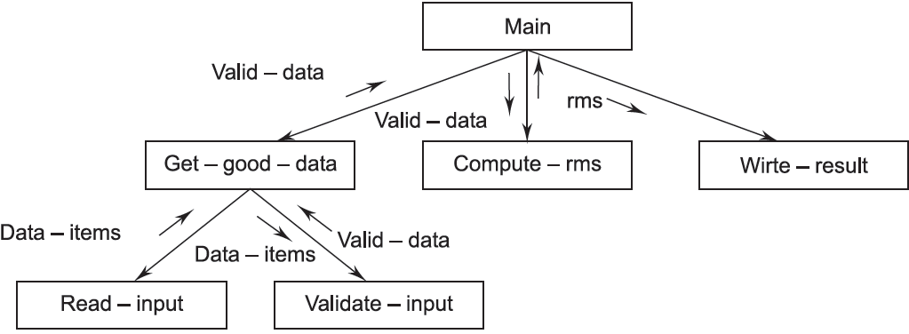
Structure Chart Example

Slide 82
Structure Charts
Structure charts are not sufficient for representing the final design, as it does not give all the information needed about the design
Design is generally supplemented with textual specifications to help the implementer

Slide 83
Structure Charts
For a given set of requirements, programs with different structures can be obtained
The objective of the design phase using function-oriented method is to control the eventual structure of the system

Slide 84
Specification
Structure charts are inadequate when the design is to be communicated
Module specification is the major part of system design specification

Slide 85
Specification
All modules in the system should be identified when the system design is complete, and these modules should be specified in the document

Slide 86
Specification
The design document must specify:
The interface of the module
The abstract behavior of the module
All other modules used by the module being specified

Slide 87
Structured Design Methodology
Structured design methodology (SDM) views every software system as having some inputs that are converted into the desired outputs by the software system
It is primarily function-oriented and relies heavily on functional abstraction and functional decomposition

Slide 88
Structured Design Methodology
The aim is to design a system so that programs implementing the design would have a hierarchical structure, with functionally cohesive modules and as few interconnections between modules as possible

Slide 89
SDM major steps
Restate the problem as a data flow diagram
Identify the input and output data elements
First-level factoring
Factoring of input, output, and transform branches

Slide 90
1. Restate as a Data Flow Diagram
Drawing a DFD for design is a very creative activity in which the designer visualizes the eventual system and its processes and data flows
As the system does not yet exist, the designer has complete freedom in creating a DFD that will solve the problem stated in the SRS

Slide 91
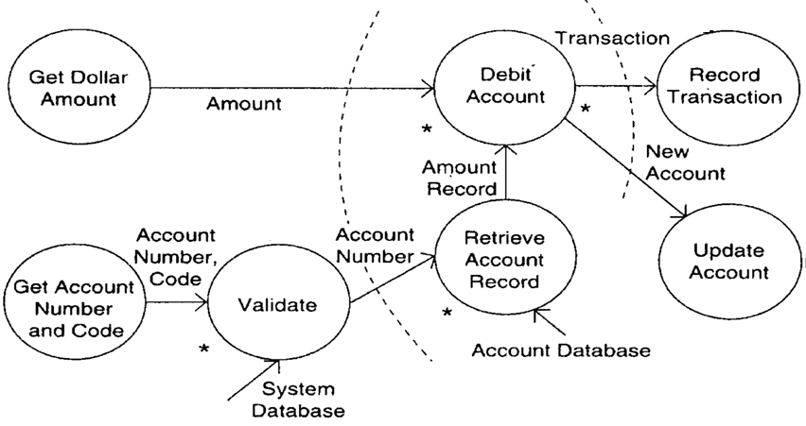
1. Restate as a Data Flow Diagram
A DFD for an ATM Machine

Slide 92
1. Restate as a Data Flow Diagram
Count Different Words in an Input File

Slide 93
2. Most Abstract input and output data elements
MAI are those data elements that are farthest removed from the physical inputs but can still be considered inputs to the system
MAIs obtained after operations like error checking, data validation, proper formatting, and conversion are complete

Slide 94
3. Word counting
First-Level Factoring

Slide 95
ATM First-Level Factoring

Slide 96
A DFD for an ATM Machine
.

Slide 97
4. Factoring the Input, Output, and Transform Branches
The first-level factoring results in a very high-level structure, where each subordinate module has a lot of processing to do
To simplify these modules, they must be factored into subordinate modules that will distribute the work of a module

Slide 98
Factoring the input module

Slide 99
Factoring the central transform

Slide 100
exercise
Using the structured design methodology, design a software system called “RMS software”
It reads three integral numbers from the user in the range between –1000 and +1000 and determines the root mean square (rms) of the three input numbers and then displays it

Slide 101
exercise
Using the structured design methodology, design a software system that receives two numbers X and Y from a keyboard. If X < Y, the system displays the sum of the two numbers. Otherwise, it displays [X-Y]

Slide 102
exercise
The input numbers are received from the keyboard in ASCII format, and the output result must be converted to ASCII format to be displayed correctly

Slide 103
Pseudo-Code
Pseudo-code notation can be used in both the preliminary and detailed design phases
Using pseudo-code, the designer describes system characteristics using short, concise English language phrases that are structured by keywords, such as If-Then-Else, While-Do, and End

Slide 104
Pseudo-Code
Pseudo-code consists of English-like statements describing an algorithm
It is written using simple phrases and avoids cryptic symbols
It is independent of high-level languages and is a very good means of expressing an algorithm
It is written in a structured manner and indentation is used to increase clarity

Slide 105
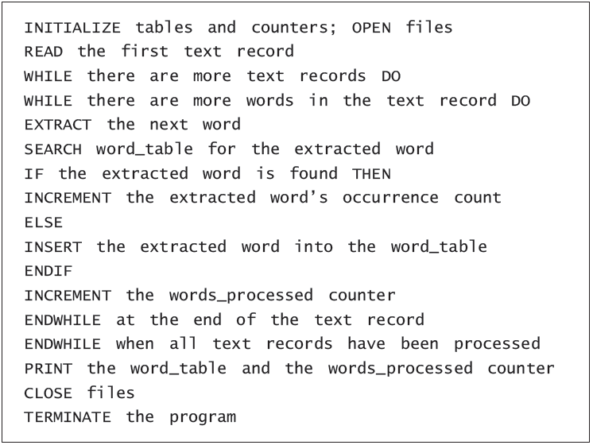
Pseudo-Code
Design Specification Example

Slide 106
Advantages of Pseudo-Code
Converting a pseudo-code to a programming language is much easier compared to converting a flowchart or decision table
Compared to a flowchart, it is easier to modify the pseudo-code of program logic whenever program modifications are necessary

Slide 107
Advantages of Pseudo-Code
Writing of pseudo-code involves much less time and effort than the equivalent flowchart
Pseudo-code is easier to write than writing a program in a programming language because pseudo-code as a method has only a few rules to follow

Slide 108
DisAdvantages of Pseudo-Code
There are no standard rules to follow in using pseudo-code
problems occur due to lack of standardization
For a beginner, it is more difficult to follow the logic or write the pseudo-code as compared to flowcharting

Slide 109
Flowcharts
A flowchart is a convenient technique to represent the flow of control in a program
Flowcharts are the plan to be followed when the program is written
Flowcharts also help during testing and modifications in the programs

Slide 110
Verification for Design
If the design is expressed in some formal notation, then through tools it can be checked for internal consistency (e.g., those modules used by another are defined, the interface of a module is consistent with the way others use it, data usage is consistent with declaration, etc.)

Slide 111
Verification for Design
If the design is not specified in a formal, executable language, it cannot be processed through tools
Other means for verification have to be used. The most common approach for verification is design review or inspections

Slide 112
Verification for Design
The review group must include a member of both the system design team and the detailed design team, the author of the requirements document, the author responsible for maintaining the design document, and an independent software quality engineer

Slide 113
Verification for Design
The most significant design error is omission or misinterpretation of specified requirements
Sometimes, the misinterpretation of specified requirements design error is caused by ambiguities in the requirements

Slide 114
Verification for Design
There are some other quality factors that are not strictly design errors but that have implications on the reliability and maintainability (as weak cohesion and/or strong coupling)

Slide 115
A Sample design Checklist
Is each of the functional requirements taken into account?
Are there analysis to demonstrate that performance requirements can be met?
Are there any constraints on the design beyond those in the requirements?

Slide 116
A Sample design Checklist
Are external specifications of each module completely specified?
Have exceptional conditions been handled?
Are all the data formats consistent with the requirements?

Slide 117
Design Metrics
Size is always a product metric of interest, as size is the single most influential factor deciding the cost of the project

Slide 118
Verification for Design
Another metric of interest is complexity
Reducing the complexity will directly improve the testability and maintainability
Complex modules are often more error-prone

Slide 119
Network complexity Metrics
Network metrics for design focus on the call graph component of the structure chart and define some metrics of how "good" the structure or network is in an effort to quantify the complexity of the call graph

Slide 120
Network complexity Metrics
As coupling of a module increases if it is called by more modules, a good structure is considered one that has exactly one caller
That is, the call graph structure is simplest if it is a pure tree
Graph Impurity =
n (nodes) - e (edges) - 1

Slide 121
Design document project
عمل Design واحد لكل 3 طلاب في موضوع تصميم مشروع الحضانة Infant Incubator.
جميع الطلاب سيسألون في كل جزء مكتوب وفي خطوات تنفيذه
التقيد بالضوابط هو الشرط للحصول على الدرجات
الغلاف يكتب عليه: أسماء الطلاب – اسم مشروع التخرج – عناوين مساهمة كل طالب بوضوح تام
تأكد من تحقق Design Objectives.

Slide 122
Design document project
عمل 2 Review Sessions على الأقل بمجموع زمن 4 ساعات على الأقل.
عمل Checklist خاصة بعملية الــ Review وإرفاقها مع الـ Design، وعمل Structure Shart للمشروع.
يتم تسليم كل ما يتعلق بـ Review بصورة منفصلة، بما في ذلك أسماء من لعبوا الأدوار المختلفة ولماذا تم اختيارهم بالذات وتاريخ ووقت كل جلسة وما اكتشف من أخطاء والوثائق المتعلقة بمخرجاتها.

Slide 123
Design document project
عمل Treacability Matrix تربط بين الـ Requirements وأجزاء الــ Design المتعلقة بها.
أن تحتوي على جميع ما تم دراسته بالفصل السادس.
عمل Modular System بأعلى Cohesion وأقل Coupling.
الاسترشاد بأحسن ما في نماذج الـ Design المرفقة.
إرفاق صورة من هذه الضوابط المذكورة هنا وعمل علامة √ أمام الأجزاء التي تم إنجازها.

Slide 124
Design document project
كل ما لا يمكن دمجه مع SDS يتم تسليمه منفصلا.
كتابة Abstraction لكل Module في التصميم.
عمل Pseudo Code و Flow Chart للمشروع.
لكل Module ناقش الـ Cohesion Level.
قم بتطبيق Structured Design Methodology على المشروع.
كل مجموعة في المشروع عبارة عن 3 طلاب فقط.
آخر موعد لتسليم المشروع 1/ 12/ 2013.

