Slide 1
Chapter 5 – Software Testing & Maintenance (Evolution)

Slide 2
Topics covered
Development testing
Test-driven development
Release testing
User testing
Evolution processes
Program evolution dynamics
Software maintenance
Legacy system management

Slide 3
Program testing
Testing is intended to show that a program does what it is intended to do and to discover program defects before it is put into use.
When you test software, you execute a program using artificial data.
You check the results of the test run for errors, anomalies or information about the program’s non-functional attributes.
Can reveal the presence of errors NOT their
absence.
Testing is part of a more general verification and validation process, which also includes static validation techniques.

Slide 4
Program testing goals
To demonstrate to the developer and the customer that the software meets its requirements.
  For custom software, this means that there should be at least one test for every requirement in the requirements document. For generic software products, it means that there should be tests for all of the system features, plus combinations of these features, that will be incorporated in the product release.
To discover situations in which the behavior of the software is incorrect, undesirable or does not conform to its specification.
  Defect testing is concerned with rooting out undesirable system behavior such as system crashes, unwanted interactions with other systems, incorrect computations and data corruption.

Slide 5
Validation and defect testing
The first goal leads to validation testing
  You expect the system to perform correctly using a given set of test cases that reflect the system’s expected use.
The second goal leads to defect testing
  The test cases are designed to expose defects. The test cases in defect testing can be deliberately obscure and need not reflect how the system is normally used.

Slide 6
Testing process goals
Validation testing
  To demonstrate to the developer and the system customer that the software meets its requirements
  A successful test shows that the system operates as intended.
Defect testing
  To discover faults or defects in the software where its behaviour is incorrect or not in conformance with its specification
  A successful test is a test that makes the system perform incorrectly and so exposes a defect in the system.

Slide 7
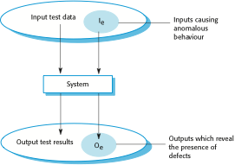
An input-output model of program testing

Slide 8
Verification vs validation
Verification:
"Are we building the product right”.
The software should conform to its specification.
Validation:
"Are we building the right product”.
The software should do what the user really requires.

Slide 9
V & V confidence
Aim of V & V is to establish confidence that the system is ‘fit for purpose’.
Depends on system’s purpose, user expectations and marketing environment
  Software purpose
    The level of confidence depends on how critical the software is to an organisation.
  User expectations
    Users may have low expectations of certain kinds of software.
  Marketing environment
    Getting a product to market early may be more important than finding defects in the program.

Slide 10
Inspections and testing
Software inspectionsConcerned with analysis of
the static system representation to discover problems (static verification)
  May be supplement by tool-based document and code analysis.
  Discussed in Chapter 15.
Software testingConcerned with exercising and
observing product behaviour (dynamic verification)
  The system is executed with test data and its operational behaviour is observed.

Slide 11
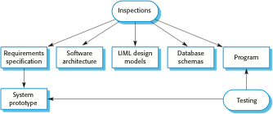
Inspections and testing

Slide 12
Software inspections
These involve people examining the source representation with the aim of discovering anomalies and defects.
Inspections not require execution of a system so may be used before implementation.
They may be applied to any representation of the system (requirements, design,configuration data, test data, etc.).
They have been shown to be an effective technique for discovering program errors.

Slide 13
Advantages of inspections
During testing, errors can mask (hide) other errors. Because inspection is a static process, you don’t have to be concerned with interactions between errors.
Incomplete versions of a system can be inspected without additional costs. If a program is incomplete, then you need to develop specialized test harnesses to test the parts that are available.
As well as searching for program defects, an inspection can also consider broader quality attributes of a program, such as compliance with standards, portability and maintainability.

Slide 14
Inspections and testing
Inspections and testing are complementary and not opposing verification techniques.
Both should be used during the V & V process.
Inspections can check conformance with a specification but not conformance with the customer’s real requirements.
Inspections cannot check non-functional characteristics such as performance, usability, etc.

Slide 15

A model of the software testing process

Slide 16
Stages of testing
Development testing, where the system is tested during development to discover bugs and defects.
Release testing, where a separate testing team test a complete version of the system before it is released to users.
User testing, where users or potential users of a system test the system in their own environment.

Slide 17
Development testing
Development testing includes all testing activities that are carried out by the team developing the system.
  Unit testing, where individual program units or object classes are tested. Unit testing should focus on testing the functionality of objects or methods.
  Component testing, where several individual units are integrated to create composite components. Component testing should focus on testing component interfaces.
  System testing, where some or all of the components in a system are integrated and the system is tested as a whole. System testing should focus on testing component interactions.

Slide 18
Unit testing
Unit testing is the process of testing individual components in isolation.
It is a defect testing process.
Units may be:
  Individual functions or methods within an object
  Object classes with several attributes and methods
  Composite components with defined interfaces used to access their functionality.

Slide 19
Object class testing
Complete test coverage of a class involves
  Testing all operations associated with an object
  Setting and interrogating all object attributes
  Exercising the object in all possible states.
Inheritance makes it more difficult to design object class tests as the information to be tested is not localised.

Slide 20
Automated testing
Whenever possible, unit testing should be automated so that tests are run and checked without manual intervention.
In automated unit testing, you make use of a test automation framework (such as JUnit) to write and run your program tests.
Unit testing frameworks provide generic test classes that you extend to create specific test cases. They can then run all of the tests that you have implemented and report, often through some GUI, on the success of otherwise of the tests.

Slide 21
Automated test components
A setup part, where you initialize the system with the test case, namely the inputs and expected outputs.
A call part, where you call the object or method to be tested.
An assertion part where you compare the result of the call with the expected result. If the assertion evaluates to true, the test has been successful if false, then it has failed.

Slide 22
Testing strategies
Partition testing, where you identify groups of inputs that have common characteristics and should be processed in the same way.
  You should choose tests from within each of these groups.
Guideline-based testing, where you use testing guidelines to choose test cases.
  These guidelines reflect previous experience of the kinds of errors that programmers often make when developing components.

Slide 23
Partition testing
Input data and output results often fall into different classes where all members of a class are related.
Each of these classes is an equivalence partition or domain where the program behaves in an equivalent way for each class member.
Test cases should be chosen from each partition.

Slide 24
Testing guidelines (sequences)
Test software with sequences which have only a single value.
Use sequences of different sizes in different tests.
Derive tests so that the first, middle and last elements of the sequence are accessed.
Test with sequences of zero length.

Slide 25
General testing guidelines
Choose inputs that force the system to generate all error messages
Design inputs that cause input buffers to overflow
Repeat the same input or series of inputs numerous times
Force invalid outputs to be generated
Force computation results to be too large or too small.

Slide 26
Component testing
Software components are often composite components that are made up of several interacting objects.
  For example, in the weather station system, the reconfiguration component includes objects that deal with each aspect of the reconfiguration.
You access the functionality of these objects through the defined component interface.
Testing composite components should therefore focus on showing that the component interface behaves according to its specification.
  You can assume that unit tests on the individual objects within the component have been completed.

Slide 27
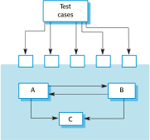
Interface testing

Slide 28
Interface testing
Objectives are to detect faults due to interface errors or invalid assumptions about interfaces.
Interface types
  Parameter interfaces Data passed from one method or procedure to another.
  Shared memory interfaces Block of memory is shared between procedures or functions.
  Procedural interfaces Sub-system encapsulates a set of procedures to be called by other sub-systems.
  Message passing interfaces Sub-systems request services from other sub-systems

Slide 29
Interface errors
Interface misuse
  A calling component calls another component and makes an error in its use of its interface e.g. parameters in the wrong order.
Interface misunderstanding
  A calling component embeds assumptions about the behaviour of the called component which are incorrect.
Timing errors
  The called and the calling component operate at different speeds and out-of-date information is accessed.

Slide 30
Interface testing guidelines
Design tests so that parameters to a called procedure are at the extreme ends of their ranges.
Always test pointer parameters with null pointers.
Design tests which cause the component to fail.
Use stress testing in message passing systems.
In shared memory systems, vary the order in which components are activated.

Slide 31
System testing
System testing during development involves integrating components to create a version of the system and then testing the integrated system.
The focus in system testing is testing the interactions between components.
System testing checks that components are compatible, interact correctly and transfer the right data at the right time across their interfaces.
System testing tests the emergent behaviour of a system.

Slide 32
System and component testing
During system testing, reusable components that have been separately developed and off-the-shelf systems may be integrated with newly developed components. The complete system is then tested.
Components developed by different team members or sub-teams may be integrated at this stage. System testing is a collective rather than an individual process.
  In some companies, system testing may involve a separate testing team with no involvement from designers and programmers.

Slide 33
Use-case testing
The use-cases developed to identify system interactions can be used as a basis for system testing.
Each use case usually involves several system components so testing the use case forces these interactions to occur.
The sequence diagrams associated with the use case documents the components and interactions that are being tested.

Slide 34
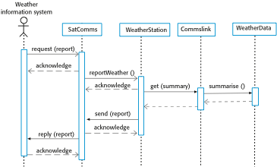
Collectweather data sequence chart

Slide 35
Software Evolution

Slide 36
Software change
Software change is inevitable
  New requirements emerge when the software is used;
  The business environment changes;
  Errors must be repaired;
  New computers and equipment is added to the system;
  The performance or reliability of the system may have to be improved.
A key problem for all organizations is implementing and managing change to their existing software systems.

Slide 37
Importance of evolution
Organisations have huge investments in their software systems - they are critical business assets.
To maintain the value of these assets to the business, they must be changed and updated.
The majority of the software budget in large companies is devoted to changing and evolving existing software rather than developing new software.

Slide 38
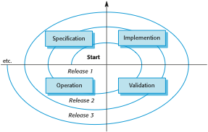
A spiral model of development and evolution

Slide 39

Evolution and servicing

Slide 40
Evolution and servicing
Evolution
  The stage in a software system’s life cycle where it is in operational use and is evolving as new requirements are proposed and implemented in the system.
Servicing
  At this stage, the software remains useful but the only changes made are those required to keep it operational i.e. bug fixes and changes to reflect changes in the software’s environment. No new functionality is added.
Phase-out
  The software may still be used but no further changes are made to it.

Slide 41
Evolution processes
Software evolution processes depend on
  The type of software being maintained;
  The development processes used;
  The skills and experience of the people involved.
Proposals for change are the driver for system evolution.
  Should be linked with components that are affected by the change, thus allowing the cost and impact of the change to be estimated.
Change identification and evolution continues throughout the system lifetime.

Slide 42
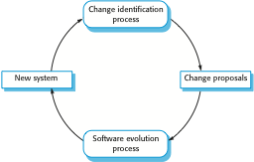
Change identification and evolution processes

Slide 43
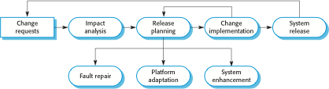
The software evolution process

Slide 44

Change implementation

Slide 45
Change implementation
Iteration of the development process where the revisions to the system are designed, implemented and tested.
A critical difference is that the first stage of change implementation may involve program understanding, especially if the original system developers are not responsible for the change implementation.
During the program understanding phase, you have to understand how the program is structured, how it delivers functionality and how the proposed change might affect the program.

Slide 46
Software maintenance
Modifying a program after it has been put into use.
The term is mostly used for changing custom software. Generic software products are said to evolve to create new versions.
Maintenance does not normally involve major changes to the system’s architecture.
Changes are implemented by modifying existing components and adding new components to the system.

Slide 47
Types of maintenance
Maintenance to repair software faults
  Changing a system to correct deficiencies in the way meets its requirements.
Maintenance to adapt software to a different operating environment
  Changing a system so that it operates in a different environment (computer, OS, etc.) from its initial implementation.
Maintenance to add to or modify the system’s functionality
  Modifying the system to satisfy new requirements.

Slide 48
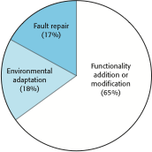
Maintenance effort distribution

Slide 49
Maintenance costs
Usually greater than development costs (2* to
100* depending on the application).
Affected by both technical and non-technical
factors.
Increases as software is maintained.
Maintenance corrupts the software structure so
makes further maintenance more difficult.
Ageing software can have high support costs
(e.g. old languages, compilers etc.).

Slide 50
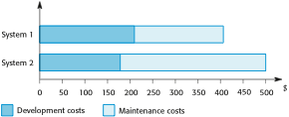
Development and maintenance costs

