Slide 1

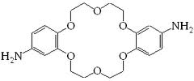
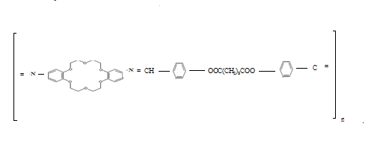
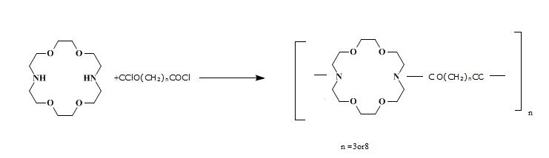
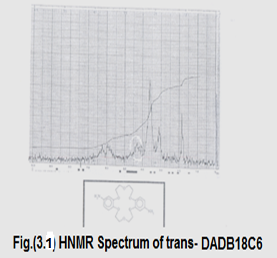
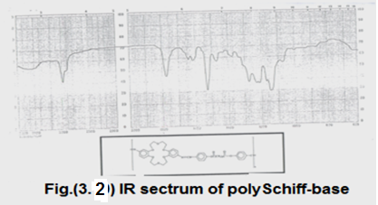
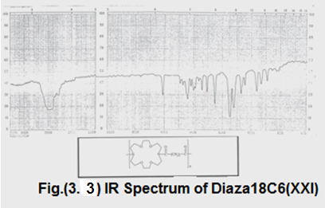
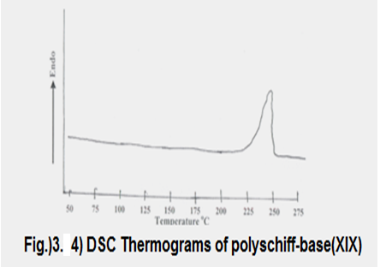
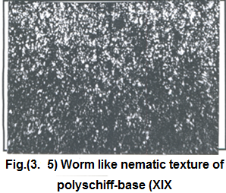
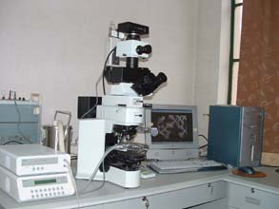
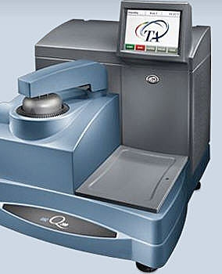
Preparation of some models and polyschiff-bases of dibenzo-18-crown-6 and, two polyamides of diaza-18-crown-6 and studying their liquid crystalline properties
By Nawal mahgoub suleman
Assistant professor at chemistry department
Zilfi Faculty of Education
Sudan Journal of Basic Science (under publishing)
LOGO
Abstract
Results
This study had been aimed for preparation of six models, one polyaschiffbase of dibenzo-18-crown-6, and two polyamides of diaza-18-crown-6, and studding their liquid crystalline properties..The prepared compounds have been characterized using (IR) spectra ,and (CHN) mass spectra. The cis and trans diaminodibenzo-18-crown-6 have been analyzed using the proton magnetic resonance spectra (H¹NMR ) .These results have been in agreement with the expected structure of these products. The inherent viscosity of these polymers was measured, and was found to have intermediate molecular weight .The liquid crystalline properties of these polymers was also studied using deferential scanning Calorimeter (DSC), and hot-stage microscope. . All polymers are of moderate molecular weight, except the polyschiff-base which has small molecular weight
3.1Poly Schiff-bases and model compounds of diaminodibenzo-18-crown-6
The structure of the two isomDAD18C6 were verified by IR and ¹HNMR(fig 3.1) spectroscopy in addition to the( CHN) data .The IR spectrum of polyschiff-base(fig 3.2)shows three characteristic bands at 1140 cm⁻¹ (-COO- stretching) ,and 1640 cm⁻¹ ( C=N stretching). The disappearance of the absorption bands of the NH₂ group indicates the complete conversion of this group to azomethane(-CH=N) group. The values of CHN percentage are correct compared with the calculated values (table 3.1). The inherent viscosity of this polymer was found to be 0.2 dl\g.
3.2 Polyamides of diaza-18-crown-6
The IR spectra of these compounds showed two characteristic bands ,the first at 1610 cm⁻¹( tertiary amide C=O stretching ) ,and the other at 2790 cm⁻¹ (N-CH₂ (C-H stretching ),see fig (3.3 ).
3.3 Thermotropic Liquid Crystalline Properties of the polymers
Pollyschiff-base Dsc thermogram (Fig 3. 4) shows a broad beak at 238-247 ºC .Microscopic observation of the thin film at melting temperature showed a nematic mesophase with a typical worm texture which is normally accompanying the texture occurs by main –chain liquid crystalline polymers
(table 3.1)
Introduction
yield % | Found |  |  | Calculated
 | N% | H% | C% | N% | H% | C%
20.0 | 3.47 | 6.32 | 68.99 | 3.66 | 6.33 | 69.10
Crown ethers are very important compounds in the extraction of alkali, alkaline earth, and transition metal ions that by formation of complexes with these ions .Crown ether polymers may have more ability of extraction compared with their monomers .In addition these polymers may be less poison, expensive, and can be used as catalysts. Feigenbaum and Michel ¹ prepared 4,4'-diaminodibenzo-18-crown-6 .Polyamides were prepared using cis-4,4'-diaminodibenzo-18-crown-6^{2, 3 .}The mobility of Na⁺ and Rb⁺ in poly(dibenzo-18-crown-6)has been studied⁴. main chain liquid-crystalline polymers containing dibenzo-18-crown-6 was reported by Percec and Rodenhouse ⁵. The EDTA dianhydride was used in the reaction with diazacrown ⁶. Bearing in mind the practical importance of these compounds ,it was decided to synthesize new models of polyschifsbases and polyamides containg crown ethers .
CHART or
PICTURE
CHART or
PICTURE
CHART or
PICTURE
Methods and Materials
2. 1 Synthesis of dinitrodibenzo-18-crown-6 (DNDB18C6)
In 500 ml two-neck round flask equipped with reflux condenser ,and dropping funnel ;6.41g(17mmole) dibenzo-18-crown-6(DB18C6) ,and 130ml chloroform were reacted .
2.2 Synthesis of the acid chloride
2.3 Synthesis of 4-n-alkoxybenzaldehyde
A mixture of 2.2 g(18 mmole) of 4-hydroxybenzaldehyde ,and 5.5g (40mmole) of anhydrous K₂CO₃,were dissolved in 8 ml cyclohexane . (16 mmole)of appropriate n-alkyl bromide was added,(n =2,4,5 or6) and the mixture was refluxed with vigorous stirring for overnight then followed by distillation under vacuum.
2. 4 Synthesis of Schiff-bases of diaminodibenzo-18-crown-6
A reaction mixture of diaminodibenzo-18-crown-6 0.59g (1.5 mmole) in absolute ethanol, 3 mmole of the appropriate 4-alkoxybenzaldehyde, and 3 drops of glacial acetic acid was refluxed for 3 hours
Figure_1.astrucure of trans-DADB18C6
Figure_1.bstrucure of poly schif-base
Figure_1cstrucuree of polydiaza18C6
CHART or
PICTURE
CHART or
PICTURE
Conclusions
1. Solution polymerization is a good method for the synthesis of these polymers.
2. All polymers are of moderate molecular weight, except the polyschiff-base which has small molecular weight.
3. The models of Schiff-base show a semectic mesophase, while the poly Schiff-base gives a nematic one.
4. The polyamide of diaza18C6 with glutryl chloride unit show a nematic mesophase, while that derived from sebacoyl chloride did not show any liquid crystalline properties
Hot –stage microscope
Deferential scanning calorimeter
2.6 Synthesis of polyschiff-bases of diaminodibenzo-18-crown-6
Trans-diaminodibenzo-18-crown-6 0.2g (0.5 mmole) was dissolved in 5 ml absolute ethanol, and 3 drops of glacial acetic acid was added .A solution of di(p-formyl phenyl) α, ω-octane dicarboxylate o.21 g (0.5 mmole) in 5 ml ethanol was added. The reaction mixture was refluxed for 4 hours
2. 7 Synthesis of polyamides of diaza –18-crown-6
Diaza-18-crown-6 0.5 g (1.91mmole) was dissolved in 5 ml of pyridine .The appropriate diacid chloride (1.91 mmole) was added dropwise under dry nitrogen atmosphere .The reaction mixture was left stirring overnight under nitrogen
The prepared compounds have been characterized using (IR) spectra ,and (CHN) mass spectra. The cis and trans diaminodibenzo-18-crown-6 have been analyzed using the proton magnetic resonance spectra (H¹NMR ) .
The liquid crystalline properties of these polymers was also studied using deferential scanning Calorimeter (DSC), and hot-stage microscope
References
1 . Feigenbaum W.H. and Michel R.H. J. Polymer Sci., A₁, 9,817(1971).
2. Shchori E. and Jagur-Grodzinski J., J.App.Polymer Sci.20, 1665, (1976)
3. Beer P.D, Crane C.G., and Drew.M.G.J.Chem.Soc. Dalton Trans., 3235(1991).
4. Pecec, V.and Rodenhouse, R.Macromolcules, 22, 2043, (1989).
5. Jian Z. L., Chun H. H., and Sheng Y. Q., Chinese Chem. Letters 16, No. 1, 27-30, (2005) .
6. Gray, G.W., J.Chem.Soc. 1467(1954)

