Slide 1
Clinical Anatomy of Genitourinary system-I
Lecture 16

Slide 2
Learning Objectives
At the end of this session, the student should be able to:
  1. Define cystoscopy and suprapubic aspiration.
  2. Describe bimanual pelvic examination of bladder.
  3. Describe the anatomy of emergency Cesar.
  4. Discuss sonography of female pelvis.

Slide 3
Suggested Ref:
  Snell RS. Clinical Anatomy by Regions. 9th edition, P 240-330. 2012, Lippincott Williams & Wilkins.
  Faiz O and Moffat D. Anatomy at a glance. P 54-61 2006, Blackwell Science, USA.
  Ellis H. A clinical Anatomy; A revision and Applied Anatomy for Clinical Students. 11 edition, P 81-92, Blackwell Science, USA

Slide 4
Cystoscopy
The mucous membrane of the bladder, two ureteric orifices, and the urethral meatus can easily be observed by means of a cystoscope.
With the bladder distended with fluid, an illuminated tube fitted with lenses is introduced into the bladder through the urethra.
Over the trigone, the mucous membrane is pink and smooth. If the bladder is partially emptied, the mucous membrane over the trigone remains smooth, but it is thrown into folds elsewhere. The ureteric orifices are slitlike and eject a drop of urine at intervals of about 1 minute. The interureteric ridge and the uvula vesicae can easily be recognized.

Slide 5
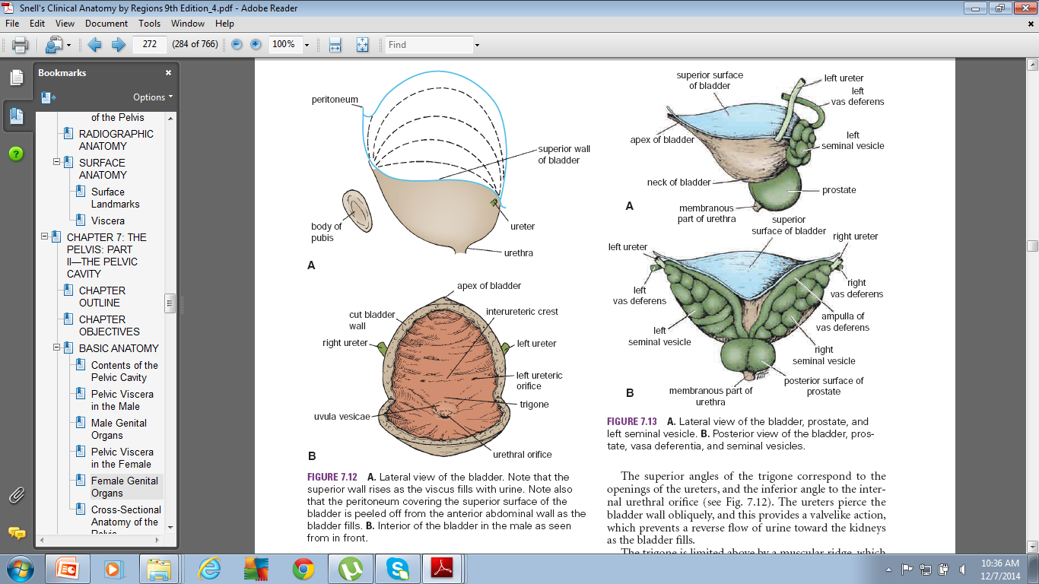

Slide 6
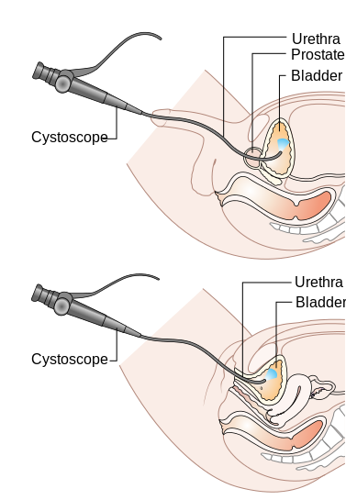

Slide 7
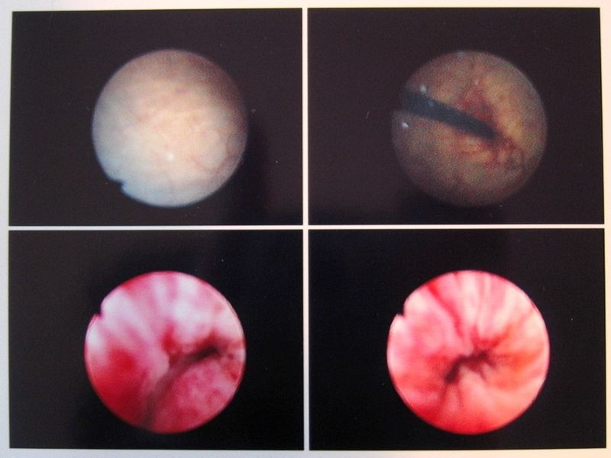

Slide 9
The interior of the bladder is easily inspected by means of a cystoscope.
The ureteric orifices lie 1 in apart in the empty bladder, but when this is distended for cystoscopic examination, the distance increases to 2 in.
Most of submucosa and mucosa are only loosely adherent to the underlying muscle and are thrown into folds when the bladder is empty, smoothing out during distension of the organ.
Over the trigone, mucosa is adherent and remains smooth even in the empty bladder.
Between the ureters, a raised fold of mucosa can be seen called the interureteric ridge which is produced by an underlying bar of muscle.

Slide 10
Suprapubic Aspiration
As the bladder fills, the superior wall rises out of the pelvis and peels the peritoneum off the posterior surface of the anterior abdominal wall.
In cases of acute retention of urine, when catheterization has failed, it is possible to pass a needle into the bladder through the anterior abdominal wall above the symphysis pubis, without entering the peritoneal cavity. This is a simple method of draining off the urine in an emergency.

Slide 11
Palpation of the Urinary Bladder
The full bladder in the adult projects up into the abdomen and may be palpated through the anterior abdominal wall above the symphysis pubis.
Bimanual palpation of the empty bladder with or without a general anesthetic is an important method of examining the bladder.

Slide 12
Bimanual palpation of the empty bladder
Male: One hand is placed on the anterior abdominal wall above the symphysis pubis, and the gloved index finger of other hand is inserted into the rectum. Bladder wall can be palpated between the examining fingers.
Female: An abdomino-vaginal examination can be similarly made.
Child: The bladder is in a higher position than in the adult because of the relatively smaller size of the pelvis.

Slide 13
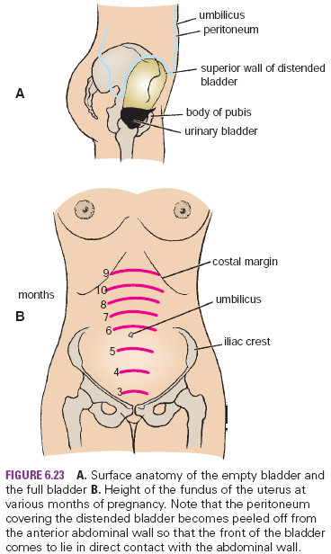

Slide 14
Anatomy of emergency cesarian section
1. The bladder is emptied, and an indwelling catheter is left in position. This allows the empty bladder to sink down away from the operating field.
2. A midline skin incision is made that extends from just below the umbilicus to just above the symphysis pubis. The following structures are incised:
  superficial fascia, fatty layer, and the membranous layer;
  deep fascia (thin layer)
  linea alba
  fascia transversalis
  extraperitoneal fatty layer
  and parietal peritoneum

Slide 15
3. The bladder is identified, and a cut is made in the floor of the uterovesical pouch. The bladder is then separated from the lower part of the body of the uterus and depressed downward into the pelvis.
4. The uterus is palpated to identify the presenting part of the fetus.
5. A transverse incision about 1 in. long is made into the exposed lower segment of the body of the uterus. Care is taken that the uterine wall is not immediately penetrated and the fetus injured.

Slide 16
6. As the uterine cavity entered, the amniotic cavity is opened. The uterine incision is then enlarged sufficiently to deliver the head and trunk of the fetus. Great care has to be taken to avoid the large uterine arteries that course along the lateral margin of the uterus.
7. Once the fetus is delivered, the umbilical cord is clamped and divided.
8. The contracting uterus will cause the placenta to bulge through the uterine incision. The placenta and fetal membranes are then delivered.

Slide 17
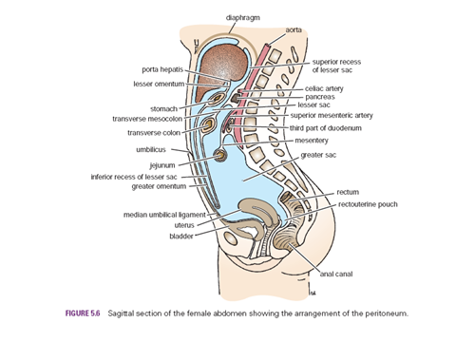

Slide 18
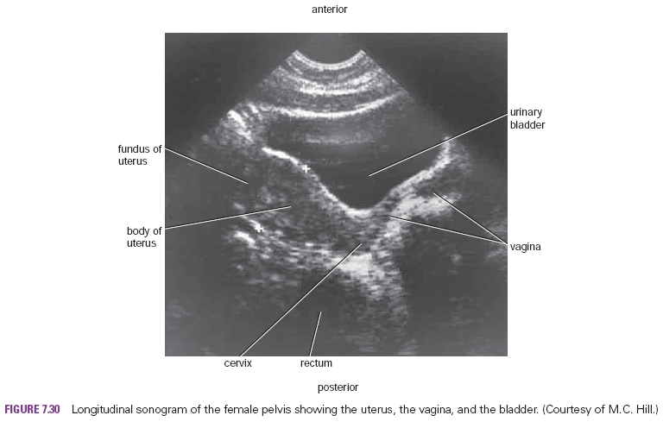

Slide 19
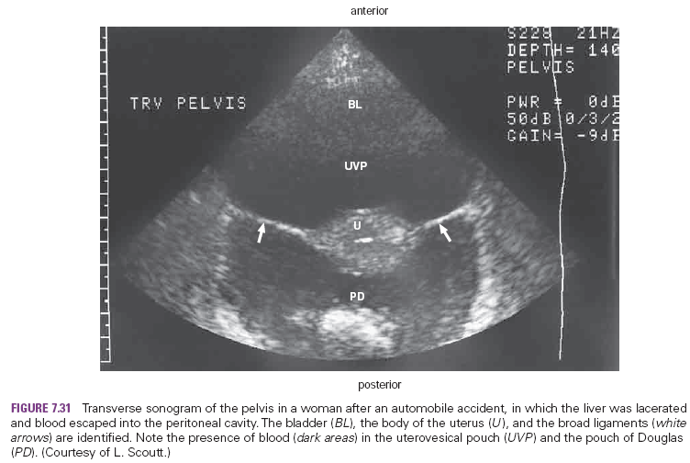

Slide 20
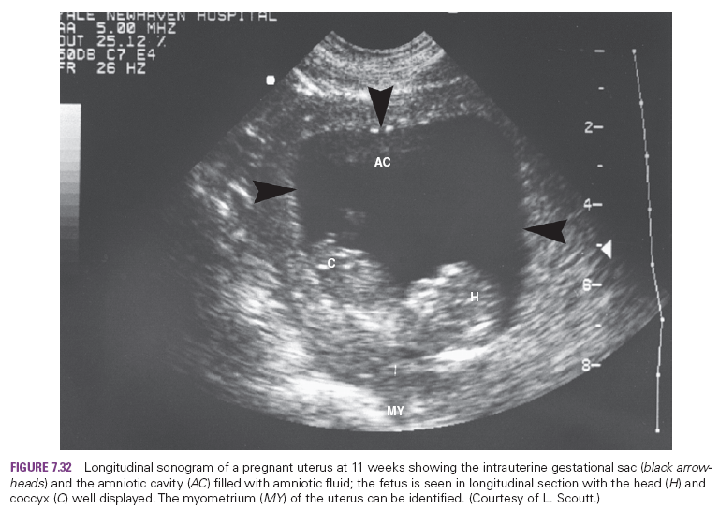

Slide 21
