Slide 1
Advantages of E.R. Model
Exceptional conceptual simplicity
Visual representation
Effective communication tool
Integrated with the relational data model
Disadvantages of E.R. Model
Limited constraint representation
Limited relationship representation
No data manipulation language
Loss of information content

Slide 2
عناصر ال ERD
1) Entity Set
وهو الكائن مثل مفهومه في ال OOP
ويتم وضعها في التصميم على شكل مستطيل
Examples: a computer, an employee, a song, a mathematical theorem. Entities are represented as rectangles.
2) attribute
وهو خواص ال كائن
وياخذ الشكل البيضاوى
3) Primary key
يتم وضع خط تحت ال attribute المستخدم ك مفتاح أساسى
4) Relationship
العلاقات ، وهى تحدد كيفية اتصال 2 entities
مع بعضهم ، وهى تأخذ شكل الماسي diamond

Slide 3
و في اغلب الاحيان يكون اسم الكيان اسماً مفردا
امثلة على الكيان : مريض ، دواء ، يعالج بـ .
العلاقة الرابطة“Relationships“: هي العلاقة التي تربط بين الكيانات و تمثل رابطة العالم المصغر الذي تمثله قاعدة البيانات.
تعبر العلاقات الرابطة عن الروابط بين البيانات في الواقع و تمثل في اغلب الاحوال بفعل مضارع او فعلاً مبني للمجهول

Slide 4
امثلة على العلاقات الرابطة
  الكيان طالب و الكيان مدرس و مقرر دراسي يوجد بينهم عدة علاقات رابطه منها
    الطالب يدرس مقرر درسي
    المدرس يُدرس المقرر الدراسي.
    المدرس يُدرس الطالب المقرر الدراسي .
    المدرس يرشد الطالب الى المقرر المناسب.
الطالب يُرشد بواسطة المدرس

Slide 5
انواع الروابط بين عناصر البيانات
  رابطة واحدة One Association : رابطة بين عنصرين تعني آن كل عنصر بيانات من خاصية ما يقابلها عنصر بيانات واحد من العنصر الثاني (كل رقم طالب يقابله اسم طالب واحد )
  رابطة متعددة Many Association : رابطة بين عنصرين تعني ان كل عنصر بيانات من خاصية ما يقابلها عناصر بيانات متعددة من العنصر الثاني (كل رقم طالب يقابله اكثر من مقرر مادة )
  رابطة كاردينالتي (Cardinal Association)
  نوع الرابطة هنا يتداخل مع الرابطة الواحدة و الرابطة المتعددة
    مع الرابطة الواحدة تحدد نسبة 0:1 اي من صفر الى واحد مثل الرابط بين رقم السرير و رقم المريض
        مع الرابطة المتعددة تحدد نسبة 0:N اي من صفر الى واحد مثل الرابط بين رقم السرير و رقم المريض
        طبعا ممكن ان تكون النسبة 1 بدل صفر في جميع الامثلة اعلاه
رقم الطالب
1
اسم الطالب
1:1
رقم الطالب
1
المقرر
1:N
رقم الغرفة
0
رقم المريض
رقم السرير
0
رقم المريض
0:N
0:1

Slide 6
What is the relationships?
Relationships can be thought of as verbs, linking two or more nouns. Examples: an owns relationship between a company and a computer, a supervises relationship between an employee and a department, a performs relationship between an artist and a song, a proved relationship between a mathematician and a theorem. Relationships are represented as diamonds, connected by lines to each of the entities in the relationship

Slide 7
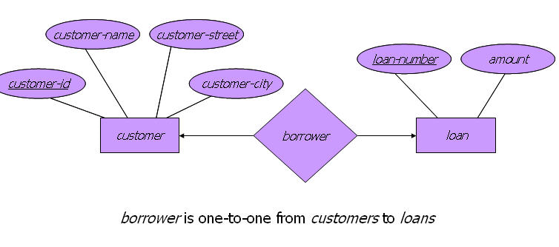
ER diagram ForSchool

Slide 8
Explanation of the previous example
we have 5 entities
teacher
student
subject
group
Mark
كل منهما له attributes
وما تحته خط هو المفتاح الأساسي
ولدينا 3 علاقات
منهما
علاقة ثنائية " ما بين 2 entities "
belong
وعلاقتين ثلاثية " ما بين 3 entities
give
supervises

Slide 9
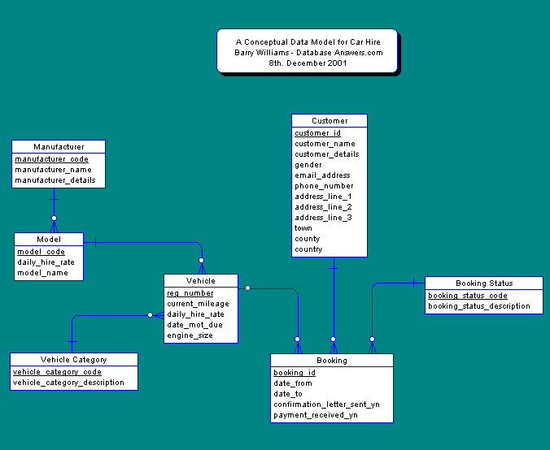
Car rent

Slide 10
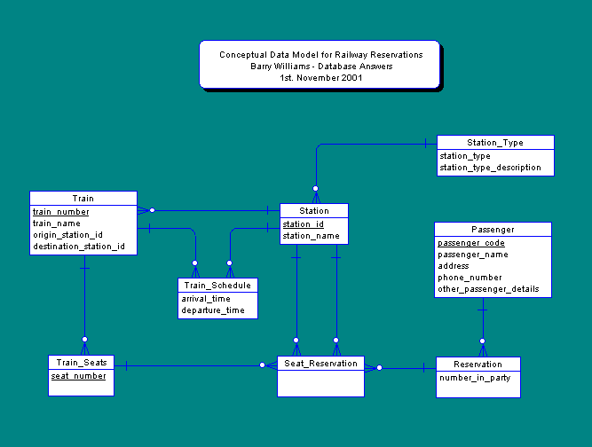
Train teckets

Slide 11
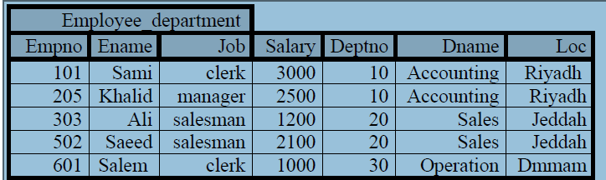
Data anomalies problem
مشكلة تكرار البيانات
Adding problems : we cant add new department unless it as employee because the primary key is Empno
Updating and deleting problem : to update the Loc field from jeddah to riadh for one employee will corapt the other employee locations

Slide 12
To solve those problems
Function dependency FD -→
A-→ B
Means B is depending Functionally on A
I.e A value define B value
Example:
For each empl. Only unique name
For each empl. Only unique dept

Slide 13
FD1: Empno →Ename
FD2: Empno →Deptno
We can write it as:
FD1: Empno →Ename,Deptno
FD :Functional Dependency

Slide 14
Basic Structure
Formally, given sets D₁, D₂, …. D_{n} a relation r is a subset of
D₁ x D₂ x … x D_{n}
Thus a relation is a set of n-tuples (a₁, a₂, …, a_{n}) where
each a_{i} ∈ D_{i}
Example: if
customer-name = {Jones, Smith, Curry, Lindsay}
customer-street = {Main, North, Park}
customer-city = {Harrison, Rye, Pittsfield}
Then r ⊆ customer-name x customer-street x customer-city
r = { (Jones, Main, Harrison),
(Smith, North, Rye),
(Curry, North, Rye),
(Lindsay, Park, Pittsfield)}
is a relation over customer-name x customer-street x customer-city

Slide 15
Attribute Types
Each attribute of a relation has a name
The set of allowed values for each attribute is called the domain of the attribute
Attribute values are (normally) required to be atomic, that is, indivisible
  E.g. multivalued attribute values are not atomic
  E.g. composite attribute values are not atomic
The special value null is a member of every domain
The null value causes complications in the definition of many operations
  we shall ignore the effect of null values in our main presentation and consider their effect later

Slide 16
Relation Schema
A₁, A₂, …, A_{n} are attributes
R = (A₁, A₂, …, A_{n} ) is a relation schema
E.g. Customer-schema =
(customer-name, customer-street, customer-city)
r(R) is a relation on the relation schema R
E.g. customer (Customer-schema)

Slide 17
Relation Instance
The current values (relation instance) of a relation are specified by a table
An element t of r is a tuple, represented by a row in a table
attributes
(or columns)
customer-name
customer-street
customer-city
Jones
Smith
Curry
Lindsay
Main
North
North
Park
Harrison
Rye
Rye
Pittsfield
tuples
(or rows)
customer

Slide 18
Determining Keys from E-R Sets
Strong entity set. The primary key of the entity set becomes the primary key of the relation.
Weak entity set. The primary key of the relation consists of the union of the primary key of the strong entity set and the discriminator of the weak entity set.
Relationship set. The union of the primary keys of the related entity sets becomes a super key of the relation.
  For binary many-to-one relationship sets, the primary key of the “many” entity set becomes the relation’s primary key.
  For one-to-one relationship sets, the relation’s primary key can be that of either entity set.
  For many-to-many relationship sets, the union of the primary keys becomes the relation’s primary key

Slide 19
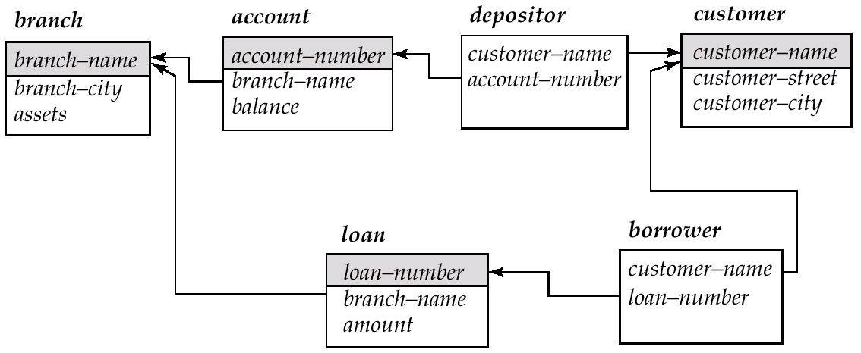
Schema Diagram for the Banking Enterprise

Slide 20
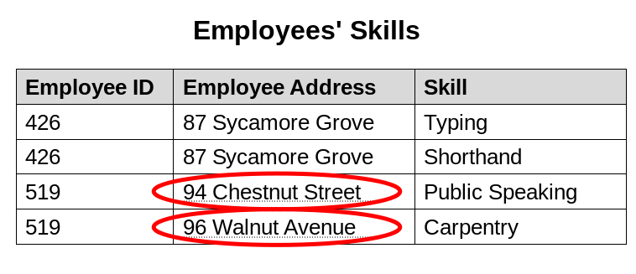
Normalization
An update anomaly
An update anomaly. Employee 519 is shown as having different addresses on different records.

Slide 21
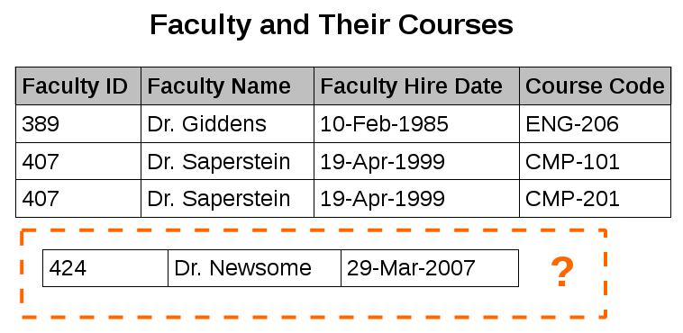
insertion anomaly
An insertion anomaly. Until the new faculty member, Dr. Newsome, is assigned to teach at least one course, his details cannot be recorded.

Slide 22
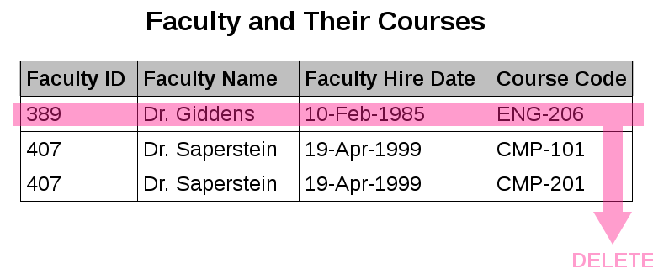
A deletion anomaly
A deletion anomaly. All information about Dr. Giddens is lost when he temporarily ceases to be assigned to any courses.

Slide 25
Query Languages
Language in which user requests information from the database.
Categories of languages
  procedural
  non-procedural
“Pure” languages:
  Relational Algebra
  Tuple Relational Calculus
  Domain Relational Calculus
Pure languages form underlying basis of query languages that people use.

Slide 26
Relational Algebra
Procedural language
Six basic operators
  select
  project
  union
  set difference
  Cartesian product
  rename
The operators take two or more relations as inputs and give a new relation as a result.

Slide 27
Select Operation – Example
Relation r
A
B
C
D








1
5
12
23
7
7
3
10
_{A=B ^ D > 5} (r)
A
B
C
D




1
23
7
10

Slide 28
Select Operation
Notation: σ _{p}(r)
p is called the selection predicate الاختيار المبنى عليه
Defined as:
σ_{p}(r) = {t | t ∈ r and p(t)}
Where p is a formula in propositional calculus consisting of terms connected by : ∧ (and), ∨ (or), ¬ (not)
Each term is one of:
<attribute> op <attribute> or <constant>
where op is one of: =, ≠, >, ≥. <. ≤
Example of selection:
σ_{p}(r) تمثل σ _{branch-name=“Perryridge”}(account)

Slide 29
Relational Model algebra
Structure of Relational Databases
Relational Algebra
Tuple Relational Calculus العلاقات المضاعفة الحسابية
Domain Relational Calculus
Extended Relational-Algebra-Operations
Modification of the Database
Views

Slide 30
Projection Operation
Given a relation R, the projection operation is used to create a new relation S, such that each tuple t_{s} is formed by taking a tuple t_{R} and removing one or more columns.
Formally, the projection of R over columns A₁, A₂, …,A_{n} is defined as:

Slide 31
Project Operation – Example
Relation r:
A
B
C




10
20
30
40
1
1
1
2
∏_{A,C} (r)
A
C
A
C




1
1
1
2



1
1
2
=

Slide 32
Project Operation
Notation: لاحظ ان
∏_{A1, A2, …, Ak} (r)
where A₁, A₂ are attribute names and r is a relation name.
The result is defined as the relation of k columns obtained by erasing the columns that are not listed
Duplicate rows removed from result, since relations are sets
E.g. To eliminate the branch-name attribute of account
∏_{account-number, balance} (account)

Slide 33
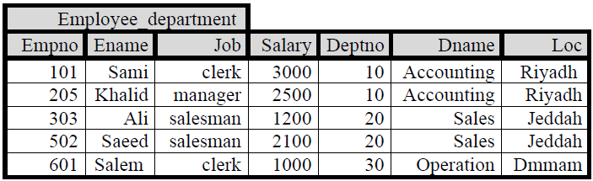
Data anomalies
What is the problem of this DB table?
1- adding, deleting and updating problems
Adding prob: We cant add new dept without Empno because the prim key is Empno
2-redandance in data of Dname and Loc, so if we changed Lc from jeddah to riyadh for one Emp, will must change for all Emp

Slide 34
FD rules
|= تعنى انه إذا تحقق ما قبلها فإنه يمكن استنتاج الجانب الآخر
1- reflection rule قاعدة الانعكاس
If Y is a part of X ➔
Then X→Y ( Y تحدد قيمة X)
2- Augmentation rule قاعدة الإضافة
{X→Y} |= XZ→YZ

Slide 35
3- Transitive قاعدة التعدي
{ X→Y , Y →Z} |= X→Z
اذا كانت X تحدد Y و كانت Y تحدد Z فإن X تحدد Z
4- Union الاتحاد
{ X→Y , X →Z} |= X→YZ
اذا كانت X تحدد Y و كانت X تحدد Z فإن X تحدد ZY

Slide 36
Union Operation – Example
A
B
A
B
Relations r, s:



1
2
1


2
3
s
r
A
B
r U s:




1
2
1
3

Slide 37
Union Operation
Notation: r ∪ s
Defined as:
r ∪ s = {t | t ∈ r or t ∈ s}
For r ∪ s to be valid.
1. r, s must have the same arity (same number of attributes)
2. The attribute domains must be compatible (e.g., 2nd column
of r deals with the same type of values as does the 2nd
column of s)
E.g. to find all customers with either an account or a loan
∏_{customer-name} (depositor) ∪ ∏_{customer-name} (borrower)

Slide 38
Set Difference Operation – Example
Relations r, s:
A
B
A
B



1
2
1


2
3
s
r
r – s:
A
B


1
1

Slide 39
Set Difference Operation
Notation r – s
Defined as:
r – s = {t | t ∈ r and t ∉ s}
Set differences must be taken between compatible relations.
  r and s must have the same arity
  attribute domains of r and s must be compatible

Slide 40
Cartesian-Product Operation-Example
A
B
C
D
E
Relations r, s:


1
2




10
10
20
10
a
a
b
b
r
s
A
B
C
D
E
r x s:








1
1
1
1
2
2
2
2








10
10
20
10
10
10
20
10
a
a
b
b
a
a
b
b

Slide 41
Cartesian-Product Operation
Notation r x s
Defined as:
r x s = {t q | t ∈ r and q ∈ s}
Assume that attributes of r(R) and s(S) are disjoint. (That is,
R ∩ S = ∅).
If attributes of r(R) and s(S) are not disjoint, then renaming must be used.
A tuple is r x s is made by concatenating the columns from the first tuple, with the those of the second tuple.

Slide 42
Composition of Operations
Can build expressions using multiple operations
Example: σ_{A=C}(r x s)
r x s
σ_{A=C}(r x s)
A
B
C
D
E








1
1
1
1
2
2
2
2








10
10
20
10
10
10
20
10
a
a
b
b
a
a
b
b
A
B
C
D
E



1
2
2



10
20
20
a
a
b

Slide 43
Rename Operation
Allows us to name, and therefore to refer to, the results of relational-algebra expressions.
Allows us to refer to a relation by more than one name.
Example:
ρ _{x} (E)
returns the expression E under the name X
If a relational-algebra expression E has arity n, then
ρ_{x} _{(A1, A2, …, An)} (E)
returns the result of expression E under the name X, and with the
attributes renamed to A1, A2, …., An.

Slide 44
5- Decomposition التقسيم
Is the opposite of Union
{X→YZ } |= X→Y
6- pseudo transitive التعدي الزائف
{X→Y, WY→Z} |= WX→Y

Slide 45
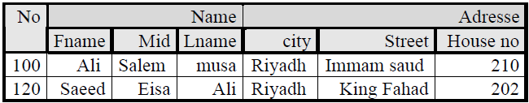
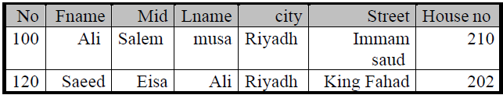
Example
The PK related to a complex table which is not allowed, so me must simplify the table

Slide 46
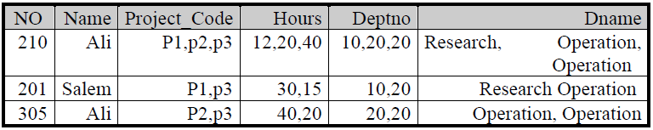
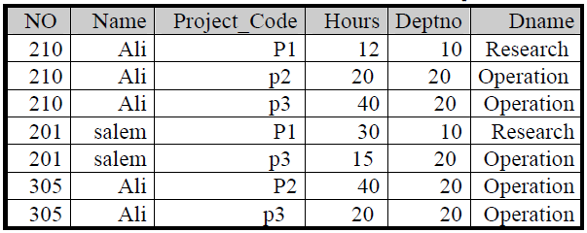
Example
Every field contain more than one vaue, so we must simplify them.
But we have another problem, the redundancy of PK with different instancesin deptno, project_code, Dname,…

Slide 47
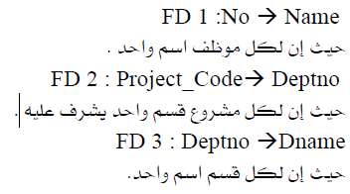
So we must use relation algebra to distinguish new PK
FD 1 :No →Name

Slide 48
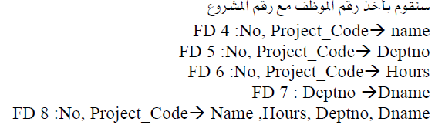
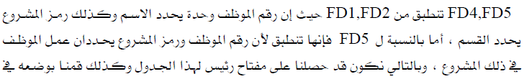
According to the previous relation we can see it follow the 1NF(first normal form)

Slide 49
Banking Example
branch (branch-name, branch-city, assets)
customer (customer-name, customer-street, customer-only)
account (account-number, branch-name, balance)
loan (loan-number, branch-name, amount)
depositor (customer-name, account-number)
borrower (customer-name, loan-number)

Slide 50
Example Queries
Find all loans of over $1200
_{amount > 1200} (loan)
Find the loan number for each loan of an amount greater than
$1200
_{loan-number} (_{amount} _{> 1200} (loan))

Slide 51
Example Queries
Find the names of all customers who have a loan, an account, or both, from the bank
  _{customer-name} (borrower)  _{customer-name} (depositor)
Find the names of all customers who have a loan and an
account at bank.
  _{customer-name} (borrower)  _{customer-name} (depositor)

Slide 52
Example Queries
Find the names of all customers who have a loan at the Perryridge branch.
_{customer-name} (_{branch-name=“Perryridge”}
(borrower.loan-number = loan.loan-number(borrower x loan)))
Find the names of all customers who have a loan at the
Perryridge branch but do not have an account at any branch of
the bank.
_{customer-name} (_{branch-name = “Perryridge”}
(borrower.loan-number = loan.loan-number(borrower x loan))) –
_{customer-name}(depositor)

Slide 53
Example Queries
Find the names of all customers who have a loan at the Perryridge branch. Two possible solutions follow:
  Query 1
  _{customer-name}(_{branch-name = “Perryridge”} (
  borrower.loan-number = loan.loan-number(borrower x loan)))
  − Query 2
  _{customer-name}(loan.loan-number = borrower.loan-number(
  (_{branch-name = “Perryridge”}(loan)) x borrower))

Slide 54
Example Queries
Find the largest account balance
Rename account relation as d
The query is:
_{balance}(account) - _{account.balance}
(_{account.balance < d.balance} (account x ρ_{d} (account)))

