Slide 1
E.R. Examples

Slide 2
A SIMPLE EXAMPLE
A company has several departments.
Each department has a supervisor and at least one employee.
Employees must be assigned to at least one, but possibly more departments. At least one employee is assigned to a project, but an employee may be on vacation and not assigned to any projects.
The first step is to define the enteties:
The important data fields are the names of the departments, projects, supervisors and employees, as well as the supervisor and employee number and a unique project number.

Slide 3
1. Identify Entities
The entities in this system are Department, Employee, Supervisor and Project. One is tempted to make Company an entity, but it is a false entity because it has only one instance in this problem. True entities must have more than one instance.

Slide 4
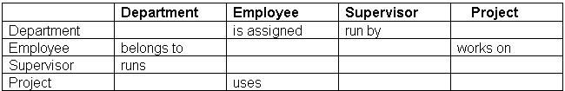
Find Relationships
We construct the following Entity Relationship Matrix:

Slide 5
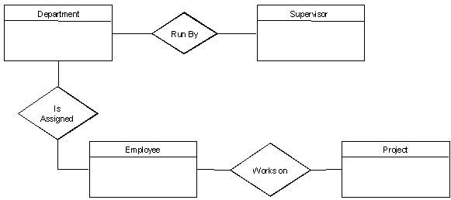
Draw Rough ERD
We connect the entities whenever a relationship is shown in the entity Relationship Matrix.

Slide 6
Fill in Cardinality
From the description of the problem we see that: Each department has exactly one supervisor.
A supervisor is in charge of one and only one department.
Each department is assigned at least one employee.
Each employee works for at least one department.
Each project has at least one employee working on it.
An employee is assigned to 0 or more projects.

Slide 7
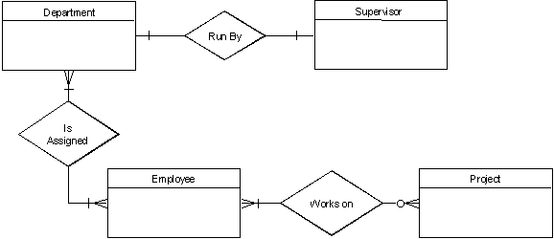

Slide 8
Define Primary Keys
The primary keys are Department Name, Supervisor Number, Employee Number, Project Number.

Slide 9
Draw Key-Based ERD
There are two many-to-many relationships in the rough ERD above, between Department and Employee and between Employee and Project. Thus we need the associative entities Department-Employee and Employee-Project. The primary key for Department-Employee is the concatenated key Department Name and Employee Number. The primary key for Employee-Project is the concatenated key Employee Number and Project Number.

Slide 10
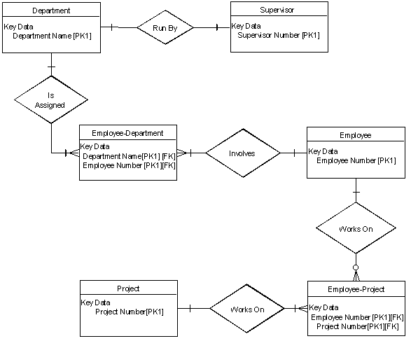

Slide 11
Identify Attributes
The only attributes indicated are the names of the departments, projects, supervisors and employees, as well as the supervisor and employee NUMBER and a unique project number.

Slide 12
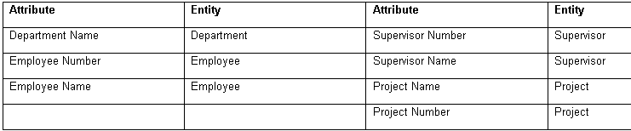
Map Attributes

Slide 13
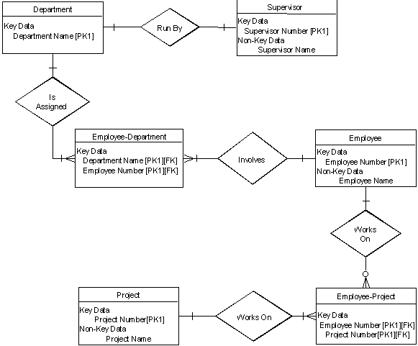
Draw Fully Attributed ERD

