Slide 1
THE COLLEGE PARTICIPATES IN THE 7TH CHARITY MARKET FESTIVAL IN AL GHAT
The College participates in the 7th Charity Market Festival in Al Ghat In accordance with the directives of His Excellency the Dean of the College, Dr. Khalid bin Abdullah Al Shafi, and under the auspices of the Deanship of community service, the College of Science and Humanities female section in Al Ghat participated in the events of the 7th Charity Market Festival, which was held from 30/04/1436 until 02/05/1436 AH. An introductory corner of the College was prepared, where a visual presentation portrayed the face of the University and highlighted the role of the College by introducing its programs and projects. Moreover, introductory brochures to the College and its departments as well as gifts bearing the name of the College were distributed to the visitors of the corner. The college corner was well received and widely attended by visitors for three consecutive days. The corner was supervised by Ms. Rehab Farouk, Ms. Manal Al Fawzan and Ms. Albandari Alma’di. It should be noted that every year the College is keen on participating in such events, which shows its important role in serving the whole society. In addition, the Dean of the College, Dr. Khalid bin Abdullah Al Shafi, expressed his thanks and appreciation to his colleagues in the female section, headed by Ms. Jamila Al Harbi, for their efforts that ensured the success of the College corner in this event.

Slide 2
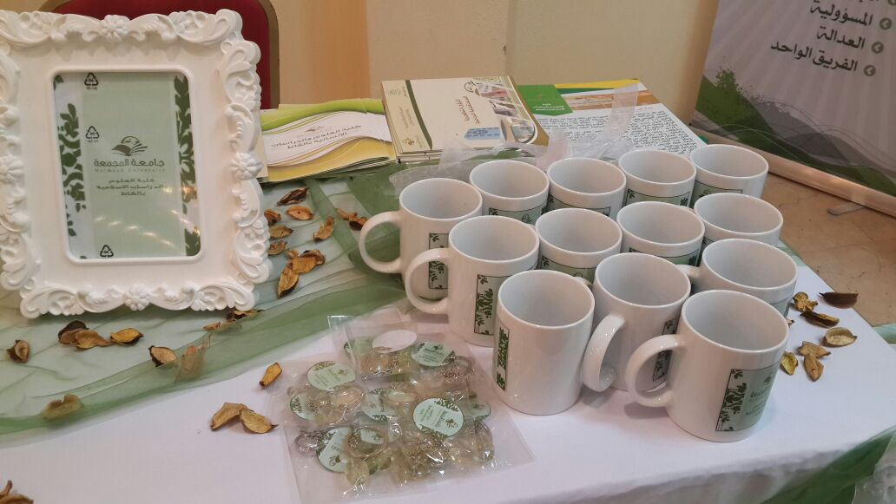
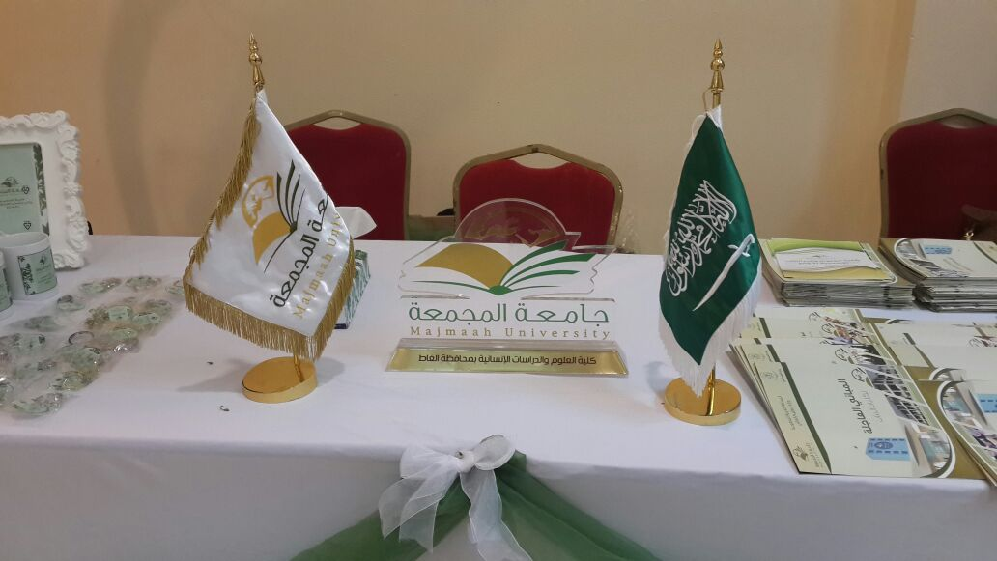
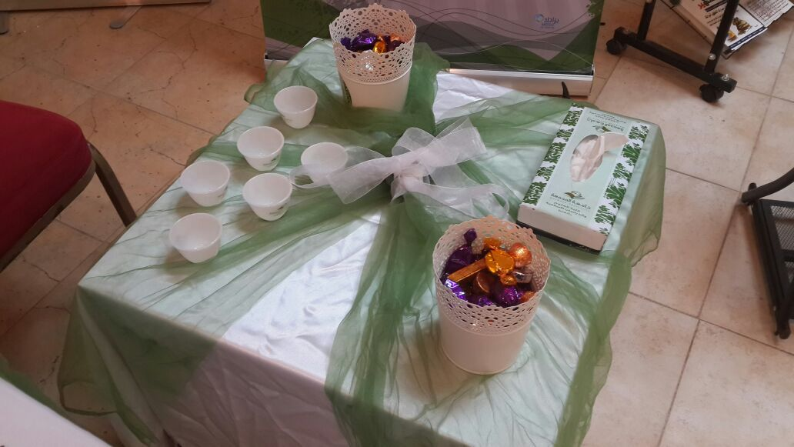
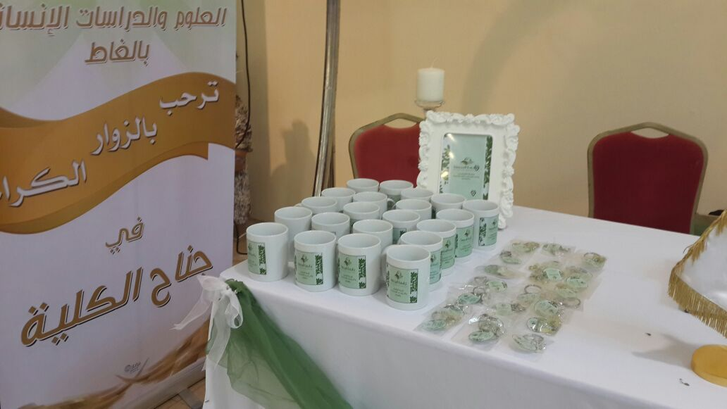
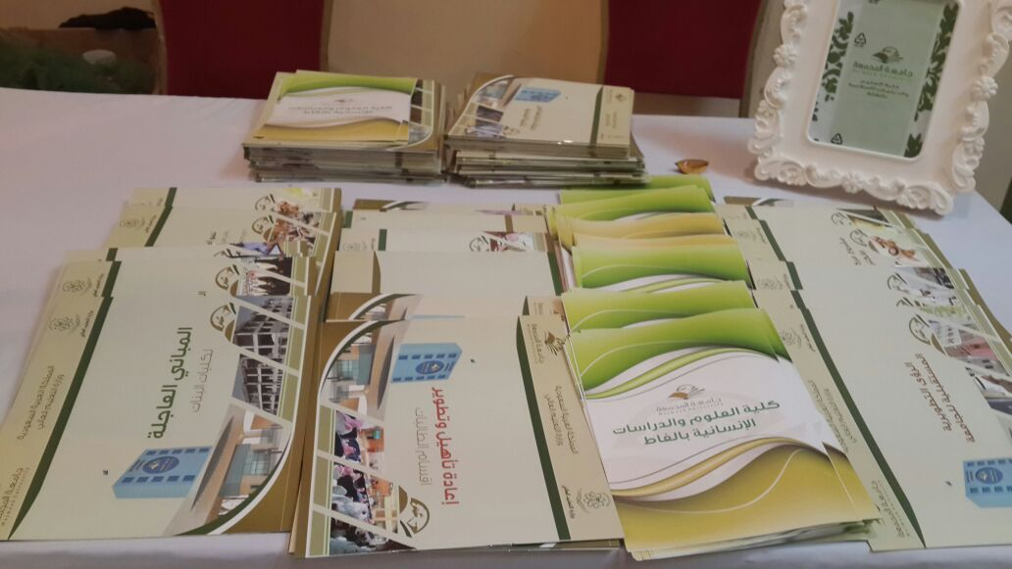
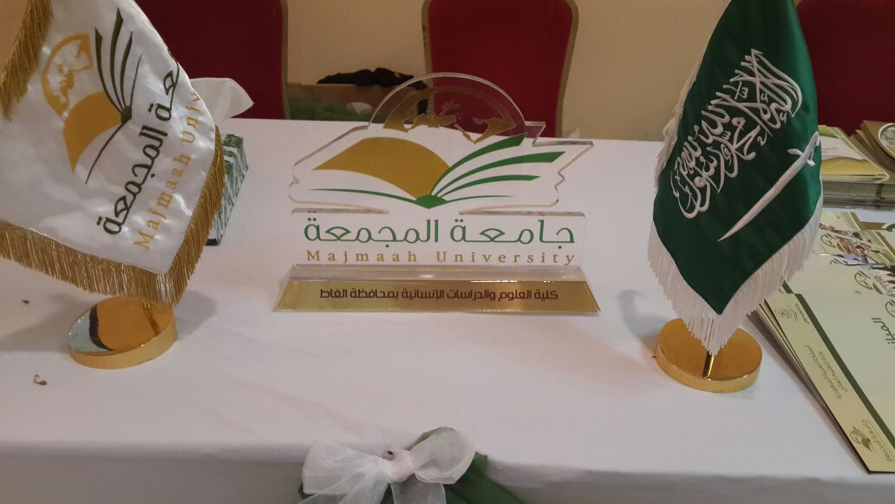
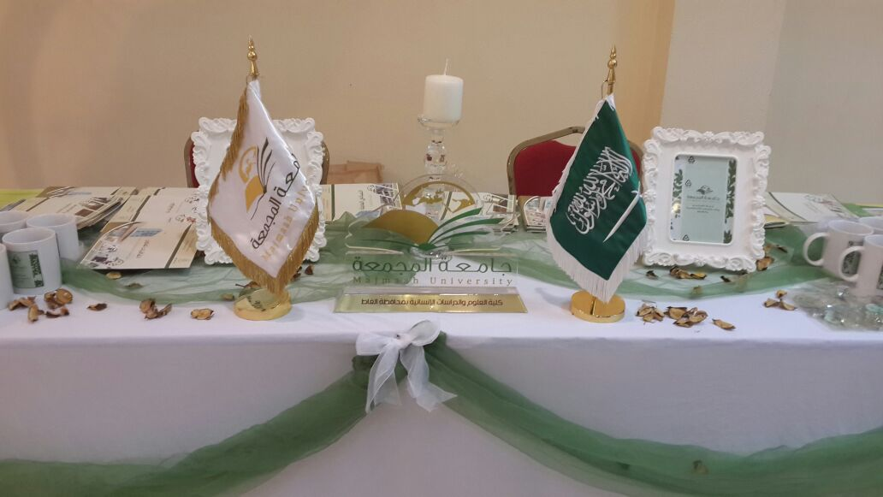
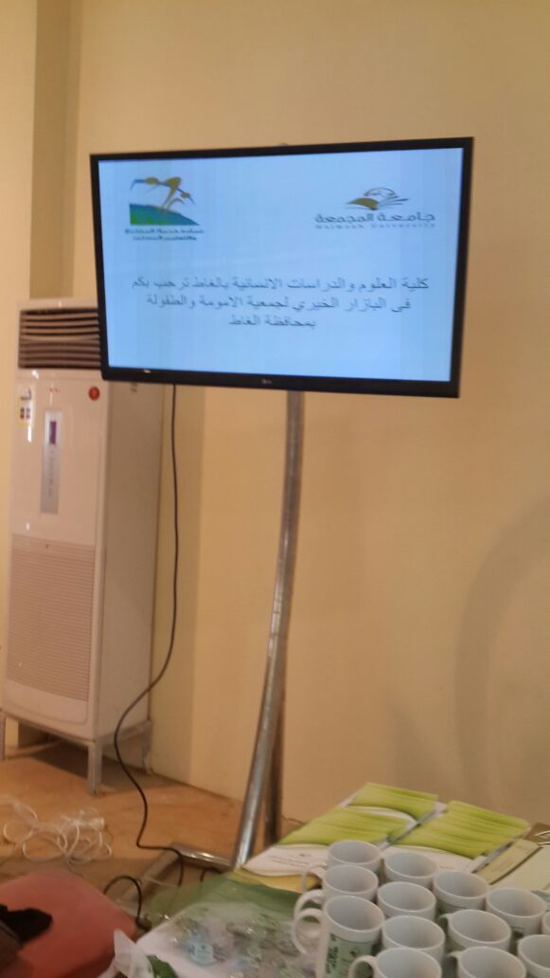

Slide 3
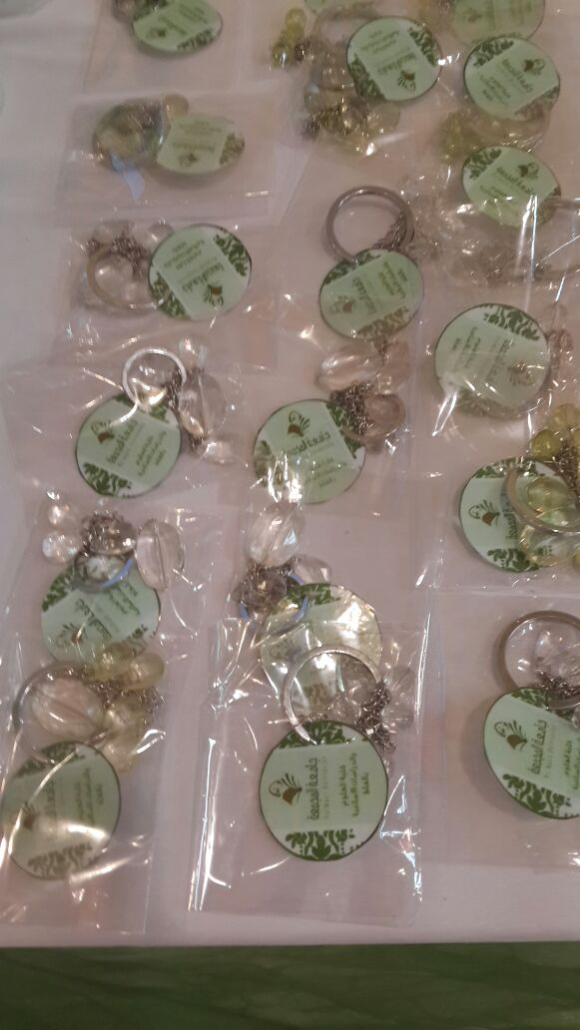

Slide 4
