Slide 1
ORGANIZATION OF ANS-I
By Dr.Sajid Hussain
OBJECTIVES
Recall the anatomic organization of ANS
Discuss the synthesis, actions and degradation of neurotransmitters – ach & NA
Explain cholinergic transmission
Describe adrenergic transmission

Slide 2
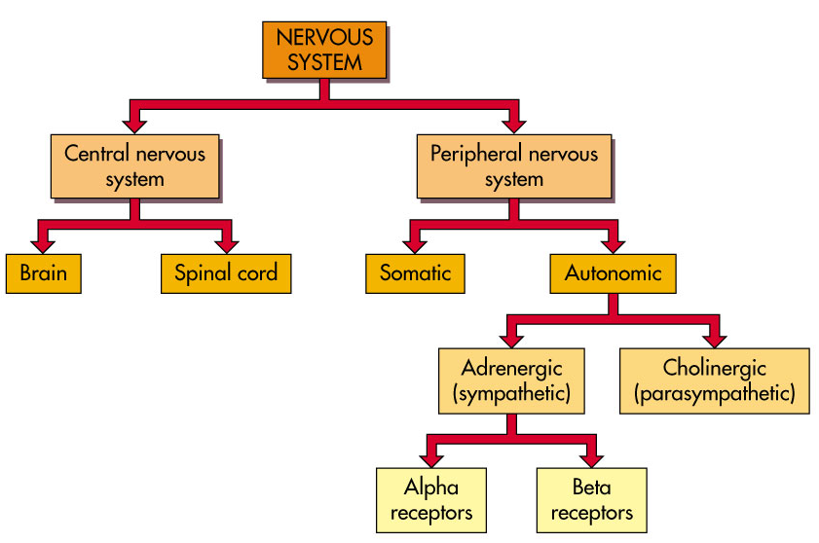
Organization of Nervous system

Slide 3
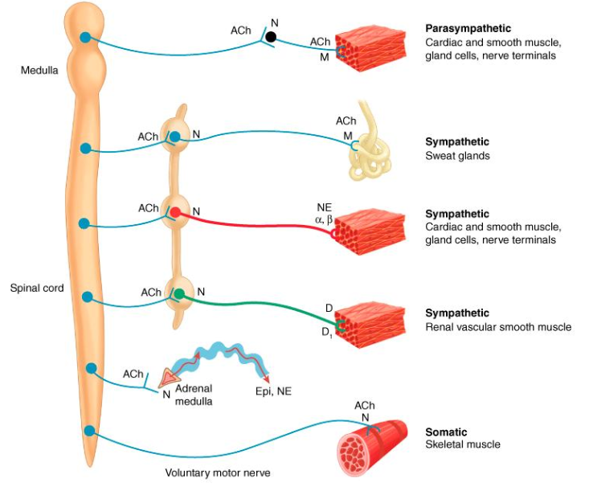
Organization of ANS

Slide 4
 | Parasympathetic | Sympathetic
Origin | Cranio-sacral | Thoraco-lumbar
Ganglia | Usually terminal or embedded in the supplied organ | Usually paravertebral in the sympathetic chain
Preganglionic | Long | short
Postganglionic | Short | Long
innervation | Most organs receive dual innervation
Control | Almost all organs except B.V. | Most of blood vessels
Actions | Usually localized Conserve energy and discharge (rest , digestion & waste removal) | Usually generalized Stress( fight and flight)

Slide 5
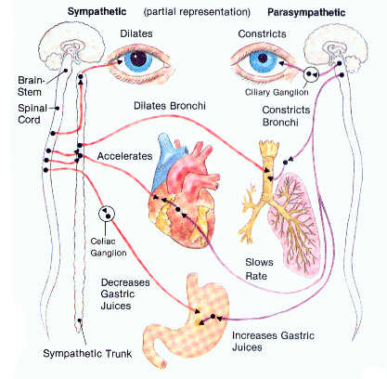

Slide 6
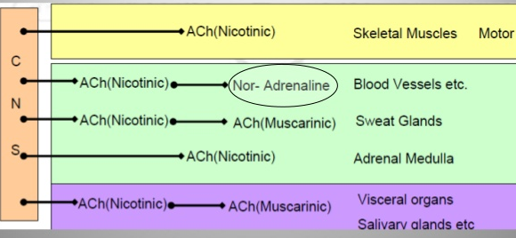
Organization of ANS

Slide 7
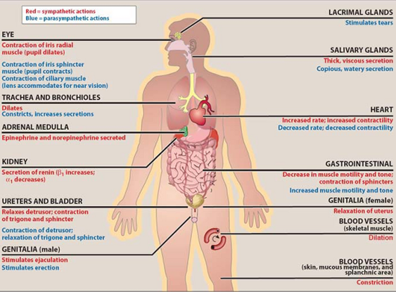
Actions of Parasymthetic Ach & NA

Slide 8
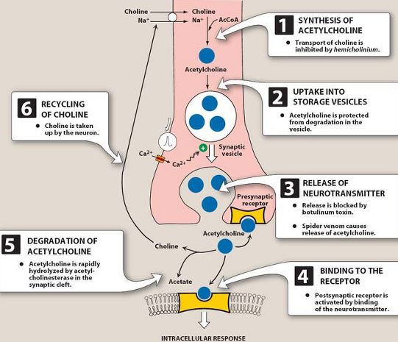
Synthesis, Storage, release & degradation of Ach

Slide 9
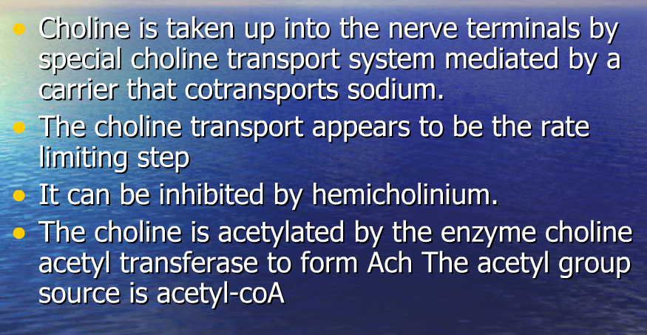
Synthesis of Ach

Slide 10
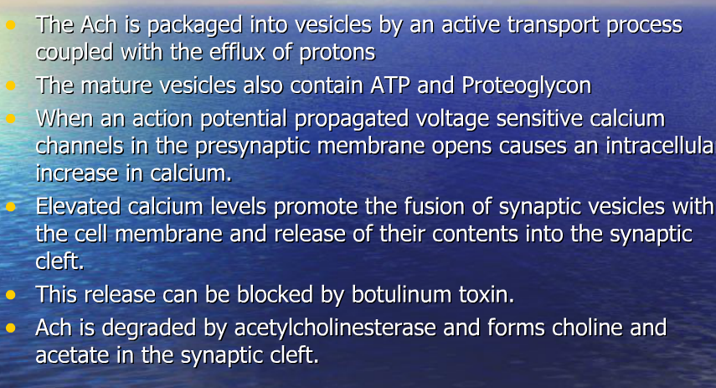
Storage, release and degradation

Slide 11
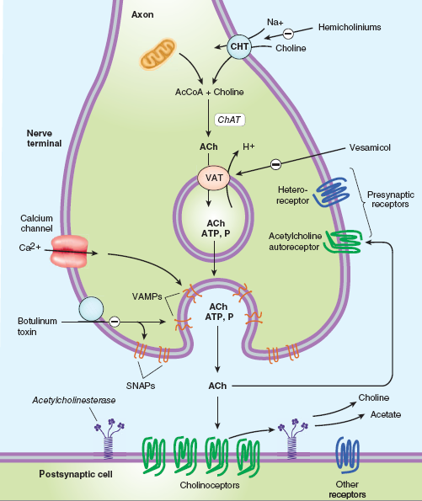
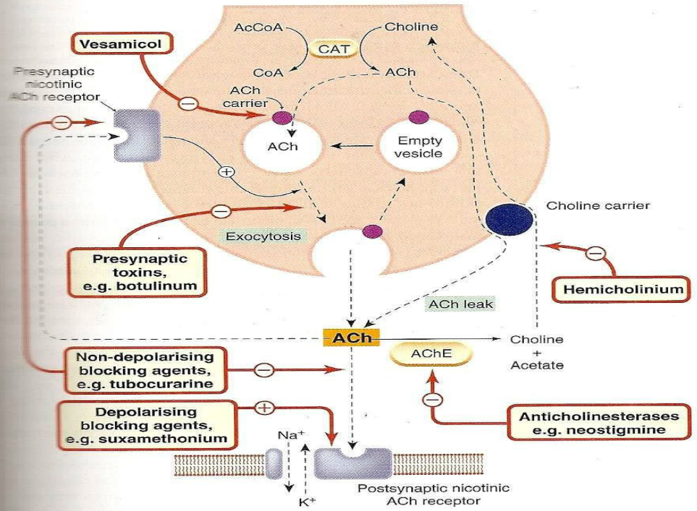
Cholinergic transmission

Slide 12
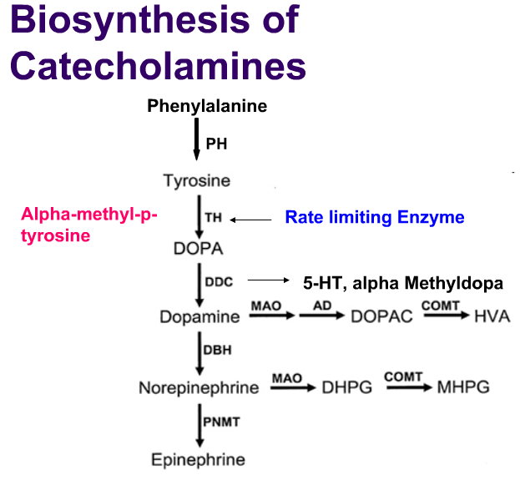

Slide 13
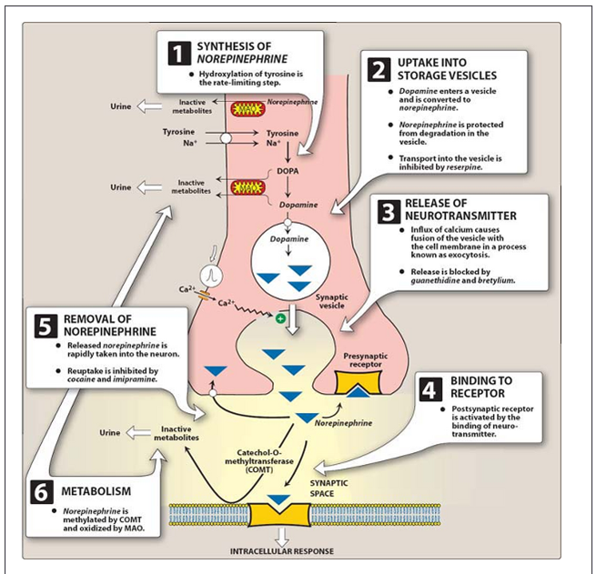
Synthesis, Storage, release & degradation of NA

Slide 14
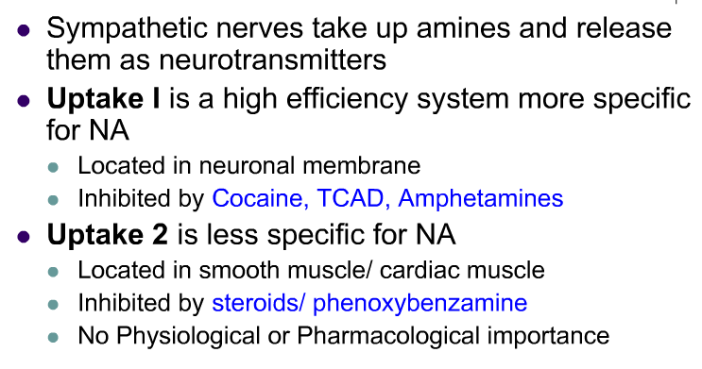
Reuptake of catecholamines

Slide 15
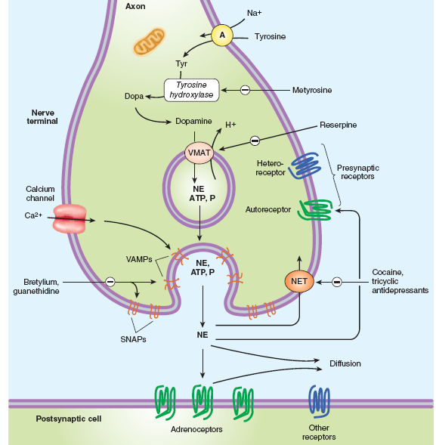
Adrenergic transmission

Slide 16
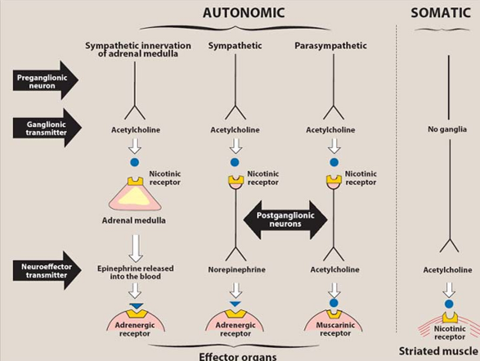
summary

Slide 17
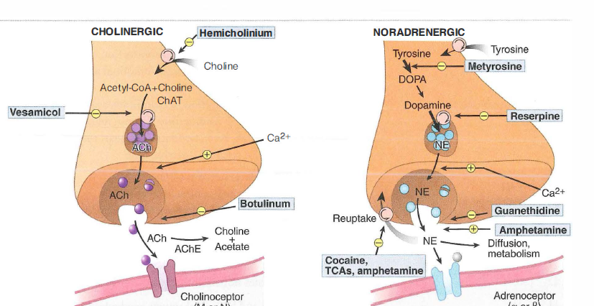
summary

Slide 18
References
Lippincott’s Illustrated review of pharmacology – 4th edition
Basic & clinical pharmacology, Bertram G katzung-12th edition
Goodman & Gilman’s -pharmacology

