Slide 1
Cholinergic agonists
By Dr.Sajid Hussain
Classify & describe cholinergic agonists including actions, therapeutic uses & adverse reactions.
Describe myaesthenia gravis & its management
Explain Organophosphorous poisoning & treatment

Slide 2
Cholinergic agonist- Classification
Direct Acting Cholinergic Drug
  Acetylcholine
  Bethanechol.
  Pilocarpine.
  Methacholine
Indirect Acting Cholinergic Drugs (Cholinesterase ors)
Reversible: water soluble- Neostigmine, Edrophonium
Pyridostigmine,
Lipid soluble- Physostigmine, Donepezil, Tacrine, Gallantamine
Irreversible.- Organophosphorous Compounds, Echothiophate, malathion, parathion, tabun
Reactivation of acetylcholinesterase- Pralidoxime

Slide 3
Actions of acetylcholine
Muscurinic actions:
Heart: it decreases the heart rate and cardiac output.
Blood vessels: it causes vasodilatation and decreases BP.
GIT: It increases the salivary & intestinal secretion.
Increases intestinal motility and relaxes sphincters
Respiratory system: bronchoconstriction & Increased secretions.
Eyes: it causes:
  Miosis.
  Accommodation of near vision.
  Decrease the IOP due to increase in the out flow of aqueous humor.
Genitourinary tract: it causes:
Urination.
Erection of genital in male.
CNS: it causes excitatory effect and effect on the learning, short term memory and arousal.

Slide 4
The nicotinic actions:
NMJ: contraction of skeletal muscles.
Stimulates both sympathetic and parasympathetic ganglia.
Stimulates the release of adrenaline from the adrenal medulla and chromoffin.
In CNS: stimulates the release of ADH at the hypothalamus.
Therapeutic uses:
Uses as eye drop to produce rapid and complete miosis after cataract surgery.

Slide 5
BETHANECHOL
  Not hydrolyzed by acetylcholinesterase but it is hydrolyzed by other esterase.
  It has no nicotinic actions.
  It is longer duration of action than acetylcholine.
Therapeutic uses:
    Post operative non-abstractive urinary retention.
    Post-operative ileus.

Slide 6
PILOCARPINE
    It is natural alkaloid, not hydrolyzed by acetylcholinesterase.
    It has marked muscarinic actions.
Actions:
Eye: loss of accommodation, miosis and lowering the intraocular pressure (IOP).
Other actions: it stimulates the secretary glands and causes sweating, salivation and lacrimation.
Therapeutic uses of pilocarpine:
In the treatment of GLAUCOMA.
To reverse cycloplagic and mydriatic effect of atropine.
Side effects:
CNS disturbance because it is crossing the BBB.
Sweating and salivation.

Slide 7
PHYSOSTIGMINE:
It is an alkaloid.
Well absorbed and penetrate the BBB.
Therapeutic uses:
Glaucoma.
Atropine poisoning
Alzheimer s disease.
Side effects:
CNS: convulsions.
Heart: bradycardia.
Paralysis of skeletal muscles which it is rare seen in the therapeutic dose.
Lid muscles twitching.

Slide 8
NEOSTIGMINE
  It is synthetic anticholinergic drug.
  It is poorly absorbed.
  It is polar compound and so that not cross to the CNS.
Therapeutic uses:
As antidote for tubocurarine poisoning
Management of Mysthenia Gravis:
it is an a autoimmune disorder due to antibodies against Ach receptor,

Slide 9
. Organophosphorous compounds
They are irreversible anticholinesterase:
They are insecticides and nerve gases.
They include: parathion, malthion, and sarin.
They are highly lipid soluble compounds. So that they cross the BBB.

Slide 10
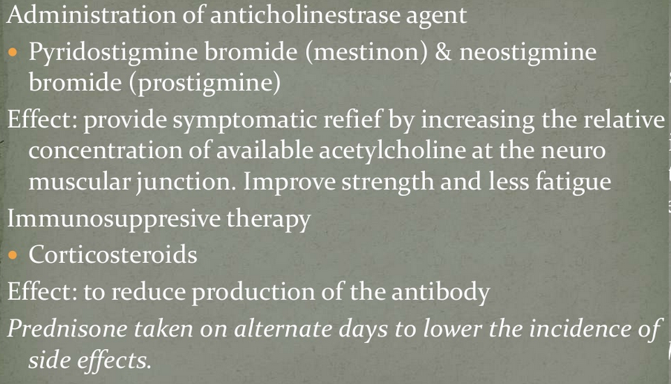
Management of myaesthenia gravis

Slide 11
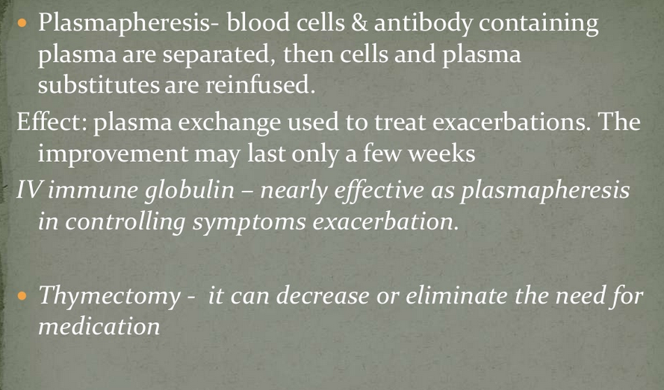
Management of myaesthenia gravis(contd.)

Slide 12
Toxicity / poisoning of organophosphorous compounds:
Mechanism of toxicity:
They inactivate enzyme ACHE irreversibly and increase the level of acetylcholine.
Actions:
  Acute toxicity: paralysis of respiratory muscle and excessive bronchial secretion.
  Chronic toxicity: neuropathy and demyelination of axons.

Slide 13
Treatment of organophosphate poisoning
Maintenance of vital signs: aspiration of bronchial secretions, endotracheal intubations and artificial respiration.
Decontamination: to prevent further absorption, removal of the contaminated clothes and washing the skin, gastric lavage if need.
atropine:
Cholinesterase reactivator Examples: pralidoxime (PAM).
Diazepam.

Slide 14
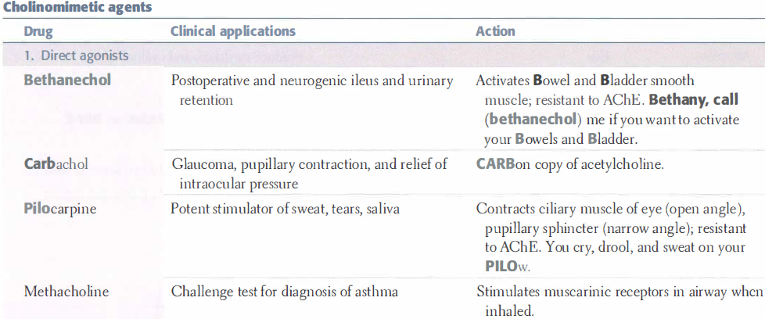
summary

Slide 15
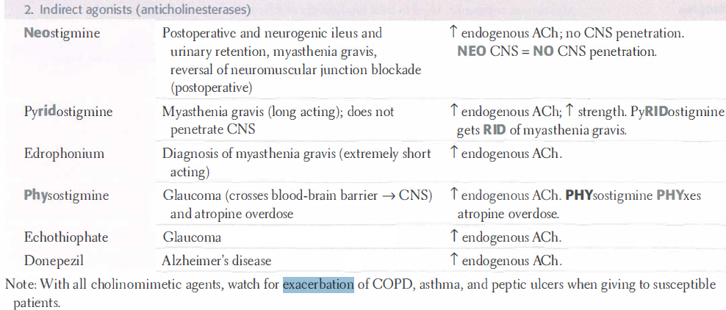
summary

Slide 16
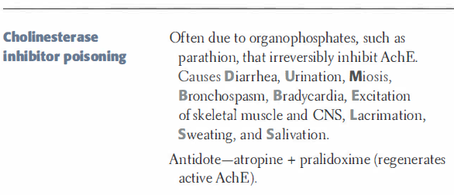
summary
Or organophosphate
poisoning
Treat of organophosphate poisoning
Treatment of organophosphate
poisoning

Slide 17
References
Lippincott’s Illustrated review of pharmacology – 4th edition
Basic & clinical pharmacology, Bertram G katzung-12th edition
Goodman & Gilman’s –pharmacology
Internet resource

