Slide 1
Cholinergic antagonist/ muscarinic antagonist / muscarinic blocker.

Slide 2
OBJECTIVES
Classify & describe cholinergic antagonists
Explain actions, therapeutic uses & adverse reactions of cholinergic antagonists

Slide 3
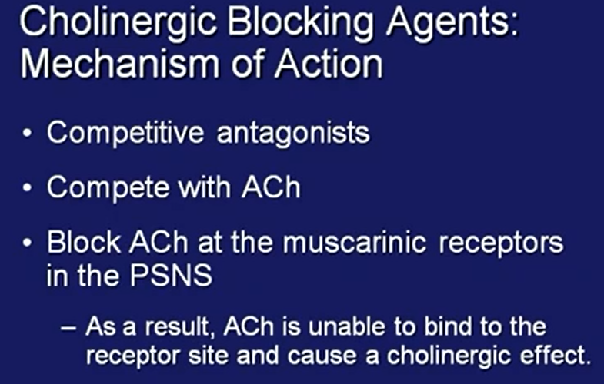
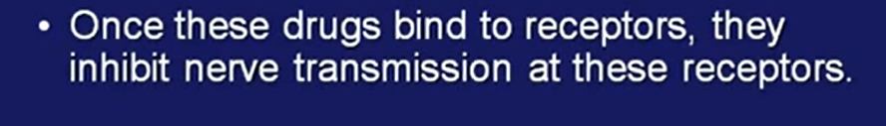
Cholinergic antagonist / Cholinergic blockers
(Parasympathetic nervous system)

Slide 4
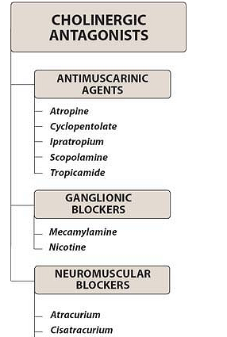
M (-) muscaarinic blockers
N_{N} (-) Nicotinic neuronal blockers
N_{M} (-) Nicotinic neuromuscular blockers

Slide 5
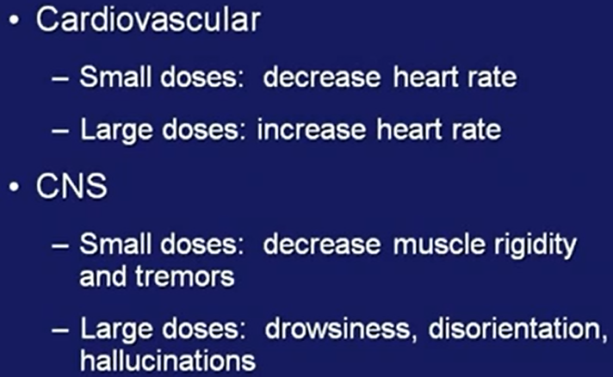
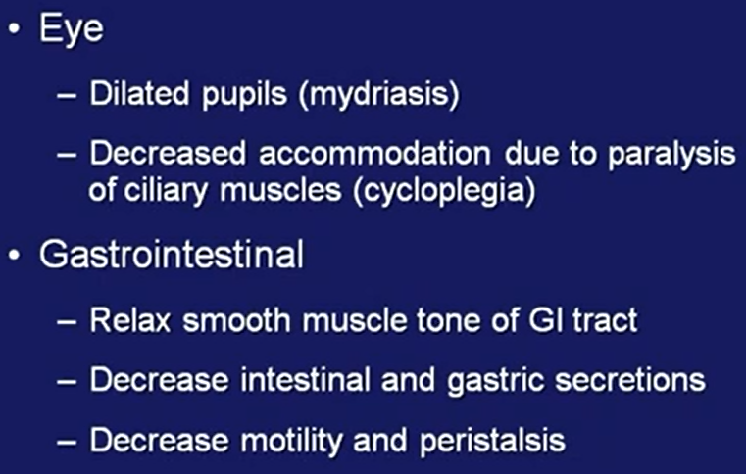
Actions of cholinergic/ muscarinic antagonist

Slide 6
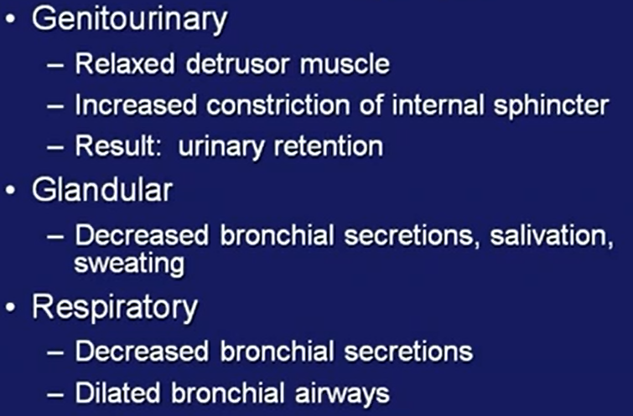

Slide 7
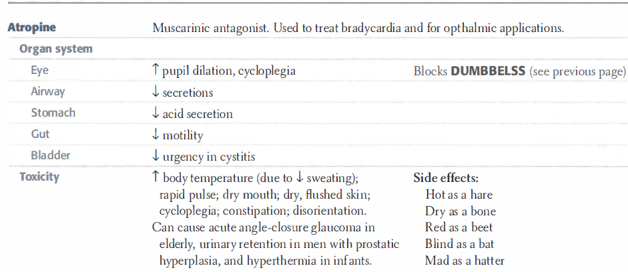
Diarrhea, Urination, Bradycardia, Bronchospasm, Excitation of CNS, Lacrimation, Sweating & Salivation

Slide 8
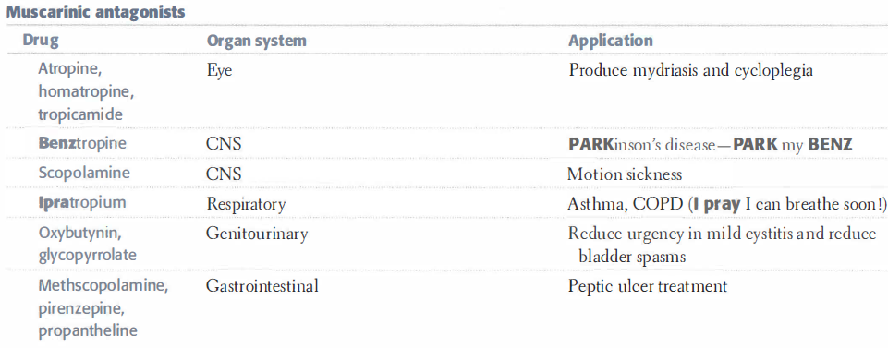

Slide 9
Uses of atropine/ muscarinic antagonist
Organophosphorous poisoning
Fundoscopic examination of eye- Mydriasis
Pre-anaesthetic medication
Parkinsons disease
Asthma/ COPD
Urinary urgency
Motion sickness
Bradycardia
Peptic ulcer disease / IBD

Slide 10
Adverse effects of atropine / Muscarinic antagonist
Constipation
Dryness of mouth
Blurring of vision
Drowsiness
Tachycardia / palpitation
Photophobia / decreased accomodation
Note: Atropine toxicity is treated with physostigmine

