Slide 1
Adrenergic agonist drugs
Objectives
Discuss the pharmacology of catecholamines
Classify & describe adrenergic α-agonists including actions, therapeutic uses & adverse
reactions.
Classify & describe adrenergic β-agonists including actions, therapeutic uses & adverse
reactions

Slide 2
Adrenergic transmission

Slide 3
Catacholamines - Epinephrine (α1α2β1β2),Norepinephrine(α1α2β1), Isoproterenol (β1β2)

Slide 4
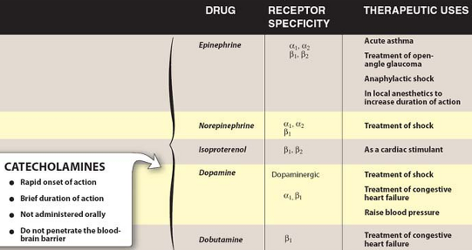

Slide 5
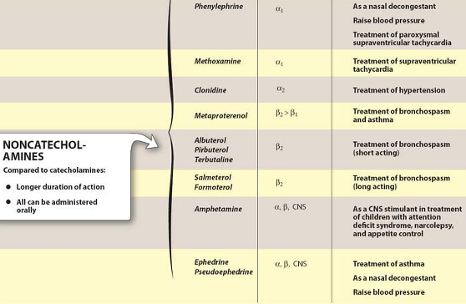

Slide 6
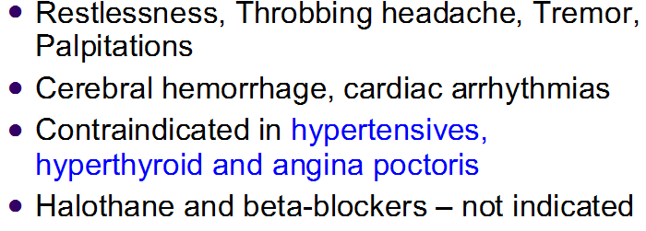
Adrenaline- α1 α2 β1 β2
ADR-

Slide 7
Other catecholamines
Noradrenaline (α1 α2 β1 ) is used in severe shock
NA adverse effects are similat to adrenaline. In addition NA causes severe sloughing of skin due vasoconstriction
Dobutamine(β1) is preferred in Acute congestive heart failure
Dopamine- (α, β1, D ) -used in cardiogenic & septic shock-

Slide 8
Therapeutic classification of adrenergic drugs

Slide 9
Ephedrine

Slide 10
Phenylepherine

Slide 11
Nasal decongestants

Slide 12
Amphetamine

Slide 14
Anorectics

Slide 15
Clonidine

Slide 17
β2 adrenergic agonist

Slide 18
Uterine relaxants

Slide 19
Summary of Sympathomimmetics – α- agonist

Slide 20
Summary of β- Agonists

Slide 21
References-
Lippincotts Illustrated pharmacology
Katzung Basic & Clinical Pharmacology

