Slide 1
Adrenergic antagonist / Blockers
Classify adrenergic antagonists
Describe actions, therapeutic uses & adverse effects of adrenergic antagonist.
b. Discuss the role of autonomic drugs in central nervous system disorders
c. Enlist drugs used in glaucoma

Slide 2
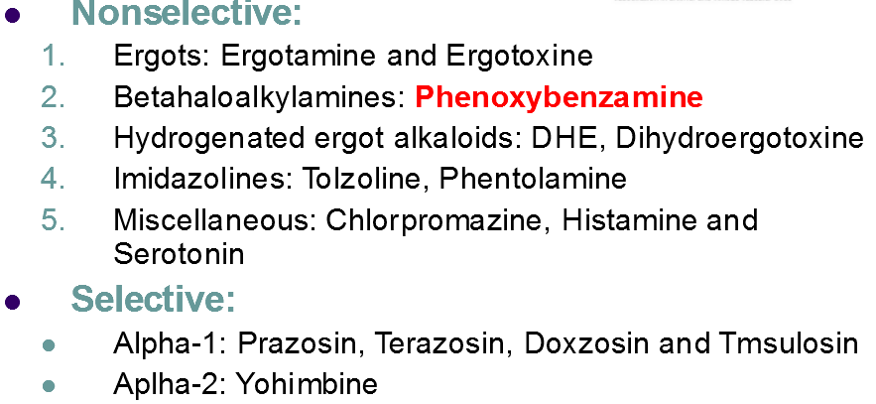
Classification of α adrenergic antagonist

Slide 3
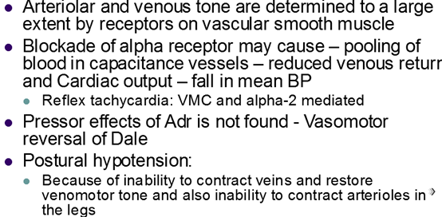
Effect of α- blockade on CVS

Slide 4
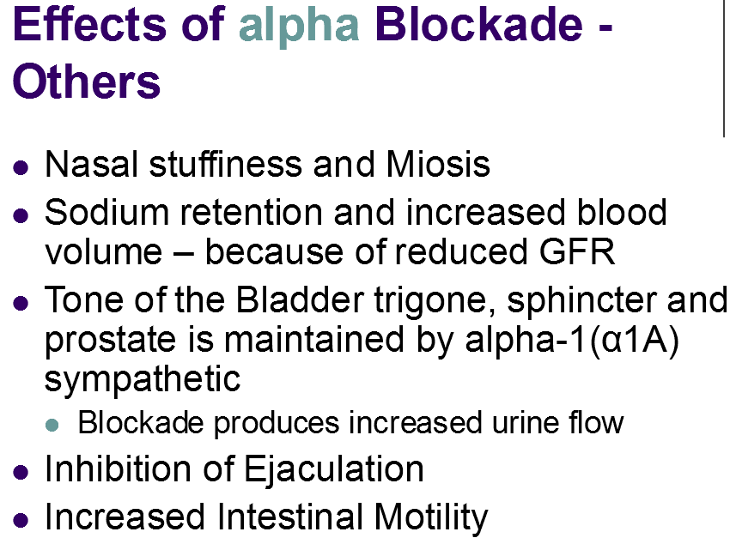

Slide 5
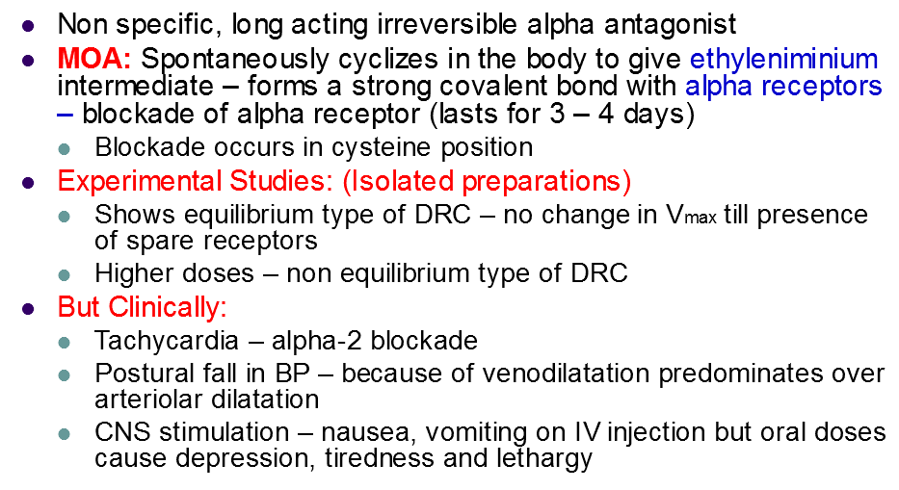
Phenoxybenzamine
Uses – phechromocytoma & peripheral vascular disease

Slide 6
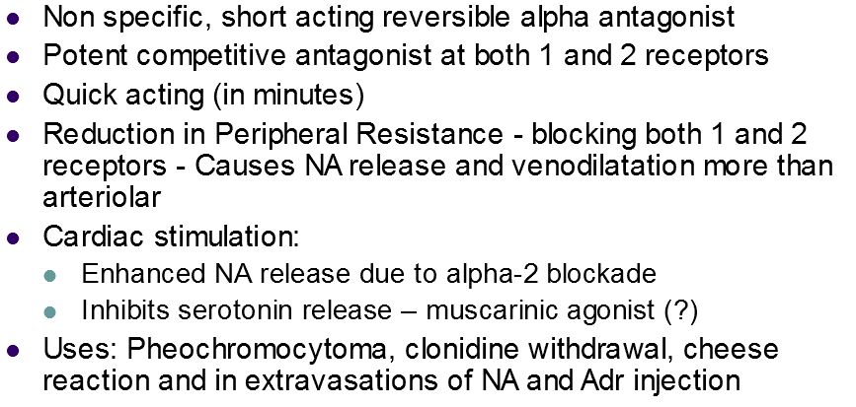
Phentolamine

Slide 7
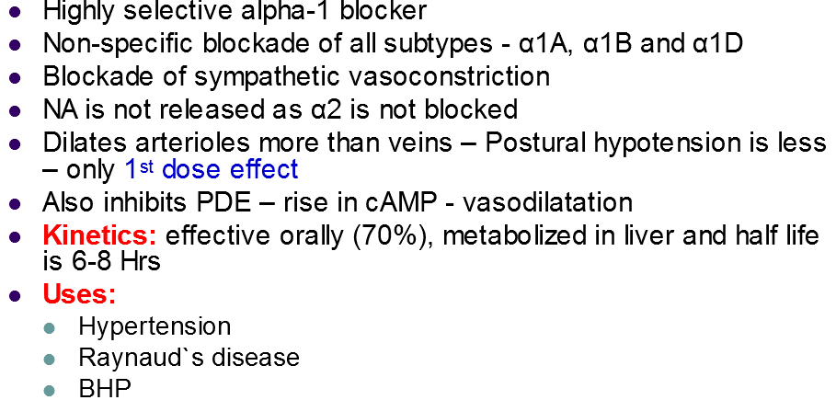
Prazosin

Slide 8
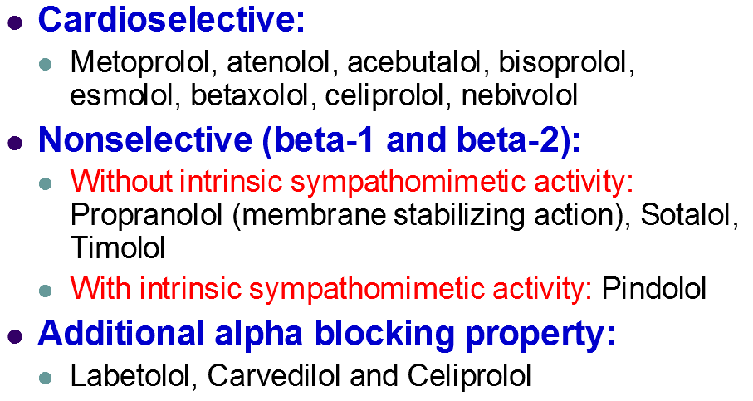
β . Adrenergic blockers- Classification

Slide 9
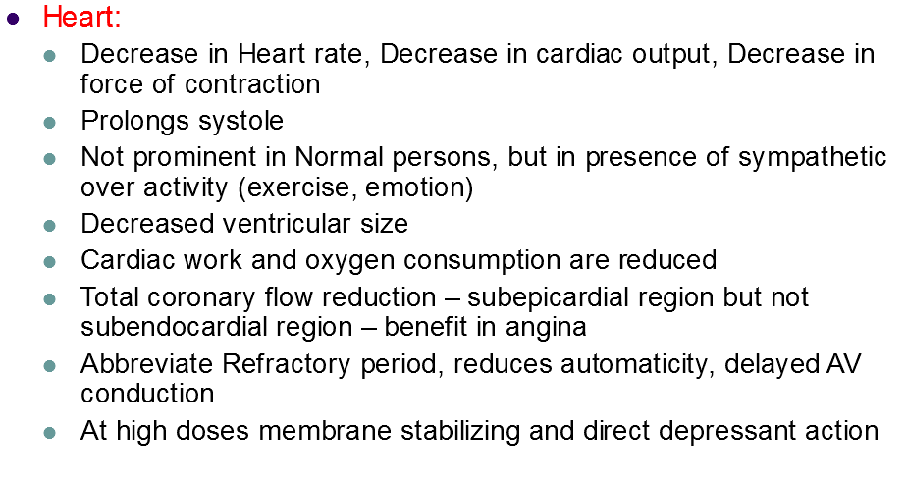
Actions of Propranolol

Slide 10
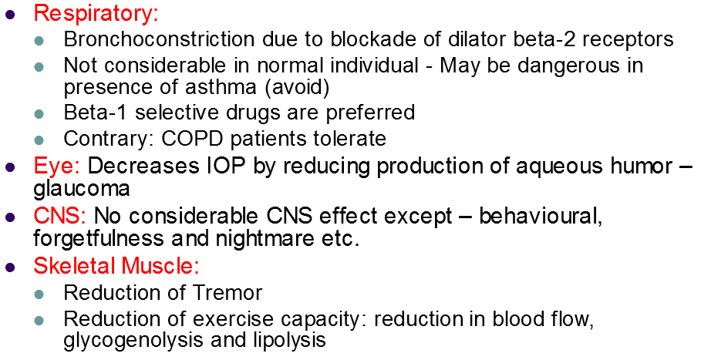

Slide 11
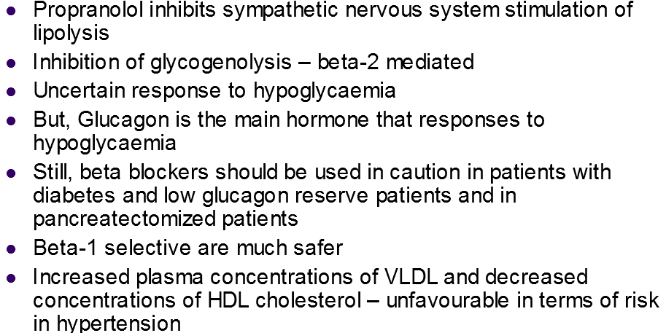

Slide 12
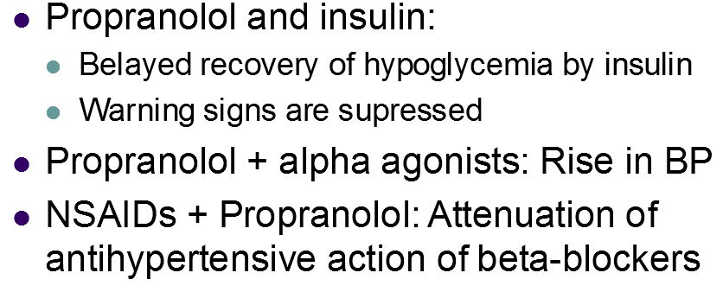
Drug interactions of Propranolol
D

Slide 13
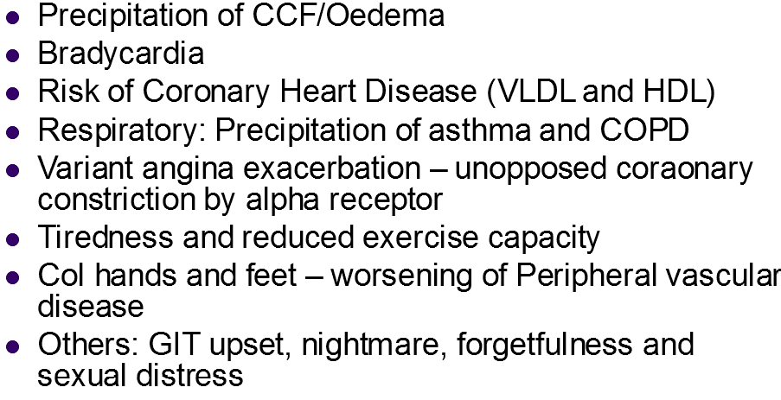
Adverse drug reactions- Propranolol

Slide 14
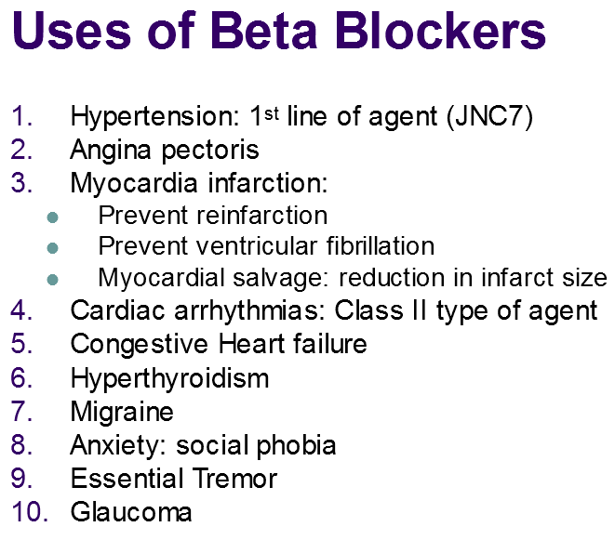

Slide 15
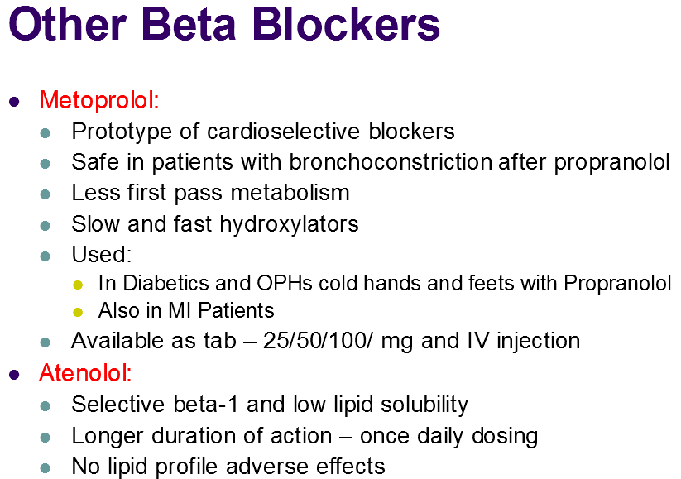

Slide 16
Drugs used in glaucoma
Apraclonidine (α-agonist)
Timolol (β-blocker)
Echothiophate
Pilocarpine
Carbachol

Slide 17
References-
Lippincotts Illustrated pharmacology
Katzung Basic & Clinical Pharmacology
Internet resource

