Slide 1
Case study
A 24 year old male patient John , suffers from allergic rhinitis. Every winter, he develops a runny nose, itchy eyes, and sneezing.
To relieve his symptoms, he takes an over-the-counter antihistamine, diphenhydramine.
John is annoyed by the unpleasant effects that accompany his allergy medication. Every time he takes his antihistamine, he feels drowsy and his mouth feels dry.
He makes an appointment with his doctor who, advises him to take loratadine. Upon taking new allergy medication, his symptoms are relieved and he experiences no drowsiness or other adverse effects.

Slide 2
Questions
Why does John develop seasonal rhinitis?
Why does diphenhydramine relieve John`s symptoms?
Why does diphenhydramine cause drowsiness?
Why doesn't loratadine cause drowsiness?

Slide 3
Autacoids (Histamine & Antihistamine)
Prepared by
Dr Rupinder Kaur Hashmi
Conducted By
Dr Naser Ashraf Tadvi

Slide 4
Objectives
Describe the pharmacology of histamine & enumerate its related drugs.
Classify the generation and sub-group of Histamine-1(H1) antagonists.
Discuss the pharmacology of H1 Antihistaminics with emphasis on clinical uses, adverse drug reactions & interactions

Slide 5
Autacoids
Autos = self; Akos = remedy (Greek).
Secreted locally to increase or decrease the activity of nearby cells.
Includes
Histamine, Serotonin
Prostaglandins and Leukotrines
Cytokines

Slide 6
Histamine
Histos: Tissue
Present mostly in mast cells:
skin, lungs, GIT Mucosa
Non mast cell histamine:
Brain, Gastric Mucosa
Histamine is a biogenic amine present in many animal and plant tissues .
Notes:
A chemical messenger that mediates a wide range of cellular responses.
Natural constituent of many mammalian tissues, hence the word ‘histamine’ is derived from the greek word ‘histos’ which means tissue
Widely distributed.
Present in bacteria, plants, animals and venoms and stinging fluids (stinging nettle, insect stings, bee venom).
High amounts found in lung, skin and GI tract.
In tissues, mast cells are the predominant site for storage & in blood, histamine is stored in basophils.

Slide 7
Synthesis of histamine
Synthesized by decarboxylation of amino acid histidine
Histamine is present in storage granules of mast cells & also found in skin, lungs, liver, gastric mucosa etc.
Synthesis occurs in same tissues in which histamine is stored.
Stored in granules
Notes:
Slowly turning over pool-
in mast cells and basophils
Release involves complete degranulation of cells.
Several weeks required to replenish the stores.
Rapidly turning over pool
In gastric ECL cells and histaminergic CNS neurons.
Synthesis and release depend on stimuli.

Slide 8
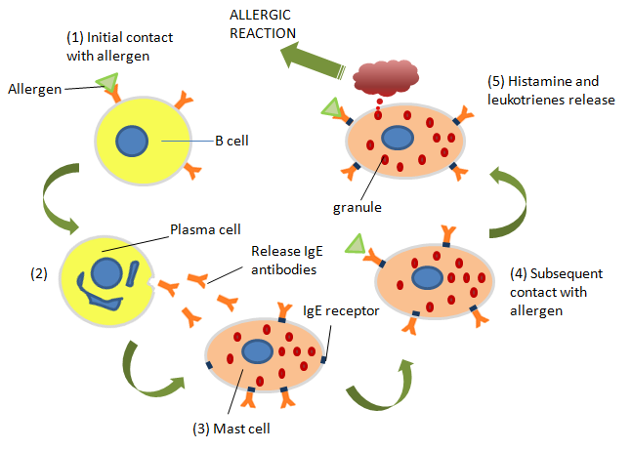
Release
Notes:
Immunologic: Mast cells & basophils, if sensitized by IgE antibodies attached to their surface membranes
Mediator in type I allergic reaction

Slide 9
Mechanism of action
Four types of receptors-
H1 , H2, H3 and H4.
All are seven transmembrane G-protein coupled receptors.
Some wide actions are mediated by both (H1 and H2) receptors.

Slide 10
Mechanism of Action of Histamine
Histamine
H₁ Receptors
H₂ Receptors
H₃ Receptors
(presynaptic auto receptors)
↑ Ca2+
↑ cAMP
↓ cAMP
Smooth muscle contraction
Increased capillary permeability
Vasodilation
Sensory nerve endings pain & itching
↑ Gastric acid secretion
Blood vessels: vasodilation
Increased capillary permeability
↓ histamine release
↓secretion
Vasodilation

Slide 11
Histamine receptor subtypes
Receptor subtype | Tissue distribution
H1 | Smooth muscle, vascular endothelium, brain
H2 | Gastric parietal cells, cardiac muscle, mast cells brain.
H3 | CNS and some peripheral nerves.
H4 | Hematopoietic cells, gastric mucosa.

Slide 12
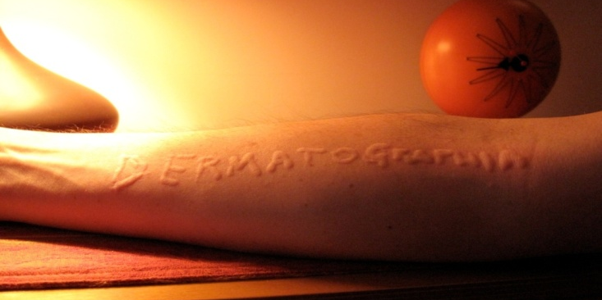
Actions of histamine
Tissues | Effects | Clinical manifestations | Receptor subtype
Lungs | Bronchoconstriction | Asthma-like symptoms | H1
Vascular smooth muscle | Post capillary venule dilation Terminal arteriole dialtion Venoconstriction | Erythema | H1
Vascular endothelium | Contraction and separation of endothelial cells | Edema, wheal response | H1
Peripheral nerves | Sensitization of afferent nerve terminals | Itch, pain | H1

Slide 13
Actions of histamine (contd.)
Tissue | Effects | Clinical manifestations | Receptor subtype
Stomach | Increased gastric acid secretion | Peptic ulcer disease, heartburn | H2
CNS | Neurotransmitter | Circadian rhythms, wakefulness | H3

Slide 14
Drugs that cause release of histamine
D-tubocurarine
Morphine

Slide 15
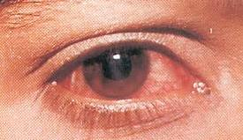
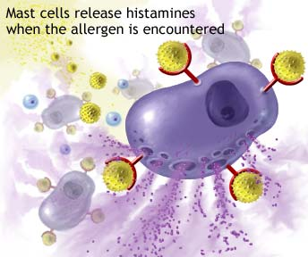
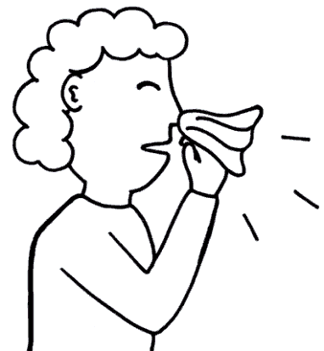
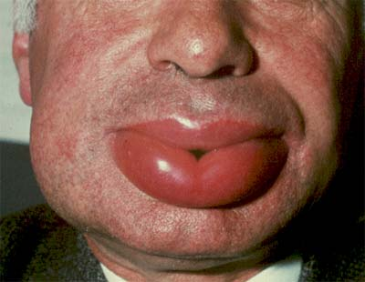
Adverse effects of histamine release
Itching, Urticaria
Flushing
Hypotension
Tachycardia
Bronchospasm
Angioedema
Wakefullness
Increased acidity (Gastric acid secretion)

Slide 16
Antihistamines: H1 receptor blocker
First generation
Second generation

Slide 17
H1-Antinistaminics /First generation

Slide 18
H1-Antinistaminics /second generation

Slide 19
Therapeutic uses
Allergic diseases
Rhinitis, urticaria, conjunctivitis.
Bronchial asthma
Anaphylaxis
Topical preparations-
Levocabastine
Azelastine
Ketotifen
Olopatadine

Slide 20
uses: First Generation Antihistamines
Insomnia
Anxiety
Motion sickness
Nausea and vomiting
Morning sickness
Vertigo
Notes:
Motion sickness and Vestibular disturbances
first generation antihistamines like
Diphenhydramine and Promethazine are useful
Cyclizine and Meclizine- less sedative
Nausea and vomiting of pregnancy (Morning sickness)
Doxylamine

Slide 21
Uses: second Generation Antihistamines
Allergies
Reduce symptoms of itching, sneezing
Rhinorrhea
Allergic conjunctivitis

Slide 22
Common Adverse Effects
Anticholinergic (Atropine-like)
Blurred vision
Dry mouth
Tachycardia
Urinary retention
Dizziness
Drowsiness
Paradoxical excitement in infants and children
Overdose of Astemizole and Terfenadine may cause arrhythmias

Slide 24
Contraindications
Acute angle-closure glaucoma
Hypersensitivity
Urinary obstruction

Slide 25
Drug interactions
Terfenadine and astemizole
Ketoconazole
Macrolide antibiotics
Lethal ventricular arrhythmias.
Torsades de pointes
Withdrawn from market
Grapefruit juice also inhibits CYP3A4.
Increased levels of antihistamines.

Slide 26
Answers
The IgE-mediated hypersensitivity reaction is responsible for initiation of certain inflammatory disorders, like allergic rhinitis .
John suffered from allergic rhinitis, with a runny nose, itchy eyes, and sneezing.
An environmental allergen, such as pollen, crosses the nasal epithelium and enters the underlying tissue. There, the allergen encounters previously sensitized mast cells and crosslinks IgE/Fc receptor complexes on the mast cell surface.
The mast cell degranulates and releases histamine, which binds to H1 receptors in the nasal mucosa and local tissues.

Slide 27
Answers
Stimulation of H1 receptors causes blood vessel dilation and ↑es vascular permeability, leading to edema. This swelling in the nasal mucosa is responsible for the nasal congestion experienced in allergic rhinitis.
The accompanying itching, sneezing, runny nose, etc result from the combined action of histamine and other inflammatory mediators, including kinins, prostaglandins etc.
These molecules initiate the hypersecretion and irritation characteristic of allergic rhinitis.

