Slide 1
Serotonin & Anti-serotonin drugs
At the end of this session students should be able to:
Describe serotonin (5HT) receptors including serotonin & antiserotonin drugs
Explain important clinical applications of serotonin related drugs.
Explain the drugs used in the treatment & prophylaxis of migraine

Slide 3
Synthesis & metabolism

Slide 8
(5HT-2A/2C antagonist)
Tropisetron

Slide 9
cyproheptadine

Slide 20
summary

Slide 21
Serotonergic receptors & related drugs with uses

Slide 22
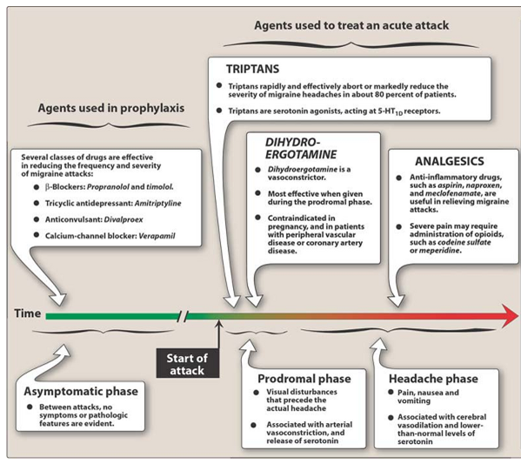
Drugs for treatment & prophylaxis of migraine

Slide 23
References
Goodman & gillman 12th ed- pharmacology
Katzung 12th – Basic & clinical pharmacology
Lippincotts illustrated review

