Slide 1
Autacoids III
EICOSANOIDS
(prostaglandins, thromboxanes, leukotrienes)

Slide 2
OBJECTIVES
1.Describe the pharmacology of prostaglandins and its clinical
Implications
2.List the major clinical implications and toxicities of ergot alkaloids on the major organ systems

Slide 3
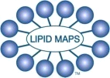
Inflammatory Biomolecules
Signal Molecules
–
Histamine
•
Made in almost all tissues
–
Eicosanoids
•
Very short half
-
life
•
Prostaglandins
•
Act locally on neighbors
•
Thromboxanes
•
Not usually stored up
20 carbon backbones
•
Leukotrienes
•
0
–
Bradykinins
•
Made from arachidonic acid
–
Cytokines
•
Interferons
•
Interleukins
•
Chemotaxins
–
Other minor molecules...
E.A.
DENNIS 2010
©

Slide 4
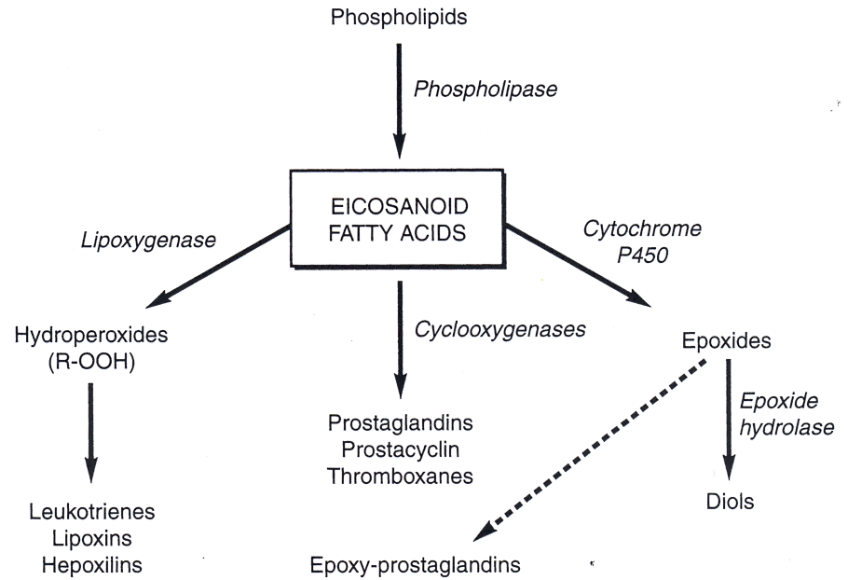
Eicosanoids
Eicosanoids are produced from arachidonic acid, a 20-carbon polyunsaturated fatty acid (5,8,11,14-eicosatetraenoic acid)
The eicosanoids are considered “autacoids"
  They act on cells close to their site of production
  They are rapidly degraded
They have both intercellular signaling, & intracellular signal cascades

Slide 5
The Cyclooxygenase Pathway
Prostanoids
Prostaglandin H₂ Synthase production of PGs, PGI₂ & TXA₂
PGH₂ synthase & Cyclooxygenase (COX) are used as synonyms
PG endoperoxides (PGG₂ & PGH₂) are more potent & long-acting than the PGs to which they decompose
TXA₂ formed mainly in platelets by TX synthase mediating vasoconstriction & platelet aggregation
PGI₂, formed mainly in endothelium by PGI synthase opposes TXA₂

Slide 6
The Cyclooxygenase Pathway
Two isoforms of COX exists: COX-1 (constitutive form) & COX-2 (inducible form)
COX-1 is constitutively expressed at low levels in many cell types
COX-2 is constitutively expressed in kidney & CNS
COX-2 gene transcription is stimulated by growth factors, cytokines, & endotoxins
A COX-1 variant, named COX-3, plays a significant role in pain sensation in paracetamol-sensitive way

Slide 7
Prostaglandin receptors:
  Prostaglandins & related compounds are transported out of the cells that synthesize them.
  Most affect other cells by interacting with plasma membrane G-protein coupled receptors.
  Depending on the cell type, the activated G-protein may stimulate or inhibit formation of cAMP, or may activate a phosphatidylinositol signal pathway leading to intracellular Ca⁺⁺ release.
  Another prostaglandin receptor, designated PPARγ, is related to a family of nuclear receptors with transcription factor activity.

Slide 8
Prostaglandin receptors are specified by the same letter code.
E.g., receptors for E-class prostaglandins are EP.
Thromboxane receptors are designated TP.
Multiple receptors for a prostaglandin are specified by subscripts (E.g., EP₁, EP₂, EP₃, etc.).
Different receptors for a particular prostaglandin may activate different signal cascades.
Effects of a particular prostaglandin may vary in different tissues, depending on which receptors are expressed.
E.g., in different cells PGE₂ may activate either stimulatory or inhibitory or G-proteins, leading to either increase or decrease in cAMP formation.

Slide 9
Prostanoids Receptors
Prostanoid receptors are AC/PLC G-protein coupled Rs
Five main classes; DP (PGD₂), FP (PGF_{2α}),IP (PGI₂),TP (TXA₂),& EP (PGE₂)
Eicosanoid synthesis is activated by:
Pathological stimulus: tissue injury/disease
Transmitter release like BK, AngII, NE

Slide 10
Prostanoids Biologic Effects
Cardiovascular System
PGI₂/D₂/E₂ →dilation of arterioles, pre-capillary sphincters & post-capillary veins → increased blood flow & cardiac output
TXA₂ is a potent vasoconstrictor
TXA₂ & PGI₂ are potent platelet aggregation inducer & inhibitor respectively (blood fluidity)
PGI₂ de-aggregate platelets clumps & reduces myocardial infarct size & ischemic organ damage
PGI₂, PGE₂, & NO are simultaneously released from endothelium
PGE₂ inhibits B- & T-lymphocyte activation & proliferation, inhibiting antibodies & lymphokines production

Slide 11
Prostanoids Biologic Effects
Smooth muscle:
Bronchial muscle relaxation by PGE₂ & PGI₂, but constriction by TXA₂, LTC₄ & LTD₄
Human pregnant uterus is contracted by PGE_{1/2}, and PGF_{2α}
GIT: PGE_{s} & PGI₂ inhibit gastric acid secretion & reduce pepsin content
They increase bicarbonate, mucus & blood flow
Increased electrolyte/water movement into intestinal lumen (diarrhea)
TXA₂ is pro-ulcerogenic

Slide 12
Prostanoids Biologic Effects
Renal System
PGs enhance urine formation, natriuresis, & kaliuresis via action on renal blood flow & tubules
PGD₂, PGE₂, PGI₂ stimulate renin release
PGs inhibit water re-absorption under ADH effect
Nervous system
Hyperthermia by PGE₂, related pyrogen-induced fever
Antipyretic action of ASA & NSAIDs is via inhibition of COX-1, -2 & -3
ِAlgesia induction & pain sensitization to histamine, BK or mechanical stimuli
Analgesic action of ASA & NSAIDs is via inhibition of COXs

Slide 13
The Lipoxygenase Pathway
Lipoxygenase, catalze the addition of O₂ to double bond(s) of arachidonic acid forming hydroperoxy-eicosatetraenoic acid (HPETE)
5-, 12- & 15- lipoxygenases → 5-, 12- & 15-HPETEs respectively
5-HPETE is converted to leukotriene-A₄ (LTA₄) , which in turn may be converted to various other leukotrienes

Slide 14
Leukotriens (Slow-Reacting Substance of Anaphylaxis, SRS-A)
Cysteinyl LTs (LTC₄/D₄/E₄/F₄) cause potent vasoconstriction & small airway constriction
They increase tracheal mucus secretion
They may be of role in immediate hypersensitivity & asthma, where corticosteroids are effective antiallergic via LTs inhibition (but NOT ASA)
LTB₄ produced from PMNLs has a potent chemotactic activity (Inflammation/damage)
LTB₄ induce aggregation of PMNLs in joint diseases (gout, arthritis) & skin diseases (psoriasis)

Slide 15
The Epoxygenase Pathway
A cytochrome P450 epoxides double bonds of the precursor FA (arachidonate) into mono-epoxide FA; epoxy eicosatetraenoic acids (EPETEs)
EPETEs are involved in vascular tone modulation, ion transport, hemostasis & hematopoiesis

Slide 16
Prostanoids Therapeutic Uses
Uterine Stimulation
Dinoprostone (PGE₂): Prostin E₂ vaginal suppositories used to induce abortion between 12th ⁻20th gestational weeks
Prostin E₂ oral tablets for elective induction of labbour/obliged induction because of HTN, toxemia, intrauterine death
Treatment of duration ≤ 18 hrs
Prostin E₂ vaginal gel used for induction of labour at term or near term (I-2 mg intravaginal, repeated Q 6hrs according to response)

Slide 17
Prostanoids Therapeutic Uses
Uterine Stimulation
Carboprost (15-methyl PGF_{2α})
Used by IM route for induction of abortion between 12th ⁻20th gestational weeks
Used at a dose of 250 μg every 1-3 hrs
Dinoprost (PGF_{2α})
Injection form for intra-amniotic administration
Used to induce labour or abortion

Slide 18
Prostanoids Therapeutic Uses
GIT
Misoprostol is a synthetic methyl ester analogue of PGE₁
Used to prevent drug-induced gastric ulceration during NSAIDs, corticosteroid or anticoagulant therapy
It can be used alone or in combination with antacids for duodenal ulcer treatment
Not used for pregnant women or whom are planning pregnancy

Slide 19
Prostanoids Therapeutic Uses
Platelet Aggregation
Epoprostenol (PGI₂):
It is used as a heparin replacement in some hemodialysis patients
Used to prevent platelet aggregation in extracorporal circulation systems
Impotence
Alprostadil (PGE₁) was used by in jection into corpora cavernosa to maintain erection
Replaced by PDE-V inhibitors

Slide 20
Leukotriens Therapeutic Importance
LTs have no therapeutic uses, but LTs antagonists have
Anti-asthma medications:
5-Lipoxygenase Inhibitors, e.g., zileutin
Leukotriene-receptor antagonists;
montelukast, & zafirlukast

Slide 21
Platelet-Activating factor (PAF)
PAF, another lipid-derived autacoid
Released from inflammatory cells & platelets by PLA₂, upon activation
It has a role in many types of inflammation, bronchial hyper-responsiveness, and delayed phase of asthma
PAF antagonists (receptor/production inhibition) are potential antiinflammatory & antiasthmatic drugs
Corticosteroids anti-inflammatory effect comprise PAF production inhibition

Slide 22
Ergot Alkaloids
Natural Products:
Ergonovine
Ergotamine
Semisynthetic Products:
Methylergonovine maleate
Dihydroergotamine mesylate
Lysergic acid diethylamine
Synthetic Products:
sumatriptan (Imitrex®)

Slide 23
Peripheral Effect
smooth muscle contractions
Cures migraine headaches
lowers blood pressure
Drugs
Ergotamine tartrate + caffeine
dihydroergotamine

Slide 24
Central Effects
  bradycardia
  vomiting
  inhibition of vasomotor center
  inhibition of pressoreceptor reflexes
  ergot alkaloids alone
  (has sedative effect)

Slide 25
Central Effects
  hyperthermia
  hyperglycemia
  mydriasis
  piloerection
  tachypnea
  hyperreflexia
  general motor
  hyperactivity

Slide 26
Uterotonic Effects
childbirth
accelerate childbirth
arrest hemorrhaging
  Drugs
  ergonovine maleate
  ergometrine
  ergotamine (prolonged effects)

Slide 27
THANK YOU

