Slide 1
Drugs Used During Pregnancy & Lactation
Dr Arif Hashmi

Slide 2
Objectives
a. Discuss the principles of prescribing drugs during pregnancy, lactation and menstruation.
b. Discuss the physiological changes occurring in pregnancy that affect the pharmacodynamics and pharmacokinetics in mother.
c. Define a teratogen and list important teratogenic drugs with their teratogenicity.

Slide 3
Pregnancy – What is different?
The need to study drugs during pregnancy relates to the physiologic changes that occur with gestation.
To accommodate fetal growth and development, and perhaps provide a measure of safety for the woman, pregnancy alters a woman’s underlying physiology.
This altered physiology can affect the pharmacokinetics of drugs.

Slide 4
PREGNANCY PHYSIOLOGY AND ITS EFFECTS ON PHARMACOKINETICS
Absorption
Gastrointestinal motility is decreased but there appears to be no major affect in drug absorption except that reduced gastric emptying delays the appearance in the plasma of orally administered drugs, especially during labor.
Absorption from an intramuscular site is likely to be efficient because tissue perfusion is increased due to vasodilatation.

Slide 5
Distribution:
Total body water increases by up to 8 Litres, creating a larger space within which water soluble drugs may distribute.
As a result of haemodilution, plasma albumin (normal 33-55 g/1) declines by some 10 g/1. Thus there is scope for increased free concentration of drugs that bind to albumin.
Unbound drug, is free to distribute, metabolized and excreted; e.g. the free (and pharmacologically active) concentration of phenytoin is unaltered, although the total plasma concentration is reduced.

Slide 6
metabolism
Hepatic metabolism increases, but not the blood flow to liver.
So, increased clearance of drugs such as phenytoin and theophylline (elimination rate depends on liver enzyme activity)
Drugs that are so rapidly metabolized that their elimination rate depends on their delivery to the liver, i.e. on hepatic blood flow, have unaltered clearance, e.g. pethidine.

Slide 7
Elimination:
Renal plasma flow almost doubles
So there is rapid loss of drugs that are excreted by kidney
e.g. amoxycillin, dose of which should be doubled for systemic infections (but not for urinary tract infections as penicillins are highly concentrated in urine).

Slide 8
PLACENTAL TRANSFER OF DRUGS
The placenta is not a perfect barrier to drugs and chemicals administered to mother.
Thalidomide tragedy, showed that placenta was capable of transferring drugs ingested by mother to fetus, with potential for great harm.
On other hand, placental transfer of drugs administered to mother has been used to treat fetal arrhythmias, congestive heart failure, & other conditions.

Slide 9
factors affecting placental drug transfer & FetaL tissue
Physicochemical properties of drug
Rate at which drug crosses placenta & amount of drug reaching the fetus
Duration of exposure to drug
Distribution characteristics in different fetal tissues
Stage of placental & fetal development at time of exposure to the drug
Effects of drugs used in combination

Slide 11
TERATOGENESIS
A teratogen is a chemical substance that can induce a malformation during development.

Slide 12
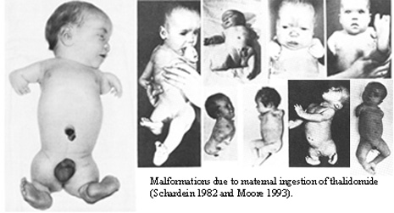

Slide 13
Principles of teratology
Teratogens act with specificity. A teratogen produces a specific abnormality or constellation of abnormalities. Eg. thalidomide produces phocomelia, and valproic acid produces neural tube defects.
Teratogens demonstrate a dose-effect relationship.
Teratogens must reach the developing conceptus in sufficient amounts to cause their effects.
The effect that a teratogenic agent has on a developing fetus depends upon the stage during development when the fetus is exposed.

Slide 14
Mechanisms of Teratogenesis
Genetic interference, gene mutation, chromosomal breakage, interference with cellular function, enzyme inhibition, and altered membrane characteristics.
The response of the developing embryo to these insults is failure of cell–cell interaction crucial for development, interference with cell migration, or mechanical cellular disruption.

Slide 16
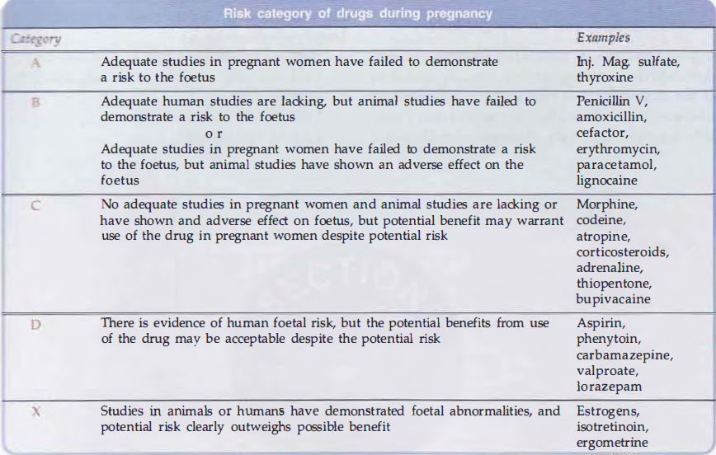

Slide 17
examples

Slide 18
PRESCRIBING IN PREGNANCY
Prescribing in pregnancy is a balance between the risk of adverse drug effects on the fetus and the risk of leaving maternal disease untreated.

Slide 19
•minimize prescribing;
use ‘tried and tested’ drugs whenever possible in preference to new agents;
• use the smallest effective dose;
• remember that the fetus is most sensitive in the first trimester;
• consider pregnancy in all women of childbearing potential;
• discuss the potential risks of taking or withholding therapy with the patient;
• seek guidance on the use of drugs in pregnancy in the British National Formulary, Drug Information Services, National Teratology Information Service (NTIS);
• warn the patient about the risks of smoking, alcohol, over-the-counter drugs and drugs of abuse.

Slide 20
DRUG USE DURING LACTATION
Most drugs administered to lactating women are detectable in breast milk. Fortunately, the concentration of drugs achieved in breast milk is usually low.
Infant would receive in a day is substantially less than what would be considered a “therapeutic dose.”
If the nursing mother must take medications and the drug is a relatively safe one, she should optimally take it 30–60 minutes after nursing and 3–4 hours before the next feeding.
Caution: Sedative-Hypnotics, Lithium Tetracyclines

Slide 21
THANK YOU

