Slide 1
Drug Development & regulations
Dr Arif hashmi

Slide 2
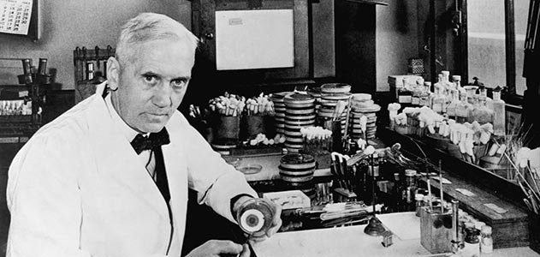

Slide 3
Drug Development
Discovery and synthesis
Preclinical development (chemical testing, biological testing, pharmacology, toxicology, safety, etc.)
Clinical development (phases I-III)
Regulatory review, marketing approval
Market launch
Post-marketing development

Slide 4
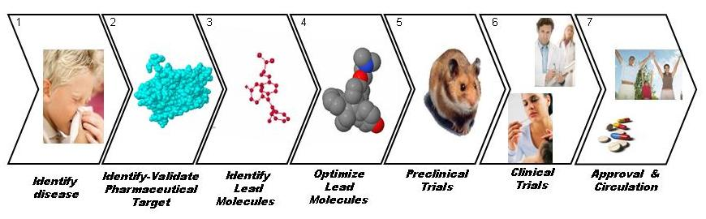

Slide 6
What is a clinical trial?
Any investigation in human subjects intended to discover or verify the clinical, pharmacological and/or other pharmacodynamic effects of an investigational product, and/or to identify any adverse reactions to an investigational product, and/or to study absorption, distribution, metabolism, and excretion of an investigational product with the object of ascertaining its safety and/or effi cacy.

Slide 7
Informed Consent
Subjects are to be informed about the aims, methods, risks, and benefits of the trial. The availability of alternatives should be explained to the subjects. Subjects should not be pressured into enrolling in the trial, but rather should voluntarily join in and should be able to leave the trial at any time without duress or penalty.

Slide 8
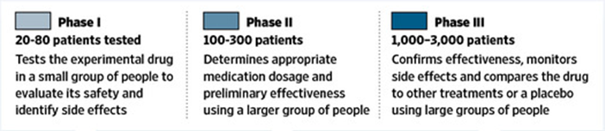

Slide 9
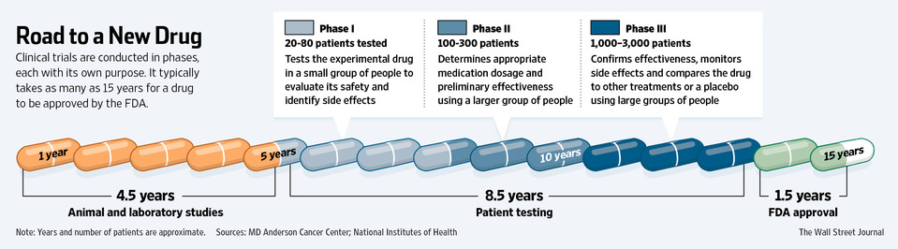

Slide 11
What is an orphan drug ?
"Orphan drugs" are medicinal products intended for diagnosis, prevention or treatment of life-threatening or debilitating rare diseases.
They are "orphans" because the pharmaceutical industry has little interest under normal market conditions in developing and marketing drugs intended for only a small number of patients suffering from very rare conditions.

Slide 12
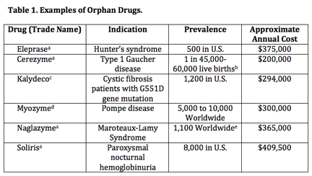

Slide 13
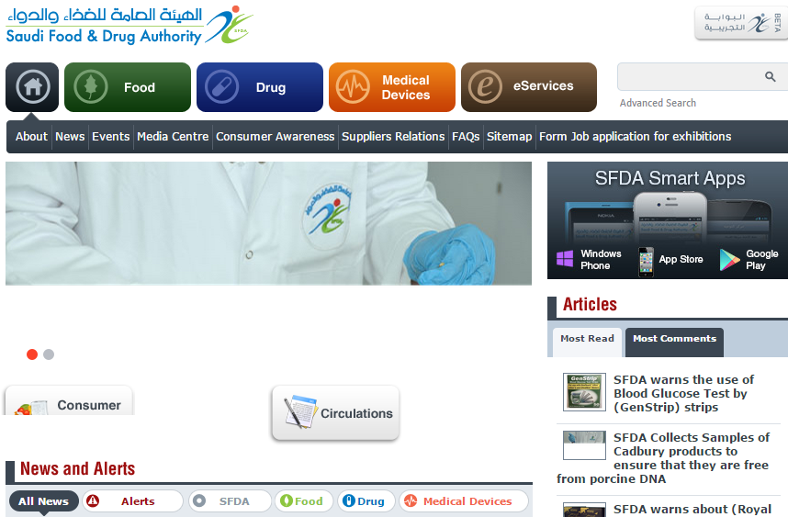

Slide 14
THANK YOU

