Slide 1
LIPOPROTEIN METABOLISM

Slide 2
Problem
What are lipids?
If so, how are these water insoluble molecules transported from one tissue to other through an aqueous environment?

Slide 3
Mark the hydrophobic and hydrophilic parts on these molecules
OH
FA

Slide 4
Structure of triacylglycerol
Glycerol
Palmitic acid
(hexadecanoic acid)

Slide 5
Phospholipid

Slide 6
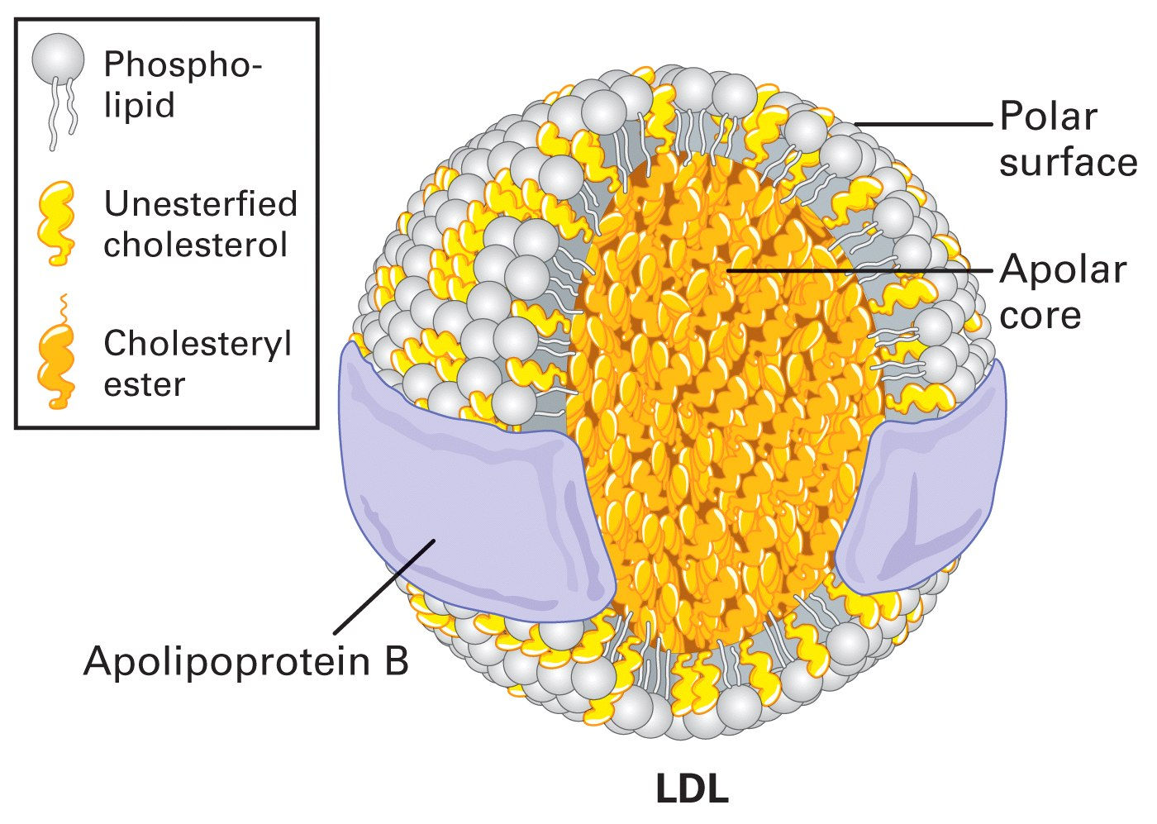

Slide 7
Proteins have both hydrophobic and hydrophilic regions
Composition of aminoacids
Proteins are absolutely essential for forming the LP particles

Slide 8
Lipoproteins
Core of TG and CE
Surface of phospholipids and some cholesterol
Apolipoproteins (regulators of LP metabolism)
CM, VLDL, IDL, LDL, HDL

Slide 10
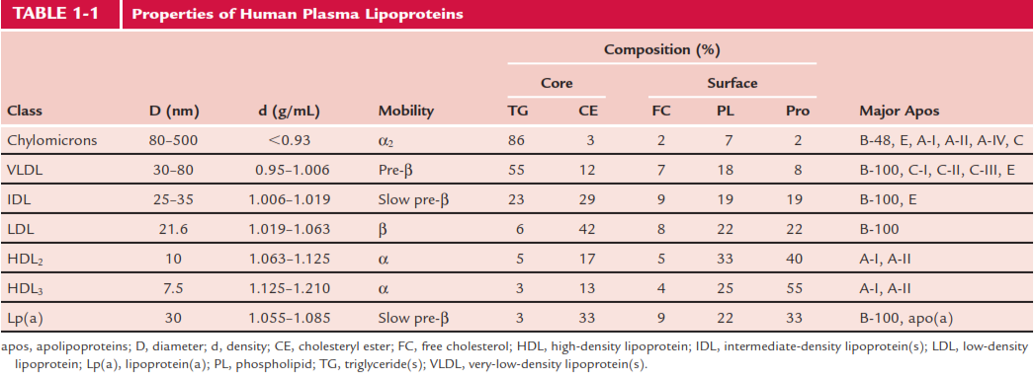

Slide 11
Type Association Function
B48 Chylomicron Carry cholesterol esters
Lacks LDL recpt
binding domain
B100 VLDL,IDL,LDL Binds LDL recpt.
C-II Chyl. VLDL, IDL, HDL Activates LPL
C-III Chyl. VLDL, IDL, HDL Inhibits LPL
E Chyl. Remnant, VLDL, IDL Binds LRP
HDL
A-1 HDL/Chylomicron LCAT activator
(lecithin:cholesterol
acyltransferase)

Slide 12
Lipid metabolism occurs in three major areas
Intestine
Liver
Extrahepatic tissues (Muscle and adipose tissue)

Slide 13
Enzymatic hydrolysis of TAG yields fatty acids and diacylglycerol, monoacylglycerol and free glycerol

Slide 14
Chylomicron assembly
Fatty acids, 2-MAG
lumen
Fatty acids, 2-MAG
Protein
ATP
ADP
intestinal
epithelium
Triacylglycerol
Apolipoproteins
Chylomicrons
Triacylglycerol
Chylomicrons
lymphatics

Slide 15
Chylomicron assembly
Assembled in enterocyte Golgi/ER
Apolipoprotein (Apo) B organizes assembly
B48
Requires
Phospholipids for surface

Slide 16
Chylomicron Assembly
2 forms of apo B
B100, large- liver
B48, smaller – intestine
Picks up apo A,C and E in plasma
TG composition closely resembles dietary intake

Slide 17
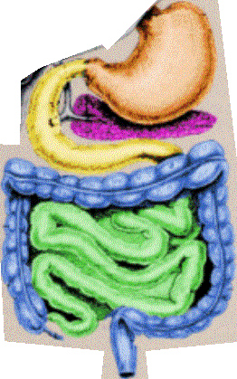
Chylomicrons are released from the intestine into the lymphatics, bypassing the liver
Lungs
Lymphatics
(thoracic duct)
Liver
Portal vein
Systemic circulation

Slide 18
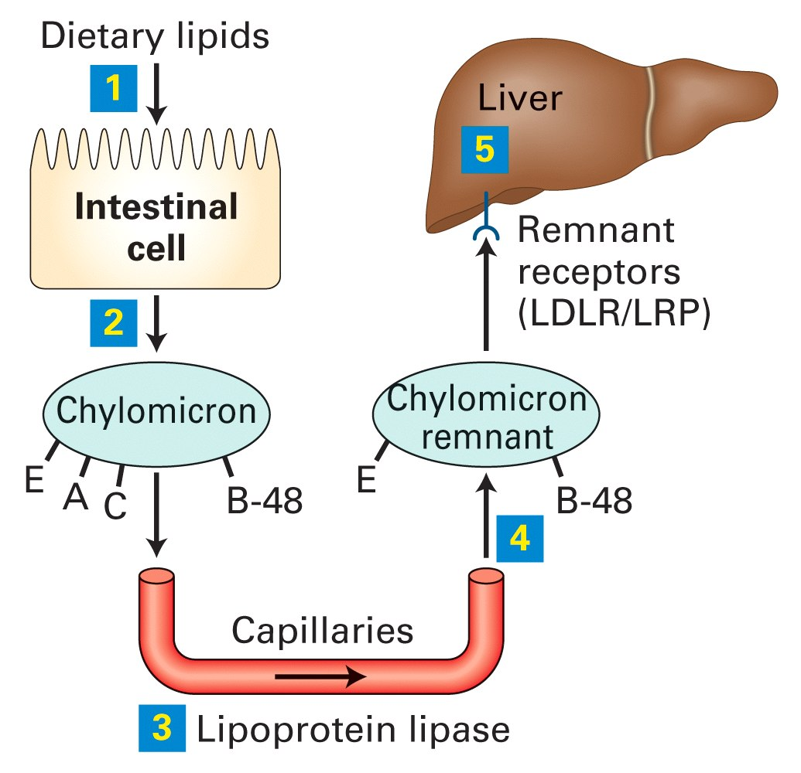

Slide 19
Questions
What are the lipids carried by CM?
Where is CM formed?
What is the source for lipids in CM?
How does the CM release FFA?
What is the fate of the FFA and Glycerol?
Where is the LPL found?
What are the components of Remnant CM?

Slide 20
VLDL Assembly

Slide 21
Endogenous Lipid Transport

Slide 22
This animation shows how VLDL are metabolised once they enter the circulation from the liver
B100
Tissues
VLDL
B100
Lipoprotein
lipase
LDL
Some LDL taken up
by liver (LDL receptors)
E
CII
Having lost TAG to tissues LDL contains a large proportion of cholesterol/cholesterol esters
Capillary wall
(endothelial surface)
Some LDL taken up by
other tissues (LDL receptors).
LDL delivers cholesterol and
TAG to the extra hepatic tissues.
E
CII
HDL
Notes:
VLDL synthesised in the liver with apoprotein B100. VLDL receives apoproteins CII and E from HDL. Like chylomicrons, VLDLs travels around the circulatory system until they associate with lipoprotein lipase, an enzyme bound to the endothelial surface. This association is mediated through apoprotein CII. The lipoprotein lipase hydrolyses the triacylglycerol to liberate free fatty acids which diffuse into the local tissues. As triacylglycerol is lost, the VLDL shrinks and forms LDL. The released fatty acids can be reassembled into triacylglycerols for storage as fat or oxidised to produce ATP. The LDL return apoprotein CII and E to HDL and are taken up by receptor mediated endocytosis by the extra hepatic tissues (with some being taken back up by the liver). LDL having lost most of their triacylglycerols are rich in cholesterol and cholesterol esters and represent the route by which cholesterol is transported form the liver to the tissues (although all tissues can make cholesterol to some extent).
As VLDL particles are transported in the bloodstream, Lipoprotein Lipase catalyzes triacylglycerols removal by hydrolysis.
With removal of triacylglycerols and some proteins, the % weight that is cholesterol esters increases. VLDL are converted to IDL, and eventually to LDL.
VLDL → IDL → LDL
The lipid core of LDL is predominantly cholesterol esters. Whereas VLDL contains 5 Apoproteins types (B-100, C-I, C-II, C-III, & E), only one protein, Apoproteins B-100, is associated with the surface monolayer of LDL.
Cells take up LDL by receptor-mediated endocytosis. The cholesterol in LDL is then used by cells, e.g., for synthesis of cellular membranes.
The LDL receptor was identified by M. Brown & J. Goldstein, who were awarded the Nobel prize.
The LDL receptor is a single-pass transmembrane glycoprotein with a modular design.
Function is to transport endogenously synthesised TAG to the extra hepatic tissues where it can be stored as fat or to muscles where the constituent fatty acids can be used for energy. The cholesterol is delivered to extra hepatic tissues once VLDL has been metabolised to LDL

Slide 23
LPL “Metabolic Gatekeeper”?
LPL deficiency (chylomicronaemia)
Massive accumulation of chylomicron -TG in plasma
Cannot clear TG normally
Normal fat storage and body weight ???!?!?

Slide 24
Regulation of Lipoprotein Lipase
Fed state -
LPL synthesis and activity (adipocytes)
LPL synthesis and activity (skeletal and heart
muscle)
Fasted/ -
exercise
state
LPL synthesis and activity (adipocytes)
LPL synthesis and activity (muscle)
Lactating -
Mammary
gland
LPL activity
Notes:
LPL is differentially regulated depending on the tissue. In the fed state LPL activity in adipocytes to promote storage of TG. In the fasted/exercised state, LPL activity in the muscle is activated or unchanged. The Km for muscle LPL is lower than that of LPL in adipose. Therefore substrates have a higher affinity for muscle LPL . The ensures that muscle LPL is always saturated regardless of TG levels and that cardiac tissues have first preference for circulating TGs.

Slide 25
QUESTIONS
Where is VLDL formed?
What are the lipids Carried by VLDL?
Which lipid is delivered by VLDL?
What is the mechanism of FFA release from VLDL?
What is the fate of Remnant VLDL?
What are the lipids present in excess when VLDL becomes VLDLR?

Slide 26
Nobel Prize 1985

Slide 27
Endogenous Lipid Transport

Slide 29
Function of LDL receptor
Endocytosis of LDL and other LP
Release free cholesterol into liver
Incorporate into plasma membrane
Inhibit new LDL receptors
Inhibit cholesterol synthesis
Promote ACAT activity (FC -> CE)
• Regulated by SREBP
monitors free cholesterol

Slide 30
Cholesterol uptake down regulates the cells own production of cholesterol and down regulates LDL receptor synthesis

Slide 31
Questions
How is LDL formed?
What is IDL?
What is HTGL?
How is CE transferred from HDL to IDL?
What is CETP?

Slide 32
CETP exchanges cholesterol esters in HDLs for triglycerides in B100 LPs
VLDL
CE
CETP
FFA
LPL
TG
IDL
Liver
(LDL receptor)
TG
CETP
HDL
CE
FFA
TG
LPL
CETP
Liver
(LDL receptor)
CE
LDL
Notes:
Interrelationship between lipoproteins. PLTP transfers phospholipids (lecithin) from VLDL, IDL and LDL to HDL.LCAT associated with HDL esterifies cholesterol. CETP transfers CE from HDL to VLDL, IDL and LDL

Slide 34
HYPERLIPIDEMIA
Major CV risk factor - 25% of population
LDL, Total Choles., Total Choles./HDL, and 1/HDL all predict CVD
Reducing LDL with diet or drugs, prevents CVD, saves lives, time and money.
Statins, fibrates, niacin, bile acid binding resins

Slide 36
Effect of Exercise
Increases LPL activity in muscle.
Reduces TGL from the particle.
Reduction in weight
Increases HDL

Slide 37
Effect of diet
Vegetarian diet – Cholesterol intake less
Reduced Carbohydrate – VLDL TG Reduced
Reduced Fat – Reduces CM TG
Unsaturated fats ( Mono and Poly)- Reduction in Plasma cholesterol
Fiber – decreases cholesterol absorption

Slide 38
Postprandial Changes in Plasma Lipid Metabolism
Fat storage via LPL
Exchange of cholesterol for VLDL TG in HDL (CETP)
LCAT activity = esterification of free cholesterol (HDL)
These postprandial changes are beneficial in maintaining whole body homeostasis of glycerides and cholesterol

Slide 39
Fat accumulation in adipose: High I/G (Fed)
Capillary endothelium
B48
(+)
CII
insulin
TG/CE
LPL
CIII
FFA-albumin (oxidation)
Glucagon
chylomicron
FFA
Glucose
glut4
(+)
Insulin
regulated
glucose
transport
CoA
G3P
Fatty acyl CoA
Triglycerides
adipose
Notes:
Fed state: High adipose LPL. Increased glucose transport into adipocyte.

Slide 40
QUESTIONS?
What is small dense LDL?
What is oxidizes LDL?
What is Lipoprotein (a)?
What is its medical importance?

