Slide 1
Respiratory Infections in Immuno-compromised Hosts
Assist Prof Microbiology
Dr. Syed Yousaf Kazmi

Slide 2
LEARNING OBJECTIVES
Describe pathogenesis, clinical findings and lab diagnosis of rhino-cerebral mucormycosis
Describe pathogenesis, clinical findings & laboratory diagnosis of pneumocystis jiroveci pneumonia

Slide 3
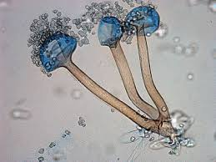
RHINO-CEREBRAL MUCORMYCOSIS
Introduction
Opportunistic mycosis(Fungus)
Rhizopus oryzae 60% cases
Others-Rhizomucor, Absidia, Mucor etc.
Very lethal infections
Usually not diagnosed until death
Recent increase incidence due to ?
Rhizopus oryzae

Slide 4
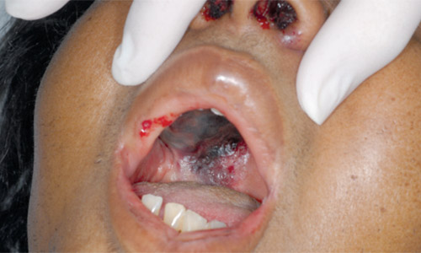
PATHOGENESIS
Saprophytic mould-decaying organic matter
Widely present in environment
Spores in air-Inhaled
Reach para-nasal sinuses
Acidosis esp Diabetic ketoacidosis-very strong link
Other conditions-leukemia, steroid therapy, burns, immunodeficiency, dialysis with iron chelator

Slide 5
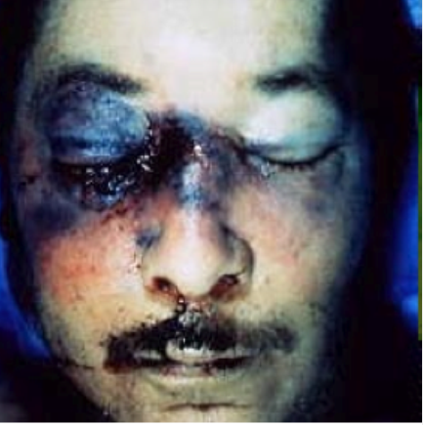
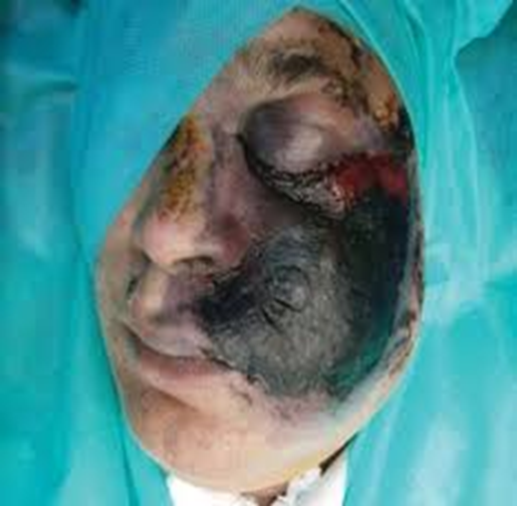
PATHOGENESIS
Spores in sinuses germinate
Hyphae invade the blood vessels
Thrombosis and infarction
Ischemic necrosis of part distal to necrosis
Plane for invasion of fungus
Sinuses, bones, cartilage, eye, brain tissue invaded
No body planes hinder its spread

Slide 6
Clinical features
Rapid and fulminant course
Oedema face, eye
Bloody nasal discharge
Fever, general illness
Confusion, delirium
Death in serious cases

Slide 7
Laboratory diagnosis
CLINICAL SUSPICION IS UTMOST IN EARLY DIAGNOSIS & TREATMENT
Blood Glucose- High in DKA
Urine ketone bodies-+ve in DKA
Blood pH-usually low
Blood CP- usually high TLC, Low Hb
Positive Urine ketone bodies

Slide 8
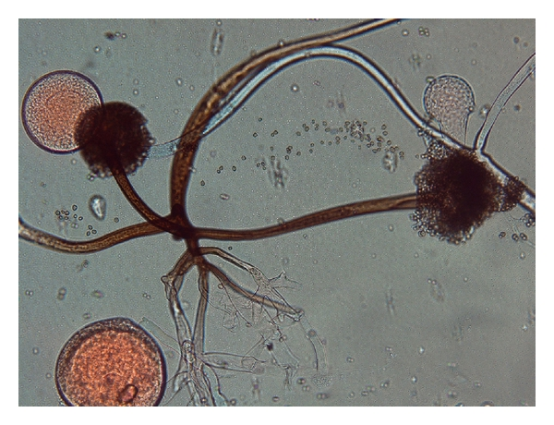
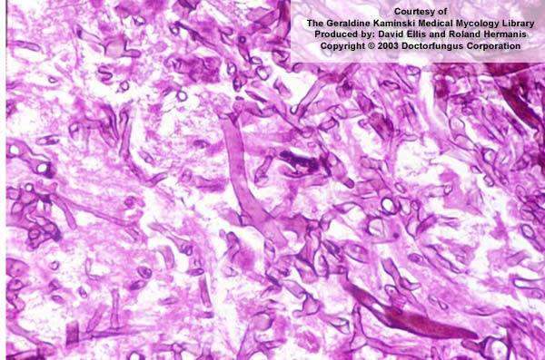
Laboratory diagnosis
Nasal swab/ fluid for microscopy
  Usually negative by Gram stain
  Special fungal stains required
  Nasal swab/ fluid for fungal culture
  Special fungal culture medium e.g. Sabauraud Agar
  Rapid growth
  Identification by microscopy
  Tissue for H/P
    Stain for fungal hypha
    Non septate hyphae

Slide 9
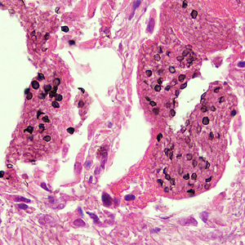
Pneumocystis jiroveci pneumonia
P. jiroveci –fungus
Present in environment
Many healthy people harbour this fungus
Opportunistic mycosis
Most common cause of non-bacterial pneumonia in AIDS patients
Cell mediated immunity-limits infection by this fungus

Slide 10
Pneumocystis jiroveci pneumonia
Transmission
Person to person transmission
Environment to person
Own flora of throat?
Predisposing conditions
HIV infection
Malnourished
Steroid therapy
Antineoplastic treatment
Organ transplant recipient

Slide 11
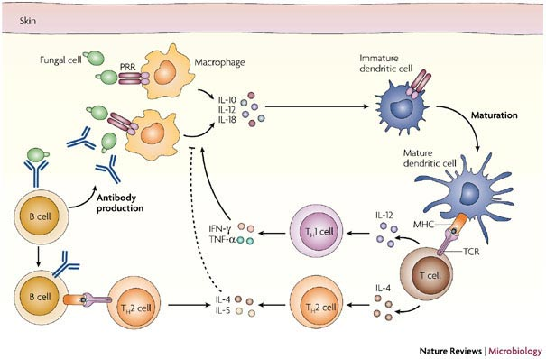
p. JIROVECI PNEUMONIA
PATHOGENESIS
Cell mediated immunity is central in combating the Pneumocystis jiroveci pneumonia
Pneumocystis jiroveci pneumonia is strongly related to AIDS
The infection usually occurs when CD4 count drops below 400/uL

Slide 12
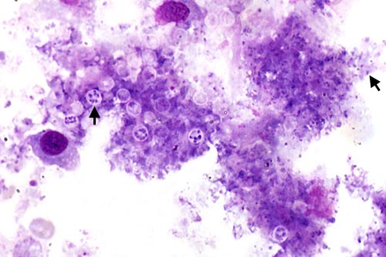
p. JIROVECI PNEUMONIA
PATHOGENESIS
Cysts of Pneumocystis jiroveci are inhaled from environment which enter alveoli
Inflammatory response to cyst
Frothy exudate accumulates in alveoli that block gaseous exchange
Pneumonia develops due to fluid in lung-hinder gaseous exchange across alveolar membrane
Trophozoite form
Cyst form
Broncho-alveolar lavage fluid

Slide 13
p. Jiroveci pneumonia- clinical features
Progressive exertional dyspnoea (95%)
Fever (>80%)
Non-productive cough (95%)
Chest discomfort
Weight loss
Chills
Haemoptysis (rare)
diffuse bilateral infiltrates

Slide 14
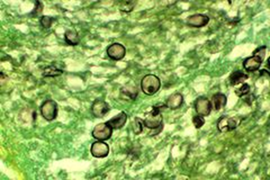
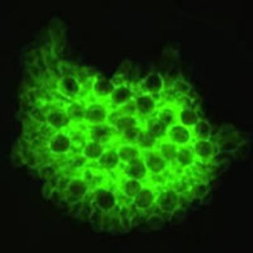
Laboratory diagnosis
Serum LDH(NV<95 IU/L)
  Usually elevated in PNP(> 200 IU/L)
  High sensitivity but low specificity
Bronchoalveolar lavage / lung biopsy for cyst stain.
  Methenamine silver, Giemsa, Calcofluor white
  Gram stain not effective
Immuno-fluorescent staining
  On broncho-alveolar lavage, lung biopsy specimen
  Sensitive test
Cysts of P. jiroveci in lung biopsy
Immuno-fluorescent staining of
P. jiroveci cysts in BAL fluid

Slide 15
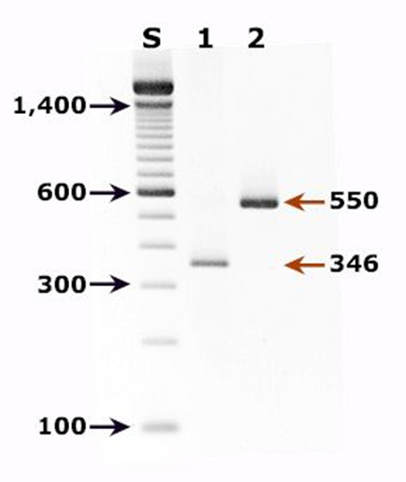
Laboratory diagnosis
PCR
  Rapid and sensitive test
Serology
  Not useful in acute infection
  Used in establishing the prevalence of P. jiroveci infection
Positive DNA PCR of P. jiroveci fungus

