Slide 1

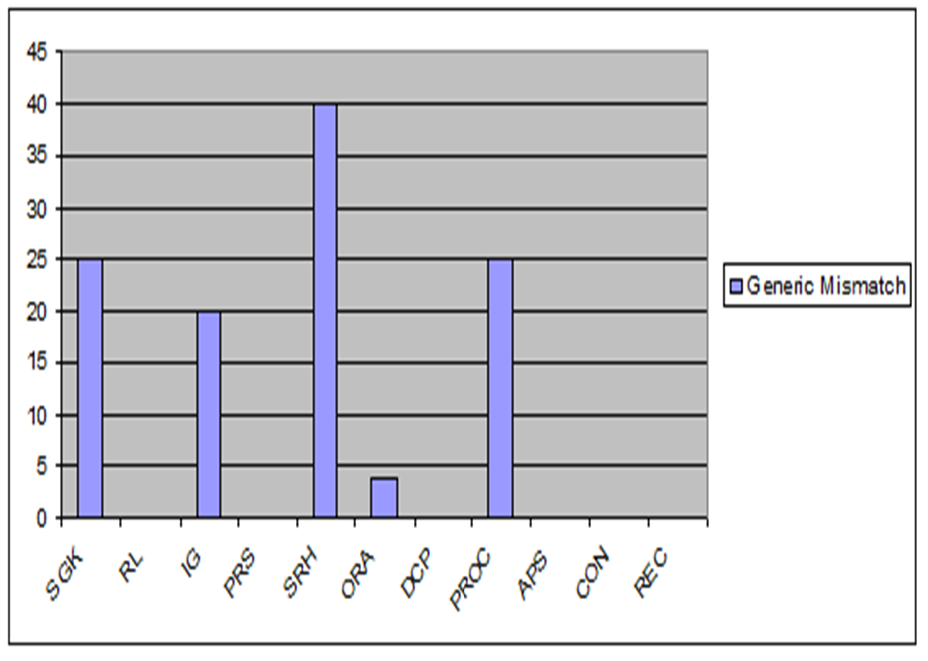
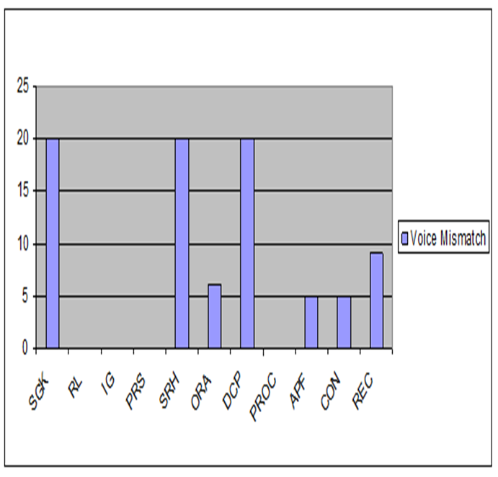
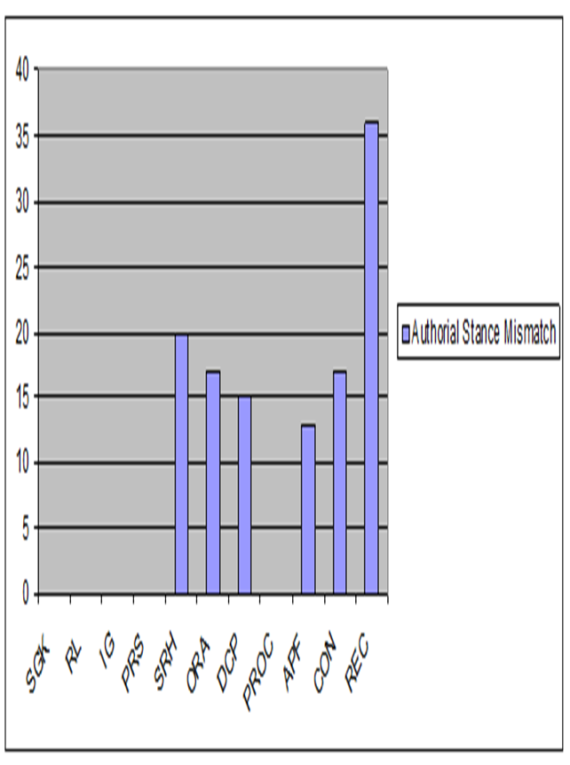
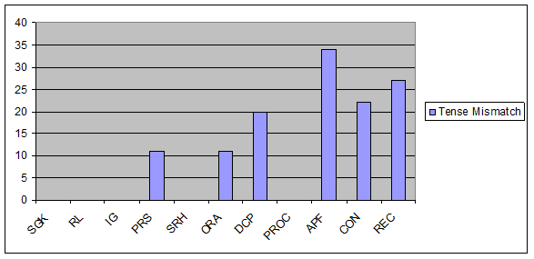
LOGO
RHETORICAL AND LINGUISTIC CHOICES IN DISSERTATION ABSTRACTS TRANSLATED FROM ENGLISH INTO ARABIC
Amani Salman
Component moves of English and Arabic abstracts | Frequency of moves in the English abstracts (%) | Frequency of moves in the Arabic abstracts (%)
1. Stating General Knowledge (SGK) | 18% | 20%
2. Reviewing Literature (RL) | 6% | 6%
3. Indicating a Gap (IG) | 10% | 8%
4. Presenting the Research Significance (PRS) | 14% | 14%
5. Stating the Research hypothesis (SRH) | 10% | 6%
6. Outlining the Research Aim (ORA) | 92% | 90%
7. Describing Data Collection Procedures (DCP) | 94% | 94%
8. Previewing the Research Organizational component (PROC) | 8% | 6%
9. Announcing Principal Findings (APF) | 72% | 72%
10. Concluding (CON) | 36% | 36%
11. Recommending (REC) | 22% | 22%
Table 1: Component moves of English and Arabic abstracts: A modified version
Abstract
The main aim of the present study is to examine the linguistic and generic choices in the abstracts translated from English into Arabic in order to find out the differences resulting from translation. At the macro-level, a move structure analysis was carried out to find out to what extent the translators maintain the original generic structure of the English texts. At the micro-level, the study investigated the discoursal and linguistic features related to voice choice, authorial stance, and tense options. To fulfill the purpose of this study, the researcher selected and analyzed a sample of 50 dissertation abstracts written in English by MA students of Linguistics and their 50 Arabic translations that were translated by the same writers. The findings of this study revealed few differences not only at the micro-level but also at the macro-level structure between the original English texts and their equivalent translated Arabic ones. The results of the study also provided some useful insights for native and non-native graduate students, regarding the structural and rhetorical features of dissertation abstracts in both languages, English and Arabic.
Chart 1 :Generic Mismatch in the Abstract Component Moves
Introduction
This chapter falls into two sections. The first section presents the genre of abstract including its definition, functions, features, types and move structures. The second section shows the theoretical background of the study.
Abstracts of academic research play an important role as pieces of text that give the gist of the research. Linguists’ interests in the genre of abstract stem from the need to understand the functions which underlie this multifunctional text. It has been assumed that the abstract as a genre functions first as a gateway for readers to read an article. Second, it provides journals and conferences with a general overview which facilitates the acceptance or rejection of a paper. Finally, it determines the rhetorical structure and linguistic realizations of the text it mirrors.
Chart 2 :voice Mismatch in the Abstract Component Moves
Methods and Materials
For the purpose of the present study, a corpus of 100 MA theses abstracts was collected for analysis. This corpus consists of 50 abstracts written in English by MA students and their 50 Arabic translated versions by the same writers. The corpus was chosen from the fields of Linguistics from three Jordanian universities: Jordan University of Science and Technology, Yarmouk University, and the University of Jordan. For the purpose of analysis, the theses abstracts were analyzed quantitively and qualitatively in terms of their generic and rhetorical structures as well as some linguistic features in order to find out any differences resulting from translation. The analysis of abstracts in this study was based on Swales' (1990) and Bhatia's (1993) Models of Move structure analysis. The process of analyzing abstracts was carried out at two levels: the macro-level and micro-level. The former involves an analysis of the types of the component moves utilized in the abstracts. The later investigates the linguistic feature of the abstracts including voice choice, authorial stance, and tense options. each move. The genre analysis was carried out on each abstract and compared to its translated version in order to find out if there are variations between the English abstracts and its equivalent translated Arabic versions. The second stage includes the linguistic analysis of the rhetorical moves of each English version as compared to its Arabic counterpart. The linguistic analysis involves identifying variation in the use of voice, authorial stance, and tense in each single move. Then, the distribution of each linguistic feature across the eleven moves of the abstracts was calculated separately to identify quantitatively and qualitatively to what extent the writers maintain these features after translating.
Chart 3: Authorial Stance Mismatch in the Abstract Component Moves
Chart 4: Tense Mismatch in the Abstract Component Moves
Conclusions
Results
The writers of the English abstracts seem to maintain the same rhetorical moves when translated into Arabic. However, in very few cases, they employ some component moves that are not found in the source texts or vice versa.
In general, the writers seem to retain the same voice options in both types of abstracts. Except for few instances, in which they used the passive voice in the English texts, whereas the active was employed in the translated versions.
Abstract writers tend to translate the same authorial stance used in the source texts into the target ones. However, few writers tend to use different authorial stances. Some of the variations might be explained in relation to the rules of the Arabic language that allow the writers to embed a noun in a verb semantically.
It was found that the writers seem to maintain the verb tense in the source and target texts though they showed the highest frequency of mismatch in translating this feature in comparison with other linguistic features. In contrary to the English abstracts that tend to use the present tense, the Arabic translations tend to employ the past tense.
6. The reason for the rhetorical and linguistic mismatch may lie in the traditional separation between the teaching of writing and the teaching of grammar. In addition, the subsequent integration and connection is thus implicitly relegated to language learners themselves without instructional guidance or teaching
The results have shown that although the English and Arabic abstracts share the same communicative purpose, writers tended to exhibit few linguistic differences with respect to the generic component preferences in terms of the number and frequency of genre moves employed, and the linguistic features of each component move used to structure genre texts. The analysis of the English abstracts and their translated Arabic versions revealed that there are eleven component moves by means of which English and Arabic abstracts are structured. The two corpus use these moves but with a few variations in degrees and frequencies, i.e. some moves are included in some abstracts but ignored in others. Based on Swales' (1990) and Bhatia's (1993) Move Models and after the survey of the abstracts, the researcher has modified a new version for analyzing the data as shown in Table 1, which are Stating General Knowledge, Reviewing Literature, Indicating a Gap, Presenting the Research Significance,. Stating the Research hypothesis,. Outlining the Research Aim,. Describing Data Collection Procedures, Previewing the Research Organizational component, Announcing Principal Findings, Concluding, and Recommending .
The overall results of data analysis regarding the macro structure have indicated that the authors in (12%) of the data did not retain the original English move structures in the Arabic translations, but they tended to use different rhetorical structures in the English abstracts in comparison with their Arabic versions.
It was also found that some writers showed a general trend in using and maintaining voice options in the original and the translated texts. The results indicated that (10%) of the data displayed mismatch in voice options.
As for the authorial stance, the main findings indicate that most writers maintained the same authorial stance used in the English source texts and the Arabic target translations. The percentage of the mismatch in the component moves of both types of data was (15%). The data analysis revealed that most writers maintain the same use of verb tense, except for 18% of the data.
References
AlKhuli, M. (1993). Comparative Linguistics: English and Arabic. Amman: Alfalah House
Al-Ali, M. (2004). How to Get Yourself on the Door of a Job: A Cross-Cultural Contrastive Study of Arabic and English Job application Letters. Journal of Multilingual and Multicultural Development 25, 1-23.
Anderson, K., & MacLean, J. (1997). A Genre Analysis Study of 80 Medical Abstracts’, Edinburgh Working Papers in Applied Linguistics 8: 1–23.
Bailey, S. (2006). Academic writing: A Handbook for International Students (2nd ed.). New York: Routledge.

