Slide 1
Introducing OvidMD™

Slide 2
In today’s presentation
What is OvidMD
Live Demonstration
Search Experience
Key Features and Benefits
Why we developed OvidMD
Benefits for librarians, physicians & clinicians
Content packages
Depth and breadth of knowledge
What clinicians are saying about OvidMD

Slide 3
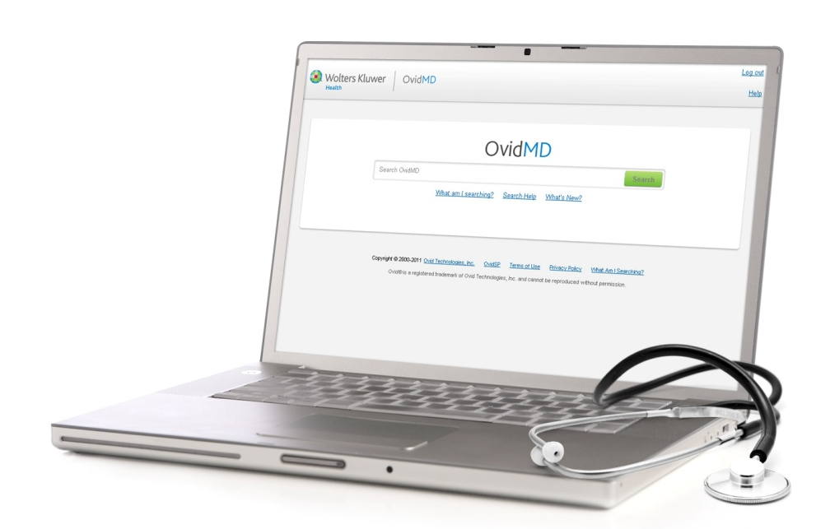
Introducing OvidMDTM
The first clinical tool from Ovid for physicians and other clinicians to find quick answers to clinical questions backed by comprehensive, evidence-based research from sources you trust
Notes:
Physicians have very little time and need current, reliable answers to their clinical questions delivered quickly and easily.
It is the First clinical tool from Ovid designed for and tested by physicians and other clinicians to find quick answers to clinical questions backed by comprehensive, evidence-based research from sources you trust in a single easy to use interface.
OvidMD gets “research into practice” by making the resources from Ovid much more accessible to clinicians
Our goal with OvidMD is to improve patient care and clinical outcomes by informing clinical decisions with relevant, evidence-based information.

Slide 4
OvidMD in action
Use Case
85 year old male
Hypertension treatment
Looking at alternatives
Cognitive decline and fractures are a concern
May have seen a clinical trial recently
Notes:
DEMO use demo script in Sales Manual.
Search Hypertension, Hypertension Treatment, Hypertension Treatment Elderly

Slide 5
Why Was OvidMD Developed?
On average, when you need to find an answer to a clinical question, how much time do you have? (n=78)
OvidSP
Point of Care Tools
Notes:
5
Time is the key element we asked clinicians- How much time do you spend on average find an answer to a clinical question.
More than 15 minutes:
OvidSP supports researchers who dedicate on average 15 min or more on research which is time intensive. Researchers need precision searching tools for that deep medical research which OvidSP meets those needs. We know physicians are brilliant but they are not brilliant searchers and these types of tools do not best fit their research needs.
2-3 minutes Point of Care tools like UTD:
Is meant to meet the need for quick (in some cases life or death) answers while the clinician is at the patients bedside, where they may be very minimal time to get what they need, very time sensitive can go deeper/take longer.

Slide 6
Research is Limited by Time
Manual pg 5
On average, when you need to find an answer to a clinical question, how much time do you have? (n=78)
This is the KEY area of focus!!
Notes:
6
Key area of focus for OvidMD is 5-15 minutes time flexible
OMD offers a variety of content that can fit into the few minutes that are available when a physician is with a patient (print out a patient handout). Within the 5-10 minutes that may be available during a break in preparation to meet with a patient, or up to 15 minutes for more in-depth research to prepare for presentations or after meeting with patients that day.
OMD bridges that gap between the point of care tool like UTD and that deep medical research workflow tool like OSP

Slide 7
Physician & Clinician Benefits
OvidMD allows Physicians & Clinicians to use their time efficiently:
Easy
Fast
Clear
Current
Trusted
Notes:
Easy to use and navigate through in one Single, easy-to-use interface
Fast - Quick & accurate answers to make the best, evidence-based clinical decisions for every patient – whether you have 5 or 15 minutes
Clear - One search uncovers a breadth of content with latest treatment options, evidence-based guidelines, and drug therapies, lets you download Customizable patient handouts, link instantly to full text, review articles and more
Stay Current and informed
Backed by trusted, peer-reviewed content

Slide 8
Library Benefits
Helps put library resources in the hands of clinicians
Extends the library’s influence in the clinical workspace
Easily provides a full spectrum of authoritative information
Saves time by allowing library staff to focus on more complex search requests
Maximizes the use of full-text holdings
Extends OvidSP and UpToDate®
Notes:
First two bullets emphasize putting research into practice
3rd bullet – breadth and depth of content
5th bullet – Puts a subset of your clinically relevant library holdings with Ovid in the hands of your clinicians
Last bullet – emphasize bridging that gap between OSP and UTD

Slide 9
Content Packages
OvidMD Clinical Interface
OvidMD
OvidMD Plus
Specialty Collections
Ovid MEDLINE®
Current Opinion Package
EBM Guidelines (Clinical Guidelines)
Medical Calculators
Drug Monographs (Facts & Comparisons)
Patient Handouts
National Guidelines Clearinghouse
Connection to UpToDate
Core OvidMD content, plus
5-Minute Clinical Consult Books
Natural Products
Transplant Library
Cardiology
Critical Care Medicine & Trauma
Endocrinology & Metabolism
Gastroenterology & Hepatology
Hematology
Infectious Diseases
Nephrology
Neurology
Obstetrics & Gynecology
Pathology
Pediatrics
and more…
Plus: Access to clinical content from Ovid!
Notes:
OvidMD is the only medical search engine that spans UpToDate, Medline and Ovid fulltext in one easy search
Great about OMD is the package of Ovid’s intelligent capabilities and rich content
OvidMD is the basic package
OvidMD Plus – is our base with extended content
Specialty Collections – If a clinician is within a specialy and wants to build out that content set they are available as add-on (costs money) specialty collections

Slide 10
Depth & Breadth
Full Text Journal Articles
11 of the most popular Current Opinion titles of Review Articles
UpToDate®
OvidMD customers get access to UpToDate’s patient education content as well as previews of UpToDate’s professional topics
Evidence-Based Guidelines
A synthesis of best available evidence written by physicians for physicians that recommends a course of action
Patient Information
Educational materials for patients from UpToDate and RelayHealth (a division of McKesson®) to improve care and patient satisfaction
A to Z Drug Facts
Features dosages, side effects and indications, information on drug therapy
Images
Your own personal image library extracted from content you subscribe to on Ovid
Medical Calculators
A wide array of medical calculators, clinical criteria sets and decision tree analysis tools used every day by clinicians
Notes:
Full-text Journal
We offer Current Opinion journals which contain peer-reviewed articles on research, techniques and diagnostic methods,
A subset of your clinically relevant Full-text holdings with Ovid are searchable and accessible for clinicians through OvidMD. 2 year rolling archive
UpToDate
UTD is dedicated to synthesizing knowledge for clinicians and patients. OvidMD plays a key role in expanding and supporting that knowledge. OvidMD searches across more than 9,000 topics in 17 specialties and includes a Topic Preview of the Full-Text and a link out to the Full-Text for UpToDate subscribers
Transplant Library database
Provides abstracts of evidence-based medicine on all aspects of organ transplantation
Evidence Based Guidelines – by Clin-eguide
a synthesis of best available evidence on diagnosis, management, and treatment of conditions that occur in primary care, inpatient and emergency department settings. It is written by physicians for physicians, updated qduarterly, and recommends a course of action for diagnosis, disease management and drug therapy
National Guidelines Clearinghouse - U.S. Department of Health and Human Services provides detailed information on clinical practice guidelines and to further their dissemination, implementation, and use.
Patient Information
Patient handouts from McKesson and UTD (Beyond the Basics)
A to Z Drug Facts E-facts from Facts and Comparisons
Medical Calculators
Hundreds of calculators from MedCalc

Slide 11
OvidMD “Pull-Through” Content
Your clinically relevant OvidSP content can be accessed through OvidMD!
LWW UpToDate collection
Ovid UpToDate collection & additional ala carte UpToDate Reviewed titles
Books and journals subject area collections
Over 100 additional journals beyond the OvidMD core package or in the add-on journal collections
Over 100 additional books beyond the OvidMD core package or the add-on book collections
Clinical textbooks
Additional evidence-based resources including the ACP Journal Club and Evidence-Based Medicine Reviews (Cochrane)
Notes:
A subset of your clinically relevant content is available thru OMD and puts your holdings in the hands of you clinicians.
This is what is searchable and accessible in OMD.

Slide 12
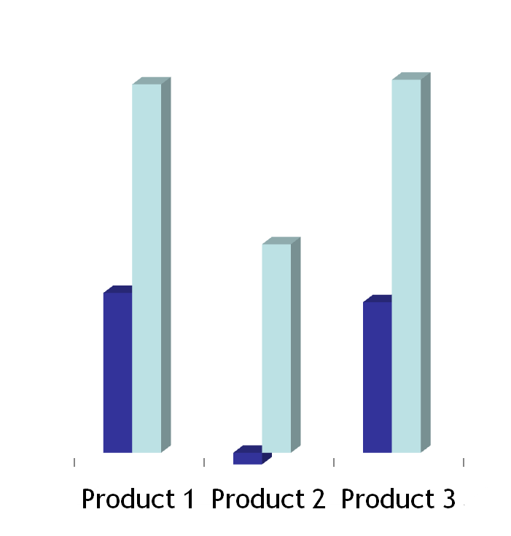
OvidMD User Acceptance Testing with Physicians
Real Clinical Searches from MDs
What is the best treatment for Polycystic Ovarian Syndrome?
tetanus prophylaxis
What is the risk of thrombocytopenia with enoxaparin therapy?
Better initial search results?
Better documents in results?
OvidMD
Competitor
Notes:
We put OMD in the hands of physicians and other clinicians who uses real world clinical searches and compared OMD to other products in the marketplace. As you can see by the light blue bar which is OMD more favorable in search relevancy and documents that come to the top that answer their clinical question.

Slide 13
If you ask a Physician a Physician will say…
“OvidMD is fast, user-friendly and gives relevant search results the first time around.”
Surender Bodhireddy, M.D. Covenant Medical Center, Lubbock TX
“OvidMD was an amazing product, and I will use it when it becomes available.”
Paul H Douglass, M.D. York Women's Health Center, York, PA
Notes:
This is what those testers said about OMD! Read the testimonials ☺

Slide 14
OvidMD – Demo

Slide 15
Questions? Thank You!
Notes:
We felt as if there was a great opportunity for Ovid to develop a product like OvidMD in the marketplace as it is a combination of our intelligent capabilities and rich content

