Slide 1
INQAAHe
International Network for Quality Assurance Agencies in Higher Education
ACCREDITATION COUNCIL FOR PRACTICAL ABILITIES
March 12, 2009, Tokyo
JEAN A. MORSE, President
Middle States Commission on Higher Education, www.msche.org
Member, INQAAHE Board of Directors, www.inqaahe.org

Slide 2
OUTLINE
Introduction to INQAAHE
Aims of INQAAHE
INQAAHE Activities
INQAAHE Publications
INQAAHE Services
INQAAHE and Capacity-building
INQAAHE and Other QA Networks
OVERVIEW: U.S. INSTITUTIONAL ACCREDITATION

Slide 3
BACKGROUND
RAPID INTERNATIONAL GROWTH OF:
Number of colleges and universities
Expansion of higher education across borders
Mobility of students and employees across countries
Interest in external quality assurance
Number of Quality Assurance Agencies (QAAs)

Slide 4
BACKGROUND
Led creation of INQAAHE, a global network of Quality Assurance Agencies (QAAs), to facilitate sharing of information and cooperation among QAAs
The main purpose of INQAAHE is to collect and disseminate information on current and developing theory and practice in the assessment, improvement and maintenance of quality in higher education.

Slide 5
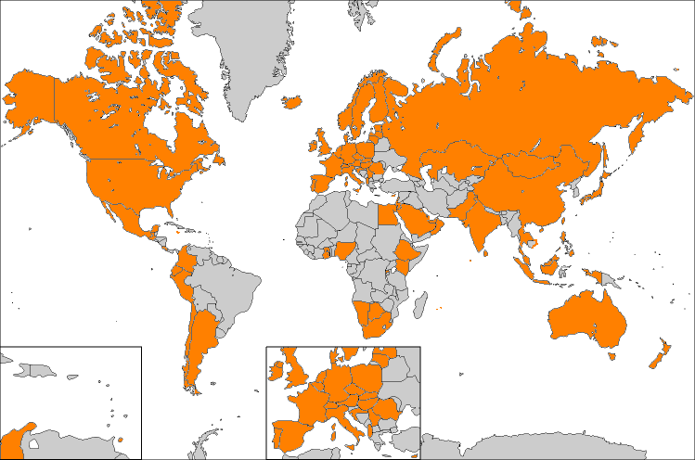
INQAAHE
Established in 1991
NGO Status with UNESCO
> 200 members (2008; up from 136 in 2007)
  six continents
  79 countries

Slide 6
AIMS
promote good practices in the maintenance and improvement of quality in HE;
facilitate research into the practice of quality management in HE;
provide advice to new QA agencies;
facilitate links between accrediting bodies;
permit better-informed international recognition of qualifications;

Slide 7
AIMS
assist members to determine the standards of institutions operating across national borders;
be able to assist in the development and use of credit transfer schemes;
enable members to be alert to dubious accrediting practices

Slide 8
INQAAHE POLICY STATEMENT
Quality assurance agencies should
  Provide public accountability
  Help institutions to improve
  Require academic freedom and integrity
  Ensure that higher education institutions have primary responsibility for quality
  Use independent evaluators who follow standards created with input from stakeholders
  Be reviewed externally themselves
  Attempt to follow the INQAAHE “Guidelines of Good Practice”

Slide 9
INQAAHE POLICY STATEMENT
INQAAHE
  Believes that cross-border education should involve cooperation between the agencies in the exporting and importing countries
  Is committed to working with regional associations as well as individual quality assurance agencies

Slide 10
REGIONAL ASSOCIATIONS
AAAC (Canada)
APQN (Asia Pacific Quality Network) has 34 members in Pacific islands and territories, New Zealand, Australia, Papua New Guinea, Russia, Afghanistan, Iran, and others
AAU (Association of African Universities),
CEEN (Central and Eastern Europe)
CANQATE (Caribbean)
C-RAC (USA)
ENQA (Europe)
EQAN (Eurasia)
MENA (Middle East and North Africa)
RIACES (Iberoamerica)

Slide 11
BIENNIAL AND GENERAL CONFERENCES
NEW APPROACHES TO QUALITY ASSURANCE IN THE CHANGING WORLD OF HIGHER EDUCATION:ABU DHABI, United Arab Emirates, 30 MARCH to 2 APRIL, 2009 (including pre-conference workshops)
GENERAL ASSEMBLY: Namibia,
May 5 – 7, 2010

Slide 12
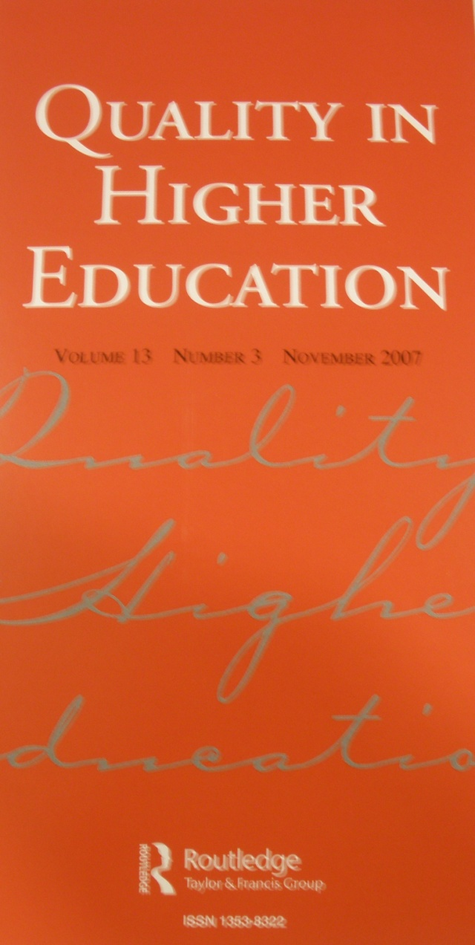
PUBLICATIONS
Journal:
Quality in Higher Education
  Published 3 times per year
  Internal and external quality assurance
  Theory and practice

Slide 13

PUBLICATIONS
Electronic Bulletin: 4 or 5 times per year
Regular news updates from members and the Board

Slide 14
SERVICES
Website, with proceedings, discussion papers, etc
Rapid answer query service – e.g. how something is done in another agency
Clearinghouse (website, under development)- –policies, practices, and procedures of 20 QAAs
Reviewers and consultants database (under development)
Education and Training courses and qualifications (under development)

Slide 15
GUIDELINES OF GOOD PRACTICE
Although one model of quality assurance can not be used in all situations, these are a set of core guidelines that should underpin QAA activities.
AGENCIES CAN APPLY FOR RECOGNITION BY INQAAHE THAT THEY MEET THESE GUIDELINES.
Section 1. The Agency
        1. Governance of the QAA
        2. Resources
        3. Quality Assurance of the QAA
        4. Reporting Public Information

Slide 16
GUIDELINES OF GOOD PRACTICE, continued
Section II. Institutions of Higher Education and the QAA
  5. The Relationship between the QAA and higher education institutions
  6. The QAA’s requirements for institutional/program performance
  7. The QAA’s requirements for Institutional Self-Evaluation and Reporting to the QAA

Slide 17
GUIDELINES OF GOOD PRACTICE, continued
Section III. QAA Review of Institutions
  8. The QAA’s evaluation of the institution or program
  9. Decisions
  10. Appeals
Section IV. External Activities
  11. Collaboration with other agencies
  12. Transnational/cross-border higher education

Slide 18
QUALITY ASSURANCE PRINCIPLES FOR ASIA-PACIFIC “CHIBA” DECLARATION:
INTERNAL QUALITY ASSURANCE
Quality assurance culture
Quality assurance embedded within the institution’s unique goals
Internal quality management systems, policies and procedures
Periodic approval, monitoring and review of programs and awards
Implemented strategy for the continuous enhancement of quality
Quality assurance of academic staff is maintained
Information about the institution is publicly available

Slide 19
CHIBA DECLARATION:
QUALITY ASSESSMENT
Quality assurance activities are undertaken on a cyclical basis.
Stakeholders participate in developing the standards and criteria.
Standards/criteria are public and applied consistently.
Procedures to ensure reviewers have no conflict of interest.
Assessment would normally include: 1. institutional self-assessment; 2. external assessment by a group of experts and site visits as agreed; 3. publication of a report, including decisions and recommendations; 4. a follow-up procedure to review actions taken in light of recommendations made.
An appeals mechanism is available.
Inclusive of different foci: Institution and program

Slide 20
CHIBA DECLARATION:
QUALITY ASSURANCE AGENCIES
* Are independent and autonomous: no third party influence
Written mission statement with clear goals and objectives
Adequate and accessible human and financial resources
Public policies, procedures, reviews, assessment reports
Clear documentation of standards, assessment methods, processes, decision criteria and appeals processes
Periodic review of activities, effects and value
Cooperates with others across national borders.
Undertakes research and provide information and advice
Inclusive of different forms: accreditation, audit

Slide 21
CAPACITY BUILDING
Funds provided by the World Bank through UNESCO
Supports various INQAAHE activities:
1. Education and training courses
2. Clearinghouse
3. Small States
4. Support for other networks

Slide 22
Education & Training courses
The creation of academic programs about internal and external Quality Assurance in Higher Education
Through joint efforts of an international network of QA agencies and HE institutions
The courses will benefit both practicing QA professionals and individuals who wish to play a role in QA of HE.

Slide 23
PROFESSIONAL QUALIFICATIONS
Creation of program to train Quality Assurance Professionals
To be offered by universities around the world as part of a Master’s degree or as a certificate
Degrees will be certified by INQAAHE
Content will be international
4 courses will include:
  Overview of international higher education
  External quality assurance
  Operating a QAA
  Maintaining quality inside an institution

Slide 24
CLEARINGHOUSE
a website for quick access to the resources referenced by the system
a thesaurus of terms, with brief definitions, relevant for quality assurance agencies
contains links to URLs within the websites of various QA agencies

Slide 25

SMALL STATES
investigating the specific needs for quality assurance of small states
exploring different models of quality assurance (including QA capacity building of universities).

Slide 26

OTHER QA NETWORKS
INQAAHE works not only with its member agencies but also with and for other networks of agencies
Various regional networks have signed a Memorandum of Cooperation with INQAAHE
Their activities are on website.

Slide 27

OTHER QA NETWORKS
Collaboration and liaison
Supporting representatives from networks to attend an annual meeting of INQAAHE
Opportunity for learning and sharing

Slide 28

INQAAHE MEMBERS
4 membership categories:
  1.Full – assure quality of postsecondary
  institutions or programs
  2. Associate – interest in quality assurance
  3. Institutional - higher education institutions
  4. Affiliate - individual

Slide 29
U.S. INSTITUTIONAL ACCREDITATON
Private, non-government, non-profit agencies. MSCHE was formed in 1887.
Review by peers from similar institutions
Based on the mission of each institution
Emphasis on improvement as well as compliance
Institution analyzes and sets its future goals during a two year “self-study”
Most institutions are accredited by accreditors in 7 regions of the U.S.
“Specialized” agencies review programs

Slide 30
U.S. ACCREDITATION
Role of Government
  Each of the 50 states has different standards for licensing institutions to grant degrees and continuing oversight.
  The federal government reviews QAAs. If it “recognizes” the QAA, then accreditation by that agency enables the students to receive federal loans and grants.
  Students can use grants at accredited institutions of their choice.

Slide 31
U.S. ACCREDITATION
REVIEWS:
  10 year self-study and team visit
  5 year extensive written report
  Annual information
  Follow-up Reports as needed
  ACTIONS: Range of 12 actions, including follow-up reports and visits, warning, and probation prior to withdrawal of accreditation

Slide 32
MSCHE ACCREDITATION STANDARDS
      INSTITUTIONAL CONTEXT
      1. Mission and Goals
      2. Planning, Resource Allocation, and Institutional Renewal
      3. Institutional Resources
      4. Leadership and Governance
      5. Administration
      6. Integrity
      7. Institutional Assessment

Slide 33
MSCHE ACCREDITATION STANDARDS
EDUCATIONAL EFFECTIVENESS
8. Student Admissions and Retention
9. Student Support Services
10. Faculty
11. Educational Offerings
12. General Education
13. Related matters – Distance learning, affiliated providers, certificates, more
14. Assessment of Student Learning

Slide 34
MIDDLE STATES: TYPES OF INTERNATIONAL ACCREDITATION
Review of locations abroad of U.S. institutions
Review of agreements with local providers for services outside of U.S.
Accreditation of institutions outside of U.S. incorporated in a U.S. state
Accreditation of institutions outside of U.S. not incorporated in U.S. – pilot project in moratorium

Slide 35
ANALYSIS OF U.S. REGIONAL ACCREDITATION
STRENGTHS
  Promotes a diversity of institutions
  Uses experienced volunteers
  Has flexibility in addressing new issues, new types of institutions and providers
  Reduces government bureaucracy
  Assures public awareness regarding the
  accreditation status of an institution
  Promotes continuous monitoring and continuous planning

Slide 36
ANALYSIS OF U.S. REGIONAL ACCREDITATION
AREAS FOR IMPROVEMENT
  Varying requirements of accreditation standards within the U.S
  Cost of the institution’s time/personnel for self-study
  Public’s difficulty in understanding an institution’s accreditation status without numerical ratings or rankings
  Possible duplication of activities among specialized and institutional accreditors

Slide 37
ANALYSIS OF U.S. REGIONAL ACCREDITATION
OPEN QUESTIONS IN U.S. HIGHER EDUCATION
  Should accreditation be national?
  Should accreditation be federal?
  Should there be standardized tests for every college graduate?
  Are measures such as graduation and job placement rates appropriate indicators of student learning?
  Should institutions be ranked?
  Should self-studies by institutions and team reports be public?

Slide 38

QUESTIONS
Ask them now!
Visit our website:
http://www.inqaahe.org or send an e-mail to inqaahe.nvao.net
Middle States questions:
www.msche.org

